Slide 1
BIKE
(Bit-Flipping Key Exchange)
Presented by Ray Perlner

Slide 2
High Level Summary
Variants of McEliece/ Neiderreiter based on Quasi-Cyclic MDPC codes
  Non-algebraic codes like MDPC codes look good for key reduction with quasi cyclic structure
    (unlike algebraic codes e.g. those used in DAGS and BigQuake)
  Performance is competitive with lattice-based schemes, but attack complexity seems easier to analyze.
  Has somewhat high dec. failure rate (< 10⁻⁷); targeting IND-CPA.
Three versions
  BIKE-1: McEliece KEM: Optimized for speed of KeyGen
  BIKE-2: Niederreiter KEM: Optimized for PK, ciphertext size.
  BIKE-3: patented LWE-like “Ouroboros” key exchange.
    Uses modified “noisy syndrome” decoder.
    Slightly different security assumption (probably.)

Slide 3
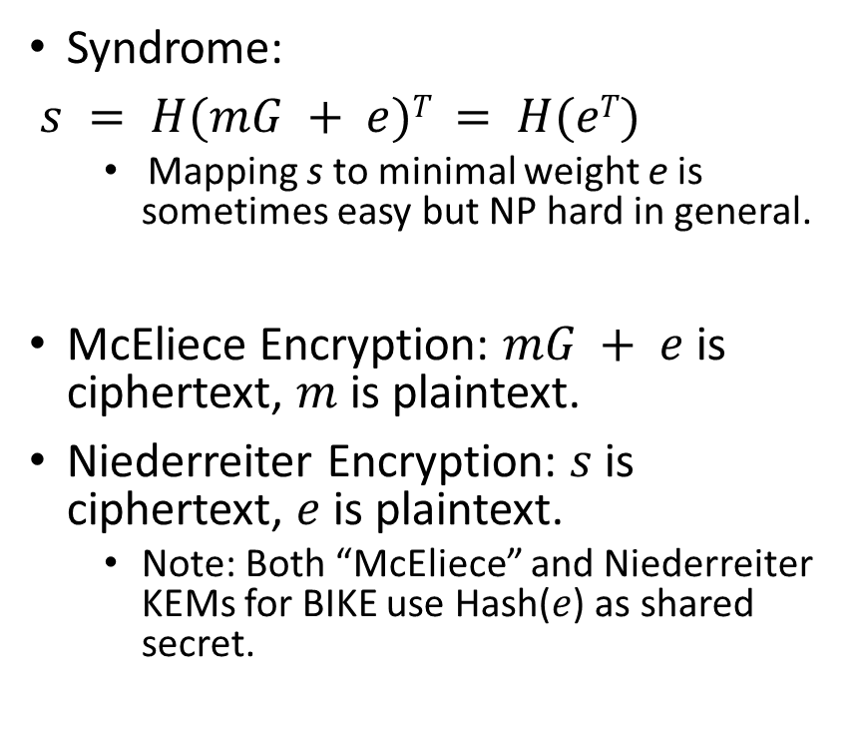
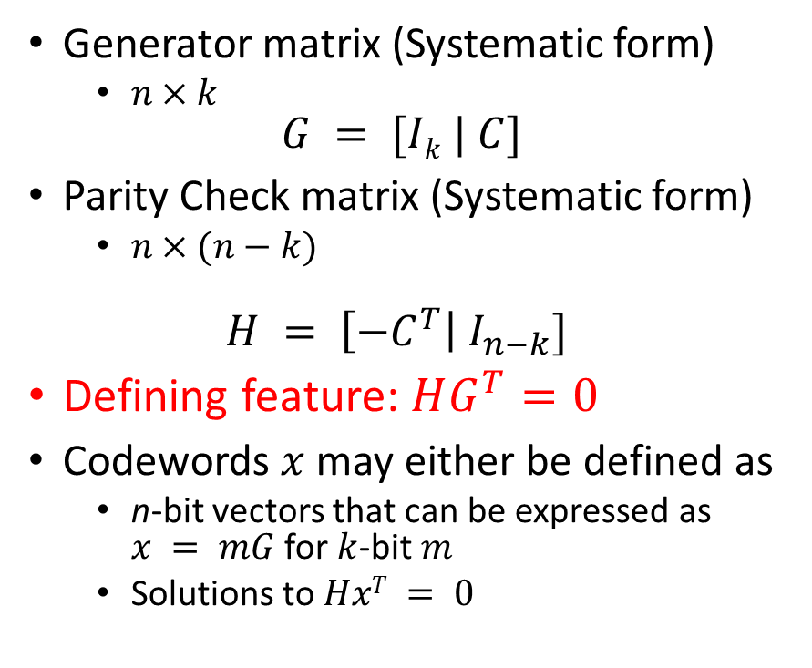
Some Coding Theory
Generator matrix (Systematic form)
  $n×k$
$$G = [Ik | C]$$
Parity Check matrix (Systematic form)
  $n×(n−k)$
$$H = \left[{−C}^{T}\right| I_{n−k}]$$
Defining feature: $HG^{T}=0$
Codewords $x$ may either be defined as
  n-bit vectors that can be expressed as $x = mG$ for $k$-bit $m$
  Solutions to $HxT = 0$
Syndrome:
$s = H(mG + e)T = H(eT)$
  Mapping s to minimal weight e is sometimes easy but NP hard in general.
McEliece Encryption: $mG + e$is ciphertext, $m$ is plaintext.
Niederreiter Encryption: $s$ is ciphertext, $e$ is plaintext.
  Note: Both “McEliece” and Niederreiter KEMs for BIKE use Hash($e$) as shared secret.

Slide 4
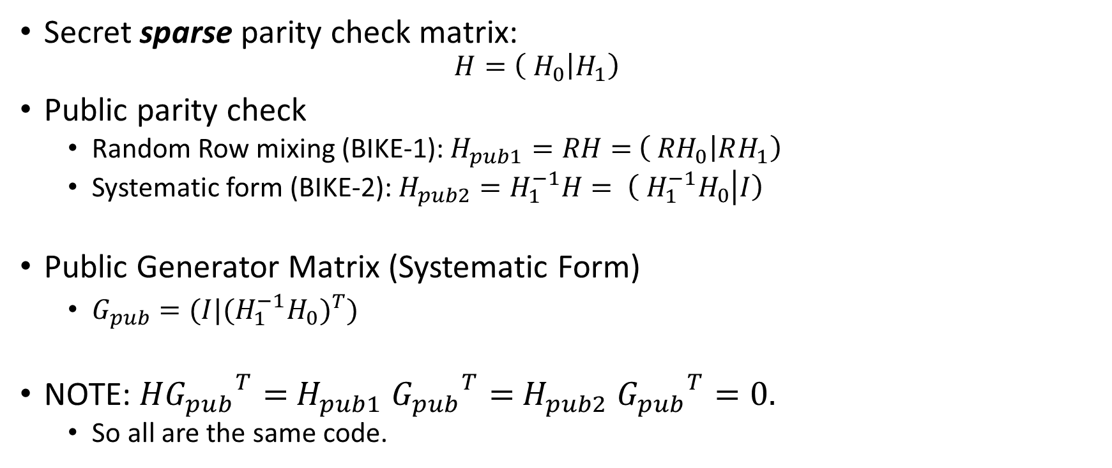
MDPC (Moderate Density Parity Check) Codes
(special case where n = 2k)
Secret sparse parity check matrix:
  $$H=\left( H_{0} | H_{1}\right)$$
Public parity check
  Random Row mixing (BIKE-1): $H_{pub1}=RH=$ $\left( {RH}_{0} | RH_{1}\right)$
  Systematic form (BIKE-2): $H_{pub2}=H_{1}^{−1}H= \left( {H_{1}^{−1}H}_{0} | I\right)$
Public Generator Matrix (Systematic Form)
  $G_{pub}=(I|{{{(H}_{1}^{−1}H}_{0})}^{T})$
NOTE: $H{G_{pub}}^{T}=$ $H_{pub1}$ ${G_{pub}}^{T}=$ $H_{pub2}$ ${G_{pub}}^{T}=0.$
  So all are the same code.

Slide 5

Decoding MDPC codes
(The Bit-Flip Algorithm)
Want to find low weight e such that $He^{T}=s$

Slide 6

Decoding MDPC codes with noisy syndrome
(used in BIKE-3)
Want to find low weight e, e’ such that $He^{T}+ {e′}^{T}=s$

Slide 7
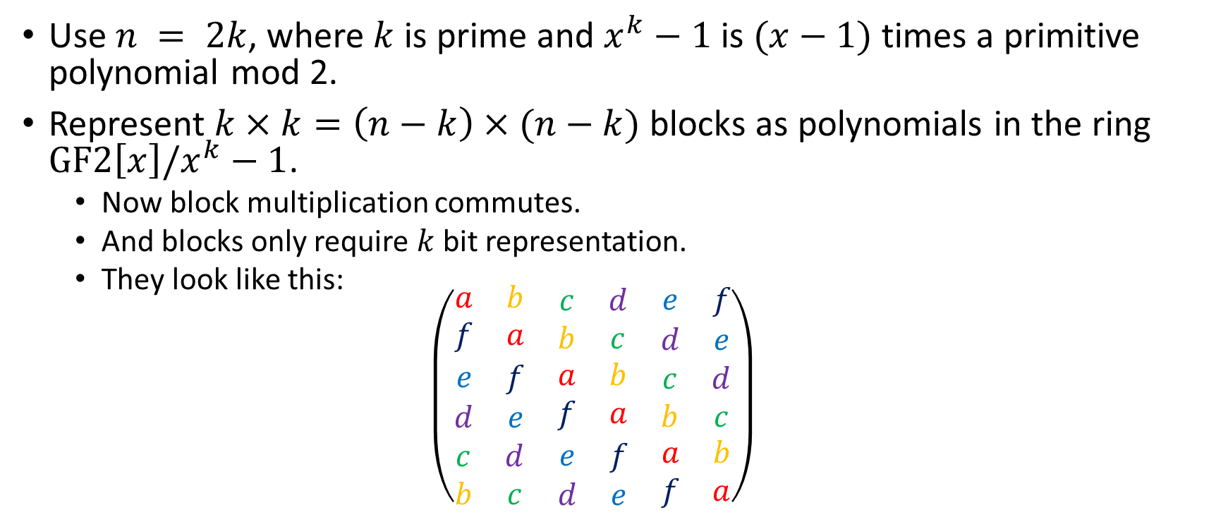
Quasi-Cyclic structure
Use $n = 2k$, where $k$ is prime and $x^{k}−1$ is $(x−1)$times a primitive polynomial mod 2.
Represent $k×k=\left(n−k\right)×(n−k)$ blocks as polynomials in the ring $GF2\left[x\right]/x^{k}−1$.
  Now block multiplication commutes.
  And blocks only require $k$ bit representation.
  They look like this:
  $$\left(\begin{matrix}\begin{matrix}a & b \\ f & a\end{matrix} & \begin{matrix}c & d \\ b & c\end{matrix} & \begin{matrix}e & f \\ d & e\end{matrix} \\ \begin{matrix}e & f \\ d & e\end{matrix} & \begin{matrix}a & b \\ f & a\end{matrix} & \begin{matrix}c & d \\ b & c\end{matrix} \\ \begin{matrix}c & d \\ b & c\end{matrix} & \begin{matrix}e & f \\ d & e\end{matrix} & \begin{matrix}a & b \\ f & a\end{matrix}\end{matrix}\right)$$

Slide 8

BIKE 1-3 Summary Table
(Switching to their notation for variable names.)
$m$ and $g$ are random polynomials in $GF2[x]$/$(x^{r}−1)$
$e0$ and $e1$ are polynomials in the same ring with hamming weights summing to $t$. e, when present has Hamming weight $t/2$.
If you do out the math $s = e0h0+e1h1$(for BIKE-1,2) and $s = e0h0+e1h1 +e$for (BIKE-3)

Slide 9

BIKE Parameters
Polynomials are over ring $GF2[x]$/$(x^{r}−1)$
$n =2r$is the number of bits in the error vector $(e0,e1)$
$t$ is the Hamming weight of the error vector.
$w$ is the row weight of the MDPC code $(h0,h1)$

Slide 10
Performance
(Note: Jacob’s numbers look similar, although consistently larger by a factor of ~2.)
BIKE-1
BIKE-2
BIKE-3

Slide 11
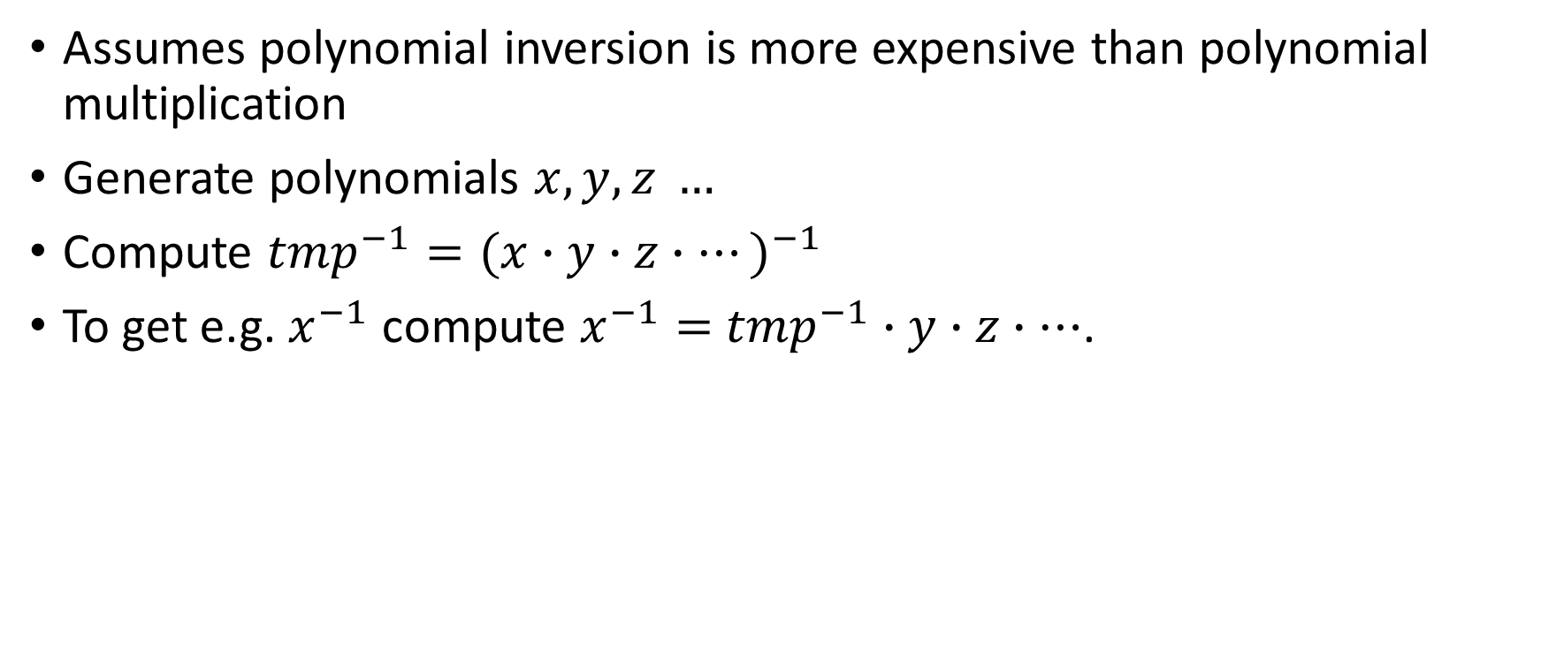
BIKE-2 Batch Key Generation
Assumes polynomial inversion is more expensive than polynomial multiplication
Generate polynomials $x, y, z …$
Compute ${tmp}^{−1}={(x∙y∙z∙…)}^{−1}$
To get e.g. $x^{−1}$ compute $x^{−1}=$ ${tmp}^{−1}$ $∙y∙z∙…$.

Slide 12
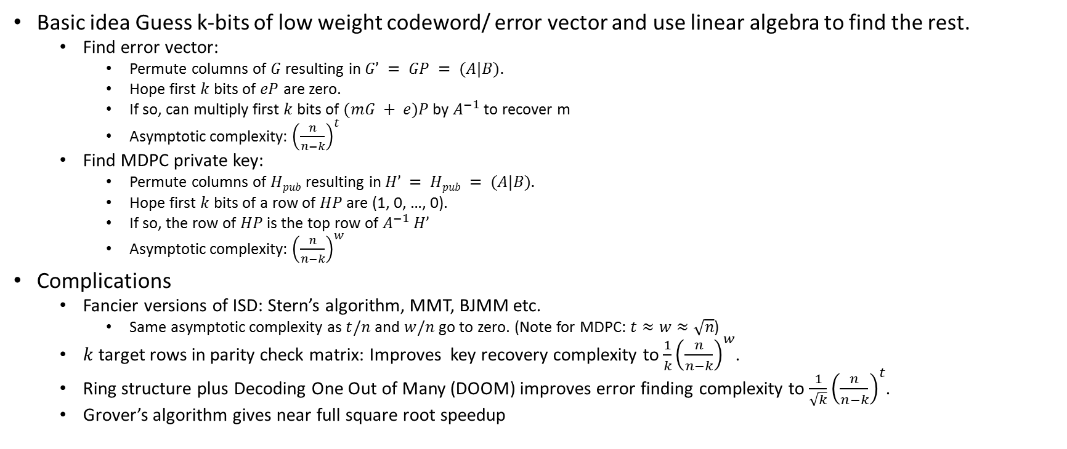
Known attacks: Information Set Decoding
Basic idea Guess k-bits of low weight codeword/ error vector and use linear algebra to find the rest.
  Find error vector:
    Permute columns of $G$ resulting in $G’ = GP = (A|B).$
    Hope first $k$ bits of $eP$ are zero.
    If so, can multiply first $k$ bits of $(mG + e)P$by $A^{−1}$ to recover m
    Asymptotic complexity: ${\left(\frac{n}{n−k}\right)}^{t}$
  Find MDPC private key:
    Permute columns of $Hpub$ resulting in $H’ = Hpub = (A|B).$
    Hope first $k$ bits of a row of $HP$ are (1, 0, …, 0).
    If so, the row of $HP$ is the top row of $A^{−1}$ $H’$
    Asymptotic complexity: ${\left(\frac{n}{n−k}\right)}^{w}$
Complications
  Fancier versions of ISD: Stern’s algorithm, MMT, BJMM etc.
    Same asymptotic complexity as $t/n$ and $w/n$ go to zero. (Note for MDPC: $t≈w≈\sqrt{n}$)
  $k$ target rows in parity check matrix: Improves key recovery complexity to $\frac{1}{k}{\left(\frac{n}{n−k}\right)}^{w}$.
  Ring structure plus Decoding One Out of Many (DOOM) improves error finding complexity to $\frac{1}{\sqrt{k}}{\left(\frac{n}{n−k}\right)}^{t}$.
  Grover’s algorithm gives near full square root speedup

Slide 13
Known attacks: Reaction Attacks
Guo, Johannson, Stankovsky [GJS 2016] show how to recover private key from statistical analysis of decryption failures.
This attack does not affect the claimed security of BIKE, since it is recommended for ephemeral-ephemeral use only, and only claims IND-CPA security.

Slide 14
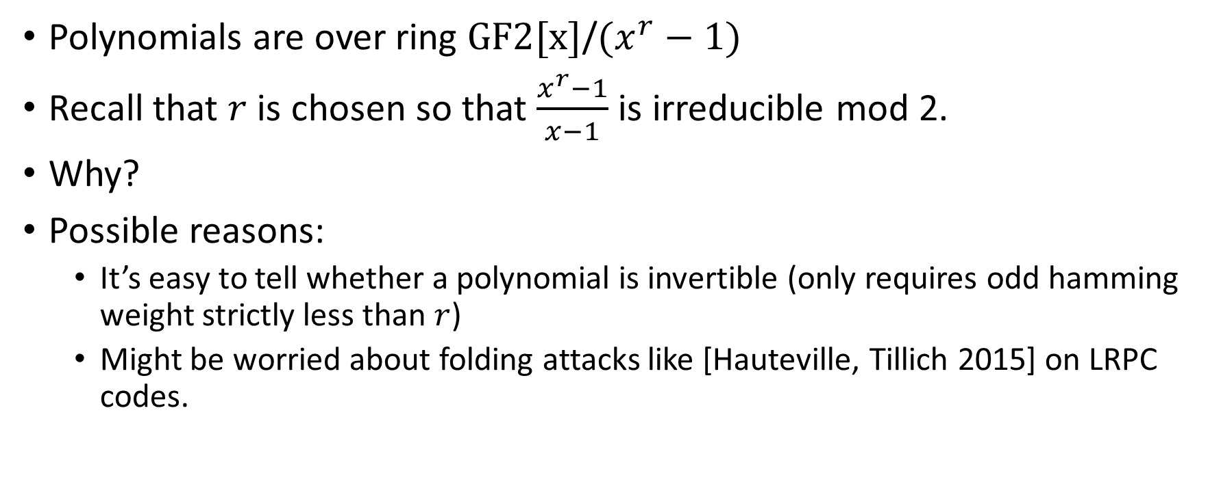
Choice of r
Polynomials are over ring $GF2[x]$/$(x^{r}−1)$
Recall that $r$ is chosen so that $\frac{x^{r}−1}{x−1}$ is irreducible mod 2.
Why?
Possible reasons:
  It’s easy to tell whether a polynomial is invertible (only requires odd hamming weight strictly less than $r$)
  Might be worried about folding attacks like [Hauteville, Tillich 2015] on LRPC codes.

Slide 15
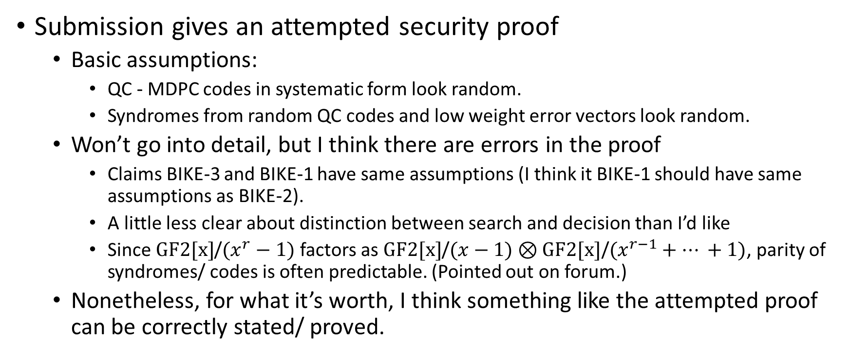
Security Proof
Submission gives an attempted security proof
  Basic assumptions:
    QC - MDPC codes in systematic form look random.
    Syndromes from random QC codes and low weight error vectors look random.
  Won’t go into detail, but I think there are errors in the proof
    Claims BIKE-3 and BIKE-1 have same assumptions (I think it BIKE-1 should have same assumptions as BIKE-2).
    A little less clear about distinction between search and decision than I’d like
    Since $GF2[x]$/$(x^{r}−1)$ factors as $GF2[x]$/$(x−1)⊗GF2[x]\text{/}(x^{r−1}+… +1)$, parity of syndromes/ codes is often predictable. (Pointed out on forum.)
  Nonetheless, for what it’s worth, I think something like the attempted proof can be correctly stated/ proved.

Slide 16
Similar submissions
Straight up knock off
  QC-MDPC-KEM
Pretty much the same problem
  HQC (If BIKE is NTRU, this is RingLWE)
Similar problem; probably harder to analyze
  LEDApkc/LEDAkem
Basically the same scheme, but Rank metric
  LAKE/Locker, Ouroboros-R
Basically the same scheme, but Euclidean metric
  NTRUxxx

Slide 17
Advantages and limitations
Advantages
  All known IND-CPA attacks are well-understood information set decoding type attacks.
    ISD has been known for 45 years and improvements have left asymptotic complexity the same.
    Compares favorably with lattice attacks (stability) and Rank-Metric attacks (newness)
  Relatively small key sizes (10,000 to 65,000 bits)
  Reasonably fast for all operations.
    Except for BIKE2 keygen without batching, operations look like they take less than a millisecond on a good processor for 128 bit security.
Limitations
  High Decryption failure rate
  Does not provide IND-CCA security
  Security proof could use improvement/clarification
  Key/Message sizes are slightly larger than some (ring/ cyclic) lattice and rank schemes.
  Vague possibility there might be something to exploit in ring structure.

Slide 18
Advantages and limitations
Basically same as QC-MDPC/BIKE
  Advantages:
    Pretty small key size (not quite as small as Rank or Lattice)
    All known CPA attacks are well understood ISD type attacks, relying on algorithms that haven’t gotten much better against parameters in this range since 1962.
  Disadvantages
    Needs ring structure to get a reasonable key size
    Decryption failures/ CCA attacks
Different from QC-MDPC/BIKE
  Doesn’t suffer from maliciously chosen ciphertext attacks like BIKE
    Attacker needs 2⁴⁰ instead of 2¹³ plaintexts for message recovery
    Fixing this (if needed) would only require superficial changes to BIKE
    Misuse resilience
  Has more structure than QC-MDPC/BIKE
    Not clear if this can be exploited by attacks, but also has no clear benefit.
  Older than QC-MDPC/BIKE
    The insecure versions are definitely older. I think the secure version is slightly older as well.

