Slide 1
Code Based Crypto end of Round 2

Slide 2
Code based Crypto in context
 | Private Decoder |  |  | Public Decoder
 | NTRU-like | Ring-LWE-like (Ouroboros) | Goppa | Ring-LWE-like
Hamming Metric | BIKE-1,2 LEDAcrypt | BIKE-3 | Classic McEliece | HQC
Rank Metric | ROLLO-1,2 | ROLLO-3 |  | RQC
Euclidean Metric | NTRU NTRU Prime |  |  | LAC NewHope

Slide 3
Code based Crypto in context
 | Private Decoder |  |  | Public Decoder
 | NTRU-like | Ring-LWE-like (Ouroboros) | Goppa | Ring-LWE-like
Hamming Metric | BIKE LEDAcrypt |  | Classic McEliece | HQC
Rank Metric | ROLLO-1,2 | ROLLO-3 |  | RQC
Euclidean Metric | NTRU NTRU Prime |  |  | LAC NewHope

Slide 4
Current Disposition
Attacked and generally inferior to BIKE
  LEDACrypt
Attacked but potentially interesting for research track
  ROLLO
  RQC
Serious consideration for Standards track
  BIKE
  HQC
  Classic McEliece

Slide 5
BIKE/HQC/ROLLO/RQC group
(and LEDAcrypt)
These four schemes share a lot of submitters and design philosophy elements
All four of these schemes look exactly like ringLWE or NTRU, except
  BIKE and HQC use Hamming Metric instead of Euclidean Metric to define “short” vectors
  ROLLO and RQC use Rank Metric
  BIKE and ROLLO use MDPC and LRPC decoder respectively to directly recover noise from Encaps
LEDAcrypt looks a lot like BIKE (previously BIKE-2)
  But it has some extra structure that enabled an attack

Slide 6
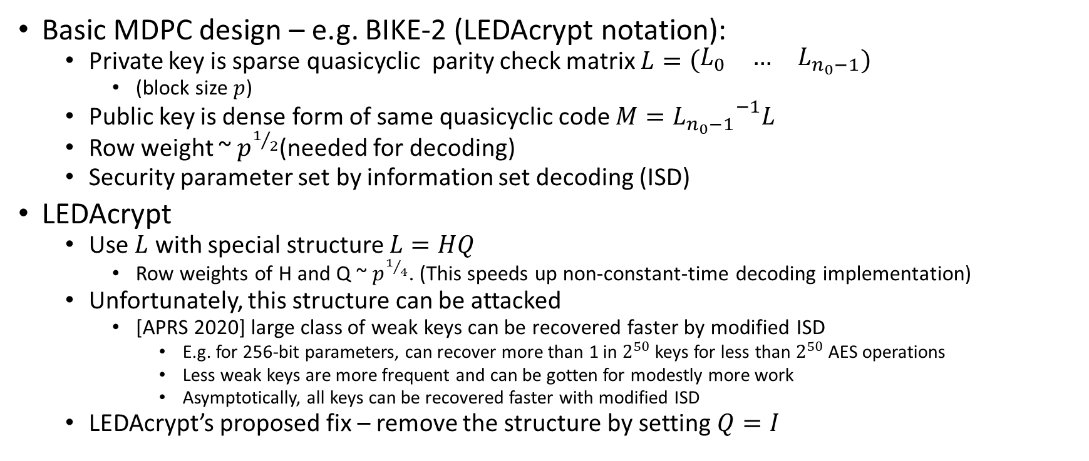
Last look at LEDAcrypt
Basic MDPC design – e.g. BIKE-2 (LEDAcrypt notation):
  Private key is sparse quasicyclic parity check matrix $L=\left(\begin{matrix}L_{0} & … & L_{n_{0}−1}\end{matrix}\right)$
    (block size $p$)
  Public key is dense form of same quasicyclic code $M={L_{n_{0}−1}}^{−1}L$
  Row weight ~ $p^{1/2}$(needed for decoding)
  Security parameter set by information set decoding (ISD)
LEDAcrypt
  Use $L$ with special structure $L=HQ$
    Row weights of H and Q ~ $p^{1/4}$. (This speeds up non-constant-time decoding implementation)
  Unfortunately, this structure can be attacked
    [APRS 2020] large class of weak keys can be recovered faster by modified ISD
      E.g. for 256-bit parameters, can recover more than 1 in $2^{50}$ keys for less than $2^{50}$ AES operations
      Less weak keys are more frequent and can be gotten for modestly more work
      Asymptotically, all keys can be recovered faster with modified ISD
  LEDAcrypt’s proposed fix – remove the structure by setting $Q=I$

Slide 7
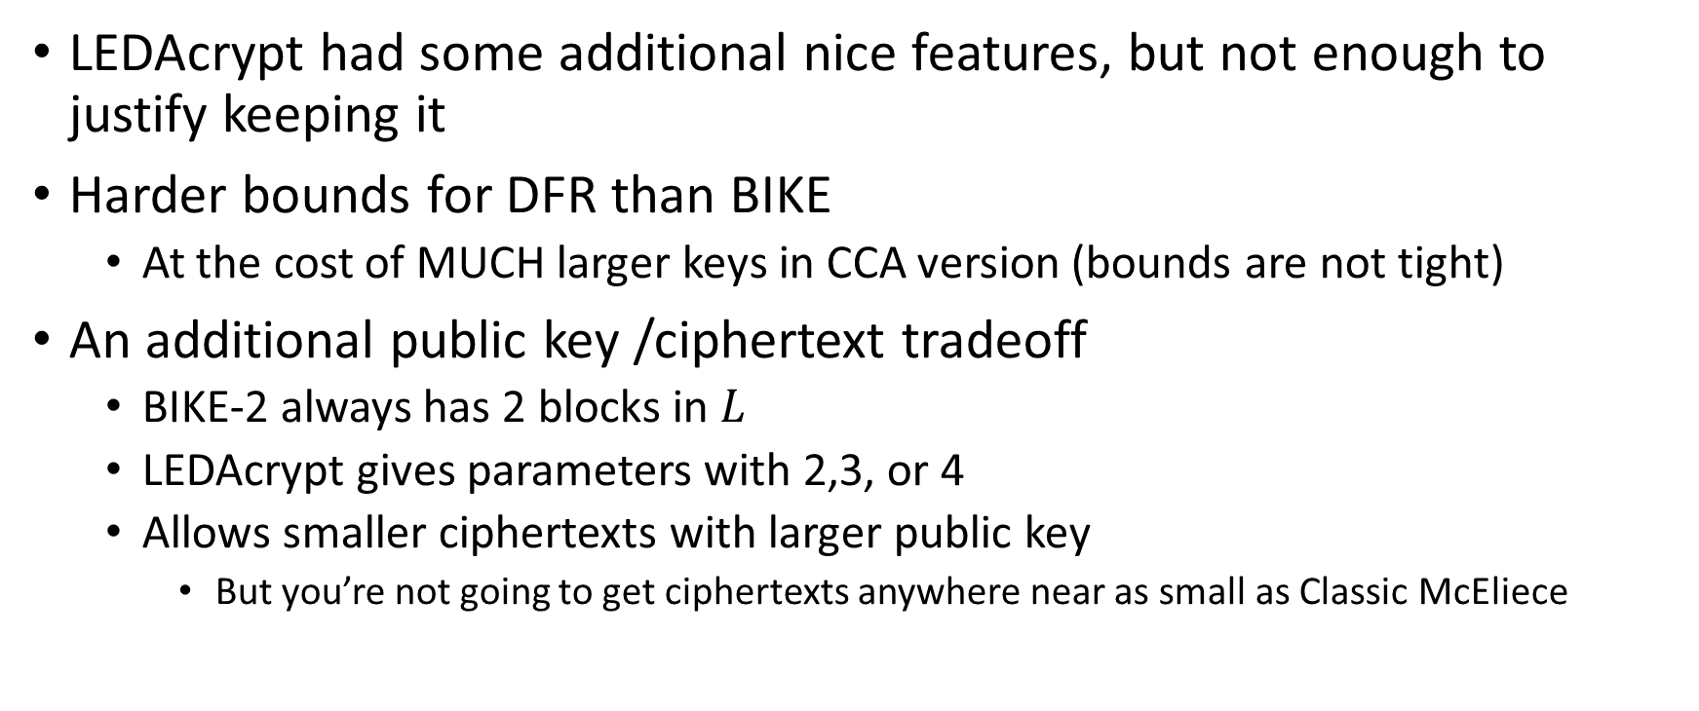
Last look at LEDAcrypt (continued)
LEDAcrypt had some additional nice features, but not enough to justify keeping it
Harder bounds for DFR than BIKE
  At the cost of MUCH larger keys in CCA version (bounds are not tight)
An additional public key /ciphertext tradeoff
  BIKE-2 always has 2 blocks in $L$
  LEDAcrypt gives parameters with 2,3, or 4
  Allows smaller ciphertexts with larger public key
    But you’re not going to get ciphertexts anywhere near as small as Classic McEliece

Slide 8
Attack on ROLLO, RQC
Hardness related to Rank Syndrome Decoding (RSD) problem
Initial submissions based security parameter on support trapping attack, dismissed algebraic attacks as impractical
In our first round report, we encouraged looking further into algebraic attacks
[BBBGNRT 2019] found algebraic attacks slightly better than claimed security for ROLLO, RQC
[BBCGPSTV 2020] used similar techniques + better analysis and optimzations to cut claimed security nearly in half
New parameters for ROLLO and RQC are ~twice as big as the old ones

Slide 9
Reasons to keep ROLLO, RQC
(in research track)
Attacks on rank-based crypto look very different from lattice attacks
  More like multivariate attacks, but we don’t have any multivariate KEMs
Even when corrected for the new attacks rank-based schemes come close to lattices on delivering cheap operations and low bandwidth
  Sometimes better than BIKE and HQC
The line of research leading to [BBCGPSTV 2020] started with old algebraic attacks like Kipnis-Shamir performing better than we could explain.
  [BBCGPSTV 2020] gives precise formulae for complexity, matches experiments, and seems to explain all unusual behavior of previous attacks
  So maybe security estimates will stabilize

Slide 10
The Case for BIKE or HQC
Performance and bandwidth are “almost” as good as structured lattices
But attacks are different
  ISD seems like pretty much the only attack
  Best known attack for both
Cost of ISD has been pretty stable over the past 50 years or so!
  Unlike RSD or lattice reduction (to a lesser extent)

Slide 11
Performance comparison
Security level 1
AVX2
 | Public key size (bytes) | Private key (bytes) | Ciphertext size (bytes) | KeyGen (kilocycles) | Encaps | Decaps | DFR
HQC | 3,024 | 40 | 6,017 | 177 | 287 | 470 | <2⁻¹²⁸
HQC-RMRS | 2,607 | 40 | 5,191 | 161 | 267 | 463 | <2⁻¹²⁸
BIKE | 1,541 | 281 | 1,573 | 600 | 220 | 2,220 | <2⁻¹²⁸
mceliece348864 | 261,120 | 6,452 | 128 | 140,870 | 46 | 137 | 0*
*for valid ciphertexts

Slide 12
Performance comparison
Security level 3
AVX2
 | Public key size (bytes) | Private key (bytes) | Ciphertext size (bytes) | KeyGen (kilocycles) | Encaps | Decaps | DFR
HQC | 5,690 | 40 | 11,364 | 389 | 635 | 943 | <2⁻¹⁹²
HQC-RMRS | 4,906 | 40 | 9,794 | 352 | 594 | 937 | <2⁻¹⁹²
BIKE | 3,083 | 419 | 3,115 | 1,780 | 465 | 6,610 | <2⁻¹⁹²
mceliece460896 | 261,120 | 6,452 | 128 | 441,517 | 83 | 273 | 0*
*for valid ciphertexts

Slide 13
Ongoing issues with BIKE/HQC
DFR for BIKE
  Analyzing an optimized bitflipping decoder with a fixed number of iterations is not easy to do rigorously
  BIKE takes a heuristic approach and extrapolates from experiments
  Aiming for CCA security (added in second round) incurs ~15% larger bandwidth and several times slower decryption
  Third round BIKE is clearly designed for CCA, but seems uncomfortable claiming to be CCA
Sparse polynomial Multiplication and Side Channels (BIKE and HQC)
  Very tempting to store (secret) sparse polynomial as list of nonzero coefficients
  Speeds up polynomial multiplication
  However, when you do this, polynomial multiplication has secret-dependent memory access
  Both BIKE, HQC now have implementations claiming not to do this

Slide 14
Security comparison
 | HQC | BIKE | Classic McEliece
Underlying security problem | (2,1) and (3,1) Decisional Parity quasi-cyclic syndrome decoding | (2,1) Decisional Parity quasi-cyclic syndrome decoding (2,1) Decisional Parity quasi-cyclic code word finding | Goppa code indistinguishability from random Syndrome Decoding
DFR analysis | Detailed approximation, supported by simulation | Extrapolation from experiments, simplified decoding models | N/A
Security levels offered | 1, 3, 5 | 1, 3 | 1, 3, 5
Known attacks | ISD | ISD | ISD
Other | Side channel vulnerabilities | Side channel vulnerabilities | 0*

Slide 15
Updates for BIKE
Dramatically reduced parameter sets
  Just BIKE-2 (now called BIKE)
  No category 5 parameter set
  All parameters now designed for CCA security (but recommended to be treated as CPA anyway)
New decoding algorithm (Black-and-Grey; 5 iterations)
New implementation
  Gets rid of secret dependent memory access
  Faster polynomial inversion (for keygen)

Slide 16
Updates for HQC
Better decryption failure rate analysis
  Analysis of error distribution
  Compared theoretical results with simulation to confirm
  Room to reduce key sizes (by 3%) and maintain low DFR
New decoding algorithm
  Concatenated Reed-Muller and Reed-Solomon
  Reduces public key size by 17% for 128-bit security
New implementation
  First update tried to protect against secret dependent memory access with randomization
  New update is slower but claims constant time and no secret dependent memory access

