Slide 1
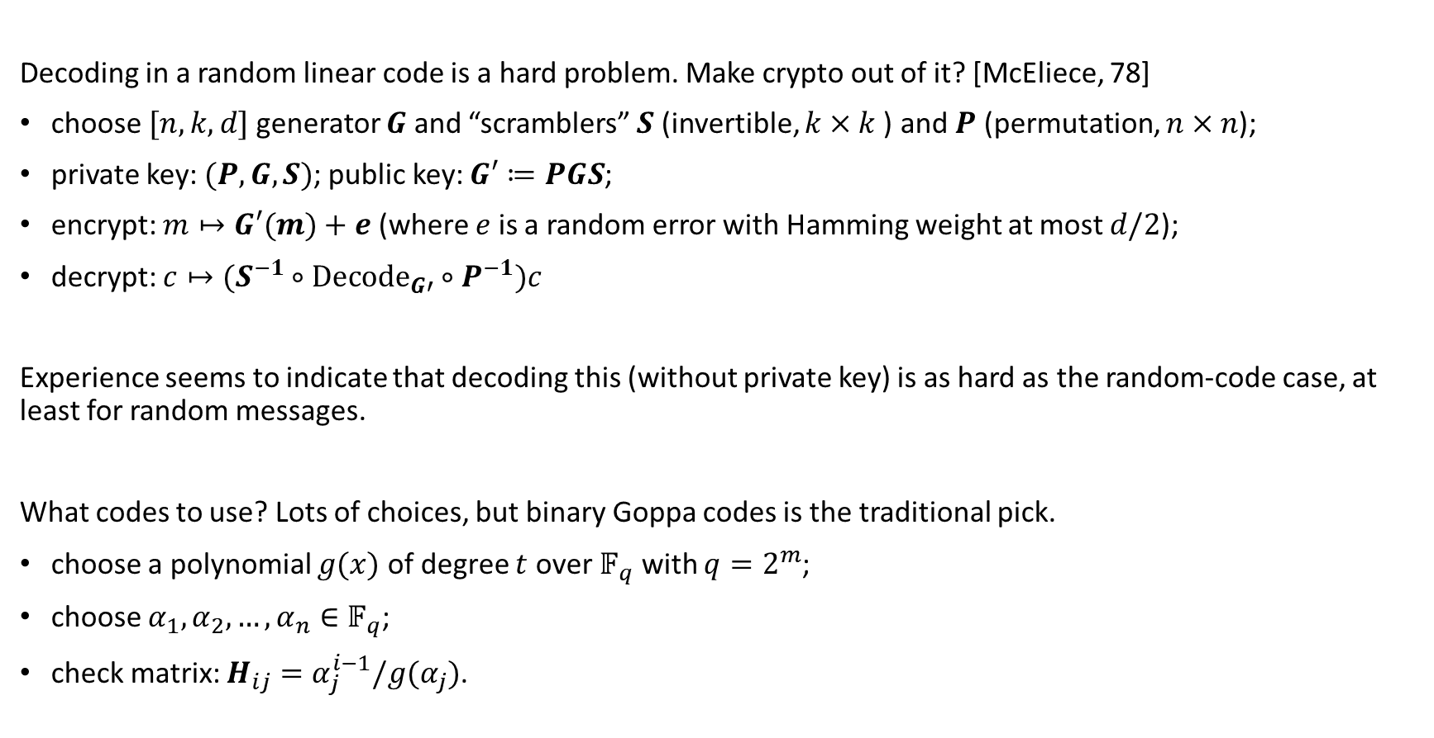
Classic McEliece and NTS-KEM
Decoding in a random linear code is a hard problem. Make crypto out of it? [McEliece, 78]
choose$[n,k,d]$generator $G$ and “scramblers” $S$ (invertible, $k×k$) and $P$ (permutation, $n×n$);
private key: $(P, G, S)$; public key: $G′≔PGS$;
encrypt: $m↦G′(m)+e$ (where $e$ is a random error with Hamming weight at most $d/2$);
decrypt: $c↦(S^{−1}∘Decode_{G′}∘P^{−1})c$
Experience seems to indicate that decoding this (without private key) is as hard as the random-code case, at least for random messages.
What codes to use? Lots of choices, but binary Goppa codes is the traditional pick.
choose a polynomial $g(x)$ of degree $t$ over $𝔽_{q}$ with $q=2^{m}$;
choose $α_{1},α_{2},…, α_{n}∈𝔽_{q}$;
check matrix: $H_{ij}=α_{j}^{i−1}/g(α_{j})$.

Slide 2
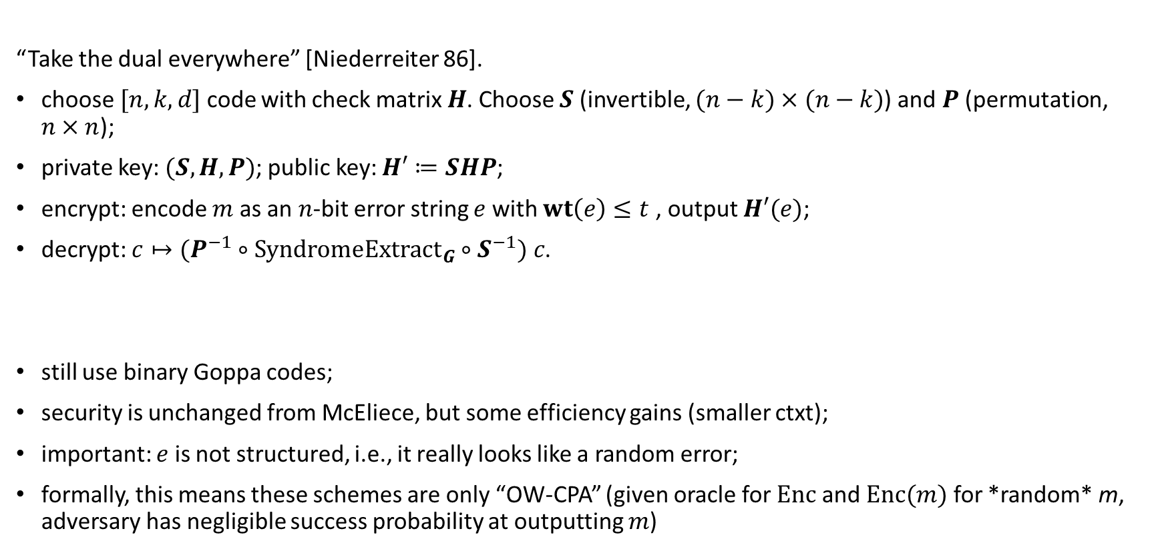
Classic McEliece and NTS-KEM
“Take the dual everywhere” [Niederreiter 86].
choose$[n,k,d]$code with check matrix $H$. Choose $S$ (invertible, $(n−k)×(n−k)$) and $P$ (permutation, $n×n$);
private key: $(S, H, P)$; public key: $H′≔SHP$;
encrypt: encode $m$ as an $n$-bit error string $e$ with $wt\left(e\right)≤t$ , output $H′(e)$;
decrypt: $c↦(P^{−1}∘SyndromeExtract_{G}∘S^{−1}) c$.
still use binary Goppa codes;
security is unchanged from McEliece, but some efficiency gains (smaller ctxt);
important: $e$ is not structured, i.e., it really looks like a random error;
formally, this means these schemes are only “OW-CPA” (given oracle for $Enc$ and $Enc(m)$ for *random* m, adversary has negligible success probability at outputting $m$)

Slide 3
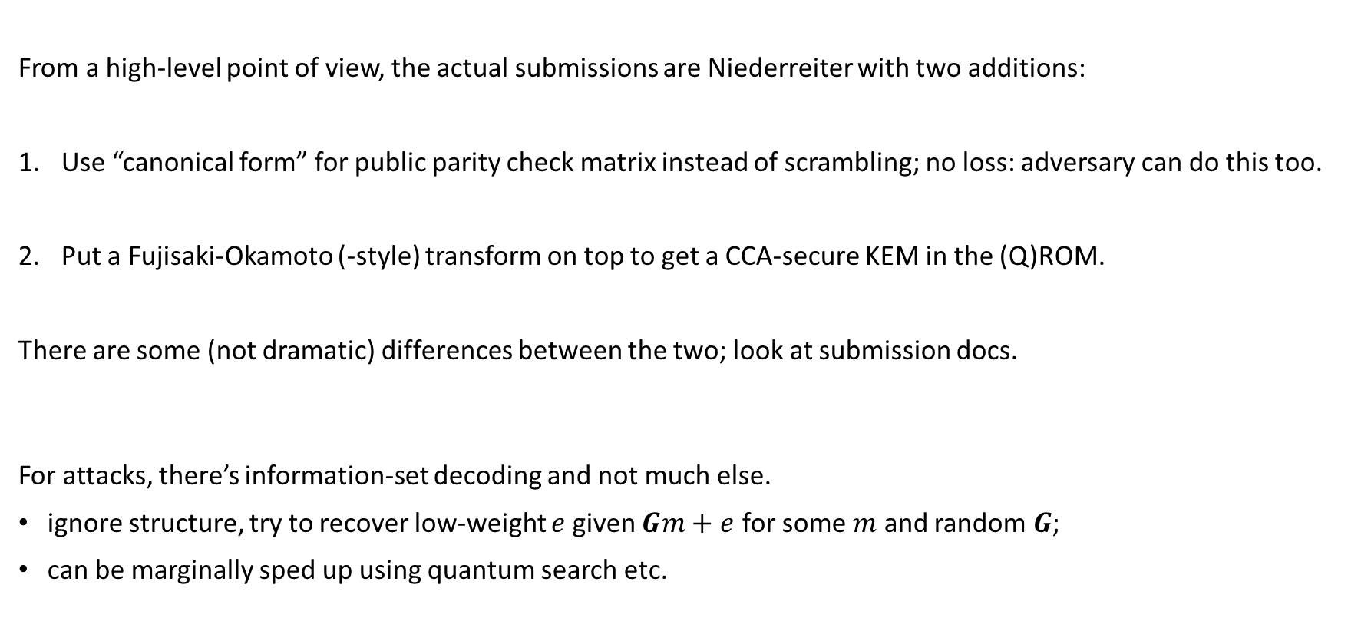
Classic McEliece and NTS-KEM
From a high-level point of view, the actual submissions are Niederreiter with two additions:
Use “canonical form” for public parity check matrix instead of scrambling; no loss: adversary can do this too.
Put a Fujisaki-Okamoto (-style) transform on top to get a CCA-secure KEM in the (Q)ROM.
There are some (not dramatic) differences between the two; look at submission docs.
For attacks, there’s information-set decoding and not much else.
ignore structure, try to recover low-weight $e$given $Gm+e$ for some $m$ and random $G$;
can be marginally sped up using quantum search etc.

Slide 4
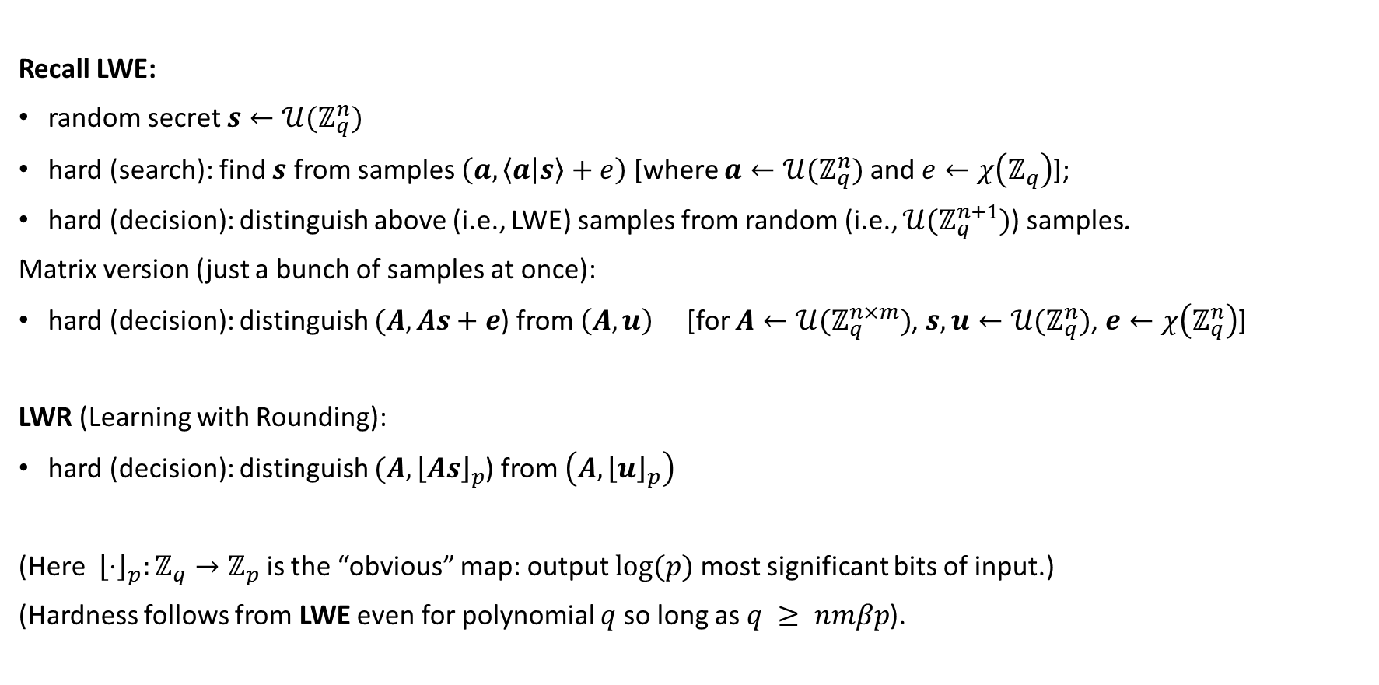
Learning with Errors (and its variants)
Recall LWE:
random secret $s←𝒰(ℤ_{q}^{n})$
hard (search): find $s$ from samples $\left(a, \left\langle a | s\right\rangle +e\right)$ [where $a←{𝒰(ℤ}_{q}^{n})$ and $e←χ\left(ℤ_{q}\right)$];
hard (decision): distinguish above (i.e., LWE) samples from random (i.e., ${𝒰(ℤ}_{q}^{n+1})$) samples.
Matrix version (just a bunch of samples at once):
hard (decision): distinguish $(A, As+e$) from $\left(A, u\right)$ [for $A←{𝒰(ℤ}_{q}^{n×m})$, $s,u←{𝒰(ℤ}_{q}^{n})$, $e←χ\left(ℤ_{q}^{n}\right)$]
LWR (Learning with Rounding):
hard (decision): distinguish $(A, {\left\lfloor As\right\rfloor }_{p}$) from $\left(A,{\left\lfloor u\right\rfloor }_{p}\right)$
(Here ${\left\lfloor ⋅\right\rfloor }_{p}:ℤ_{q}→ℤ_{p}$ is the “obvious” map: output $log⁡(p)$ most significant bits of input.)
(Hardness follows from LWE even for polynomial $q$ so long as $q ≥ nmβp$).

Slide 5
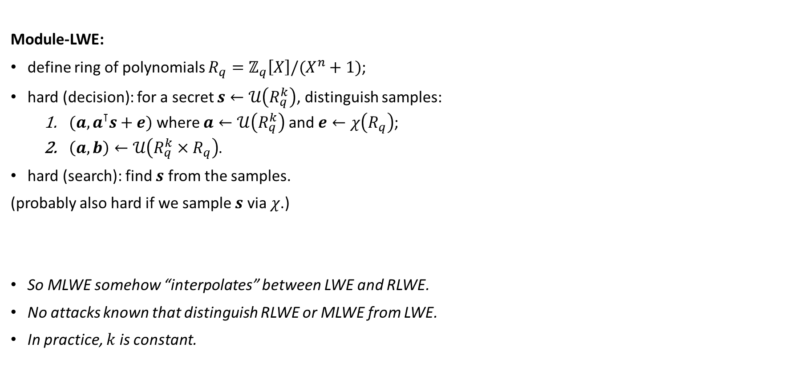
Learning with Errors (and its variants)
Module-LWE:
define ring of polynomials $R_{q}=ℤ_{q}\left[X\right]/(X^{n}+1)$;
hard (decision): for a secret $s←𝒰\left(R_{q}^{k}\right)$, distinguish samples:
    $(a, a^{⊺}s+e)$ where $a←𝒰\left(R_{q}^{k}\right)$ and $e←χ\left(R_{q}\right)$;
    $\left(a, b\right)←𝒰\left(R_{q}^{k}×R_{q}\right)$.
hard (search): find $s$ from the samples.
(probably also hard if we sample $s$ via $χ$.)
So MLWE somehow “interpolates” between LWE and RLWE.
No attacks known that distinguish RLWE or MLWE from LWE.
In practice, $k$is constant.

Slide 6
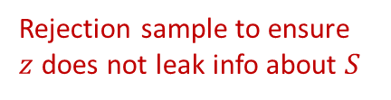

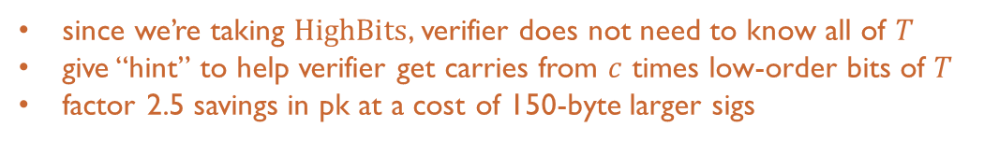
Dilithium and qTesla
“Fiat-Shamir from lattices.”
Generate some MLWE keys: $(A, T≔AS+E)$
To sign a message $μ$, do:
  sample a random $y$, compute $w=HighBits(Ay)$;
  compute hash $c≔H(w, μ)$;
  set $z≔y+Sc$;
  output $(z, c)$.
To verify a signature $(z, c)$ of message $μ$:
  Compute $w′=HighBits(Az−Tc)$;
  Return $c==H\left(w^{′}, μ\right).$
Check: $Az−Tc=(Ay+ASc) −\left(ASc+Ec\right)=Ay−Ec$.
commit
challenge
Rejection sample to ensure
$z$ does not leak info about $S$
response
since we’re taking $HighBits$, verifier does not need to know all of $T$
give “hint” to help verifier get carries from $c$ times low-order bits of $T$
factor 2.5 savings in pk at a cost of 150-byte larger sigs

Slide 7
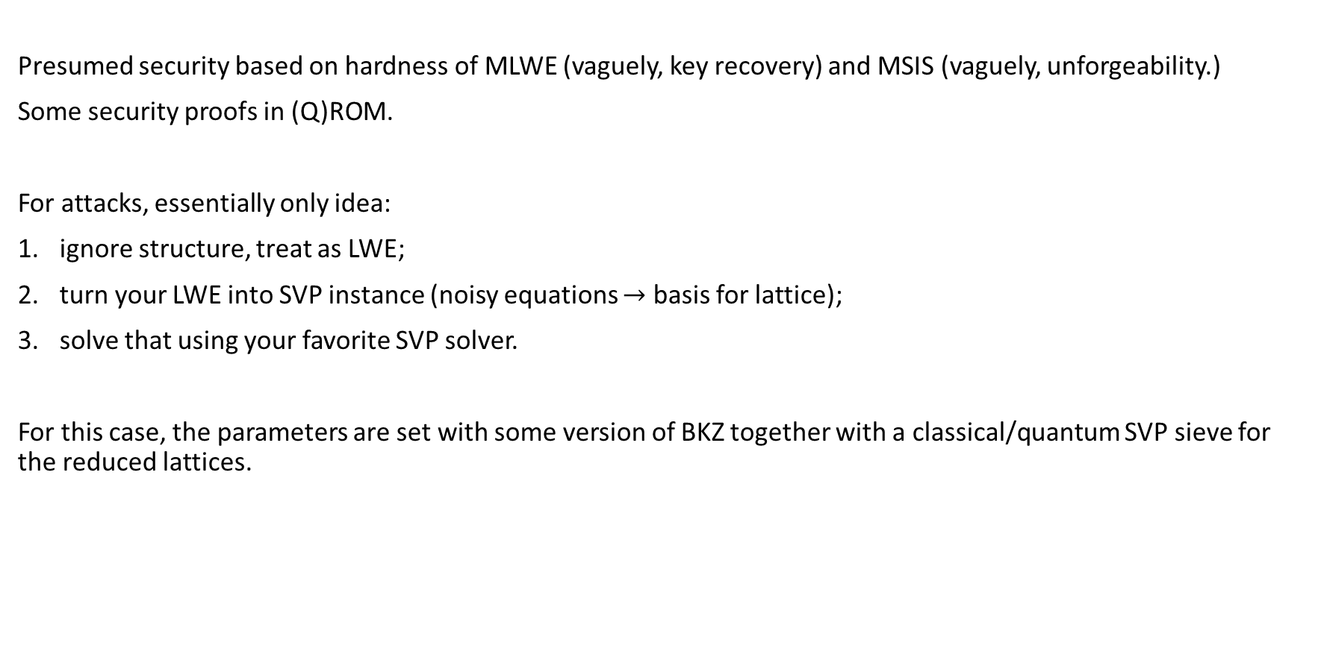
Security
Presumed security based on hardness of MLWE (vaguely, key recovery) and MSIS (vaguely, unforgeability.)
Some security proofs in (Q)ROM.
For attacks, essentially only idea:
ignore structure, treat as LWE;
turn your LWE into SVP instance (noisy equations $→$ basis for lattice);
solve that using your favorite SVP solver.
For this case, the parameters are set with some version of BKZ together with a classical/quantum SVP sieve for the reduced lattices.

