Slide 1
FrodoKEM in the third round
Gorjan Alagic
NIST internal
11/19/2021

Slide 2
Frodo from Mars
What is it?
KEM based on (plain) Learning with Errors.
The team:
Erdem Alkim, Joppe W. Bos, Leo Ducas, Patrick Longa, Ilya Mironov, Michael Naehrig, Valeria Nikolaenko, Chris Peikert, Ananth Raghunathan, Douglas Stebila
Security levels offered:
Level 1: FrodoKEM-640
Level 3: FrodoKEM-976
Level 5: FrodoKEM-1344
Why is it interesting?
It’s the most conservative lattice-based KEM.

Slide 3

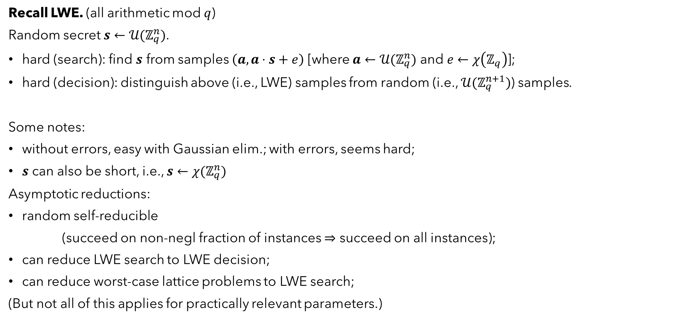
Learning with Errors [Regev05] (and earlier…)
error distribution, e.g., Gaussian
Recall LWE. (all arithmetic mod $q$)
Random secret $s←𝒰(ℤ_{q}^{n})$.
hard (search): find $s$ from samples $\left(a, a⋅s+e\right)$ [where $a←{𝒰(ℤ}_{q}^{n})$ and $e←χ\left(ℤ_{q}\right)$];
hard (decision): distinguish above (i.e., LWE) samples from random (i.e., ${𝒰(ℤ}_{q}^{n+1})$) samples.
Some notes:
without errors, easy with Gaussian elim.; with errors, seems hard;
$s$ can also be short, i.e., $s←χ(ℤ_{q}^{n})$
Asymptotic reductions:
random self-reducible
(succeed on non-negl fraction of instances $⇒$ succeed on all instances);
can reduce LWE search to LWE decision;
can reduce worst-case lattice problems to LWE search;
(But not all of this applies for practically relevant parameters.)
Besides all this awesomeness,
you can also build pretty much
any cryptographic thing you
want from LWE!
Products,
not
quotients!
FRODO!
Give us
Kyber!
IP SUCKS
LWE
NOW!
DOWN WITH
CNRS

Slide 4
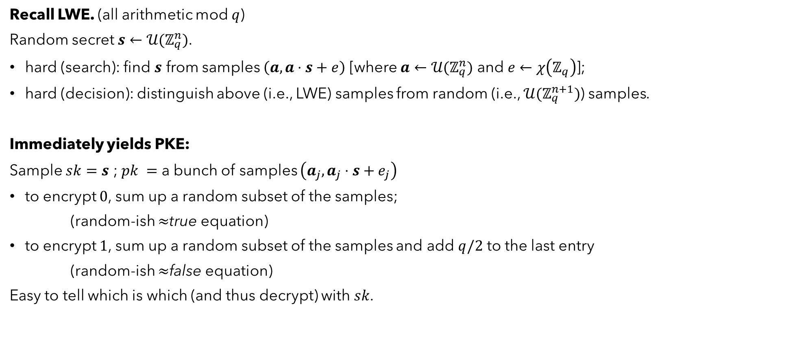
Learning with Errors [Regev05]
error distribution, e.g., Gaussian
Recall LWE. (all arithmetic mod $q$)
Random secret $s←𝒰(ℤ_{q}^{n})$.
hard (search): find $s$ from samples $\left(a, a⋅s+e\right)$ [where $a←{𝒰(ℤ}_{q}^{n})$ and $e←χ\left(ℤ_{q}\right)$];
hard (decision): distinguish above (i.e., LWE) samples from random (i.e., ${𝒰(ℤ}_{q}^{n+1})$) samples.
Immediately yields PKE:
Sample $sk=s$ ; $pk =$ a bunch of samples $\left(a_{j}, a_{j}⋅s+e_{j}\right)$
to encrypt $0$, sum up a random subset of the samples;
(random-ish $≈$true equation)
to encrypt $1$, sum up a random subset of the samples and add $q/2$ to the last entry
(random-ish $≈$false equation)
Easy to tell which is which (and thus decrypt) with $sk$.

Slide 5

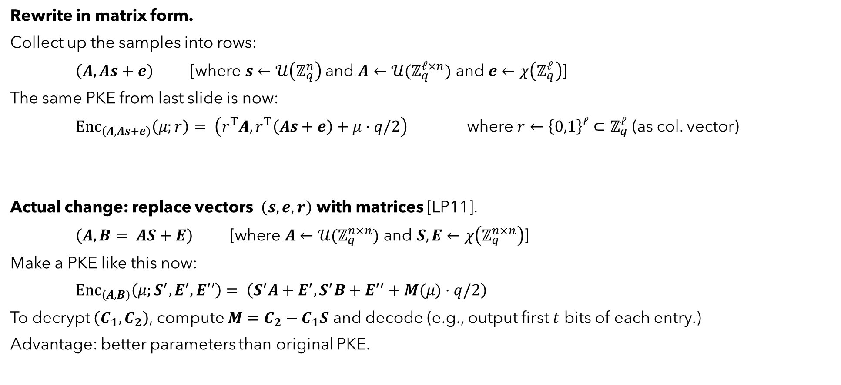
Learning with Errors [Regev05, LP11]
unstructured LWE (compare to, e.g., Ring/Module-LWE)
Rewrite in matrix form.
Collect up the samples into rows:
$\left(A, As+e\right) \text{ [}\text{where} s←𝒰\left(ℤ_{q}^{n}\right)$and $A←{𝒰(ℤ}_{q}^{ℓ×n}) \text{and} e←χ\left(ℤ_{q}^{ℓ}\right)$]
The same PKE from last slide is now:
$Enc_{\left(A, As+e\right)}\left(μ;r\right)= \left(r^{T}A,r^{T}\left(As+e\right)+μ⋅q/2\right)$ where $r←{\left\{0,1\right\}}^{ℓ}⊂ℤ_{q}^{ℓ}$ (as col. vector)
Actual change: replace vectors $\left(s,e,r\right)$ with matrices [LP11].
$\left(A, B= AS+E\right) \text{ [}\text{where} A←{𝒰(ℤ}_{q}^{n×n}) \text{and} S,E←χ\left(ℤ_{q}^{n×\overline{n}}\right)$]
Make a PKE like this now:
$Enc_{\left(A,B\right)}\left(μ;S^{′},E^{′},E′′\right)= \left(S^{′}A+E^{′},S^{′}B+E^{′′}+M(μ)⋅q/2\right)$
To decrypt $\left(C_{1},C_{2}\right)$, compute $M=C_{2}−C_{1}S$ and decode (e.g., output first $t$ bits of each entry.)
Advantage: better parameters than original PKE.
$+e′$ $←$ could add more error at encryption stage
some encoding of ptxt $m$ into a matrix

Slide 6

From LP11 to FrodoPKE
Efficient LWE PKE [LP11]. $\left(A, B= AS+E\right) \text{ [}\text{where} A←{𝒰(ℤ}_{q}^{n×n}) \text{and} S,E←χ\left(ℤ_{q}^{n×\overline{n}}\right)$]
To encrypt $μ$ : $Enc_{\left(A,B\right)}\left(μ;S^{′},E^{′},E′′\right)= \left(S^{′}A+E^{′},S^{′}B+E^{′′}+M(μ)⋅q/2\right)$
where $S^{′},E′←χ\left(ℤ_{q}^{\overline{m}×n}\right)$ and $E′′←χ\left(ℤ_{q}^{\overline{m}×\overline{n}}\right)$
To decrypt $\left(C_{1},C_{2}\right)$ : compute $M=C_{2}−C_{1}S$ and decode (e.g., output first $t$ bits of each entry.)
LP11

Slide 7
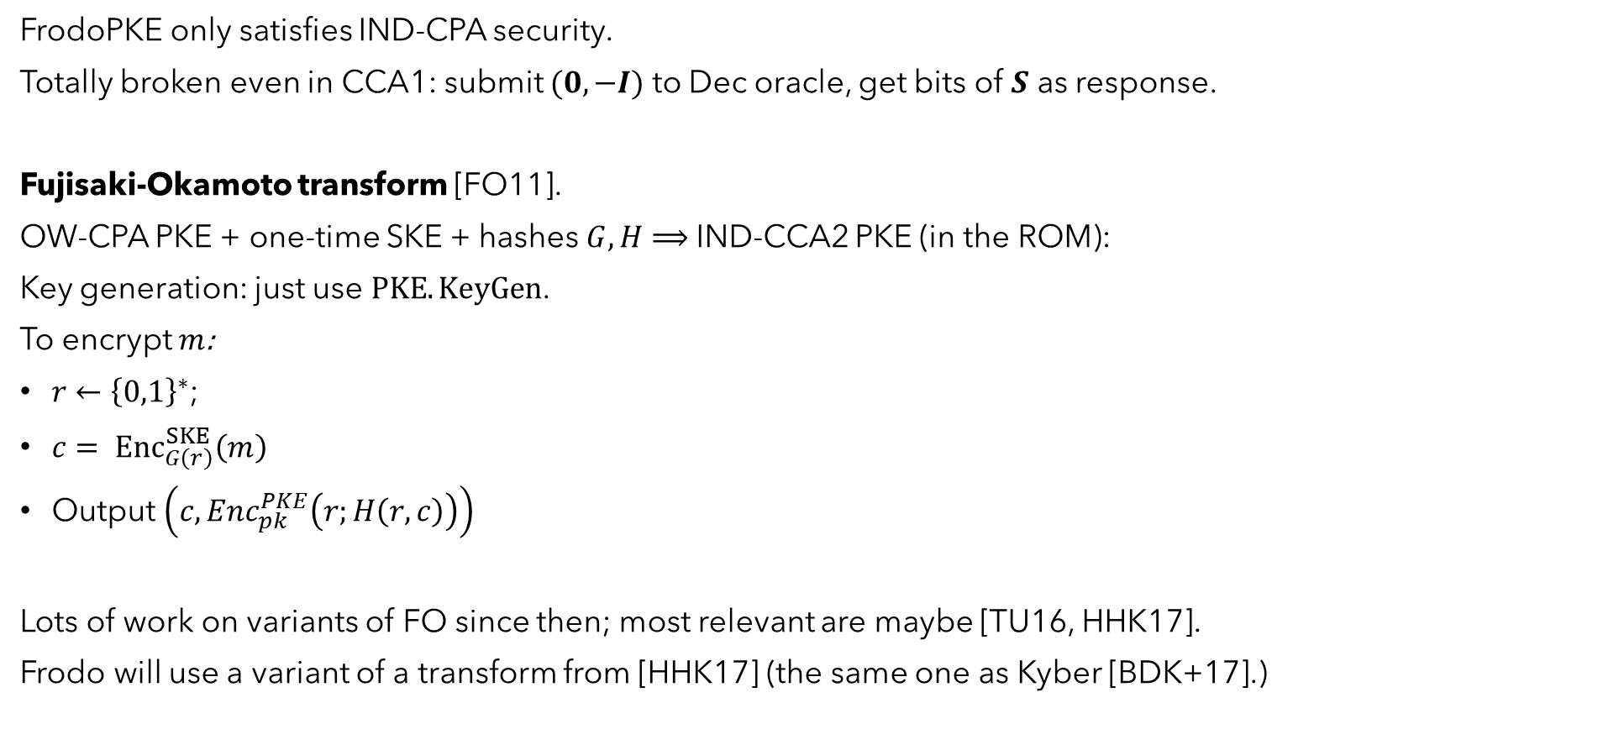
From FrodoPKE to FrodoKEM
FrodoPKE only satisfies IND-CPA security.
Totally broken even in CCA1: submit $(0, −I)$ to Dec oracle, get bits of $S$ as response.
Fujisaki-Okamoto transform [FO11].
OW-CPA PKE + one-time SKE + hashes $G,H$ $⟹$ IND-CCA2 PKE (in the ROM):
Key generation: just use $PKE.KeyGen$.
To encrypt $m$:
$r←{\left\{0,1\right\}}^{∗}$;
$c= {Enc}_{G\left(r\right)}^{SKE}\left(m\right)$
Output $\left(c, Enc_{pk}^{PKE}\left(r;H\left(r, c\right)\right)\right)$
Lots of work on variants of FO since then; most relevant are maybe [TU16, HHK17].
Frodo will use a variant of a transform from [HHK17] (the same one as Kyber [BDK+17].)

Slide 8

From FrodoPKE to FrodoKEM
FrodoPKE only satisfies IND-CPA security.
Totally broken even in CCA1: submit $(0, −I)$ to Dec oracle, get bits of $S$ as response.
HHK transform [HHK17]: “FO with implicit rejection.”
OW-CPA PKE + hash $H$ $⟹$ IND-CCA2 KEM (in the ROM):
for implicit
rejection
implicit rejection
shared secret

Slide 9
From FrodoPKE to FrodoKEM
The FrodoKEM transform (Variant of [HHK17])
HHK17

Slide 10
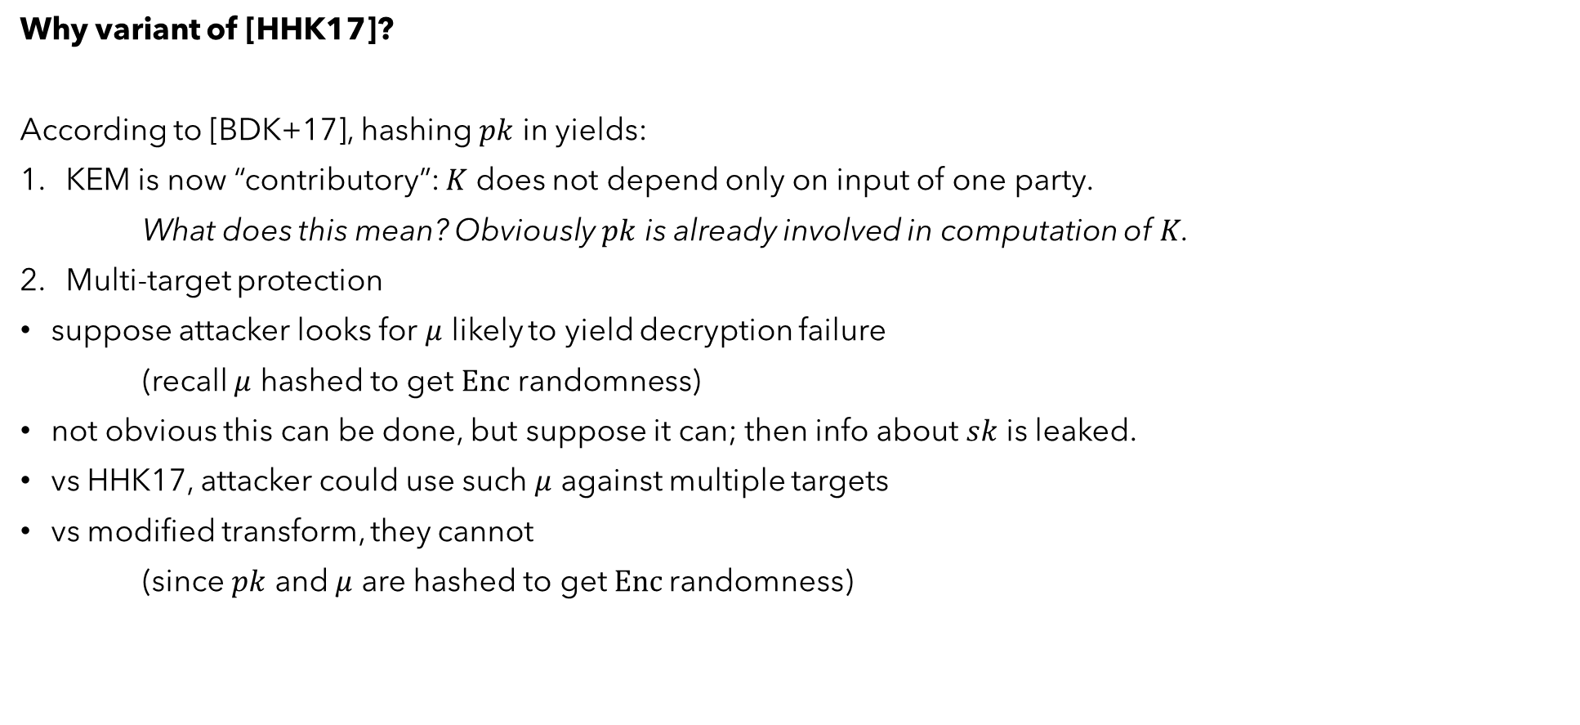
From FrodoPKE to FrodoKEM
Why variant of [HHK17]?
According to [BDK+17], hashing $pk$ in yields:
KEM is now “contributory”: $K$ does not depend only on input of one party.
What does this mean? Obviously $pk$ is already involved in computation of $K$.
Multi-target protection
suppose attacker looks for $μ$ likely to yield decryption failure
(recall $μ$ hashed to get $Enc$ randomness)
not obvious this can be done, but suppose it can; then info about $sk$ is leaked.
vs HHK17, attacker could use such $μ$ against multiple targets
vs modified transform, they cannot
(since $pk$ and $μ$ are hashed to get $Enc$randomness)

Slide 11
The actual FrodoKEM (Encaps)
FrodoPKE
FO xform variant

Slide 12

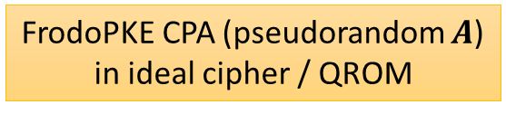

Security (asymptotic)
Known results.
not known: is FrodoKEM CCA2-secure in plain model, under any assumption? (same as all our KEMs)
known:
($A⇒B$ means if $A$ is hard/secure, then so is $B$.)
FrodoKEM CCA2 in ROM
FrodoKEM CCA2 in QROM
tight
non-tight
FrodoPKE CPA (pseudorandom $A$)
in ideal cipher / QROM
FrodoPKE CPA (random $A$)
average-case decision LWE
(a version of) worst-case BDD

Slide 13

Security (concrete)
Parameters based on actual cryptanalytic attacks.
the best attacks are primal and dual BKZ [CN11];
roughly, these are two different ways of converting an LWE instance into an SVP instance
In either case, SVP is then solved with BKZ with block size $b$
This involves poly-many calls to SVP in dimension $b$;
Core-SVP hardness : set params under assumption only one SVP call enough to break;
based on “known unknowns”
discussion in Kyber round 3 spec

Slide 14

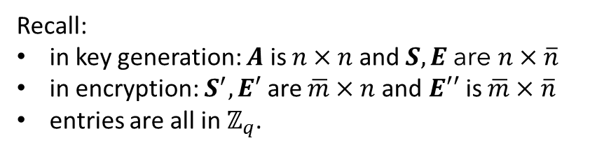

Parameters, details
L1, L3, L5 Parameter sets:
error distribution is not quite Gaussian;
it’s simpler and easier to sample from…
… and a divergence argument shows it’s just as good.
Two variants: $SHAKE$ and $AES$ (latter for platforms with $AES$hardware acceleration)
of the matrix $M(μ)$
error distribution
and its std dev
Recall:
in key generation: $A$ is $n×n$ and $S,E$ are $n×\overline{n}$
in encryption: $S^{′},E′$ are $\overline{m}×n$and $E′′$ is $\overline{m}×\overline{n}$
entries are all in $ℤ_{q}$.

Slide 15
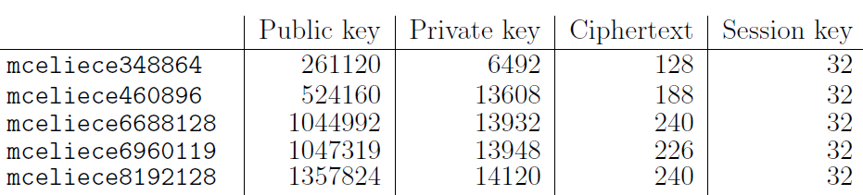

Performance : space (bytes)
(secret value + $pk$)
L1
L3
L5
L1
Kyber512 | 1632 | 800 | 768 | 32
Kyber768 | 2400 | 1184 | 1088 | 32
Kyber1024 | 3168 | 1568 | 1568 | 32
L3
L5
L1
L3
L5
L5
L5

Slide 16

Performance : speed (kcycles)
$SHAKE$version.

Slide 17

Performance : speed (kcycles)
$AES$version.

Slide 18
Performance : speed (kcycles)
ARM.

Slide 19
Performance : memory usage

Slide 20
Performance : speed (kcycles) [comparison to McE]
L1 McE 348864 | 58,034 | 44 | 44 | 88
L3 McE 460896 | 215,785 | 116 | 118 | 234
L5 McE 6688128 | 556,496 | 149 | 151 | 300
Average times using AVX
on 3.5 Ghz Xeon E3-1275 v3 (Haswell)

Slide 21
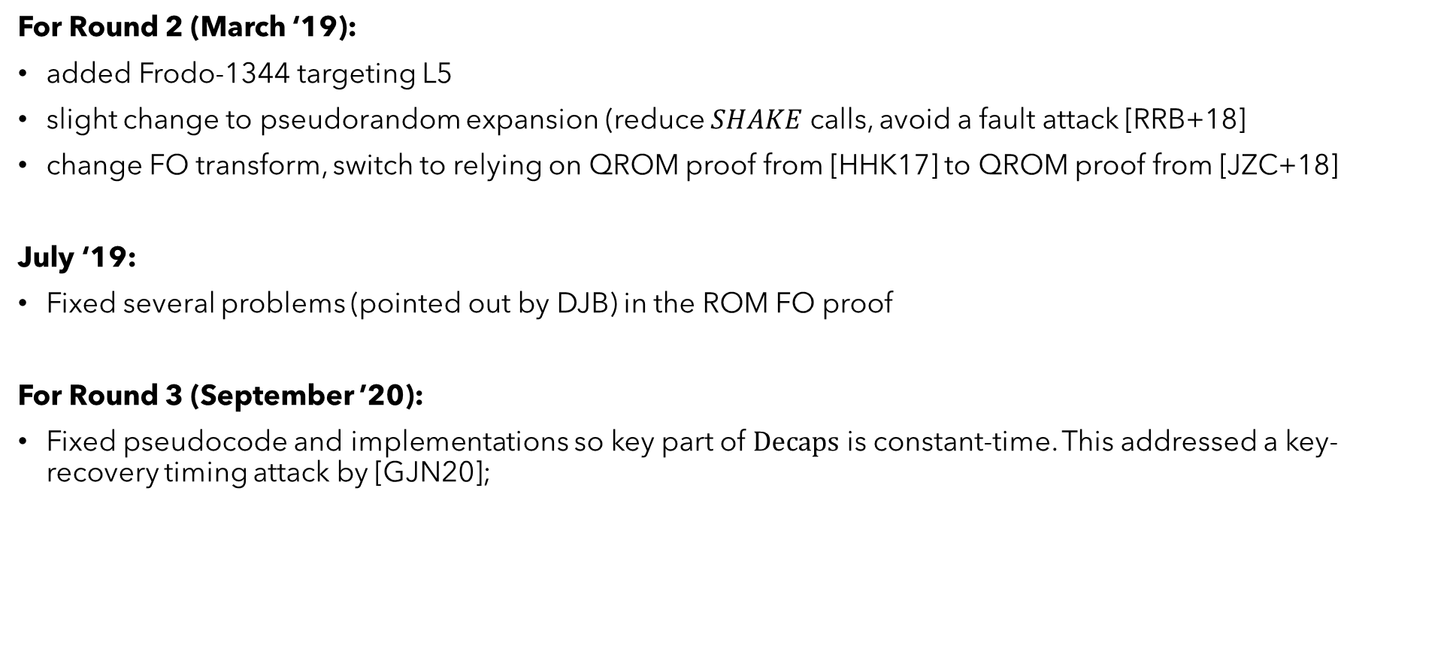
Notable revisions
For Round 2 (March ‘19):
added Frodo-1344 targeting L5
slight change to pseudorandom expansion (reduce $SHAKE$ calls, avoid a fault attack [RRB+18]
change FO transform, switch to relying on QROM proof from [HHK17] to QROM proof from [JZC+18]
July ‘19:
Fixed several problems (pointed out by DJB) in the ROM FO proof
For Round 3 (September ’20):
Fixed pseudocode and implementations so key part of $Decaps$ is constant-time. This addressed a key-recovery timing attack by [GJN20];

Slide 22
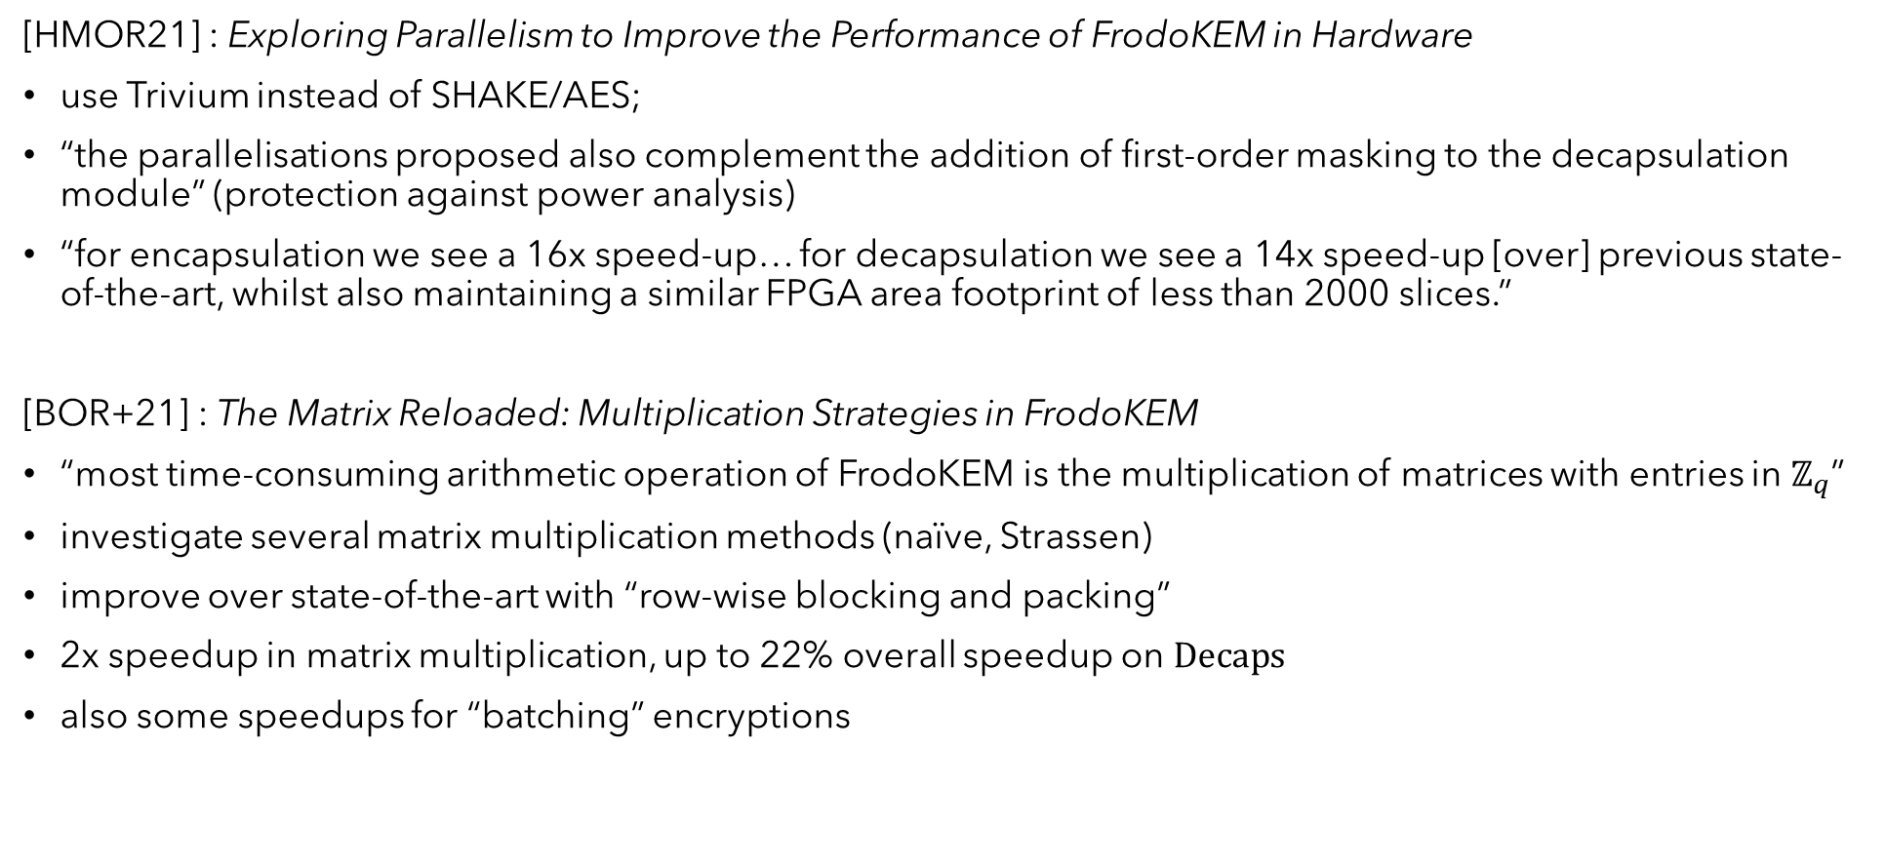
Additional recent results
[HMOR21] : Exploring Parallelism to Improve the Performance of FrodoKEM in Hardware
use Trivium instead of SHAKE/AES;
“the parallelisations proposed also complement the addition of first-order masking to the decapsulation module” (protection against power analysis)
“for encapsulation we see a 16x speed-up… for decapsulation we see a 14x speed-up [over] previous state-of-the-art, whilst also maintaining a similar FPGA area footprint of less than 2000 slices.”
[BOR+21] : The Matrix Reloaded: Multiplication Strategies in FrodoKEM
“most time-consuming arithmetic operation of FrodoKEM is the multiplication of matrices with entries in $ℤ_{q}$”
investigate several matrix multiplication methods (naïve, Strassen)
improve over state-of-the-art with “row-wise blocking and packing”
2x speedup in matrix multiplication, up to 22% overall speedup on $Decaps$
also some speedups for “batching” encryptions

Slide 23
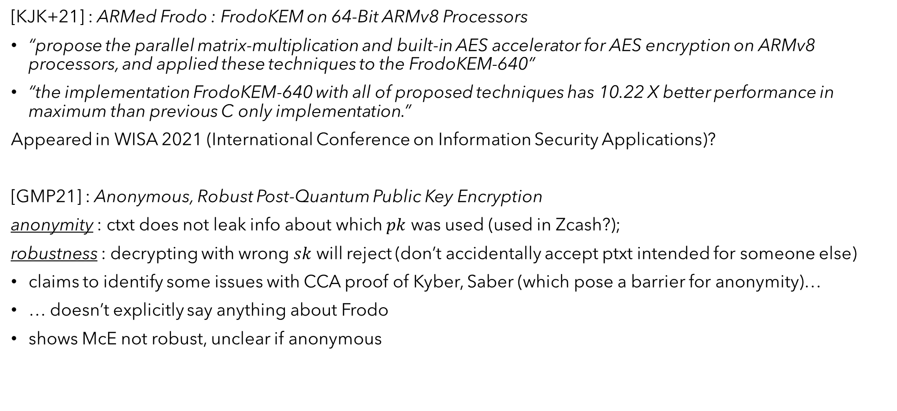
Additional recent results
[KJK+21] : ARMed Frodo : FrodoKEM on 64-Bit ARMv8 Processors
“propose the parallel matrix-multiplication and built-in AES accelerator for AES encryption on ARMv8 processors, and applied these techniques to the FrodoKEM-640”
“the implementation FrodoKEM-640 with all of proposed techniques has 10.22 X better performance in maximum than previous C only implementation.”
Appeared in WISA 2021 (International Conference on Information Security Applications)?
[GMP21] : Anonymous, Robust Post-Quantum Public Key Encryption
anonymity : ctxt does not leak info about which $pk$ was used (used in Zcash?);
robustness : decrypting with wrong $sk$ will reject (don’t accidentally accept ptxt intended for someone else)
claims to identify some issues with CCA proof of Kyber, Saber (which pose a barrier for anonymity)…
… doesn’t explicitly say anything about Frodo
shows McE not robust, unclear if anonymous

Slide 24
Additional recent results
[Xagawa21a, Xagawa21b] : Anonymity of NIST PQC Round-3 KEMs
claims to show anonymity and robustness (and some other stuff) for FrodoKEM (and NTRU, Bike, HQC, NTRULPrime, SIKE); Frodo might just be an application of a result from [GMP21]
seems to confirm Kyber FO proof issue, also finds issue with Streamlined NTRU Prime
Does Zhandry’s indifferentiability for QROM actually address both these problems? Need to check this.
[XIU+21] : Fault-Injection Attacks against NIST's Post-Quantum Cryptography Round 3 KEM Candidates
investigates instruction-skipping fault attacks: skip the re-encryption equality test (in the FO transform)
seems like almost everything is totally broken in this case
[UXT+21] : Curse of Re-encryption: A Generic Power/EM Analysis on Post-Quantum KEMs
exploits side-channel leakage during execution of PRF in re-encryption step;
yields full key recovery against everything except McEliece
This is hardly all… a lot of work is happening!

Slide 25
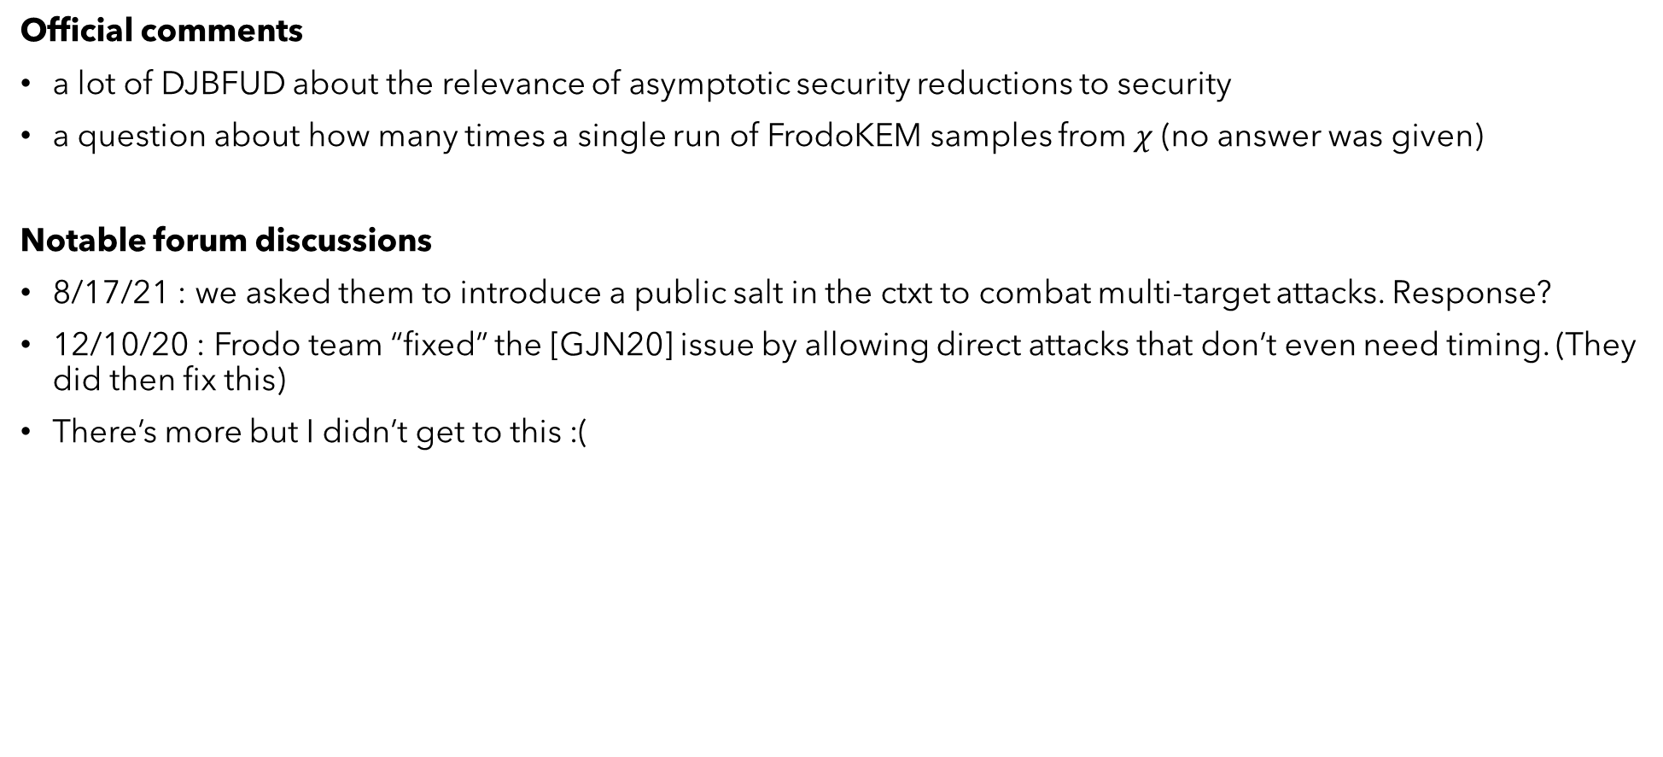
Forum discussions / official comments
Official comments
a lot of DJBFUD about the relevance of asymptotic security reductions to security
a question about how many times a single run of FrodoKEM samples from $χ$ (no answer was given)
Notable forum discussions
8/17/21 : we asked them to introduce a public salt in the ctxt to combat multi-target attacks. Response?
12/10/20 : Frodo team “fixed” the [GJN20] issue by allowing direct attacks that don’t even need timing. (They did then fix this)
There’s more but I didn’t get to this :(

Slide 26
References
[Regev05] : https://dl.acm.org/doi/pdf/10.1145/1568318.1568324
[LP11] : https://eprint.iacr.org/2010/613
[FO11] : https://link.springer.com/content/pdf/10.1007/s00145-011-9114-1.pdf
[TU16] : https://eprint.iacr.org/2015/1210
[HHK17] : https://eprint.iacr.org/2017/604
[BDK+17] : https://eprint.iacr.org/2017/634
[CN11] : https://www.iacr.org/archive/asiacrypt2011/70730001/70730001.pdf
[RRB+18] : https://eprint.iacr.org/2018/211
[JZC+18] : https://eprint.iacr.org/2017/1096
[GJN20] : https://eprint.iacr.org/2020/743
[HMOR21] : https://eprint.iacr.org/2021/155
[BOR+21] : https://eprint.iacr.org/2021/711
[KJK+21] : https://link.springer.com/chapter/10.1007%2F978-3-030-89432-0_17

Slide 27
References
[GMP21] : https://eprint.iacr.org/2021/708
[Xagawa21a] : https://eprint.iacr.org/2021/1323
[Xagawa21b] : https://eprint.iacr.org/2021/741
[XIU+21] : https://eprint.iacr.org/2021/840
[UXT+21] : https://eprint.iacr.org/2021/849

