Slide 1
MLWE/MLWR-based schemes
NIST internal presentation by Gorjan Alagic

Slide 2
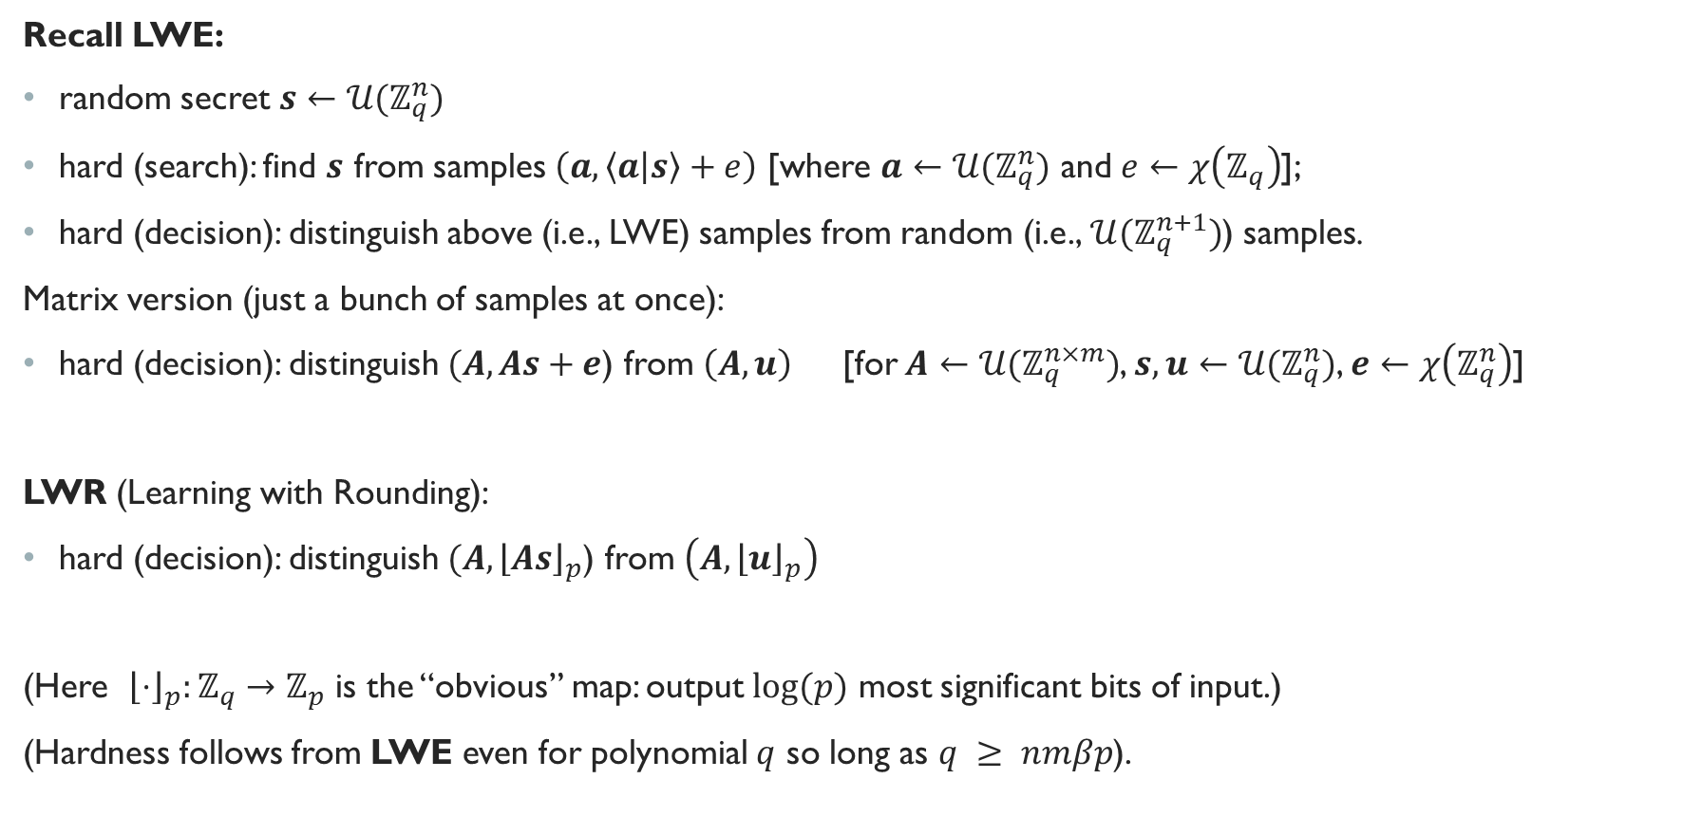
MATH: LWE, LWR
Recall LWE:
random secret $s←𝒰(ℤ_{q}^{n})$
hard (search): find $s$ from samples $\left(a, \left\langle a | s\right\rangle +e\right)$ [where $a←{𝒰(ℤ}_{q}^{n})$ and $e←χ\left(ℤ_{q}\right)$];
hard (decision): distinguish above (i.e., LWE) samples from random (i.e., ${𝒰(ℤ}_{q}^{n+1})$) samples.
Matrix version (just a bunch of samples at once):
hard (decision): distinguish $(A, As+e$) from $\left(A, u\right)$ [for $A←{𝒰(ℤ}_{q}^{n×m})$, $s,u←{𝒰(ℤ}_{q}^{n})$, $e←χ\left(ℤ_{q}^{n}\right)$]
LWR (Learning with Rounding):
hard (decision): distinguish $(A, {\left\lfloor As\right\rfloor }_{p}$) from $\left(A,{\left\lfloor u\right\rfloor }_{p}\right)$
(Here ${\left\lfloor ⋅\right\rfloor }_{p}:ℤ_{q}→ℤ_{p}$ is the “obvious” map: output $log⁡(p)$ most significant bits of input.)
(Hardness follows from LWE even for polynomial $q$ so long as $q ≥ nmβp$).

Slide 3

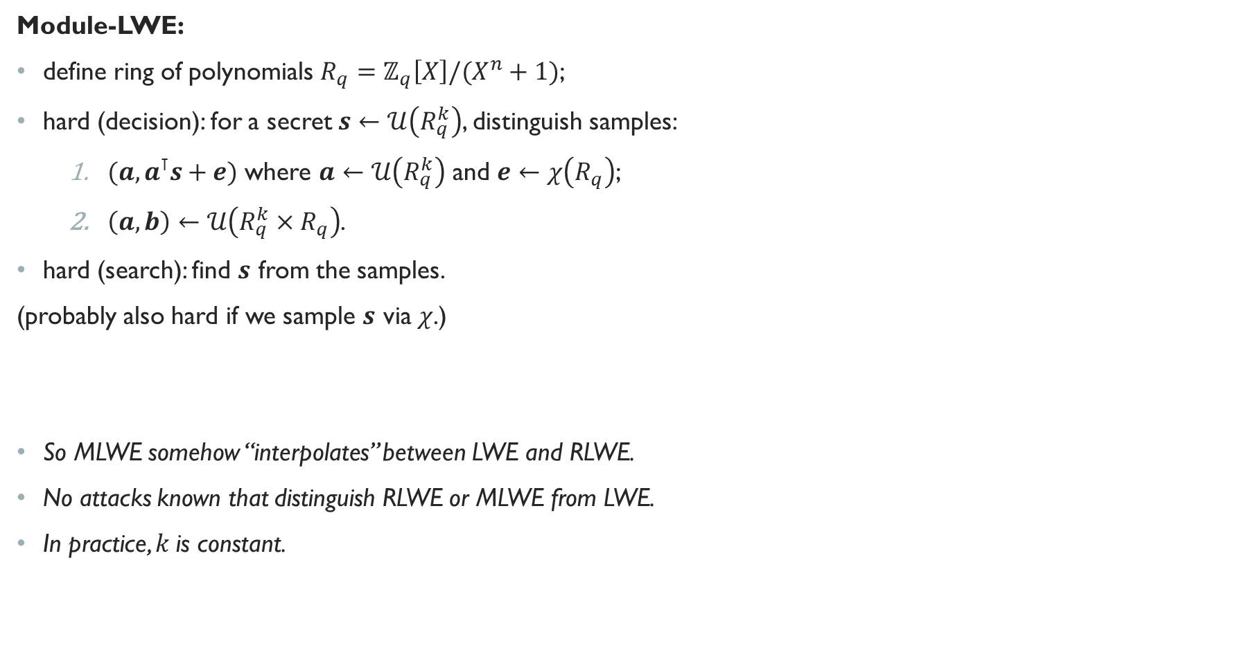
MATH: MLWE
Module-LWE:
define ring of polynomials $R_{q}=ℤ_{q}\left[X\right]/(X^{n}+1)$;
hard (decision): for a secret $s←𝒰\left(R_{q}^{k}\right)$, distinguish samples:
    $(a, a^{⊺}s+e)$ where $a←𝒰\left(R_{q}^{k}\right)$ and $e←χ\left(R_{q}\right)$;
    $\left(a, b\right)←𝒰\left(R_{q}^{k}×R_{q}\right)$.
hard (search): find $s$ from the samples.
(probably also hard if we sample $s$ via $χ$.)
So MLWE somehow “interpolates” between LWE and RLWE.
No attacks known that distinguish RLWE or MLWE from LWE.
In practice, $k$is constant.
Ring-LWE: set $k=1$
e.g., entrywise
Gaussian

Slide 4

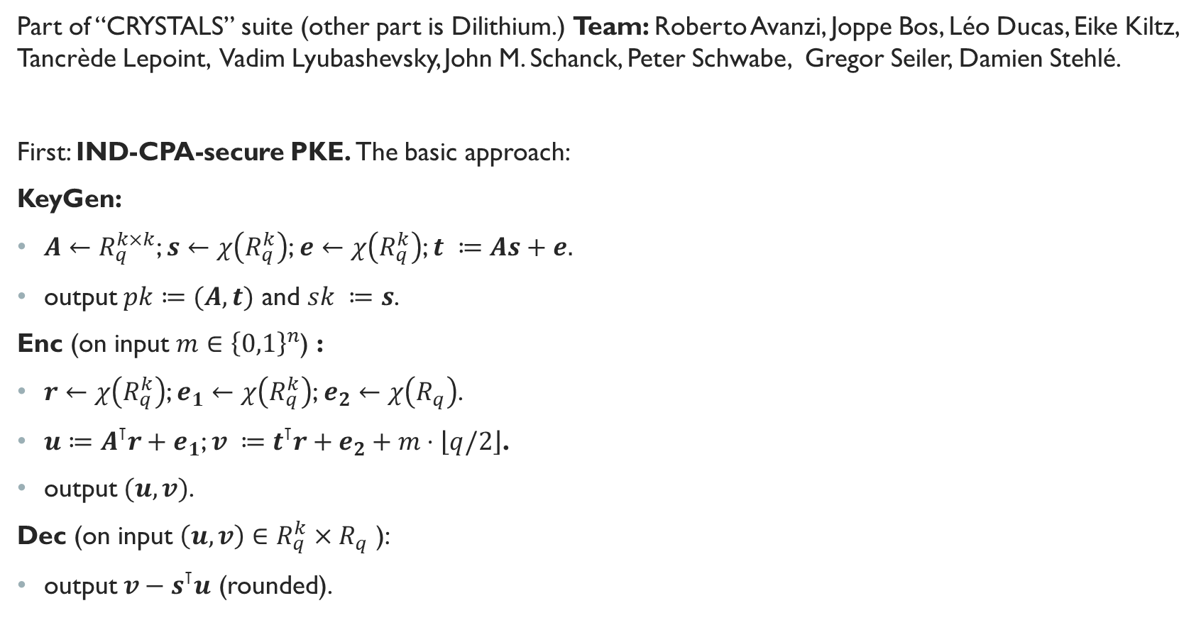
kyber
Part of “CRYSTALS” suite (other part is Dilithium.) Team: Roberto Avanzi, Joppe Bos, Léo Ducas, Eike Kiltz, Tancrède Lepoint, Vadim Lyubashevsky, John M. Schanck, Peter Schwabe, Gregor Seiler, Damien Stehlé.
First: IND-CPA-secure PKE. The basic approach:
KeyGen:
$A←R_{q}^{k×k}$; $s←χ\left(R_{q}^{k}\right)$; $e←χ\left(R_{q}^{k}\right)$; $t ≔As+e.$
output $pk≔(A, t)$ and $sk ≔s$.
Enc (on input $m∈{\left\{0,1\right\}}^{n}$) :
$r←χ\left(R_{q}^{k}\right)$; $e_{1}←χ\left(R_{q}^{k}\right)$; $e_{2}←χ\left(R_{q}\right)$.
$u≔A^{⊺}r+e_{1}$; $v ≔t^{⊺}r+e_{2}+m⋅\left\lfloor q/2\right\rfloor$.
output $(u, v)$.
Dec (on input $\left(u, v\right)∈R_{q}^{k}×R_{q}$ ):
output $v−s^{⊺}u$ (rounded).
viewed as a poly
with $\{0,1\}$-coeff.

Slide 5

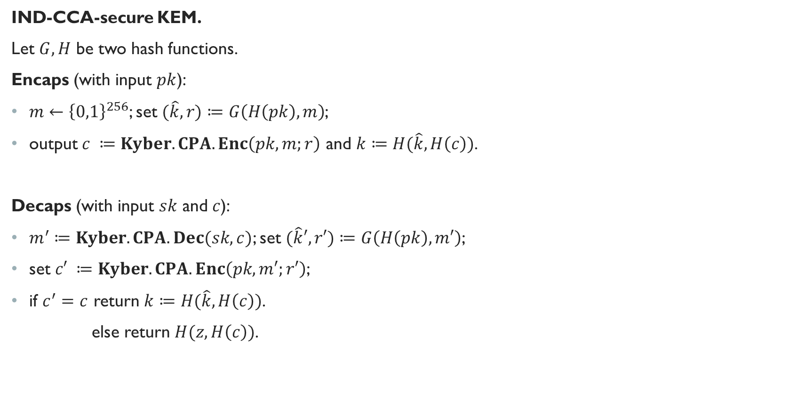
Kyber.CCAKEM
IND-CCA-secure KEM.
Let $G, H$ be two hash functions.
Encaps (with input $pk$):
$m←{\left\{0,1\right\}}^{256}$; set $(\hat{k}, r)≔G\left(H\left(pk\right), m\right)$;
output $c ≔Kyber.CPA.Enc\left(pk, m;r\right)$ and $k≔H(\hat{k},H\left(c\right))$.
Decaps (with input $sk$ and $c$):
$m^{′}≔Kyber.CPA.Dec(sk, c)$; set $(\hat{k}′, r′)≔G\left(H\left(pk\right), m′\right)$;
set $c′ ≔Kyber.CPA.Enc\left(pk, m′;r′\right)$;
if $c^{′}=c$ return $k≔H(\hat{k},H\left(c\right))$.
else return $H(z, H\left(c\right))$.
random string
included in $sk$

Slide 6
Kyber.CPAPKE (some details)
IND-CPA-secure PKE. In more detail (from Kyber paper):
This is CPA-secure (under Module-LWE hardness) if we drop the compression/decompression.
Actual spec algorithm is more complicated, due to optimizations (encoding/decoding, NTTs, etc.)

Slide 7
Kyber.CCAKEM (some details)
IND-CCA-secure KEM. In more detail (from Kyber paper):
Actual spec algorithm is a bit more complicated, due to some optimizations.

Slide 8
KYBER: Security proofs
tight reduction from Module-LWE in ROM:
non-tight reduction from Module-LWE in QROM:
some caveats:
+ there has been more progress recently on some of these reductions;
- it was observed that they actually also rely on LWR so it’s not clear to me what these proofs mean.

Slide 9

KYBER: Parameter sets, security strength
noise
param
Dec failure
probability
$n$ chosen so you can encaps 256-bit keys
$k$ is the matrix dimension
$q$ is smallest prime s.t. $2n | q−1$ (for NTT.)
rest are set to balance security, sizes of things, and Dec failure probability.
not important

Slide 10
KYBER: performance
Jacob’s cycle counts seem
quite different from this

Slide 11
Kyber: Pros / cons
Kyber (vs SIDH): 3x larger keys, but 2x faster, and more standard assumption;
Kyber (vs code-based): much smaller keys, but less conservative assumption (besides QC-MDPC, which (they say) can’t be used for CCA KEMs.)
Kyber (vs LWE, e.g., Frodo): “10x smaller keys, 10x faster,” but more structured assumption;
Kyber (vs Ring-LWE, e.g., NewHope): easier to scale up security strength, a bit less structure;
Kyber (vs NTRU): more efficient, fewer known attack approaches.

Slide 12
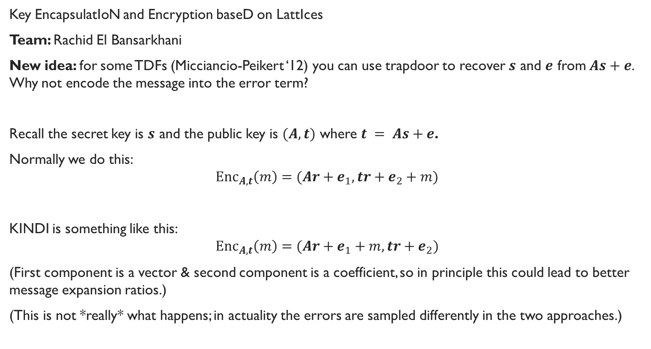
KINDI
Key EncapsulatIoN and Encryption baseD on LattIces
Team: Rachid El Bansarkhani
New idea: for some TDFs (Micciancio-Peikert ‘12) you can use trapdoor to recover $s$ and $e$ from $As+e$. Why not encode the message into the error term?
Recall the secret key is $s$ and the public key is $(A, t)$ where $t = As+e$.
Normally we do this:
$$Enc_{A, t}\left(m\right)=(Ar+e_{1}, tr+e_{2}+m)$$
KINDI is something like this:
$$Enc_{A, t}\left(m\right)=(Ar+e_{1}+m, tr+e_{2})$$
(First component is a vector & second component is a coefficient, so in principle this could lead to better message expansion ratios.)
(This is not *really* what happens; in actuality the errors are sampled differently in the two approaches.)

Slide 13
KINDI (CPA): Keygen and enc

Slide 14
KINDI (CPA): Dec

Slide 15
KINDI (CCA): KEM

Slide 16
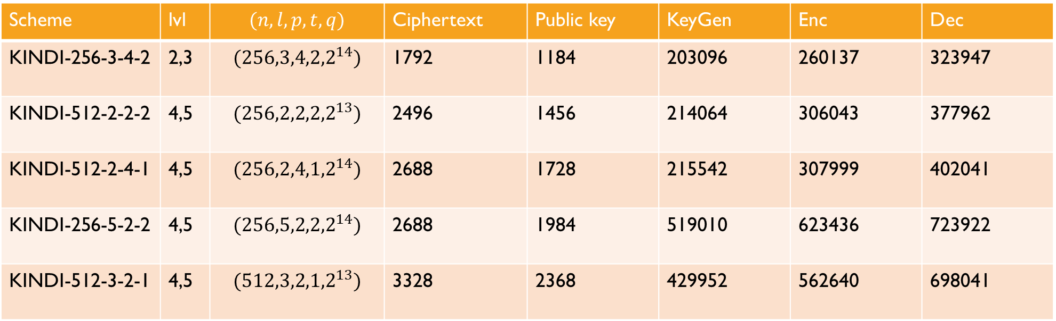


KINDI: Parameter sets, strength, performance
Scheme | lvl | $$(n,l,p,t,q)$$ | Ciphertext | Public key | KeyGen | Enc | Dec
KINDI-256-3-4-2 | 2,3 | $$({256,3,4,2,2}^{14})$$ | 1792 | 1184 | 203096 | 260137 | 323947
KINDI-512-2-2-2 | 4,5 | $$({256,2,2,2,2}^{13})$$ | 2496 | 1456 | 214064 | 306043 | 377962
KINDI-512-2-4-1 | 4,5 | $$({256,2,4,1,2}^{14})$$ | 2688 | 1728 | 215542 | 307999 | 402041
KINDI-256-5-2-2 | 4,5 | $$({256,5,2,2,2}^{14})$$ | 2688 | 1984 | 519010 | 623436 | 723922
KINDI-512-3-2-1 | 4,5 | $$({512,3,2,1,2}^{13})$$ | 3328 | 2368 | 429952 | 562640 | 698041
$n$: ring degree
$l$: module rank (like $k$ for Kyber)
$p$: coefficient range for secrets and errors
$t$: number of truncated bits per coefficient of the public key
$q$: modulus
Note: message sizes are not 256,
they are 383-575 bytes!
Dec failure rates are low ($< 2^{−165}$)

Slide 17
KINDI: Pros / cons
Security: similar story to Kyber: they use the same FO transform, and apply the same (tight) ROM and (non-tight) QROM proof. They also do some rounding, so maybe they have the same “actually need LWR assumption too” issue? (They also need ROM to prove security of the CPA scheme because of the message → error thing. Does anyone care about that?)
Putting message into error: I’m not sure how revolutionary this idea is. Paper appeared in Financial Crypto ’15, and has 4 citations. It doesn’t seem to affect security negatively (asymptotically.) In practice?
Design docs: reasonably well-written and detailed.
Performance: Kyber seems better across the board (unless Kyber’s numbers are fudged : Jacob?)
Things that make me nervous: new idea, one team member, few citations, no comments…

Slide 18
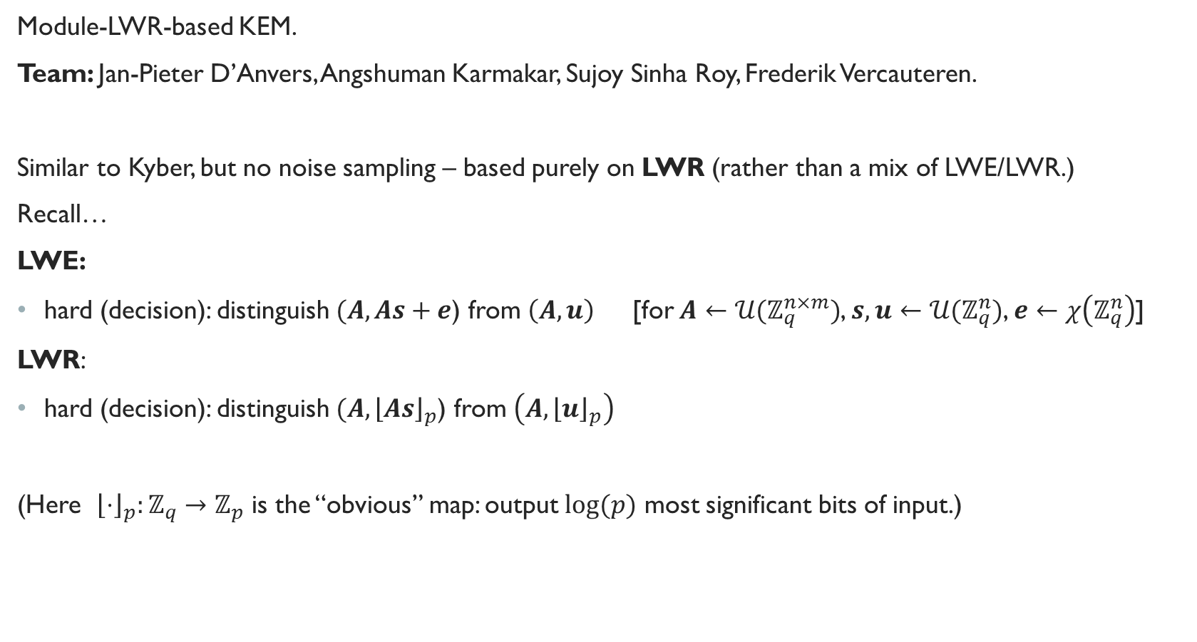
SABER
Module-LWR-based KEM.
Team: Jan-Pieter D’Anvers, Angshuman Karmakar, Sujoy Sinha Roy, Frederik Vercauteren.
Similar to Kyber, but no noise sampling – based purely on LWR (rather than a mix of LWE/LWR.)
Recall…
LWE:
hard (decision): distinguish $(A, As+e$) from $\left(A, u\right)$ [for $A←{𝒰(ℤ}_{q}^{n×m})$, $s,u←{𝒰(ℤ}_{q}^{n})$, $e←χ\left(ℤ_{q}^{n}\right)$]
LWR:
hard (decision): distinguish $(A, {\left\lfloor As\right\rfloor }_{p}$) from $\left(A,{\left\lfloor u\right\rfloor }_{p}\right)$
(Here ${\left\lfloor ⋅\right\rfloor }_{p}:ℤ_{q}→ℤ_{p}$ is the “obvious” map: output $log⁡(p)$ most significant bits of input.)

Slide 19
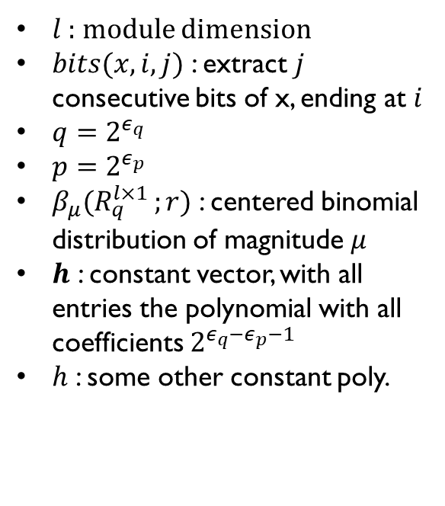
SABER.PKE (CPA)
$l$ : module dimension
$bits(x,i,j)$ : extract $j$ consecutive bits of x, ending at $i$
$q=2^{ε_{q}}$
$p=2^{ε_{p}}$
$β_{μ}(R_{q}^{l×1 };r)$ : centered binomial distribution of magnitude $μ$
$h$ : constant vector, with all entries the polynomial with all coefficients $2^{ε_{q}−ε_{p}−1}$
$h$ : some other constant poly.

Slide 20
SABER.KEM (CCA)
Same as PKE

Slide 21
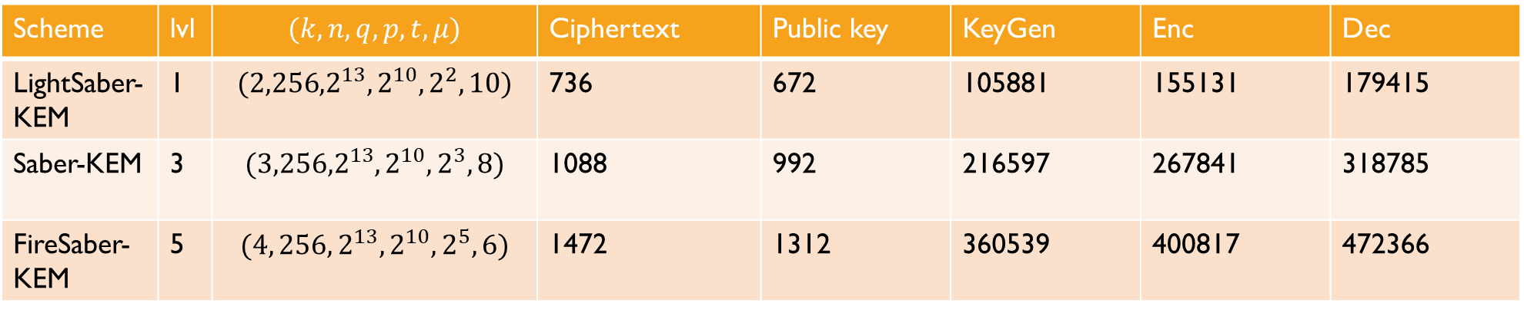


SABER.KEM: Parameter sets, strength, performance
Scheme | lvl | $$(k,n,q,p,t,μ)$$ | Ciphertext | Public key | KeyGen | Enc | Dec
LightSaber-KEM | 1 | $$({2,256,2}^{13},2^{10},2^{2}, 10)$$ | 736 | 672 | 105881 | 155131 | 179415
Saber-KEM | 3 | $$({3,256,2}^{13},2^{10}, 2^{3}, 8)$$ | 1088 | 992 | 216597 | 267841 | 318785
FireSaber-KEM | 5 | $$(4, 256, 2^{13},2^{10},2^{5},6)$$ | 1472 | 1312 | 360539 | 400817 | 472366
$n$: ring degree
$k$: module rank? $= l$?
$q$: big modulus
$p$: small modulus
$t$: number of truncated bits per coefficient of the public key
$μ$: magnitude of centered binomial distribution (for sampling secrets.)
Jacob’s cycle counts seem
quite different from this
Dec failure rates are low ($2^{−120}$ to $2^{−165}$)

Slide 22
SABER: Pros / cons
Security: similar story to Kyber: similar FO transform, same (tight) ROM and (non-tight) QROM proof, reducing from IND-CPA of base scheme. IND-CPA of base scheme is based on decisional MLWR problem. (Presumably for constant dimension breaking MLWR means breaking RLWE?)
LWR: (arguably) simpler scheme, “noise” comes from a deterministic process, reduced key+ctxt bandwidth
Module: easy adjustment of security strength.
Design docs: good.
Bonus points: they actually realized they were basing security on LWR…

Slide 23
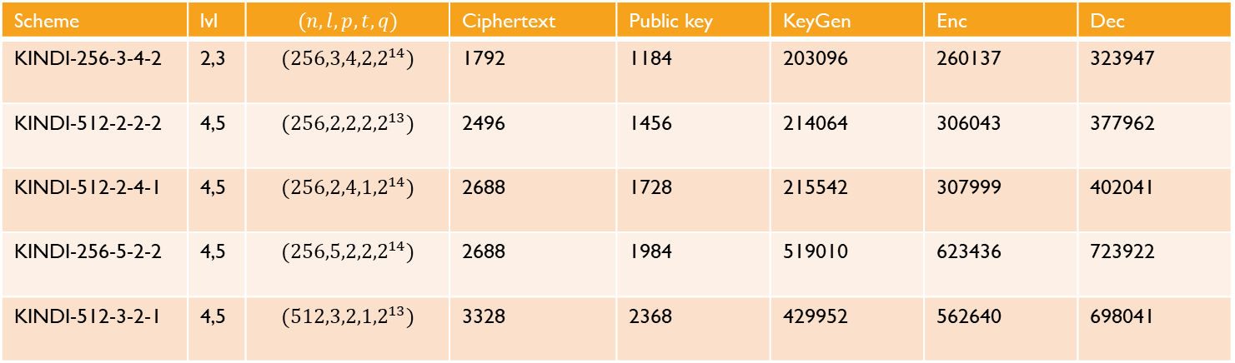
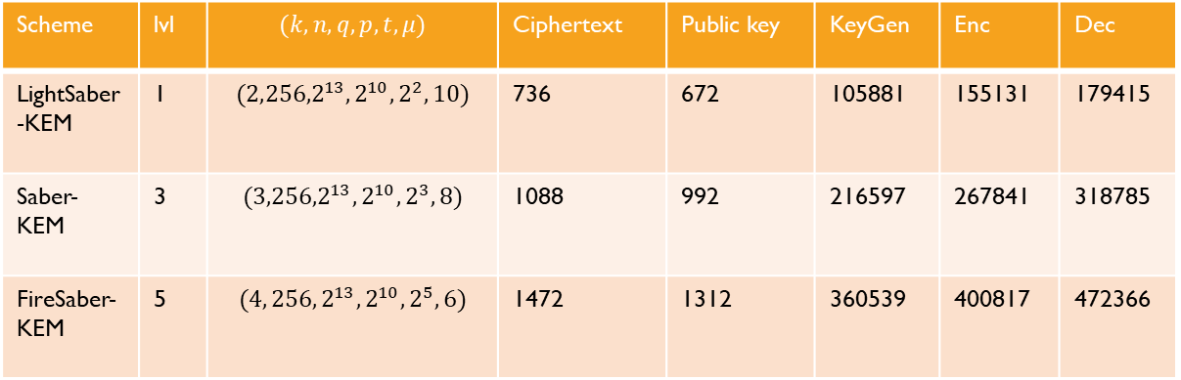
Scheme | lvl | $$(k,n,q,p,t,μ)$$ | Ciphertext | Public key | KeyGen | Enc | Dec
LightSaber-KEM | 1 | $$({2,256,2}^{13},2^{10},2^{2}, 10)$$ | 736 | 672 | 105881 | 155131 | 179415
Saber-KEM | 3 | $$({3,256,2}^{13},2^{10}, 2^{3}, 8)$$ | 1088 | 992 | 216597 | 267841 | 318785
FireSaber-KEM | 5 | $$(4, 256, 2^{13},2^{10},2^{5},6)$$ | 1472 | 1312 | 360539 | 400817 | 472366
Scheme | lvl | $$(n,l,p,t,q)$$ | Ciphertext | Public key | KeyGen | Enc | Dec
KINDI-256-3-4-2 | 2,3 | $$({256,3,4,2,2}^{14})$$ | 1792 | 1184 | 203096 | 260137 | 323947
KINDI-512-2-2-2 | 4,5 | $$({256,2,2,2,2}^{13})$$ | 2496 | 1456 | 214064 | 306043 | 377962
KINDI-512-2-4-1 | 4,5 | $$({256,2,4,1,2}^{14})$$ | 2688 | 1728 | 215542 | 307999 | 402041
KINDI-256-5-2-2 | 4,5 | $$({256,5,2,2,2}^{14})$$ | 2688 | 1984 | 519010 | 623436 | 723922
KINDI-512-3-2-1 | 4,5 | $$({512,3,2,1,2}^{13})$$ | 3328 | 2368 | 429952 | 562640 | 698041

Slide 24
Submission | Specific Implementation | NIST Category Claim | KeyPair Median | Keypair Average | Enc Median | Enc Average | Dec Median | Dec Average | sk | pk | ct
KINDI | KINDI-256-3-4-2 | 2 | 227117 | 871196 | 295381 | 855183 | 369271 | 518385 | 1472 | 1184 | 1824
KINDI | KINDI-512-2-4-1 | 4 | 248456 | 391711 | 354531 | 731676 | 470032 | 522123 | 2112 | 1728 | 2752
KINDI | KINDI-512-2-2-2 | 4 | 245888 | 255523 | 350311 | 965053 | 464508 | 780283 | 1712 | 1456 | 2544
KINDI | KINDI-512-3-2-1 | 5 | 505446 | 778837 | 667797 | 1035852 | 841280 | 2095633 | 2752 | 2368 | 3392
KINDI | KINDI-256-5-2-2 | 5 | 611826 | 1076438 | 718598 | 1394991 | 866469 | 1168212 | 2304 | 1984 | 2752
Saber | light_saber | 1 | 296367 | 327746 | 611052 | 696182 | 893702 | 970295 | 1568 | 672 | 736
Saber | saber | 3 | 665715 | 778853 | 1123379 | 1574776 | 1562633 | 2168113 | 2304 | 992 | 1088
Saber | fire_saber | 5 | 1126078 | 1361952 | 1720618 | 1825775 | 2256904 | 2852649 | 3040 | 1312 | 1472
CRYSTALS-Kyber | kyber512 | 1 | 440519 | 777761 | 639967 | 928656 | 783765 | 1373997 | 1632 | 736 | 800
CRYSTALS-Kyber | kyber768 | 3 | 729808 | 1225270 | 982173 | 1618276 | 1171685 | 1749946 | 2400 | 1088 | 1152
CRYSTALS-Kyber | kyber1024 | 5 | 1074457 | 1351579 | 1366784 | 2112734 | 1652596 | 2703872 | 3168 | 1440 | 1504
Frodo | FrodoKEM-640 | 1 | 1364752 | 1589050 | 1815181 | 2938233 | 1804051 | 4428250 | 19872 | 9616 | 9736
Frodo | FrodoKEM-976 | 3 | 2772340 | 4078228 | 3665833 | 7419629 | 3560771 | 6801659 | 31272 | 15632 | 15768
NewHope | newhope512cpa | 1 | 438874 | 483028 | 674805 | 714350 | 129251 | 132934 | 896 | 928 | 1088
NewHope | newhope512cca | 1 | 513054 | 551834 | 776525 | 819449 | 874199 | 1013095 | 1888 | 928 | 1120
NewHope | newhope1024cpa | 5 | 955693 | 985806 | 1402605 | 1525623 | 267971 | 281615 | 1792 | 1824 | 2176
NewHope | newhope1024cca | 5 | 1023877 | 1076737 | 1528702 | 1627156 | 1755817 | 1825233 | 3680 | 1824 | 2208
Jacob’s cycle counts

