Slide 1
Classic mceliece nist pqc submission
presented by Gorjan Alagic

Slide 2
Classic McEliece
Website: https://classic.mceliece.org/
Team:
Daniel J. Bernstein, University of Illinois at Chicago
Tung Chou, Osaka University
Tanja Lange, Technische Universiteit Eindhoven
Ingo von Maurich, self
Rafael Misoczki, Intel Corporation
Ruben Niederhagen, Fraunhofer SIT
Edoardo Persichetti, Florida Atlantic University
Christiane Peters, self
Peter Schwabe, Radboud University
Nicolas Sendrier, Inria
Jakub Szefer, Yale University
Wen Wang, Yale University

Slide 3
Linear codes over Finite fields
Hamming distance
Recall:
An $[n,k,d]$ code over $𝔽_{q}$ is a subspace $C$ of $𝔽_{q}^{n}$ with $dim C = k$, and $\min_{x, y∈C; x≠y}d\left(x,y\right)=d$.
elements of $C$ are called codewords;
$d$ is called the distance; code can correct $t$errors where $d = 2t+1.$
generator matrix: $G :𝔽_{q}^{k}→𝔽_{q}^{n}$ with $Im\left(G\right)= C$ (put basis for $C$ as columns.)
our convention: $G$ acts on left, i.e., for a message $m∈𝔽_{q}^{k}$, the codeword is $c = Gm∈𝔽_{q}^{n}$.
$$k$$
$$G$$
$$m$$
$$c$$
$$n$$
=

Slide 4
Linear codes over Finite fields
Hamming distance
Recall:
An $[n,k,d]$ code over $𝔽_{q}$ is a subspace $C$ of $𝔽_{q}^{n}$ with $dim C = k$, and $\min_{x, y∈C; x≠y}d\left(x,y\right)=d$.
elements of $C$ are called codewords;
$d$ is called the distance; code can correct $t$errors where $d = 2t+1.$
generator matrix: $G :𝔽_{q}^{k}→𝔽_{q}^{n}$ with $Im\left(G\right)= C$ (put basis for $C$ as columns.)
our convention: $G$ acts on left, i.e., for a message $m∈𝔽_{q}^{k}$, the codeword is $c = Gm∈𝔽_{q}^{n}$.
systematic form: express $G^{⊥}=\left(I_{k}\right|P)$ (via Gaussian elimination);
$$k$$
$$k$$
$$I_{k}$$
$$P$$
$$n$$

Slide 5
Linear codes over Finite fields
Hamming distance
Recall:
An $[n,k,d]$ code over $𝔽_{q}$ is a subspace $C$ of $𝔽_{q}^{n}$ with $dim C = k$, and $\min_{x, y∈C; x≠y}d\left(x,y\right)=d$.
elements of $C$ are called codewords;
$d$ is called the distance; code can correct $t$errors where $d = 2t+1.$
generator matrix: $G :𝔽_{q}^{k}→𝔽_{q}^{n}$ with $Im\left(G\right)= C$ (put basis for $C$ as columns.)
our convention: $G$ acts on left, i.e., for a message $m∈𝔽_{q}^{k}$, the codeword is $c =Gm∈𝔽_{q}^{n}$.
systematic form: express $G^{⊥}=\left(I_{k}\right|P)$ (via Gaussian elimination);
check matrix: $H :𝔽_{q}^{n}→𝔽_{q}^{n−k}$with $ker⁡(H) = C$; can take $H = \left(−P^{⊥}\right|I_{n−k})$
Why care about check matrix? Syndrome decoding:
given noisy codeword $z∈𝔽_{q}^{n}$, do $H(z) = H(c + e) = H(e);$
now recover $e$ (not trivial) and output $c = z – e$.
(p.s.: $H^{⊥}$ is also a generator matrix: for the dual code $C^{⊥}$ of $C$.)
$$k$$
$$n$$
$$n−k$$
$$−P^{⊥}$$
$$I_{n−k}$$

Slide 6
McEliece idea
Decoding in a random code is a hard problem. Make crypto out of it? [McEliece, 78]
choose$[n,k,d]$generator matrix $G$ and “scramblers” $S$ (invertible, $k×k$) and $P$ (permutation, $n×n$);
private key: $(P, G, S)$; public key: $PGS$;
encrypt: $m↦(PGS)m+e$ (where $e$ is a random error vector with Hamming weight $wt(e)$ at most $t$);
decrypt: $c↦(S^{−1}∘Decode_{G}∘P^{−1})c$
Experience seems to indicate that decoding this (without private key) is as hard as the random-code case, at least for random messages.
What codes to use? People have tried lots of choices, but binary Goppa codes seem safest.
How to generate such a code:
choose a polynomial $g(x)$ of degree $t$ over $𝔽_{q}$ with $q=2^{m}$;
choose $α_{1},α_{2},…, α_{n}∈𝔽_{q}$;
check matrix: $H_{ij}=α_{j}^{i−1}/g(α_{j})$.

Slide 7
Niederreiter variant
“Take the dual everywhere” [Niederreiter 86]
choose$[n,k,d]$code with check matrix $H$. Choose $S$ (invertible, $(n−k)×(n−k)$) and $P$ (permutation, $n×n$);
private key: $(S, H, P)$; public key: $SHP$;
encrypt: encode $m$ as an $n$-bit error string $e$ with $wt\left(e\right)≤t$ , output $(SHP)e$;
decrypt: $c↦(P^{−1}∘SyndromeExtract_{G}∘S^{−1}) c$.
still typically use binary Goppa codes;
security is unchanged from McEliece, but some efficiency gains;
important: $e$ is not structured, i.e., it really looks like a random error;
formally, this means the scheme is only “OW-CPA” (given oracle for $Enc$ and $Enc(m)$ for *random* m, adversary has negligible success probability at outputting $m$)…
… but that’s fine for a KEM.
$$S$$
$$H$$
$$P$$
$$n−k$$
$$n$$

Slide 8
Classic McEliece (CM)
Ok, now to the actual submission: Classic McEliece (CM).
(Really, more like classic Niederreiter…)
Parameters
$q=2^{m}$
$0< n≤q$
$1<t<n/m$
$k=n −mt$
monic, irreducible, degree $m$ polynomial $f\left(z\right)∈𝔽_{2}[z]$
$𝔽_{q}:=𝔽_{2}\left[z\right]/f\left(z\right)$
cryptographic hash function $H$ with $l$ output bits.

Slide 9
Key Generation
$q=2^{m}$
$0< n≤q$
$1<t<n/m$
$k=n −mt$
monic, irred., deg-m $f\left(z\right)∈𝔽_{2}[z]$
$𝔽_{q}:=𝔽_{2}\left[z\right]/f\left(z\right)$
Hash $H$ with $l$ output bits.
Key generation for CM
Generate random monic irreducible degree-$t$ polynomial $g\left(x\right)∈𝔽_{q}\left[x\right]$;
Generate random, distinct $α_{1},α_{2},…, α_{n}∈𝔽_{q}$;
Compute $t×n$matrix $\tilde{H}=\{h_{ij}\}$ with $h_{ij}=α_{j}^{i−1}/g(α_{j})$;
Compute $mt×n$, i.e., $(n−k)×n$binary matrix $\hat{H}$ by expanding each entry $\sum_{j=0}^{m−1}{c_{j}z^{j}}$into column $\left[\begin{matrix}c_{0} \\ ⋮ \\ c_{m−1}\end{matrix}\right]$
Reduce $\hat{H}$to unique systematic form ${(I}_{n−k}| T)$ via Gaussian elimination;
Generate random $s∈{\left\{0,1\right\}}^{n}$;
Output secret key $(s, g, α_{1},α_{2},…, α_{n}$) and public key $T$.
generate check matrix
for random binary Goppa code
Instead of adding scrambling, put H in systematic form (adversary can compute this too, so no security loss.)
+ key size $k(n−k)$ instead of $kn$.
- only succeeds with probability ~29% over the choice of code
$$Γ$$

Slide 10
Encode / Decode
$q=2^{m}$
$0< n≤q$
$1<t<n/m$
$k=n −mt$
monic, irred., deg-m $f\left(z\right)∈𝔽_{2}[z]$
$𝔽_{q}:=𝔽_{2}\left[z\right]/f\left(z\right)$
Hash $H$ with $l$ output bits.
Encode
Input: public key $T$, string $e∈𝔽_{2}^{n}$ with $wt\left(e\right)=t$;
output $He=\left(I_{n−k}\right|T)e$.
Decode
Input: private key $\left(s, Γ\right)$ and string $C_{0}∈𝔽_{2}^{n−k}$
set $v∈𝔽_{2}^{n}$ to be $C_{0}$ with $k$ zeroes appended;
$c←$ ${SyndromeDecode}_{Γ}(v)$ ; output $⊥$ if failed
set $e=v−c$; if $wt\left(e\right)=t$ and $C_{0}=He$, output $e$ ; otherwise output $⊥$.
this is basically just Neiderreiter’s scheme.
as we said before, it’s only OW-CPA; so CM will turn it into a KEM to get IND-CCA2.
check: $H\left(v\right)=C_{0}$, i.e., $v$ is a noisy codeword with syndrome $C_{0}$

Slide 11
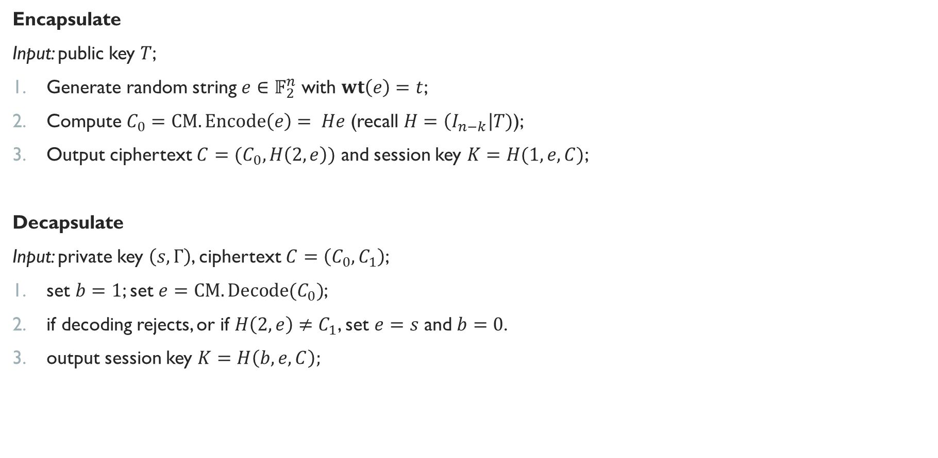
Encapsulate / Decapsulate
$q=2^{m}$
$0< n≤q$
$1<t<n/m$
$k=n −mt$
monic, irred., deg-m $f\left(z\right)∈𝔽_{2}[z]$
$𝔽_{q}:=𝔽_{2}\left[z\right]/f\left(z\right)$
Hash $H$ with $l$ output bits.
Encapsulate
Input: public key $T$;
Generate random string $e∈𝔽_{2}^{n}$ with $wt\left(e\right)=t$;
Compute $C_{0}=CM.Encode\left(e\right)= He$ (recall $H=\left(I_{n−k}\right|T)$);
Output ciphertext $C=(C_{0},H\left(2, e\right))$ and session key $K=H(1, e, C)$;
Decapsulate
Input: private key $\left(s, Γ\right)$, ciphertext $C=\left(C_{0},C_{1}\right)$;
set $b=1$; set $e=CM.Decode(C_{0})$;
if decoding rejects, or if $H\left(2, e\right)≠C_{1}$, set $e=s$ and $b=0$.
output session key $K=H\left(b, e, C\right);$

Slide 12
Theoretical security
CM uses a “standard” approach of constructing a KEM from OW-CPA PKE;
claim/hope: the resulting KEM is IND-CCA2 (if coupled with a secure DEM);
there are classical security proofs [Dent03] in the ROM of a similar construction (basically, output $⊥$ instead of a pseudorandom value when Decapsulate fails);
new result [Saito, Xagawa, Yamakawa; Eurocrypt ‘18]: IND-CCA2 for another similar KEM, but in the QROM!
submitters have a sketched proposal for extending the SXY proof to CM, but it doesn’t seem to be a complete proof, and I have not checked it;
this would be good: QROM is a much better model for post-quantum security involving (public) hash functions.

Slide 13
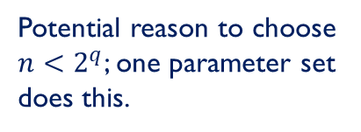
Attacks
Information-set decoding
ignore structure, try to recover low-weight $e$given $Gm+e$ for some $m$ and random $G$;
can be sped up using Grover (latest seems to be by E. Kirshanova: $2^{0.05806n+o(n)}$ PQCrypto ‘18?)
Key recovery attacks
brute force
Sendrier’s “support splitting” algorithm :
- can quickly find tuple $(α_{1},…, α_{n})$ given $g$ if $n=2^{q}$.
- can quickly find tuple $(α_{1},…, α_{n})$ given $g$ and ${\left\{α_{j}\right\}}_{j}$.
not as big of a threat as ISD (at least not yet.)
Potential reason to choose
$n<2^{q}$; one parameter set does this.

Slide 14

Parameter sets
$q=2^{m}$
$0< n≤q$
$1<t<n/m$
$k=n −mt$
monic, irred., deg-m $f\left(z\right)∈𝔽_{2}[z]$
$𝔽_{q}:=𝔽_{2}\left[z\right]/f\left(z\right)$
Hash $H$ with $l$ output bits.
kem/mceliece6960119
$m = 13, n = 6960, t=119, l=256$
$f\left(z\right)=z^{13}+z^{4}+z^{3}+z+1$
$H$ = SHAKE256 with 32-byte output.
Claimed strength: category 5 IND-CCA2 KEM.
kem/mceliece8192128
$m = 13, n =8192, t=128, l=256$
$f\left(z\right)=z^{13}+z^{4}+z^{3}+z+1$
$H$ = SHAKE256 with 32-byte output.
Claimed strength: category 5 IND-CCA2 KEM.
note $n<2^{q}$

Slide 15
Parameter sets
$q=2^{m}$
$0< n≤q$
$1<t<n/m$
$k=n −mt$
monic, irred., deg-m $f\left(z\right)∈𝔽_{2}[z]$
$𝔽_{q}:=𝔽_{2}\left[z\right]/f\left(z\right)$
Hash $H$ with $l$ output bits.
kem/mceliece6960119
$m = 13, n = 6960, t=119, l=256$
$f\left(z\right)=z^{13}+z^{4}+z^{3}+z+1$
$H$ = SHAKE256 with 32-byte output.
Claimed strength: category 5 IND-CCA2 KEM.
proposed in [BLP08]; reported ISD attack with $2^{266.94}$ bit operations;
improved ISD attacks now reduced this to “considerably below $2^{256}$”.
note $n<2^{q}$
None of these analyses took into account the costs of memory access. A closer look shows that the attack in [BLP08] is bottlenecked by random access to a huge array (much larger than the public key being attacked), and that subsequent ISD variants use even more memory.
The same amount of hardware allows much more parallelism in attacking, e.g., AES-256. Known quantum attacks multiply the security level of both ISD and AES by an asymptotic factor 0.5 + o(1), but a closer look shows that the application of Grover’s method to ISD suffers much more overhead in the inner loop.
We expect that switching from a bit-operation analysis to a cost analysis will show that this parameter set is more expensive to break than AES-256 pre-quantum and much more expensive to break than AES-256 post-quantum.
from supporting doc

Slide 16
Performance
Sizes of things.
SW platform: Intel Xeon E3-1220 v3 Haswell 3.10 GHz, 32GB RAM, Ubuntu 16.04, no hyperthreading or Turbo Boost.
HW platform: Altera Stratix V FPGA (5SGXEA7N) @ 231Mhz
 | Public key (bytes) | Private key (bytes) | Ciphertext (bytes) | Session key (bytes)
kem/mceliece6960119 | 1,357,824 | 14,080 | 240 | 32
kem/mceliece8192128 | 1,047,319 | 13,908 | 226 | 32
 | Cycles | ms
KeyGen | 4G-6G | $≈$1940
Encapsulate | $≈$300,000 | $≈$0.1ms
Decapsulate | $≈$450,000 | $≈$0.15ms
 | Cycles | ms
KeyGen | 1173750 | 5.08
Decoding | 17140 | 0.074

Slide 17
Advantages / Disadvantages
Advantages
simple, well-studied, well-understood: long history of attacks with not much effect on security parameters;
seems plausible that there’s a security proof (in the QROM?);
fast encapsulation/decapsulation
small ciphertexts
Disadvantages
huge public keys (order of MBs)
very slow key generation

