Slide 1
NTS KEM nist pqc submission
presented by Gorjan Alagic

Slide 2
NTS KEM
Code-based KEM submission.
Website: https://nts-kem.io/
Team:
Martin Albrecht, Royal Holloway University of London
Carlos Cid, Royal Holloway University of London
Kenneth G. Paterson, Royal Holloway University of London
Cen Jung Tjhai, PQ Solutions Ltd
Martin Tomlinson, PQ Solutions Ltd

Slide 3






Linear codes over Finite fields
Hamming distance
Recall:
An $[n,k,d]$ code over $𝔽_{q}$ is a subspace $C$ of $𝔽_{q}^{n}$ with $dim C = k$, and $\min_{x, y∈C; x≠y}d\left(x,y\right)=d$.
elements of $C$ are called codewords;
$d$ is called the distance; code can correct $t$errors where $d = 2t+1.$
generator matrix: $G :𝔽_{q}^{k}→𝔽_{q}^{n}$ with $Im\left(G\right)= C$ (put basis for $C$ as columns.)
our convention: $G$ acts on left, i.e., for a message $m∈𝔽_{q}^{k}$, the codeword is $c = G(m)∈𝔽_{q}^{n}$.
$$k$$
$$G$$
$$m$$
$$c$$
$$n$$
=

Slide 4


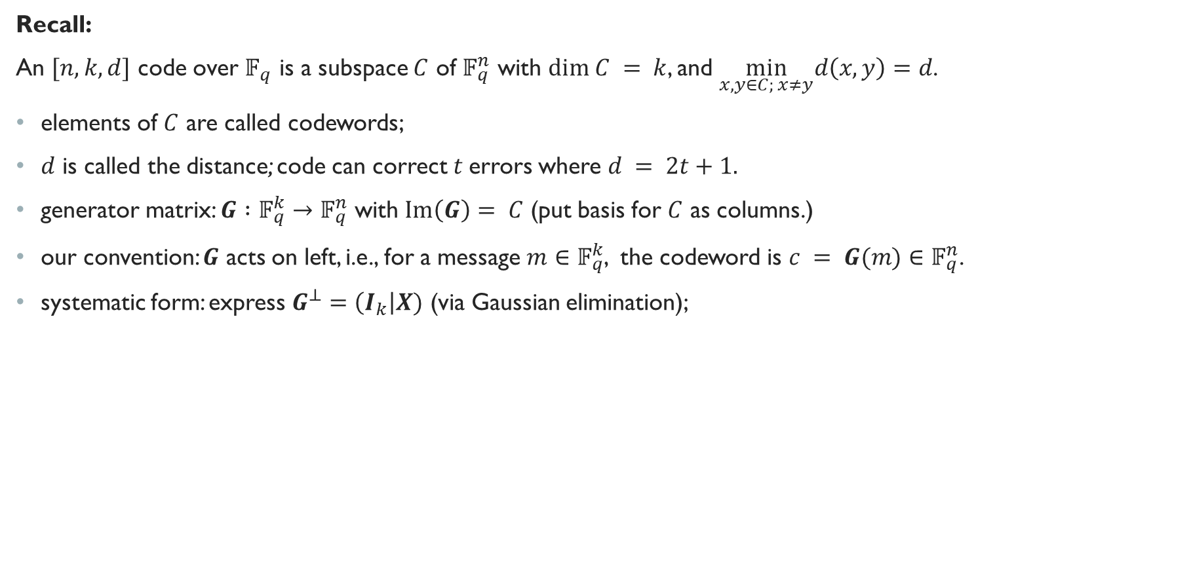



Linear codes over Finite fields
Hamming distance
Recall:
An $[n,k,d]$ code over $𝔽_{q}$ is a subspace $C$ of $𝔽_{q}^{n}$ with $dim C = k$, and $\min_{x, y∈C; x≠y}d\left(x,y\right)=d$.
elements of $C$ are called codewords;
$d$ is called the distance; code can correct $t$errors where $d = 2t+1.$
generator matrix: $G :𝔽_{q}^{k}→𝔽_{q}^{n}$ with $Im\left(G\right)= C$ (put basis for $C$ as columns.)
our convention: $G$ acts on left, i.e., for a message $m∈𝔽_{q}^{k}$, the codeword is $c = G(m)∈𝔽_{q}^{n}$.
systematic form: express $G^{⊥}=\left(I_{k}\right|X)$ (via Gaussian elimination);
$$k$$
$$k$$
$$I_{k}$$
$$P$$
$$n$$

Slide 5


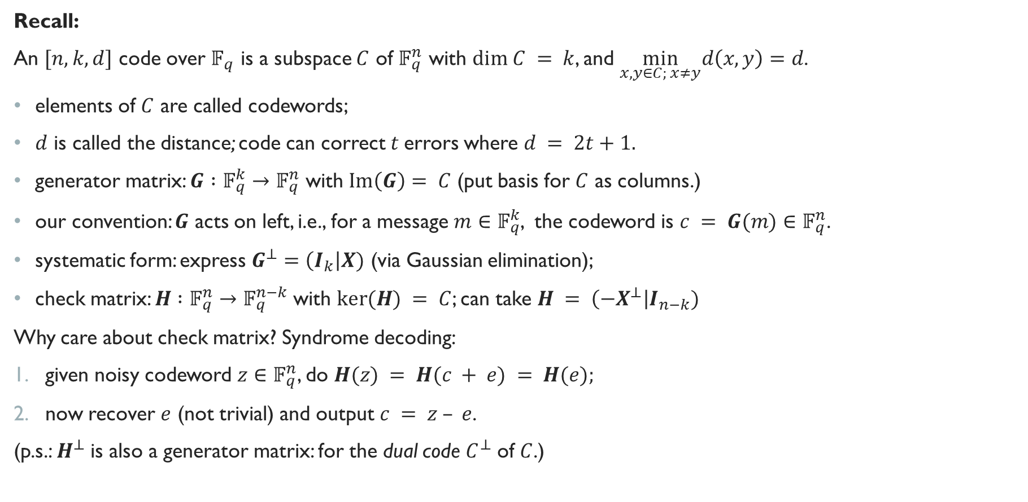


Linear codes over Finite fields
Hamming distance
Recall:
An $[n,k,d]$ code over $𝔽_{q}$ is a subspace $C$ of $𝔽_{q}^{n}$ with $dim C = k$, and $\min_{x, y∈C; x≠y}d\left(x,y\right)=d$.
elements of $C$ are called codewords;
$d$ is called the distance; code can correct $t$errors where $d = 2t+1.$
generator matrix: $G :𝔽_{q}^{k}→𝔽_{q}^{n}$ with $Im\left(G\right)= C$ (put basis for $C$ as columns.)
our convention: $G$ acts on left, i.e., for a message $m∈𝔽_{q}^{k}$, the codeword is $c = G(m)∈𝔽_{q}^{n}$.
systematic form: express $G^{⊥}=\left(I_{k}\right|X)$ (via Gaussian elimination);
check matrix: $H :𝔽_{q}^{n}→𝔽_{q}^{n−k}$with $ker⁡(H) = C$; can take $H = \left(−X^{⊥}\right|I_{n−k})$
Why care about check matrix? Syndrome decoding:
given noisy codeword $z∈𝔽_{q}^{n}$, do $H(z) = H(c + e) = H(e);$
now recover $e$ (not trivial) and output $c = z – e$.
(p.s.: $H^{⊥}$ is also a generator matrix: for the dual code $C^{⊥}$ of $C$.)
$$k$$
$$n$$
$$n−k$$
$$−X^{⊥}$$
$$I_{n−k}$$

Slide 6
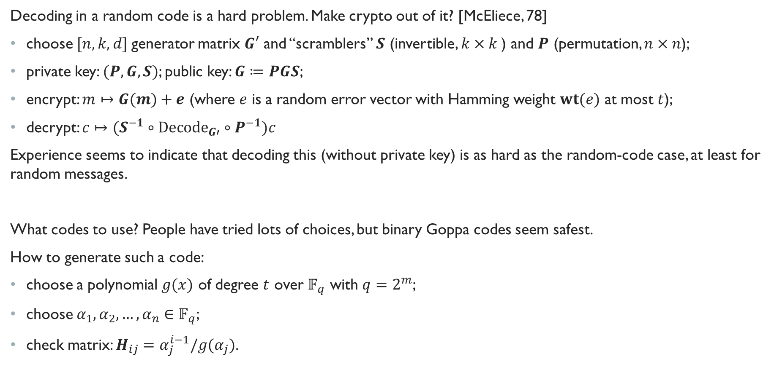
McEliece idea
Decoding in a random code is a hard problem. Make crypto out of it? [McEliece, 78]
choose$[n,k,d]$generator matrix $G′$ and “scramblers” $S$ (invertible, $k×k$) and $P$ (permutation, $n×n$);
private key: $(P, G, S)$; public key: $G≔PGS$;
encrypt: $m↦G(m)+e$ (where $e$ is a random error vector with Hamming weight $wt(e)$ at most $t$);
decrypt: $c↦(S^{−1}∘Decode_{G′}∘P^{−1})c$
Experience seems to indicate that decoding this (without private key) is as hard as the random-code case, at least for random messages.
What codes to use? People have tried lots of choices, but binary Goppa codes seem safest.
How to generate such a code:
choose a polynomial $g(x)$ of degree $t$ over $𝔽_{q}$ with $q=2^{m}$;
choose $α_{1},α_{2},…, α_{n}∈𝔽_{q}$;
check matrix: $H_{ij}=α_{j}^{i−1}/g(α_{j})$.

Slide 7

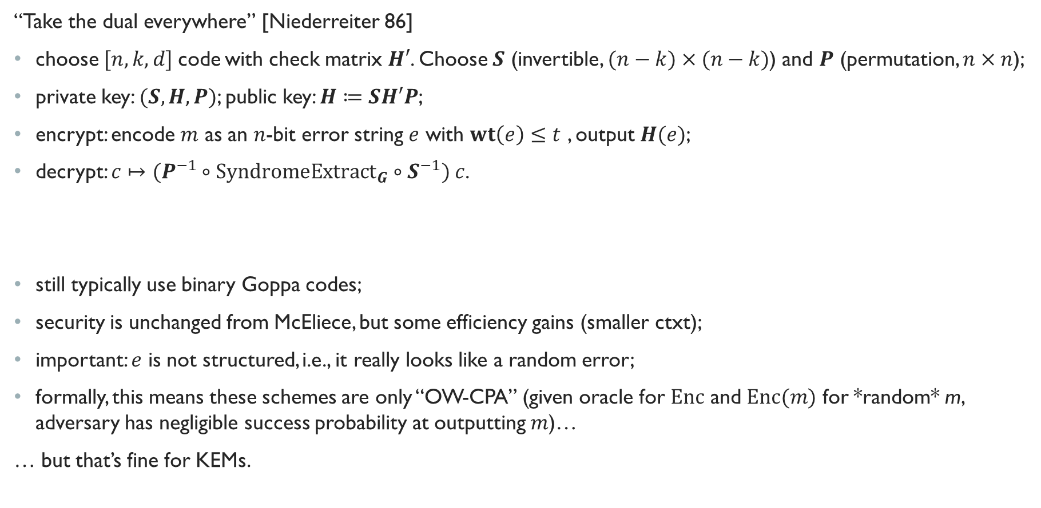


Niederreiter variant
“Take the dual everywhere” [Niederreiter 86]
choose$[n,k,d]$code with check matrix $H′$. Choose $S$ (invertible, $(n−k)×(n−k)$) and $P$ (permutation, $n×n$);
private key: $(S, H, P)$; public key: $H≔SH′P$;
encrypt: encode $m$ as an $n$-bit error string $e$ with $wt\left(e\right)≤t$ , output $H(e)$;
decrypt: $c↦(P^{−1}∘SyndromeExtract_{G}∘S^{−1}) c$.
still typically use binary Goppa codes;
security is unchanged from McEliece, but some efficiency gains (smaller ctxt);
important: $e$ is not structured, i.e., it really looks like a random error;
formally, this means these schemes are only “OW-CPA” (given oracle for $Enc$ and $Enc(m)$ for *random* m, adversary has negligible success probability at outputting $m$)…
… but that’s fine for KEMs.
$$S$$
$$H′$$
$$P$$
$$n−k$$
$$n$$

Slide 8

NTS-KEM
Ok, now to the actual submission: NTS-KEM
Parameters
$n=2^{m}$ : length of codewords;
$t$ : number of errors corrected by code;
$f$ : irreducible, degree $m$ polynomial over $𝔽_{2}$; Defines $𝔽_{n}:=𝔽_{2}\left[z\right]/f\left(z\right)$;
$l=256$ : length of key to be encapsulated;
$H$ : $256$-bit hash function, in this case SHA3-256.

Slide 9
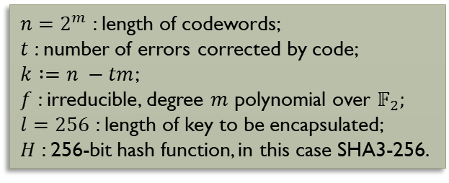


Key Generation
$n=2^{m}$ : length of codewords;
$t$ : number of errors corrected by code;
$k$ $:=n −tm$;
$f$ : irreducible, degree $m$ polynomial over $𝔽_{2}$;
$l=256$ : length of key to be encapsulated;
$H$ : 256-bit hash function, in this case SHA3-256.
Key generation algorithm:
Sample deg-$t$ Goppa poly $g\left(x\right)$ over $𝔽_{n}$; choose ordering ${a ≔(a}_{0},a_{1},…, a_{n−1})$ of $𝔽_{n}$;
Compute $t×n$parity check matrix $H’$ over $𝔽_{n}$ with $H’_{ij}≔a_{j}^{i−1}g{\left(a_{j}\right)}^{−2}.$
Compute $tm×n$ matrix $H$ over $𝔽_{2}$ (expand each $𝔽_{n}$-entry into column);
Reduce $H$ to systematic form ($Q|I_{n−k})$.
Output $pk := Q$and $sk := (a, h, π)$;
no roots in $𝔽_{n}$; no repeated roots in any extension field
permutation from step 1
first row of $H’$

Slide 10
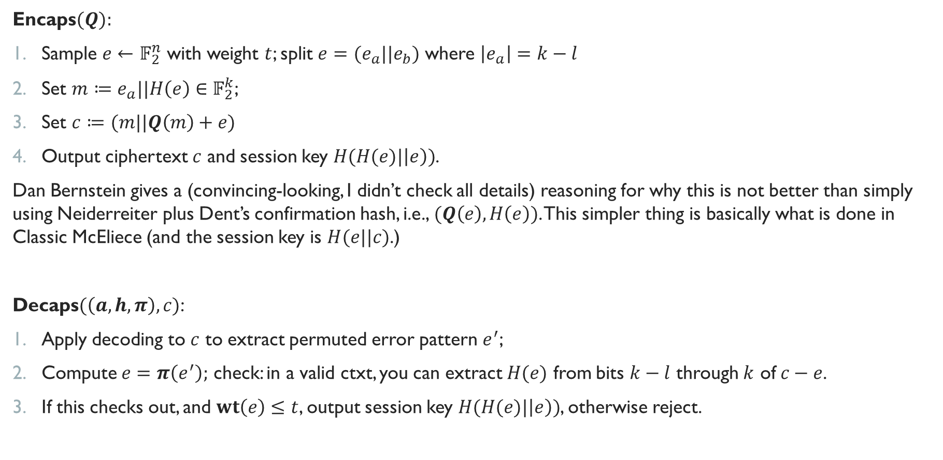
Encaps/Decaps
$n=2^{m}$ : length of codewords;
$t$ : number of errors corrected by code;
$k$ $:=n −tm$;
$f$ : irreducible, degree $m$ polynomial over $𝔽_{2}$;
$l=256$ : length of key to be encapsulated;
$H$ : 256-bit hash function, in this case SHA3-256.
Encaps$(Q):$
Sample $e←$ $𝔽_{2}^{n}$ with weight $t$; split $e=(e_{a}||e_{b})$ where $\left|e_{a}\right|=k−l$
Set $m≔e_{a}||H\left(e\right)∈𝔽_{2}^{k}$;
Set $c≔(m||Q\left(m\right)+e)$
Output ciphertext $c$ and session key $H(H(e)|\left|e\right))$.
Dan Bernstein gives a (convincing-looking, I didn’t check all details) reasoning for why this is not better than simply using Neiderreiter plus Dent’s confirmation hash, i.e., $(Q\left(e\right), H\left(e\right))$. This simpler thing is basically what is done in Classic McEliece (and the session key is $H(e||c)$.)
Decaps$(\left(a, h, π\right), c)$:
Apply decoding to $c$ to extract permuted error pattern $e^{′}$;
Compute $e=π\left(e^{′}\right);$ check: in a valid ctxt, you can extract $H(e)$ from bits $k−l$ through $k$ of $c−e$.
If this checks out, and $wt\left(e\right)≤t$, output session key $H(H(e)|\left|e\right))$, otherwise reject.

Slide 11
Parameter sets
$n=2^{m}$ : length of codewords;
$t$ : number of errors corrected by code;
$k$ $:=n −tm$;
$f$ : irreducible, degree $m$ polynomial over $𝔽_{2}$;
$l=256$ : length of key to be encapsulated;
$H$ : 256-bit hash function, in this case SHA3-256.

Slide 12
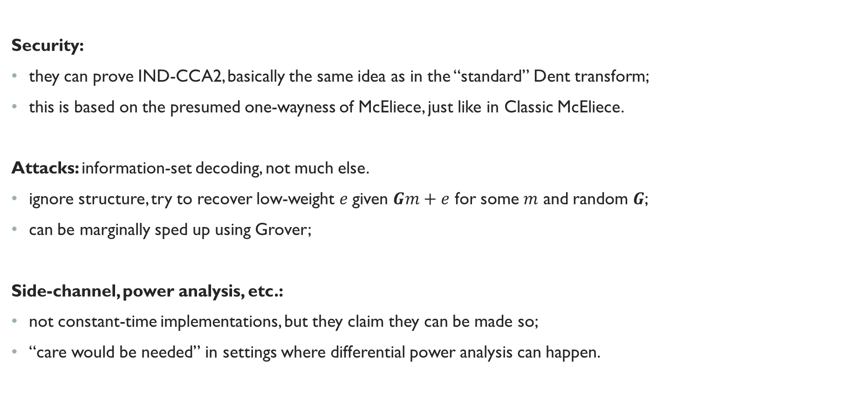
Security + Attacks
Security:
they can prove IND-CCA2, basically the same idea as in the “standard” Dent transform;
this is based on the presumed one-wayness of McEliece, just like in Classic McEliece.
Attacks: information-set decoding, not much else.
ignore structure, try to recover low-weight $e$given $Gm+e$ for some $m$ and random $G$;
can be marginally sped up using Grover;
Side-channel, power analysis, etc.:
not constant-time implementations, but they claim they can be made so;
“care would be needed” in settings where differential power analysis can happen.

Slide 13
Performance: KeyGen

Slide 14
Performance: ENCAPS

Slide 15
Performance: DECAPS

Slide 16
Sizes (+ memory reqs)

Slide 17
Advantages / Disadvantages
Advantages
based on well-studied, well-understood problem;
long history of attacks with not much effect on security parameters; no significant quantum advantage;
easy to adjust parameters;
long-term keys;
small ciphertexts, efficient operations.
Disadvantages
huge public keys (~MB)

Slide 18
What dan thinks
Analysis by “Classic McEliece Comparison Task Force” (aka Dan Bernstein’s totally unbiased opinion):
On July 4th, Tomlinson promised a response, but I didn’t
see one on official comments (maybe on the forum?)

