Slide 1
New Hope
NIST PQC submission by NewHope team
NIST internal presentation by Gorjan Alagic

Slide 2
NEW Hope
KEM submission.
Team:
Erdem Alkim (TR)
Roberto Avanzi, ARM (UK)
Joppe Bos, NXP (BE)
Léo Ducas, CWI Amsterdam (NL)
Antonio de la Piedra, Compumatica secure networks B.V. (NL)
Thomas Pöppelmann, Infineon Technologies (DE)
Peter Schwabe, Radboud University (NL)
Douglas Stebila, McMaster University (CA)

Slide 3
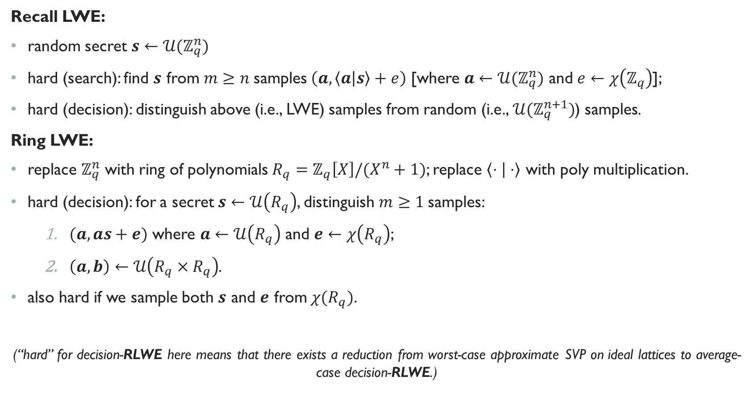
Basic math
Recall LWE:
random secret $s←𝒰(ℤ_{q}^{n})$
hard (search): find $s$ from $m≥n$samples $\left(a, \left\langle a | s\right\rangle +e\right)$ [where $a←{𝒰(ℤ}_{q}^{n})$ and $e←χ\left(ℤ_{q}\right)$];
hard (decision): distinguish above (i.e., LWE) samples from random (i.e., ${𝒰(ℤ}_{q}^{n+1})$) samples.
Ring LWE:
replace $ℤ_{q}^{n}$ with ring of polynomials $R_{q}=ℤ_{q}\left[X\right]/(X^{n}+1)$; replace $\left\langle ⋅ | ⋅\right\rangle$ with poly multiplication.
hard (decision): for a secret $s←𝒰\left(R_{q}\right)$, distinguish $m≥1$samples:
    $(a, as+e)$ where $a←𝒰\left(R_{q}\right)$ and $e←χ\left(R_{q}\right)$;
    $\left(a, b\right)←𝒰\left(R_{q}×R_{q}\right)$.
also hard if we sample both $s$ and $e$ from $χ(R_{q})$.
(“hard” for decision-RLWE here means that there exists a reduction from worst-case approximate SVP on ideal lattices to average-case decision-RLWE.)
error distribution, e.g., Gaussian
e.g., entrywise
Gaussian

Slide 4





Core idea: NewHope-SIMPLE
RLWE, not LWE. Why? Quadratically shorter keys, better performance (can use NTT to multiply coefficientwise (think: DFT and convolution)), same security -- at least right now.
Basic idea: RLWE-based, DH-inspired key exchange
Alice and Bob then “approximately share” the key $as^{′}s$.
Q: How to get exact key?
Alice
Agree on $a∈R_{q}$.
$s, e←χ$
$b=as+e$
$v^{′}≔us=as^{′}s+e^{′}s$
Bob
Agree on $a∈R_{q}$.
$s^{′}, e^{′}←χ$
$u=as^{′}+e′$
$v≔bs^{′}=as^{′}s+es′$
$$b$$
$$u$$

Slide 5

Core idea: NewHope-SIMPLE
encode bits into coefficients of a polynomial
Extra step: use the approximate shared
secret $v$ to encrypt the key $ν=μ$

Slide 6
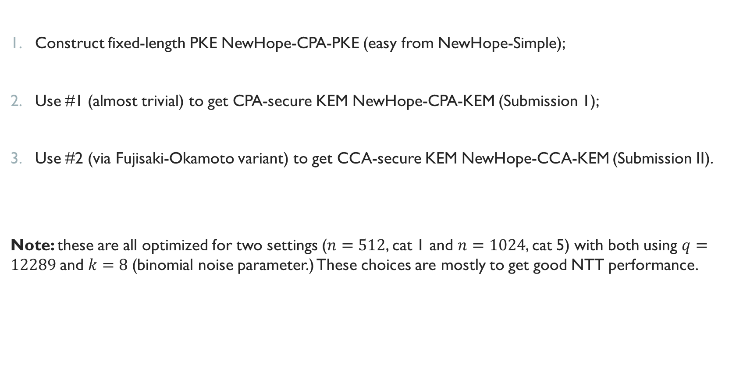
Sketch of submitted package
Construct fixed-length PKE NewHope-CPA-PKE (easy from NewHope-Simple);
Use #1 (almost trivial) to get CPA-secure KEM NewHope-CPA-KEM (Submission 1);
Use #2 (via Fujisaki-Okamoto variant) to get CCA-secure KEM NewHope-CCA-KEM (Submission II).
Note: these are all optimized for two settings ($n=512$, cat 1 and $n=1024$, cat 5) with both using $q=12289$and $k=8$(binomial noise parameter.) These choices are mostly to get good NTT performance.

Slide 7


I. NewHope-CPA-PKE
KeyGen (“Alice”).
generate $a$
sample $s, e$
Alice’s RLWE instance

Slide 8

I. NewHope-CPA-PKE
Enc (“Bob”).
plaintext
generate secret $s′$ and errors $e^{′}, e′′$
Bob’s RLWE instance
encrypt plaintext with Bob’s shared RLWE instance

Slide 9
I. NewHope-CPA-PKE
Dec.
ciphertext
decrypt with Alice’s shared RLWE instance

Slide 10
Submission 1 : NewHope-CPA-KEM
The usual idea: use PKE to encrypt key; add some hashing (in case some system randomness is revealed?)

Slide 11
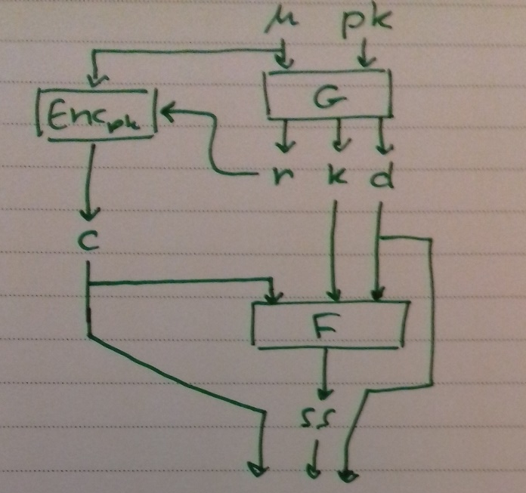
Submission 1I : NewHope-CCA-KEM
Fujisaki-Okamoto transform (variant, same as in FrodoKEM.)

Slide 12
Security proofs
Proofs are minor variants of published, probably correct theorems.
Recall: hardness of SVP on ideal lattices implies DRLWE assumption.
DRLWE assumption implies IND-CPA of NewHope-CPA-PKE (the “core ingredient.”)
IND-CPA of PKE implies IND-CCA of NewHope-CPA-KEM if all hashes are ROs (tight).
IND-CPA of PKE implies IND-CCA of NewHope-CPA-KEM if all hashes are quantum-accessible ROs (quartic loss).
I’m not sure if the proofs hold for the actual parameters selected in the submission.

Slide 13
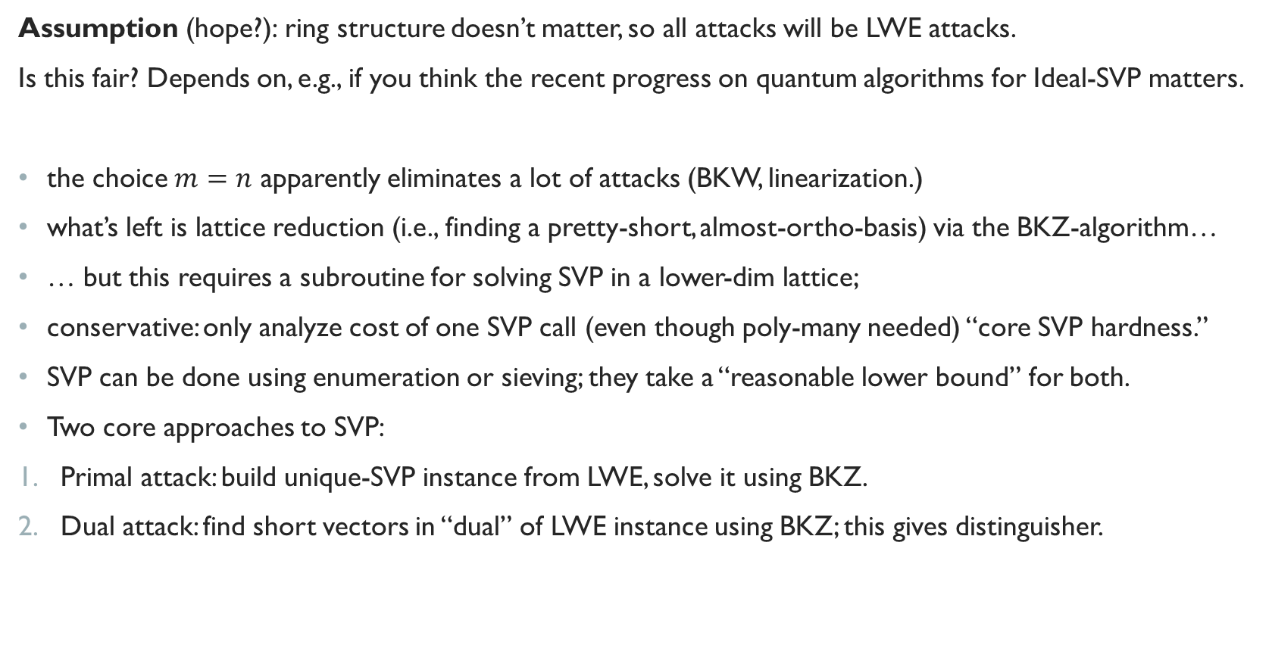
attacks
Assumption (hope?): ring structure doesn’t matter, so all attacks will be LWE attacks.
Is this fair? Depends on, e.g., if you think the recent progress on quantum algorithms for Ideal-SVP matters.
the choice $m=n$ apparently eliminates a lot of attacks (BKW, linearization.)
what’s left is lattice reduction (i.e., finding a pretty-short, almost-ortho-basis) via the BKZ-algorithm…
… but this requires a subroutine for solving SVP in a lower-dim lattice;
conservative: only analyze cost of one SVP call (even though poly-many needed) “core SVP hardness.”
SVP can be done using enumeration or sieving; they take a “reasonable lower bound” for both.
Two core approaches to SVP:
Primal attack: build unique-SVP instance from LWE, solve it using BKZ.
Dual attack: find short vectors in “dual” of LWE instance using BKZ; this gives distinguisher.

Slide 14
attacks

Slide 15
Parameters / sizes

Slide 16
performance

Slide 17
Pros / cons
Pros
theirs: good performance and sizes of things, simplicity and ease of implementation, memory efficiency, conservative design, implementation security;
maybe also: heavily studied problem in past decade, security proofs (under DRLWE + assumption that all hashes are ROs,) good documentation.
Cons
theirs: small noise distribution, RLWE could be considered less conservative than plain LWE, limited parametrization, restricted to particular form of NTT;
maybe also: problem is relatively young, cryptanalysis not fully stabilized – even against core hard problems.

Slide 18
Other algorithms

Slide 19
Other algorithms

Slide 20
Other algorithms

Slide 21
Other algorithms

Slide 22
Other algorithms

Slide 23
Other algorithms

Slide 24
Other algorithms

Slide 25
Other algorithms

