Slide 1
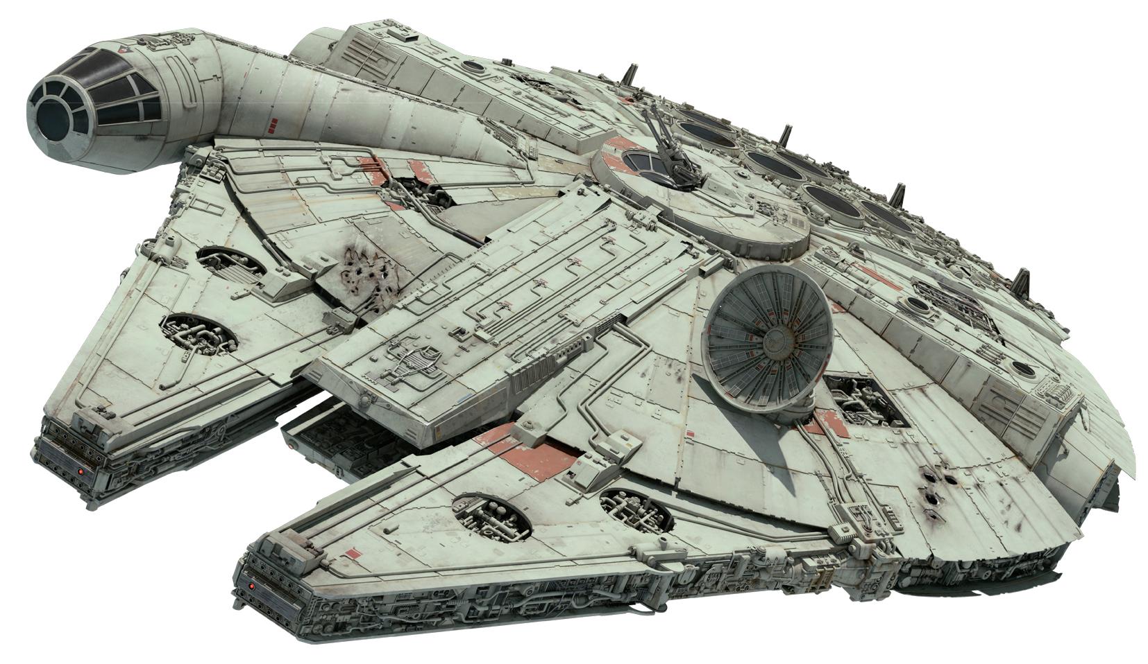
vs. Two Go In. Only one comes out?
Only for internal use 11/9/2021

Slide 2
This Talk
Dilithium / Fiat-Shamir
Overview of Scheme
Security: Theory
Falcon / Hash-and-Sign
Overview of Scheme
Security: Theory
Security Comparison: Practical
Implementation Issues
Performance Data & Application Scenarios
Opinions from the Presenters

Slide 3
This Talk
Dilithium / Fiat-Shamir
Overview of Scheme
Security: Theory
Falcon / Hash-and-Sign
Overview of Scheme
Security: Theory
Security Comparison: Practical
Implementation Issues
Performance Data & Application Scenarios
Opinions from the Presenters

Slide 4
FALCON
Uses NTRU structured lattices
Lattice points are represented by polynomials.
“Structured” means matrices are generated by a polynomial f via
rowi = x^{i} f
Uses GPV sampling/FFT to find lattice points close to a target

Slide 5
FALCON
Public key is a polynomial h with n coefficients modulo 12289.
All polynomial arithmetic is modulo $φ=x^{n}+1$ (n usually 1024).
Private key is $B=\left(\begin{matrix}g & −f \\ G & −F\end{matrix}\right)$ with
$$h=g/fmodφmodq$$
$fG−gF=qmodφ$
$g,f,G,F$ are small-norm (about $\sqrt{q}$ )

Slide 6
FALCON
Falcon is very complicated. Probably difficult to protect against side channels
The complexity is about how to make everything efficient
Other than that, this is basically NTRU. It lives and dies by the NTRU assumption.

Slide 7
DILITHIUM compared to Falcon
Much simpler than Falcon. Constant-time implementations.
Looks less “structured” to me.
Module-LWE instead of NTRU assumptions.
Uniform sampling (Falcon uses Gaussian sampling).
Bigger signatures.
Modulus is about $2^{23}$ instead of 12289. Polynomials of length 256 (instead of 1024).
“Hints” in each signature to compensate for “incomplete” public key.

Slide 8
Dilithium Design Philosophy
Fiat-Shamir style system (based on Module-LWE)
Make it simple to securely implement everywhere
only uniform sampling
Public key size is also important
want to minimize (sig size + pk size)
Make adjusting security levels simple
always operate over the ring Z_{q}[X]/(X²⁵⁶+1)

Slide 13
Falcon Design Philosophy
Hash-and-Sign style system (based on NTRU over GPV framework)
Hyper compactness (min |pk| + |sig|)
Allow for very complicated trapdoor sampling to get SPEED
Not as easy to adjust security levels (only Cat 1 (?) and Cat 5 (?))

Slide 14
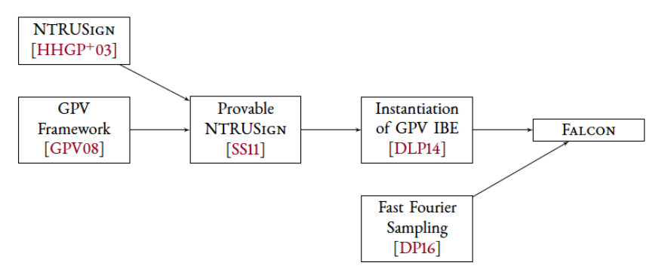
Genealogy of Falcon

Slide 15
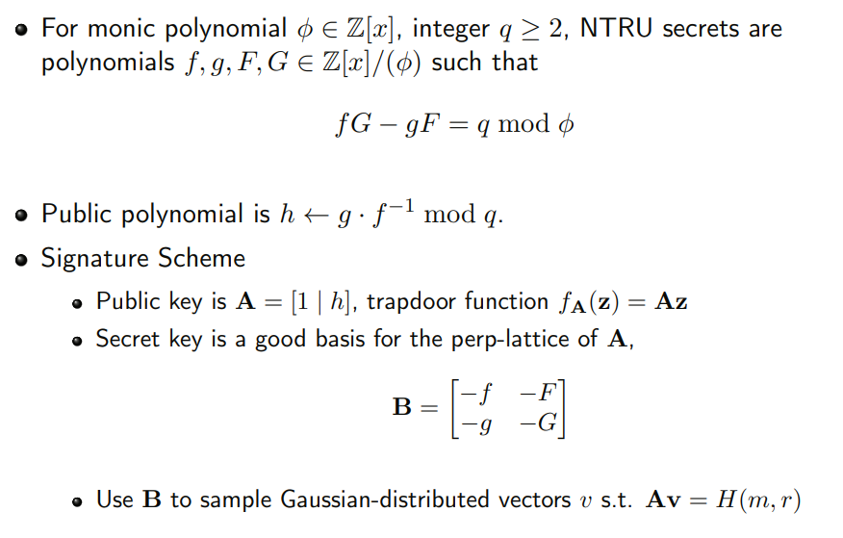
GPV Hash-and-Sign with NTRU Lattices
Falcon Trees are complicated…

Slide 17
This Talk
Dilithium / Fiat-Shamir
Overview of Scheme
Security: Theory
Falcon / Hash-and-Sign
Overview of Scheme
Security: Theory
Security Comparison: Practical
Implementation Issues
Performance Data & Application Scenarios
Opinions from the Presenters

Slide 18
Practical parameter comparison
Scheme | Target Category | Core-SVP(+) key recovery | Qu Core-SVP(+) key recovery | Core-SVP(+) forgery | Qu Core-SVP(+) forgery
Dilithium2 | 2 | 123 / 159 log(#gate) | 112 (MLWE) | 123 / 121 advice | 112 / 110 (MSIS)
Dilithium3 | 3 | 182 / 217 | 165 | 186 / 176 | 169 / 159
Dilithium5 | 5 | 252 / 285 | 229 | 265 / 253 | 241 / 230
Falcon-512 | 1 | 133 | 121 (NTRU-SIS) | 120 | 108
Falcon-1024 | 5 | 273 | 248 | 277 | 252

Slide 19
This Talk
Dilithium / Fiat-Shamir
Overview of Scheme
Security: Theory
Falcon / Hash-and-Sign
Overview of Scheme
Security: Theory
Security Comparison: Practical
Implementation Issues
Performance Data & Application Scenarios
Opinions from the Presenters

Slide 20
Implementation issues
Dilithium – pretty straightforward? (uniform sampling everywhere)
Security concern for latter on? ..could be? (speculation)
Falcon keygen and FFT-samp are delicate to implement
Floating-pt arithmetic
53 bits of precision – no problem in software. A concern in resource-constrained hardware without native support
Discrete Gaussian sampling with side channel protection ‘solved’ now

Slide 21
This Talk
Dilithium / Fiat-Shamir
Overview of Scheme
Security: Theory
Falcon / Hash-and-Sign
Overview of Scheme
Security: Theory
Security Comparison: Practical
Implementation Issues
Performance Data & Application Scenarios
Opinions from the Presenters

Slide 22
SUPERCOP - Haswell
 | Public Key | Signature | Key generation | Sign | Verify | Total cost (2000)
Dilithium2-AES | 1312 | 2420 | 65,950 | 193,882 | 81,619 | 7,739,501
Dilithium2 | 1312 | 2420 | 98,739 | 263,265 | 111,614 | 7,838,879
Falcon512-dyn | 897 | 666 | 19,672,294 | 807,968 | 91,786 | 4,025,754
Falcon512-tree | 897 | 666 | 20,063,575 | 415,540 | 74,870 | 3,616,410
Dilithium3-AES | 1952 | 3293 | 103,010 | 250,929 | 118,904 | 10,859,833
Dilithium3 | 1952 | 3293 | 176,975 | 381,715 | 181,011 | 11,052,726
Dilithium5-AES | 2592 | 4595 | 160,834 | 387,715 | 177,257 | 14,938,972
Dilithium5 | 2592 | 4595 | 270,474 | 509,558 | 280,618 | 15,164,176
Falcon1024-dyn | 1793 | 1280 | 61,074,190 | 1,623,284 | 183,678 | 7,952,962
Falcon1024-tree | 1793 | 1280 | 62,283,639 | 824,726 | 150,204 | 7,120,930

Slide 23
SUPERCOP - Haswell
 | Public Key | Signature | Key generation | Sign | Verify | Total cost (1000)
Dilithium2-AES | 1312 | 2420 | 65,950 | 193,882 | 81,619 | 4,007,501
Dilithium2 | 1312 | 2420 | 98,739 | 263,265 | 111,614 | 4,106,879
Falcon512-dyn | 897 | 666 | 19,672,294 | 807,968 | 91,786 | 2,462,754
Falcon512-tree | 897 | 666 | 20,063,575 | 415,540 | 74,870 | 2,053,410
Dilithium3-AES | 1952 | 3293 | 103,010 | 250,929 | 118,904 | 5,614,833
Dilithium3 | 1952 | 3293 | 176,975 | 381,715 | 181,011 | 5,807,726
Dilithium5-AES | 2592 | 4595 | 160,834 | 387,715 | 177,257 | 7,751,972
Dilithium5 | 2592 | 4595 | 270,474 | 509,558 | 280,618 | 7,977,176
Falcon1024-dyn | 1793 | 1280 | 61,074,190 | 1,623,284 | 183,678 | 4,879,962
Falcon1024-tree | 1793 | 1280 | 62,283,639 | 824,726 | 150,204 | 4,047,930

Slide 24
SUPERCOP - Haswell
 | Public Key | Signature | Key generation | Sign | Verify | Total cost (300)
Dilithium2-AES | 1312 | 2420 | 65,950 | 193,882 | 81,619 | 1,395,101
Dilithium2 | 1312 | 2420 | 98,739 | 263,265 | 111,614 | 1,494,479
Falcon512-dyn | 897 | 666 | 19,672,294 | 807,968 | 91,786 | 1,368,654
Falcon512-tree | 897 | 666 | 20,063,575 | 415,540 | 74,870 | 959,310
Dilithium3-AES | 1952 | 3293 | 103,010 | 250,929 | 118,904 | 1,943,333
Dilithium3 | 1952 | 3293 | 176,975 | 381,715 | 181,011 | 2,136,226
Dilithium5-AES | 2592 | 4595 | 160,834 | 387,715 | 177,257 | 2,721,072
Dilithium5 | 2592 | 4595 | 270,474 | 509,558 | 280,618 | 2,946,276
Falcon1024-dyn | 1793 | 1280 | 61,074,190 | 1,623,284 | 183,678 | 2,728,862
Falcon1024-tree | 1793 | 1280 | 62,283,639 | 824,726 | 150,204 | 1,896,830

Slide 25
PQM4
 | Public Key | Signature | Key generation | Sign | Verify | Total cost (2000)
Dilithium2 | 1312 | 2420 | 1,559,631 | 2,029,960 | 1,577,841 | 11,071,801
Falcon512-dyn | 897 | 666 | 102,641,420 | 38,837,777 | 464,925 | 42,408,702
Falcon512-tree | 897 | 666 | 117,772,104 | 17,510,506 | 464,503 | 21,101,009
Dilithium3 | 1952 | 3293 | 2,833,207 | 3,285,236 | 2,699,582 | 16,474,818
Falcon1024-dyn | 1793 | 1280 | 273,960,881 | 84,941,964 | 966,969 | 92,054,933

Slide 26
PQM4
 | Public Key | Signature | Key generation | Sign | Verify | Total cost (6700)
Dilithium2 | 1312 | 2420 | 1,559,631 | 2,029,960 | 1,577,841 | 28,612,201
Falcon512-dyn | 897 | 666 | 102,641,420 | 38,837,777 | 464,925 | 49,774,802
Falcon512-tree | 897 | 666 | 117,772,104 | 17,510,506 | 464,503 | 28,447,109
Dilithium3 | 1952 | 3293 | 2,833,207 | 3,285,236 | 2,699,582 | 41,126,318
Falcon1024-dyn | 1793 | 1280 | 273,960,881 | 84,941,964 | 966,969 | 106,498,033

Slide 27
PQM4 – Memory Requirements
 | Stack
 | Key generation | Sign | Verify | .text (code) | .bss (heap)
Dilithium2 | 38,276 | 51,900 | 36,188 | 10,566 | 0
Falcon512-dyn | 1,488 | 2,592 | 388 | 81,265 | 39,936
Falcon512-tree | 1,480 | 2,776 | 388 | 81,005 | 27,648
Dilithium3 | 60,804 | 79,548 | 57,692 | 10,076 | 0
Falcon1024-dyn | 1,488 | 2,568 | 496 | 81,265 | 79,872

Slide 28
Verification on M3
From “Verifying Post-Quantum Signatures in 8 kB of RAM”: https://eprint.iacr.org/2021/662
 |  | memory |  |  |  | code
 | Time [kcc] | total | buffer | .bss (heap) | stack | .text
Dilithium2 | 2,123 | 8,048 | 4,560 | 496 | 3,120 | 7,940
Falcon512 | 672 | 6,552 | 897 | 5,255 | 400 | 5,784

Slide 29
Dilithium (Round 2)
From “Compact Dilithium Implementations on Cortex-M3 and Cortex-M4” https://eprint.iacr.org/2020/1278
 | Key Gen Speed [kcc] | Sign Speed [kcc] | Stack [B]
Dilithium2 | 2,267 | 3,097 | 14,428
Dilithium3 | 3,545 | 4,578 | 17,628
Dilithium4 | 5,086 | 3,768 | 20,828
Dilithium2 | 1,315 | 13,332 | 8,924
Dilithium3 | 2,013 | 23,550 | 9,948
Dilithium4 | 2,837 | 22,658 | 10,972

Slide 30
Falcon (RAM)
“Towards Practical Microcontroller Implementation of the Signature Scheme Falcon”
https://www.emsec.ruhr-uni-bochum.de/media/seceng/veroeffentlichungen/2019/01/25/falcon_paper.pdf
Operation | M4 |  | Fixed Keys M4
 | n = 512 | n = 1024 | n = 512 | n = 1024
Key Gen | 40,560 | 51,704 | - | -
Sign | 63,652 | 120,596 | 50,508 | 94,260
“New Efficient, Constant-Time Implementations of Falcon” - https://eprint.iacr.org/2019/893.pdf
degree | make pub | verify | keygen | sign (tree) | expand key | sign (dyn)
512 | 3073 | 4097 | 15,879 | 25,607 | 26,631 | 39,943
1024 | 6145 | 8193 | 31,751 | 51,207 | 53,255 | 79,879

Slide 31
Hardware Implementations
Sapphire: A Configurable Crypto-Processor for Post-Quantum Lattice-based Protocols (Extended Version) https://eprint.iacr.org/2019/1140.pdf
Implementing CRYSTALS-Dilithium Signature Scheme on FPGAs https://eprint.iacr.org/2021/108.pdf
A Hard Crystal - Implementing Dilithium on Reconfigurable Hardware https://eprint.iacr.org/2021/355.pdf
High-Performance Hardware Implementation of CRYSTALS-Dilithium https://eprint.iacr.org/2021/1451.pdf
“It is worth noting that GeMSS and FALCON are also candidates still under consideration, but they lack any reported hardware implementations and thus are not included in our comparisons.”

Slide 32
Constrained Devices
Smartcard and Post-Quantum Crypto https://csrc.nist.gov/CSRC/media/Presentations/smartcard-and-post-quantum-crypto/images-media/session-5-greuet-smartcard-pqc.pdf
Falcon: too much RAM, too slow with countermeasures
RAM:
Time: key gen > 171 Mcycles + countermeasures overhead > 3.5 s
OS | Falcon > 25 kB
+ masking

Slide 33
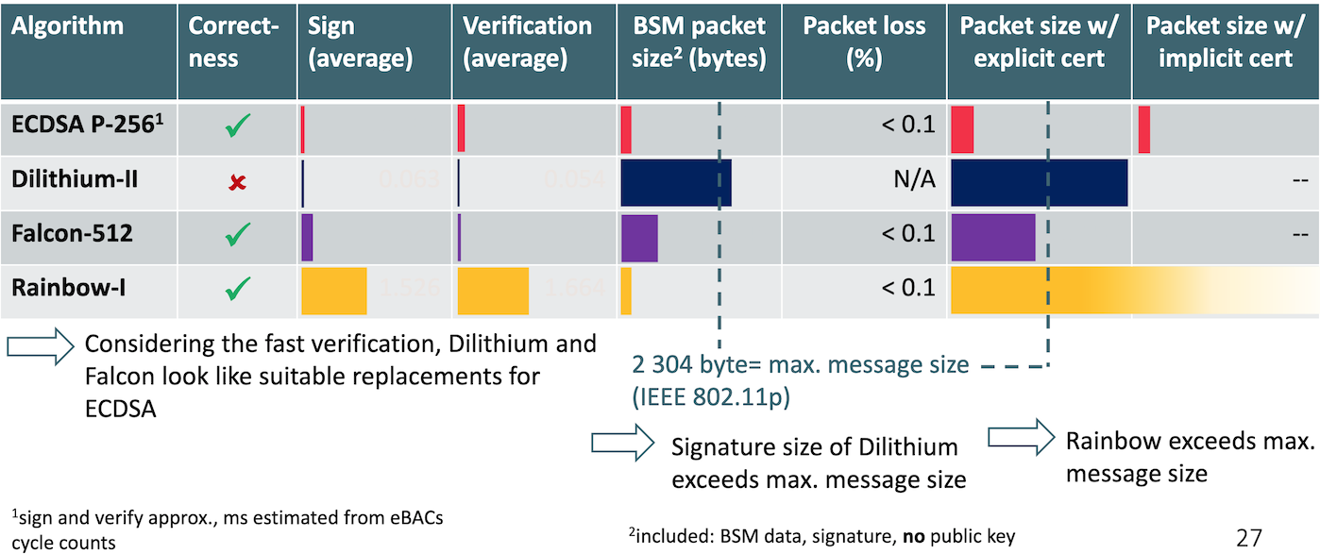
Suitability of 3rd Round Signature Candidates for Vehicle-to-Vehicle Communication https://csrc.nist.gov/CSRC/media/Presentations/suitability-of-3rd-round-signature-candidates-for/images-media/session-5-bindel-suitability-vehicle.pdf
Notes:
Not clear what type of processor would be used in real-world for signing. Would it include hardware support for floating point? Cycle counts in presentation close to numbers for Haswell.

Slide 34
Sizing Up Post-Quantum Signature for the Web https://groups.google.com/a/list.nist.gov/g/pqc-forum/c/anE3sBUWZS0
Bas Westerbaan:
In a typical TLS handshake on the Web there are at least six signatures and two public keys.
Even if they fit in the congestion window, with larger signatures, we see a double-digit percentage slowdown which can be a hard sell for browser vendors and content servers to adopt.
Because of the lead time, we shouldn’t wait too long to adopt PQ signatures on the web. It would be ideal if these six signatures and two public keys would fit together within 9kB.
Dilithium: 6 * 2420 + 2 * 1312 = 17,144
Falcon: 6 * 666 + 2 * 897 = 5,790

Slide 35
Sizing Up Post-Quantum Signature for the Web https://groups.google.com/a/list.nist.gov/g/pqc-forum/c/anE3sBUWZS0
🌈
Intermediate certificate: signature + public key
Server certificate: signature + public key
TLS handshake: signature
Stapled OCSP response: signature
Certificate Transparency: 2 signatures
Dilithium: 3 * 66 + 3 * 2420 + 2 * 1312 = 17,144 10,082
Falcon: 3 * 66 + 3 * 666 + 2 * 897 = 5,790 3,990
🌈🌈
🌈🌈🌈

Slide 36
DNS https://www.nist.gov/video/third-pqc-standardization-conference-session-v-applications
“Given the broad dependence on UDP for DNS exchanges, DNSSEC is not currently favorable to typical sizes of signatures and keys for PQC signature algorithms.”
“Firewalls and some implementations block the use of TCP.”
Should favor smaller signatures to limit amount of fragmentation needed.
Verification happens orders of magnitude more than signing, so impact on validators more important than impact on signers.
Financial incentives also favor signer, so more important to make transition easier for validator.
Falcon is the only candidate with signatures or keys that fit within the 1232 byte limit.

Slide 37
This Talk
Dilithium / Fiat-Shamir
Overview of Scheme
Security: Theory
Falcon / Hash-and-Sign
Overview of Scheme
Security: Theory
Security Comparison: Practical
Implementation Issues
Performance Data & Application Scenarios
Opinions from the Presenters

Slide 38
Some opinions, then discussion
Yada yada yada

