Slide 1
Dimensions for free
DANIEL SMITH-TONE
For internal use only… unlike a hairdryer.

Slide 2


Consider lattice sieving generically
ALGORITHM: Sieve($ℒ)$
Input: A basis $ℬ$ of dimension $n$.
Output: A list of vectors $L$.
$L←$ a set of $N$ vectors of appropriate size
while $∃\left(v,w\right)∈L^{2}$ s.t. $∥v−w∥<∥v∥$ do
$v←v−w$
end while
return $L$

Slide 3

Extra information
Output of sieve contains more than just the shortest vector.
The output list $L$ likely contains all vectors in the lattice of size bounded by
$\sqrt{\frac{4}{3}}$gh$(ℒ)$

Slide 4

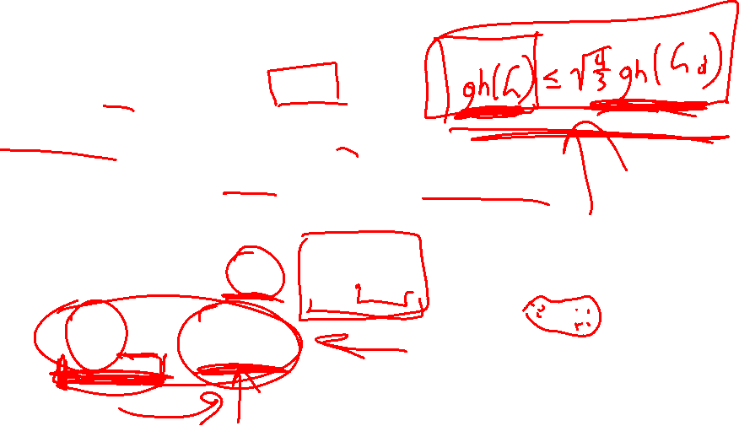
SubSieve
Pick a sub-lattice $ℒ_{d}$ of dimension $n−d$.
Run a sieve on $ℒ_{d}$ and get an output list $L_{d}$.
Hope that the shortest vector $s∈ℒ$ projects to a vector in $L_{d}$.
Can do better
  Expected length of projection $π_{d}(s)$ is $\sqrt{\frac{n−d}{n}}$gh$(ℒ)$.
  Only need$\sqrt{\frac{n−d}{n}}$gh$\left(ℒ\right)≤\sqrt{\frac{4}{3}}$gh$(ℒ_{d})$.

Slide 5

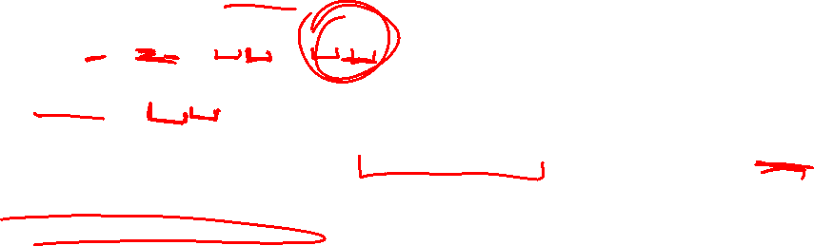
So what if it’s good?
Suppose we recover $π_{d}(s)$.
We have $s=Bx=B^{′}x^{′}+B^{′′}x′′$, where $x^{′′}∈ℤ^{n−d}$.
Since $π_{d}\left(s\right)=B_{d}x′′$, we can recover $x′′$.
Recovering $x′$ in the lattice coset $ℒ\left(B^{′}\right)−B^{′′}x′′$ is an instance of BDD.
  Babai’s Nearest-Plane algorithm

Slide 6

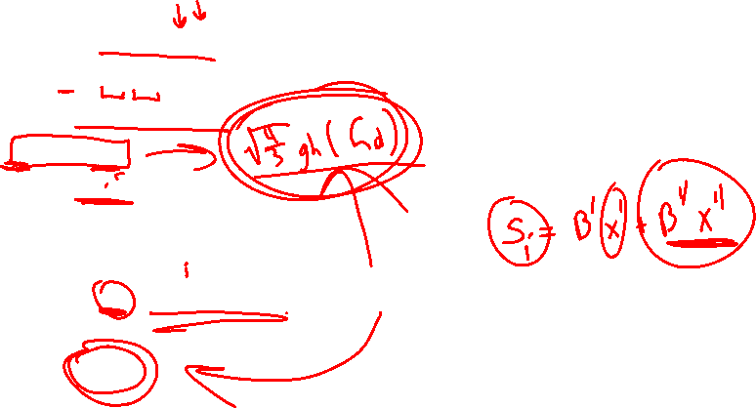
Details
Algorithm: SubSieve$(ℒ,d)$.
Input: $B=[B^{′}|B^{′′}]$ of dimension $n$.
Output: A short vector of $ℒ$.
$L←$Sieve$(ℒ_{d})$
for each $w_{i}∈L$ do
$x_{i}^{′′}←$LinSolve$(B_{d}x_{i}^{′′}=w_{i})$
$t_{i}←B^{′′}x′′$
$s_{i}←$Babai$\left(B^{′},t_{i}\right)+t_{i}$
end for
return shortest $s$

Slide 7

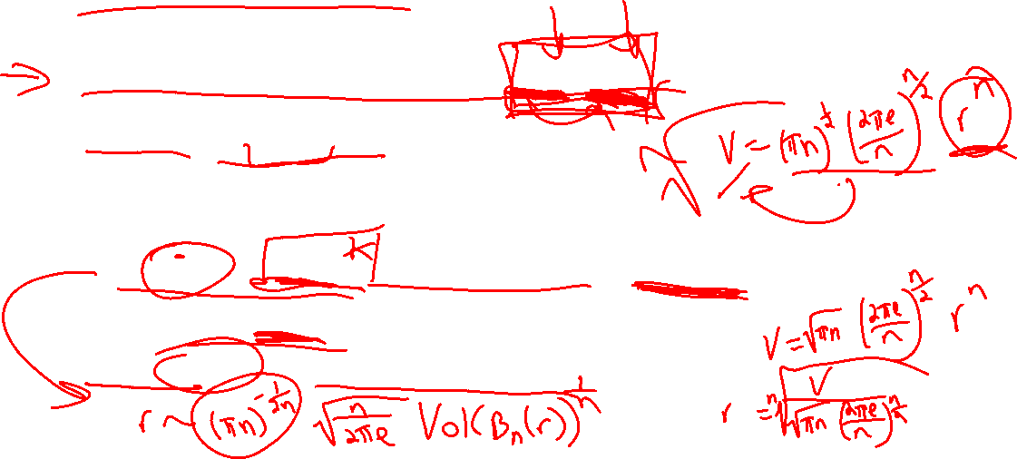
Gaussian Heuristic
Assume that the number of lattice points in $A$ is Vol$(A)/$Vol$(ℒ)$.
Vol$\left(ℬ_{n}\left(r\right)\right)=π^{\frac{n}{2}}Γ{\left(\frac{n}{2}+1\right)}^{−1}r^{n}$
Applying Stirling’s approximation to the above we have
  Vol$\left(ℬ_{n}\left(r\right)\right)\sim {\left(πn\right)}^{\frac{1}{2}}{\left(\frac{2πe}{n}\right)}^{n/2}r^{n}$
  $r\sim {\left(πn\right)}^{1/2n}\sqrt{\frac{n}{2πn}}$Vol$(ℬ_{n}\left(r\right))$, a lower bound with error a factor of $1+O(n^{−1})$.
gh$\left(ℒ\right)=\sqrt{n/2πe}$Vol${\left(ℒ\right)}^{1/n}$
gh$\left(n\right)=\sqrt{n/2πe}$ for a volume 1 lattice in $n$ dimensions

Slide 8

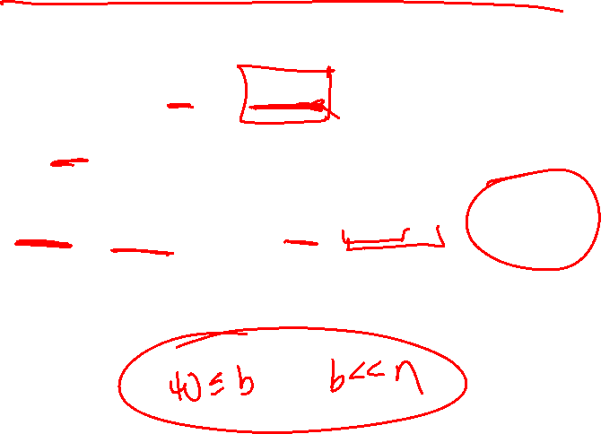
Geometric series assumption
Suppose that $B$ is a BKZ-$b$ reduced basis of a lattice of volume $1$.
Let $B^{∗}$ be the associated Gram-Schmidt orthogonalized basis.
$\left\|b_{i}^{∗}\right\|=α_{b}^{\frac{n−1}{2}−i}$, where $α_{b}=$gh${\left(b\right)}^{2/b}={\left(\frac{b}{2πe}\right)}^{1/b}$
  The quantity $α_{b}^{b}$ is essentially the radius of a $b$-ball of volume $1$.

Slide 9

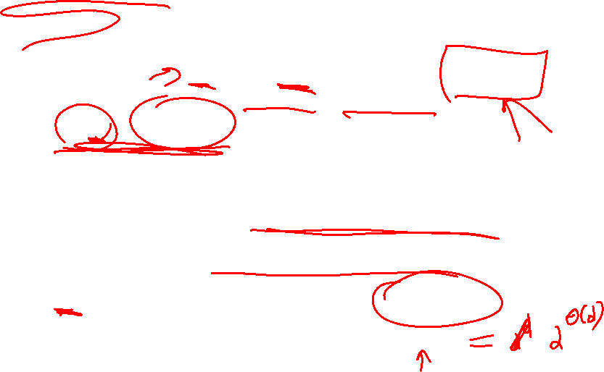
Complexity
$$\left(ℒ_{d}\right)=\prod_{i=d}^{n−1}{\left\|b_{i}^{∗}\right\|}=\prod_{i=d}^{n−1}{α_{b}^{\frac{n−1}{2}−i}}=α_{b}^{d(d−n)/2}$$
We need gh$\left(ℒ\right)≤\sqrt{4/3}$gh$(ℒ_{d})$, so we require
$$\sqrt{\frac{n}{2πe}}≤\sqrt{\frac{4}{3}}\sqrt{\frac{n−d}{2πe}}α_{b}^{−\frac{d}{2}}$$
This condition is equivalent to $d\ln{α_{b}}≤\ln{\frac{4}{3}}+\ln{(1−d/n)}$.
Choosing $b$ as some constant fraction of $n$, we solve $d=Θ(\frac{n}{\ln{n}})$.
Subsieve$(ℒ,d)$ is faster than Sieve$(ℒ)$ by a factor of $2^{Θ(\frac{n}{\ln{n}})}$.
Vol

Slide 10

Progressive Iteration
Replace the “return shortest $s$” command with
  return rank $m$ basis consisting of the $m$ values of $s$ minimizing the Gram-Schmidt lengths.
  The partial basis is completed to return a new basis $B$.
The cost is linear in $N$, the size of the sieve list, with linear algebra overhead.
Since the cost of the sieving step is sub-quadratic, this cost is negligible.
The claim is that this procedure may be better and seems to work in practice
  There is no analysis given as to why this may be better.

Slide 11

Experiments
Implemented with the following strategy.
  Set $d=n/4$
  Decrement $d$ until the shortest vector is found
  Record $d_{last}$ as the last value of $d$ that worked.
Under an assumption that the produced basis is close to HKZ-reduced
  $d≈\frac{n\ln{4/3}}{\ln{(n/2π)}}$ is the lower estimate, and
  $d≈\frac{n\ln{4/3}}{\ln{(n/2πe)}}$ is the upper estimate.

Slide 12
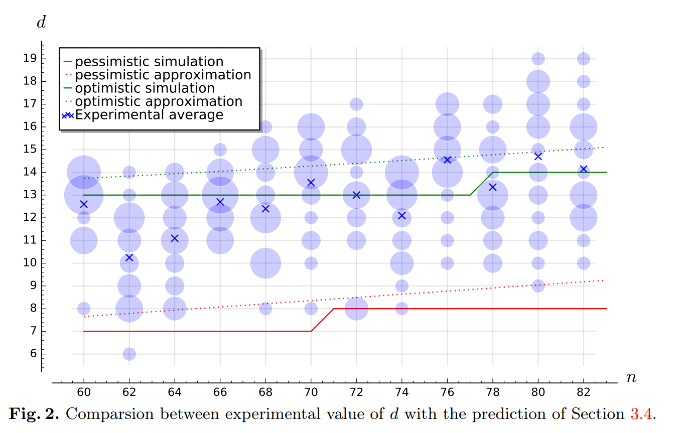
Simulation of d-values

Slide 13
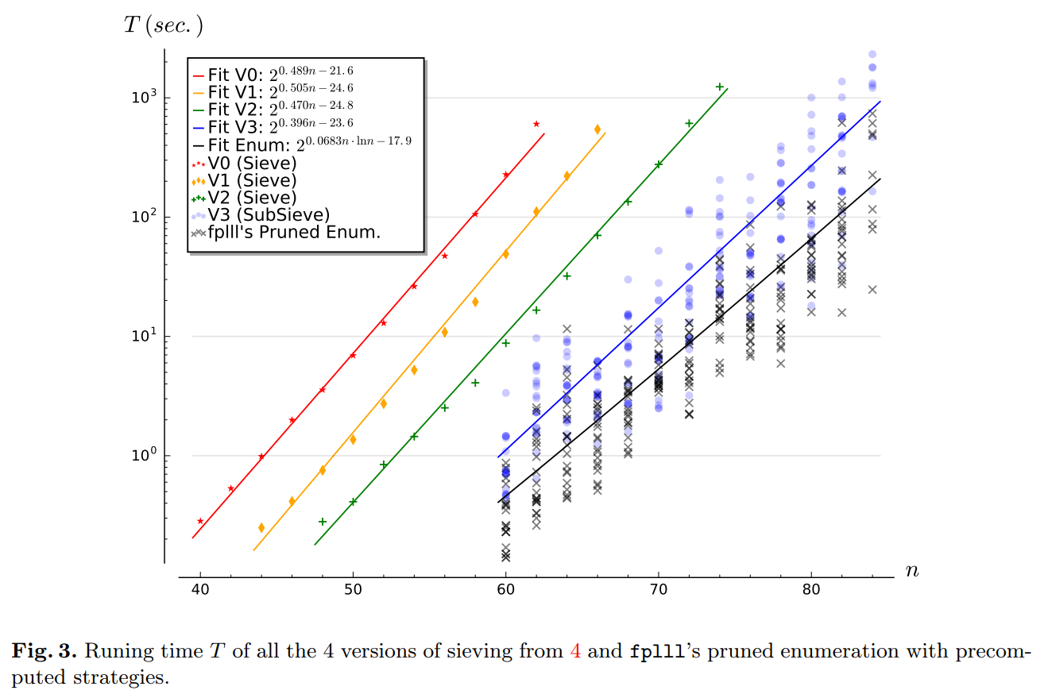
runtime

Slide 14

Summary
Lattices are broken anyway.
Do we have more data for the performance?
Let’s compare this to ${\left(\frac{4}{3}\right)}^{n+o(n)}=2^{0.415n+o(n)}$.
Compare when used with NNS-sieving (with high memory cost)
  ${\left(\frac{3}{2}\right)}^{\frac{n}{2}+o(n)}=2^{0.292n+o(n)}$

