Slide 1
Kyber
NIST PQC submission by CRYSTALS team
NIST internal presentation by Gorjan Alagic

Slide 2
kyber
KEM submission based on Module-LWE (and Module-LWR?)
Part of “CRYSTALS” suite (other part is Dilithium.)
Team: Roberto Avanzi, Joppe Bos, Léo Ducas, Eike Kiltz, Tancrède Lepoint, Vadim Lyubashevsky, John M. Schanck, Peter Schwabe, Gregor Seiler, Damien Stehlé.
Refs: supporting docs and https://eprint.iacr.org/2017/634 (CRYSTALS – Kyber: a CCA-secure module-lattice-based KEM)
The usual two steps:
Kyber.CPAPKE
Kyber.CCAKEM
“tweaked” Fujisaki-Okamoto
Kyber512 (security level 1)
Kyber768 (security level 3)
Kyber1024 (security level 5)

Slide 3
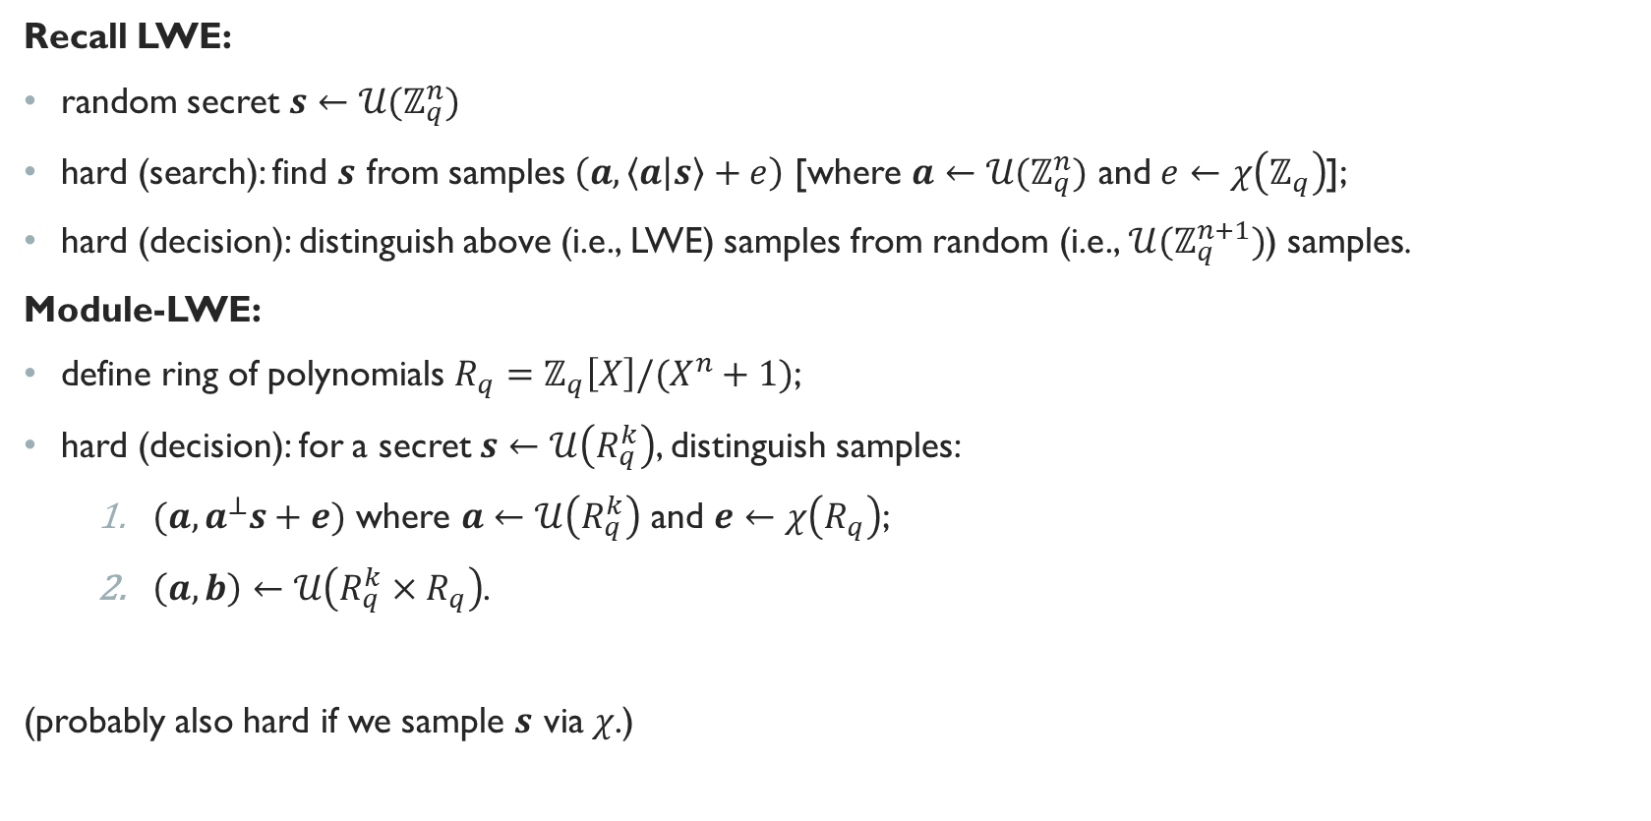
Core math
Recall LWE:
random secret $s←𝒰(ℤ_{q}^{n})$
hard (search): find $s$ from samples $\left(a, \left\langle a | s\right\rangle +e\right)$ [where $a←{𝒰(ℤ}_{q}^{n})$ and $e←χ\left(ℤ_{q}\right)$];
hard (decision): distinguish above (i.e., LWE) samples from random (i.e., ${𝒰(ℤ}_{q}^{n+1})$) samples.
Module-LWE:
define ring of polynomials $R_{q}=ℤ_{q}\left[X\right]/(X^{n}+1)$;
hard (decision): for a secret $s←𝒰\left(R_{q}^{k}\right)$, distinguish samples:
    $(a, a^{⊥}s+e)$ where $a←𝒰\left(R_{q}^{k}\right)$ and $e←χ\left(R_{q}\right)$;
    $\left(a, b\right)←𝒰\left(R_{q}^{k}×R_{q}\right)$.
(probably also hard if we sample $s$ via $χ$.)
error distribution, e.g., Gaussian
e.g., entrywise
Gaussian

Slide 4





Kyber.CPAPKE
IND-CPA-secure PKE. The basic approach:
KeyGen:
$A←R_{q}^{k×k}$; $s←χ\left(R_{q}^{k}\right)$; $e←χ\left(R_{q}^{k}\right)$; $t ≔As+e.$
output $pk≔(A, t)$ and $sk ≔s$.
Enc (on input $m∈{\left\{0,1\right\}}^{n}$) :
$r←χ\left(R_{q}^{k}\right)$; $e_{1}←χ\left(R_{q}^{k}\right)$; $e_{2}←χ\left(R_{q}\right)$.
$u≔A^{⊥}r+e_{1}$; $v ≔t^{⊥}r+e_{2}+m⋅\left\lfloor q/2\right\rfloor$.
output $(u, v)$.
Dec (on input $\left(u, v\right)∈R_{q}^{k}×R_{q}$ ):
output $v−s^{⊥}u$ (rounded).
$$r$$
$$A$$
$$t$$
viewed as a poly
with $\{0,1\}$-coeff.
encode m here

Slide 5
Kyber.CPAPKE
IND-CPA-secure PKE. In more detail (from Kyber paper):
This is CPA-secure (under Module-LWE hardness) if we drop the compression/decompression.
Actual spec algorithm is more complicated, due to optimizations (encoding/decoding, NTTs, etc.)

Slide 6

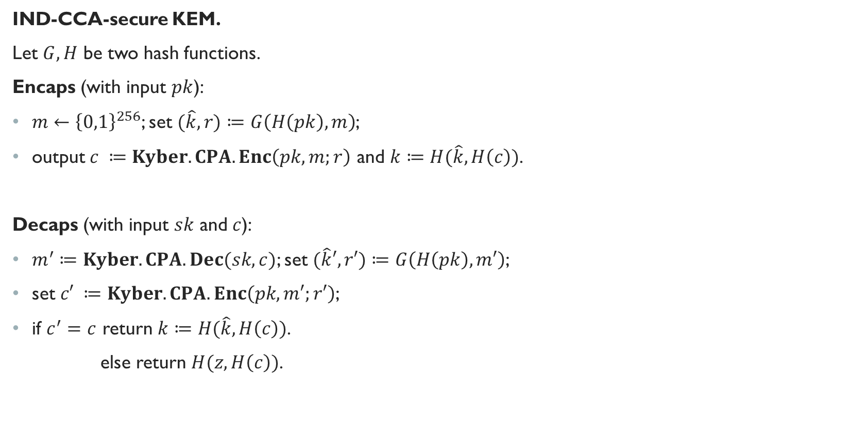
Kyber.CCAKEM
IND-CCA-secure KEM.
Let $G, H$ be two hash functions.
Encaps (with input $pk$):
$m←{\left\{0,1\right\}}^{256}$; set $(\hat{k}, r)≔G\left(H\left(pk\right), m\right)$;
output $c ≔Kyber.CPA.Enc\left(pk, m;r\right)$ and $k≔H(\hat{k},H\left(c\right))$.
Decaps (with input $sk$ and $c$):
$m^{′}≔Kyber.CPA.Dec(sk, c)$; set $(\hat{k}′, r′)≔G\left(H\left(pk\right), m′\right)$;
set $c′ ≔Kyber.CPA.Enc\left(pk, m′;r′\right)$;
if $c^{′}=c$ return $k≔H(\hat{k},H\left(c\right))$.
else return $H(z, H\left(c\right))$.
random string
included in $sk$

Slide 7
Kyber.CCAKEM
IND-CCA-secure KEM. In more detail (from Kyber paper):
Actual spec algorithm is a bit more complicated, due to some optimizations.

Slide 8
attacks
Assumption (hope?): ring structure doesn’t matter, so all attacks will be LWE attacks.
Is this fair? Depends on, e.g., if you think the recent progress on quantum algorithms for Ideal-SVP matters.
“Core-SVP hardness”
lattice reduction (i.e., finding a pretty-short, almost-ortho-basis) via the BKZ-algorithm…
… but this requires a subroutine for solving SVP in a lower-dim lattice;
conservative: only analyze cost of one SVP call (even though poly-many needed) “core SVP hardness.”
SVP can be done using enumeration or sieving; they take a “reasonable lower bound” for both.
Two core approaches to SVP:
Primal attack: build unique-SVP instance from LWE, solve it using BKZ.
Dual attack: find short vectors in “dual” of LWE instance using BKZ; this gives distinguisher.

Slide 9
Security proofs
tight reduction from Module-LWE in ROM:
non-tight reduction from Module-LWE in QROM:
some caveats:
+ there has been more progress recently on some of these reductions;
- it was observed that they actually also rely on LWR so it’s not clear to me what these proofs mean.

Slide 10

Parameter sets, security strength
noise
param
Dec failure
probability
$n$ chosen so you can encaps 256-bit keys
$k$ is the matrix dimension
$q$ is smallest prime s.t. $2n | q−1$ (for NTT.)
rest are set to balance security, sizes of things, and Dec failure probability.
not important

Slide 11
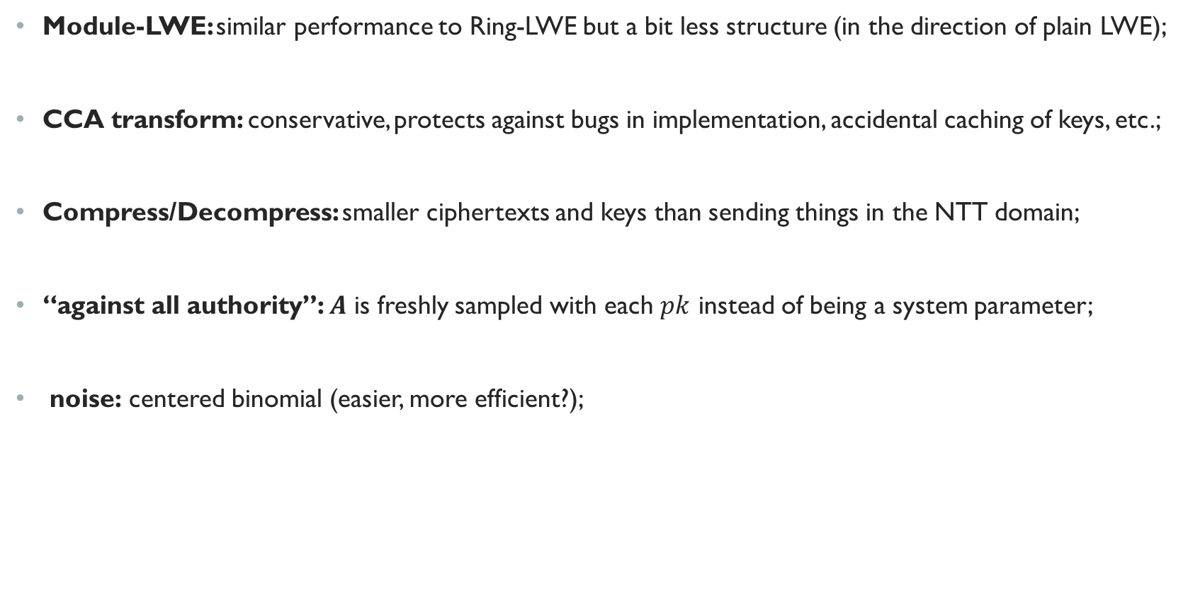
Some Design rationale
Module-LWE: similar performance to Ring-LWE but a bit less structure (in the direction of plain LWE);
CCA transform: conservative, protects against bugs in implementation, accidental caching of keys, etc.;
Compress/Decompress: smaller ciphertexts and keys than sending things in the NTT domain;
“against all authority”: $A$ is freshly sampled with each $pk$ instead of being a system parameter;
noise: centered binomial (easier, more efficient?);

Slide 12
performance

Slide 13
CRYSTALS-Kyber | kyber512 | 1 | Lattices | Times | 440519 | 777761 | 639967 | 928656 | 783765 | 1373997 | 1632 | 736 | 800 | 32 | 100
CRYSTALS-Kyber | kyber768 | 3 | Lattices | Times | 729808 | 1225270 | 982173 | 1618276 | 1171685 | 1749946 | 2400 | 1088 | 1152 | 32 | 100
CRYSTALS-Kyber | kyber1024 | 5 | Lattices | Times | 1074457 | 1351579 | 1366784 | 2112734 | 1652596 | 2703872 | 3168 | 1440 | 1504 | 32 | 100
Frodo | FrodoKEM-640 | 1 | Lattices | Times | 1364752 | 1589050 | 1815181 | 2938233 | 1804051 | 4428250 | 19872 | 9616 | 9736 | 16 | 100
Frodo | FrodoKEM-976 | 3 | Lattices | Times | 2772340 | 4078228 | 3665833 | 7419629 | 3560771 | 6801659 | 31272 | 15632 | 15768 | 24 | 100
NewHope | newhope512cpa | 1 | Lattices | Times | 438874 | 483028 | 674805 | 714350 | 129251 | 132934 | 896 | 928 | 1088 | 32 | 100
NewHope | newhope512cca | 1 | Lattices | Times | 513054 | 551834 | 776525 | 819449 | 874199 | 1013095 | 1888 | 928 | 1120 | 32 | 100
NewHope | newhope1024cpa | 5 | Lattices | Times | 955693 | 985806 | 1402605 | 1525623 | 267971 | 281615 | 1792 | 1824 | 2176 | 32 | 100
NewHope | newhope1024cca | 5 | Lattices | Times | 1023877 | 1076737 | 1528702 | 1627156 | 1755817 | 1825233 | 3680 | 1824 | 2208 | 32 | 100
NTRU Prime | sntrup4591761 | 5 | Lattices | Times | 43633012 | 43865807 | 22761101 | 27101314 | 59551582 | 62508579 | 1600 | 1218 | 1047 | 32 | 100
NTRU Prime | ntrulpr4591761 | 5 | Lattices | Times | 9579562 | 14060919 | 45677602 | 44116905 | 68706766 | 71245370 | 1238 | 1047 | 1175 | 32 | 100
NTRU-HRSS-KEM | NTRU-HRSS-KEM | 1 | Lattices | Times | 177885211 | 191376309 | 3738930 | 3965430 | 10952767 | 11383908 | 1418 | 1138 | 1278 | 32 | 100
NTRUEncrypt | ntru-kem-443 | 1 | Lattices | Times | 1157176 | 1257307 | 324235 | 394406 | 343907 | 363281 | 701 | 611 | 611 | 32 | 100
NTRUEncrypt | ntru-kem-743 | 5 | Lattices | Times | 2895635 | 3031086 | 530839 | 579527 | 668692 | 767267 | 1173 | 1023 | 1023 | 48 | 100
NTRUEncrypt | ntru-kem-1024 | 5 | Lattices | Times | 130923156 | 135483043 | 214349837 | 224147211 | 373198501 | 385916996 | 8194 | 4097 | 4097 | 48 | 100
Lizard | KEM_CATEGORY1_N536 | 1 | Lattices | Times | 40869466 | 45807345 | 1362446 | 1382731 | 1029449 | 1359913 | 8608 | 1130496 | 17696 | 32 | 100
Lizard | KEM_CATEGORY1_N663 | 1 | Lattices | Times | 53580859 | 58381975 | 1680898 | 2124422 | 1265266 | 1828766 | 10640 | 1390592 | 10896 | 32 | 100
Lizard | RING_CATEGORY3_N1024 | 3 | Lattices | Times | 357107 | 916915 | 156802 | 334678 | 205620 | 217213 | 641 | 4096 | 4144 | 48 | 100

Slide 14
Pros / cons
Kyber (vs SIDH): 3x larger keys, but 2x faster, and more standard assumption;
Kyber (vs code-based): much smaller keys, but less conservative assumption (besides QC-MDPC, which (they say) can’t be used for CCA KEMs.)
Kyber (vs LWE, e.g., Frodo): “10x smaller keys, 10x faster,” but more structured assumption;
Kyber (vs Ring-LWE, e.g., NewHope): easier to scale up security strength, a bit less structure;
Kyber (vs NTRU): more efficient, fewer known attack approaches.

