Slide 1
LAC
(LAttice based Cryptosystem)
Presented by Ray Perlner

Slide 2
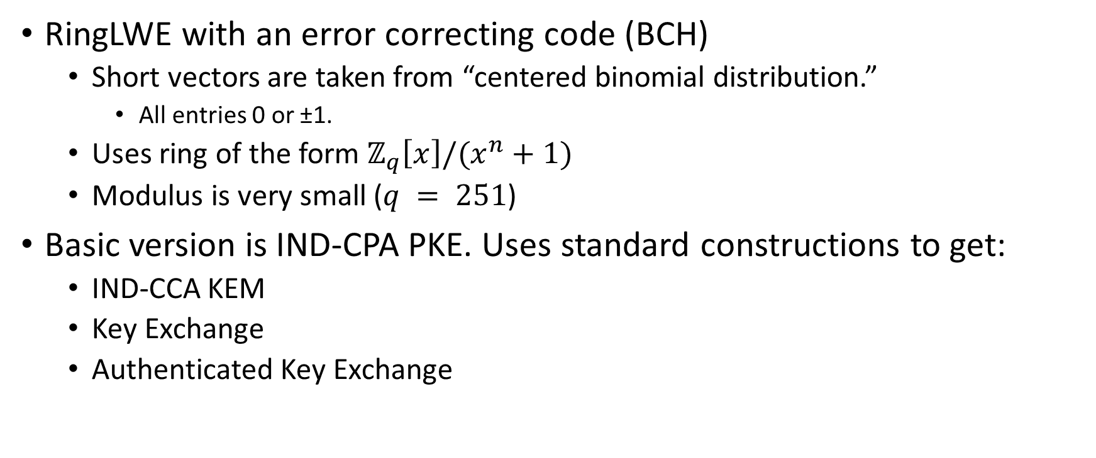
General Summary
RingLWE with an error correcting code (BCH)
  Short vectors are taken from “centered binomial distribution.”
    All entries 0 or ±1.
  Uses ring of the form $ℤ_{q}\left[x\right]/(x^{n}+1)$
  Modulus is very small ($q = 251$)
Basic version is IND-CPA PKE. Uses standard constructions to get:
  IND-CCA KEM
  Key Exchange
  Authenticated Key Exchange

Slide 3
Key Generation

Slide 4
Encryption

Slide 5
Decryption

Slide 6

Error Correction Code
BCH code parameters
  $n_{e}$: length of codeword (usually n)
  $l_{e}$: length of encoded message (usually k)
  $d_{e}$: Minimum distance of the code
  $t_{e}$: Maximum number of errors

Slide 7
“Centered Binomial Distribution”

Slide 8
Parameters

Slide 9
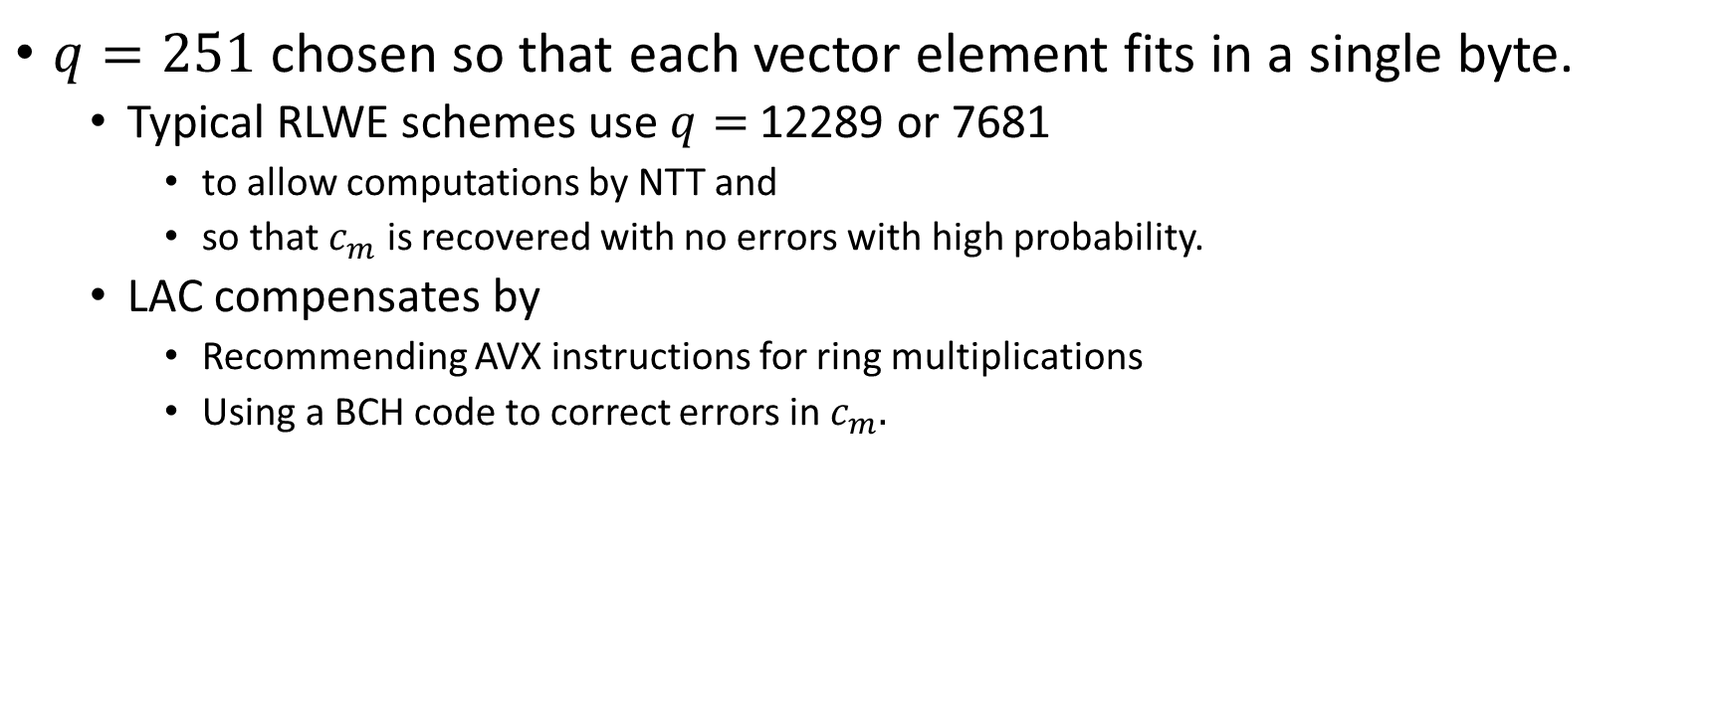
Design rationale
$q=251$ chosen so that each vector element fits in a single byte.
  Typical RLWE schemes use $q=$ 12289 or 7681
    to allow computations by NTT and
    so that $c_{m}$ is recovered with no errors with high probability.
  LAC compensates by
    Recommending AVX instructions for ring multiplications
    Using a BCH code to correct errors in $c_{m}.$

Slide 10
Sizes

Slide 11
Performance (No AVX)

Slide 12
Performance (AVX)

Slide 13
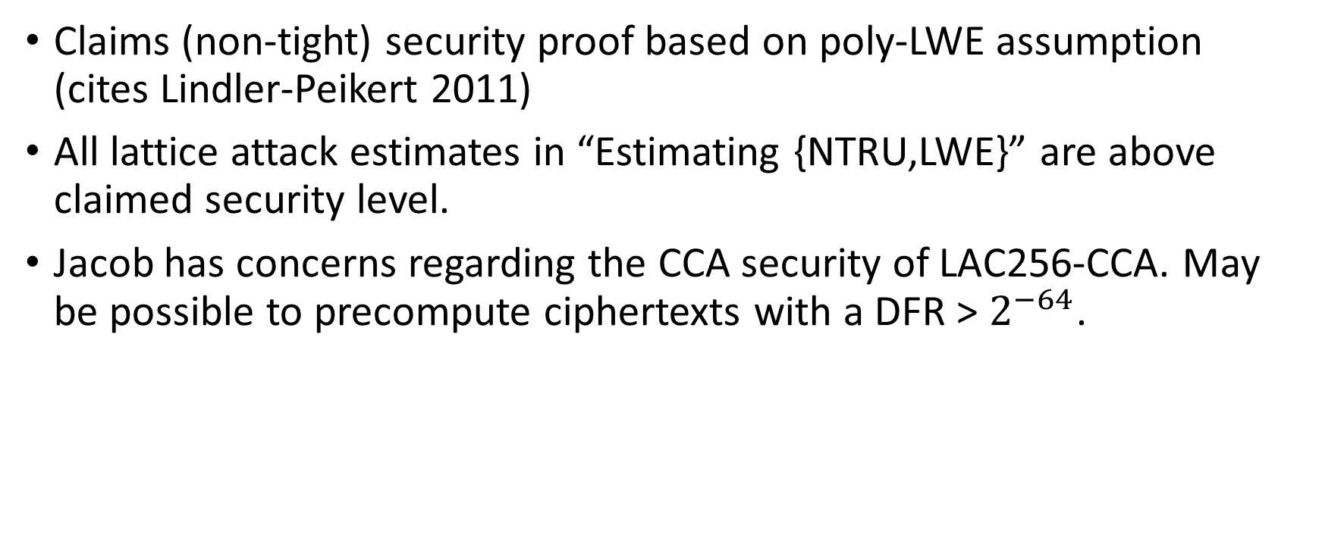
Security
Claims (non-tight) security proof based on poly-LWE assumption (cites Lindler-Peikert 2011)
All lattice attack estimates in “Estimating {NTRU,LWE}” are above claimed security level.
Jacob has concerns regarding the CCA security of LAC256-CCA. May be possible to precompute ciphertexts with a DFR > $2^{−64}$.

Slide 14
Advantages/Limitations
Mostly same as other Ring LWE schemes.
Additional Advantages
  Fast when AVX instructions are available.
  Small public key size (even for RingLWE)
Additional Limitations
  Not quite as fast without AVX (Can’t do NTT.)
  Ciphertext size is not quite as good.
  ECC adds memory complexity
  256-bit parameters may be susceptible to CCA attack.

