Slide 3
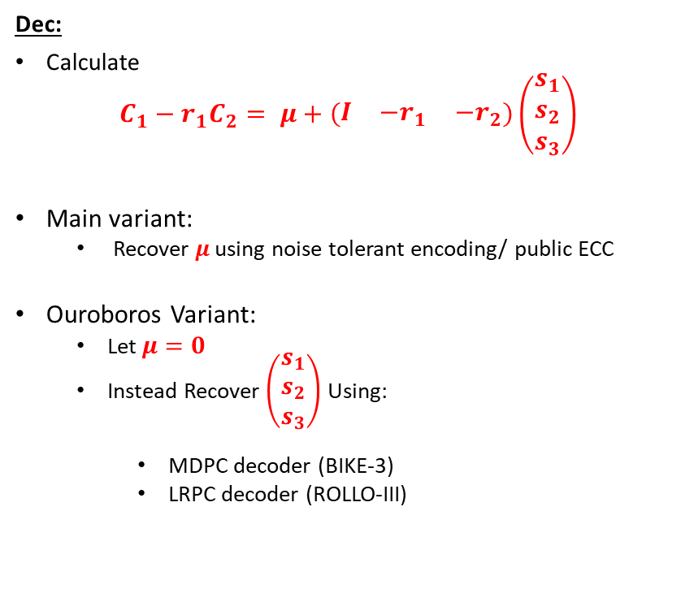
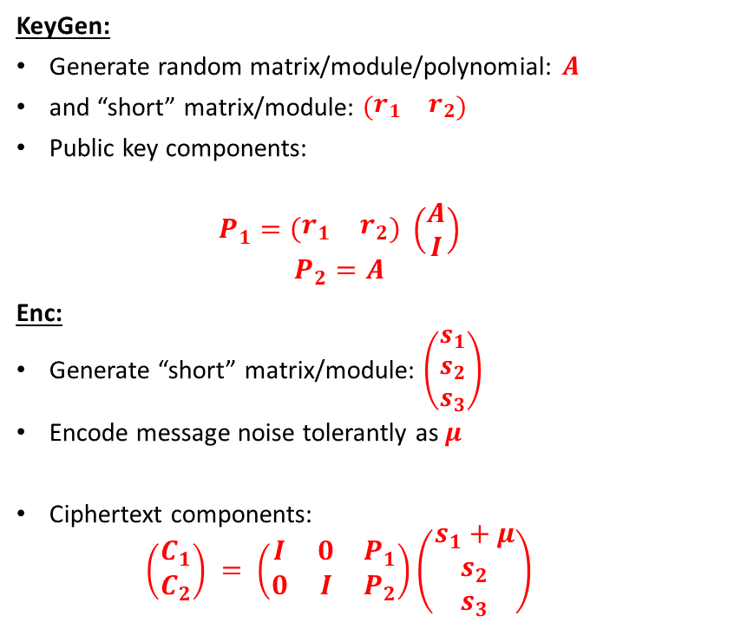
Product LWE (Typical LWE cryptosystem)
KeyGen:
Generate random matrix/module/polynomial: $A$
and “short” matrix/module: $\left(\begin{matrix}r_{1} & r_{2}\end{matrix}\right)$
Public key components:
  $$P_{1}=\left(\begin{matrix}r_{1} & r_{2}\end{matrix}\right) \left(\begin{matrix}A \\ I\end{matrix}\right)$$
  $$P_{2}=A$$
Enc:
Generate “short” matrix/module: $\left(\begin{matrix}s_{1} \\ s_{2} \\ s_{3}\end{matrix}\right)$
Encode message noise tolerantly as $μ$
Ciphertext components:
  $$\left(\begin{matrix}C_{1} \\ C_{2}\end{matrix}\right) = \left(\begin{matrix}I & 0 & P_{1} \\ 0 & I & P_{2}\end{matrix}\right)\left(\begin{matrix}s_{1}+μ \\ s_{2} \\ s_{3}\end{matrix}\right)$$
Dec:
Calculate
$$C_{1}−r_{1}C_{2}= μ+\left(\begin{matrix}I & {−r}_{1} & {−r}_{2}\end{matrix}\right)\left(\begin{matrix}s_{1} \\ s_{2} \\ s_{3}\end{matrix}\right)$$
Main variant:
  Recover $μ$ using noise tolerant encoding/ public ECC
Ouroboros Variant:
  Let $μ=0$
  Instead Recover $\left(\begin{matrix}s_{1} \\ s_{2} \\ s_{3}\end{matrix}\right)$ Using:
    MDPC decoder (BIKE-3)
    LRPC decoder (ROLLO-III)

Slide 4
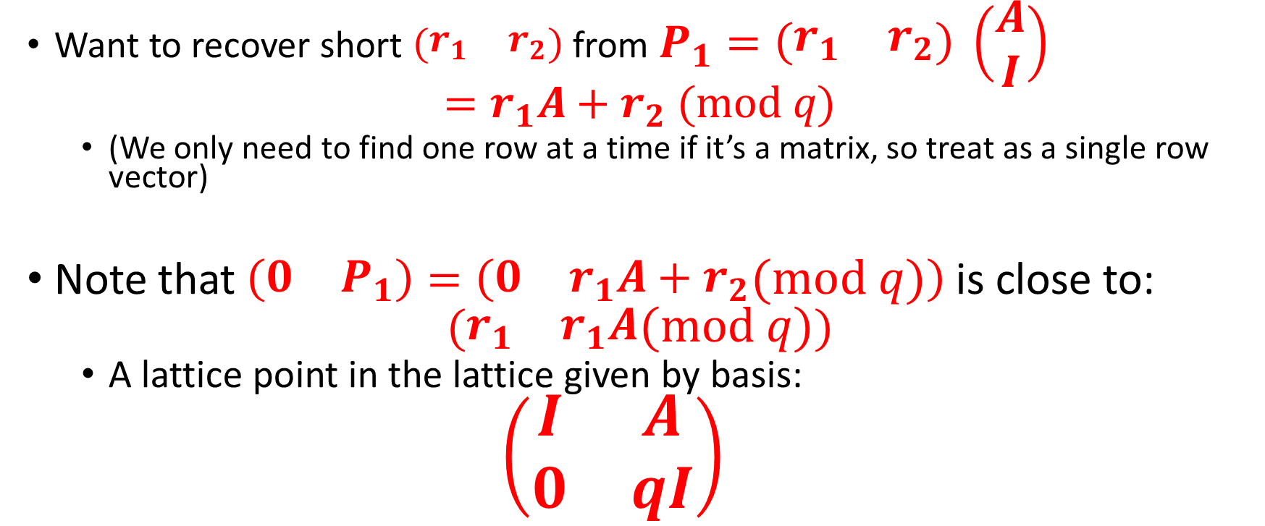
Primal Attack (1):
A lattice associated with LWE
Want to recover short $\left(\begin{matrix}r_{1} & r_{2}\end{matrix}\right)$ from $P_{1}=\left(\begin{matrix}r_{1} & r_{2}\end{matrix}\right) \left(\begin{matrix}A \\ I\end{matrix}\right)$
$$=r_{1}A+r_{2} (mod q)$$
  (We only need to find one row at a time if it’s a matrix, so treat as a single row vector)
Note that $\left(\begin{matrix}0 & P_{1}\end{matrix}\right)=\left(\begin{matrix}0 & r_{1}A+r_{2}\end{matrix}(mod q)\right)$is close to:
$$(\begin{matrix}r_{1} & r_{1}A\end{matrix}(mod q))$$
  A lattice point in the lattice given by basis:
  $$\left(\begin{matrix}I & A \\ 0 & qI\end{matrix}\right)$$

Slide 5
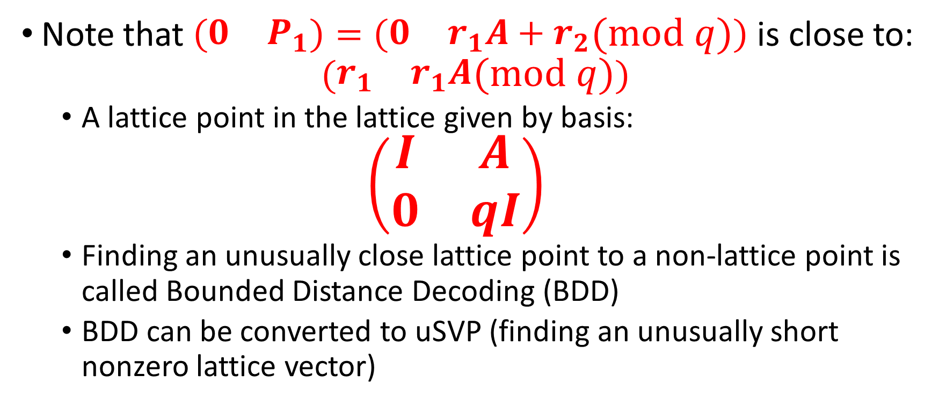
Primal attack (2)
LWE as BDD
Note that $\left(\begin{matrix}0 & P_{1}\end{matrix}\right)=\left(\begin{matrix}0 & r_{1}A+r_{2}\end{matrix}(mod q)\right)$is close to:
$$(\begin{matrix}r_{1} & r_{1}A\end{matrix}(mod q))$$
  A lattice point in the lattice given by basis:
  $$\left(\begin{matrix}I & A \\ 0 & qI\end{matrix}\right)$$
  Finding an unusually close lattice point to a non-lattice point is called Bounded Distance Decoding (BDD)
  BDD can be converted to uSVP (finding an unusually short nonzero lattice vector)

Slide 6
Primal Attack (3)
BDD to uSVP
BDD looks like this:

Slide 7
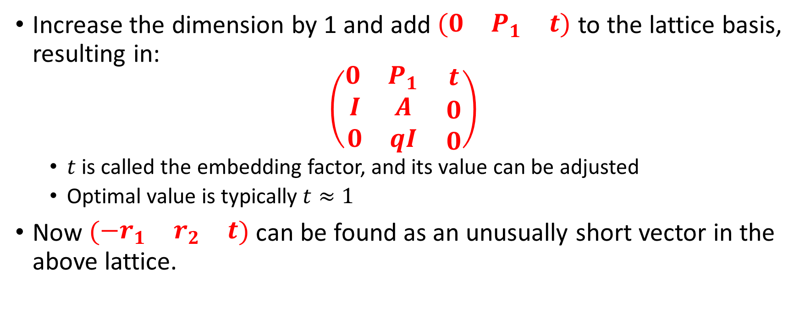
Primal Attack (Final)
LWE recovery as uSVP
Increase the dimension by 1 and add $\left(\begin{matrix}0 & P_{1} & t\end{matrix}\right)$ to the lattice basis, resulting in:
$$\left(\begin{matrix}\begin{matrix}0 & P_{1}\end{matrix} & t \\ \begin{matrix}I & A \\ 0 & qI\end{matrix} & \begin{matrix}0 \\ 0\end{matrix}\end{matrix}\right)$$
  $t$ is called the embedding factor, and its value can be adjusted
  Optimal value is typically $t≈1$
Now $\left(\begin{matrix}−r_{1} & r_{2} & t\end{matrix}\right)$ can be found as an unusually short vector in the above lattice.

Slide 8
Dual Attack

Slide 9
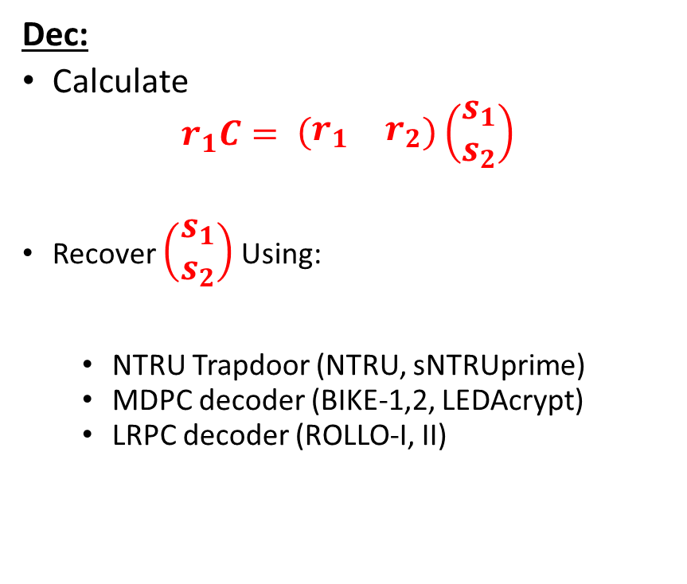
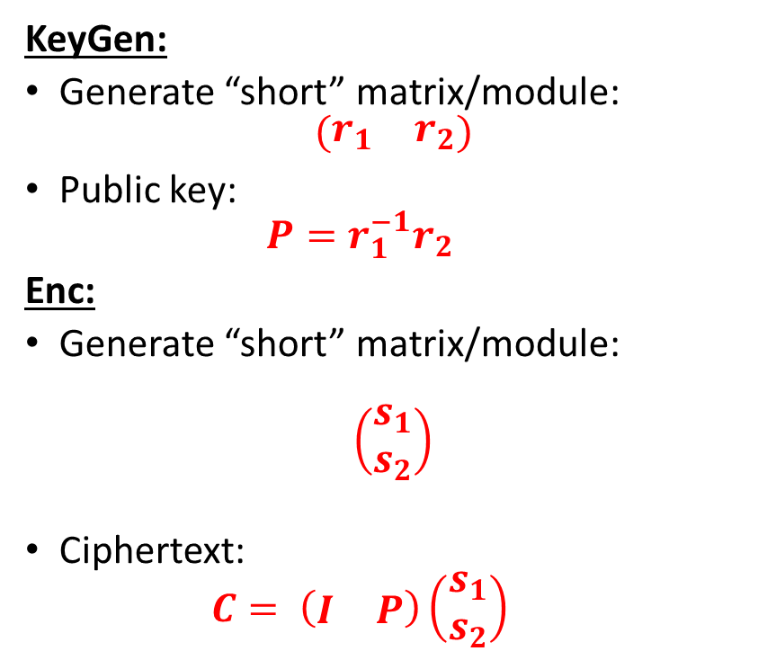
Quotient LWE (NTRU)
KeyGen:
Generate “short” matrix/module:
$$\left(\begin{matrix}r_{1} & r_{2}\end{matrix}\right)$$
Public key:
  $$P=r_{1}^{−1}r_{2}$$
Enc:
Generate “short” matrix/module:
$$\left(\begin{matrix}s_{1} \\ s_{2}\end{matrix}\right)$$
Ciphertext:
  $$C= \left(\begin{matrix}I & P\end{matrix}\right)\left(\begin{matrix}s_{1} \\ s_{2}\end{matrix}\right)$$
Dec:
Calculate
$$r_{1}C= \left(\begin{matrix}r_{1} & r_{2}\end{matrix}\right)\left(\begin{matrix}s_{1} \\ s_{2}\end{matrix}\right)$$
Recover $\left(\begin{matrix}s_{1} \\ s_{2}\end{matrix}\right)$ Using:
  NTRU Trapdoor (NTRU, sNTRUprime)
  MDPC decoder (BIKE-1,2, LEDAcrypt)
  LRPC decoder (ROLLO-I, II)

