Slide 1
Intro to Lattice Reduction Attacks on Lattice-based Crypto

Slide 2
This talk (outline)
BKZ overview (and how it helps break our lattice cryptosystems)
Some nice pictures of lattices
Mathematical tools for reasoning about BKZ
  Lattice determinant, Minkowski, the Gaussian Heuristic, GS Orthoganalization,
  QR factorization, HKZ reduction, the Geometric Series assumption, etc.
Enumeration and Sieving
The Primal attack and the Dual attack (guessing/hybrid attacks?)
How to attack LWE (how to attack NTRU)
  Turning cryptosystems (viewed as LWE/NTRU samples) into bad bases for BKZ
Discussion

Slide 3
Last preliminary issue: Lecture book-keeping
If we have interesting discussion along the way or if a speaker makes good comments not on slides, it would be good to keep an ongoing record of this on Sharepoint (where anyone can access it later).
I recommend we adopt the “scribing” model, akin to lectures in a grad school course on a specialized topic
  Person A is giving a talk; Person B will be a scribe (Dustin is scribe today)
    Everyone tries to sign up for each job at most once, in a “rotating schedule”
  Person A prepares slides from a paper, gives a talk to the group
  Person B writes 1-2 pages of notes (in LaTeX?) capturing the main ideas,
  and uploads it somewhere (Sharepoint?) so that we can all access it later

Slide 4
Ok, let’s get started. ☺

Slide 5
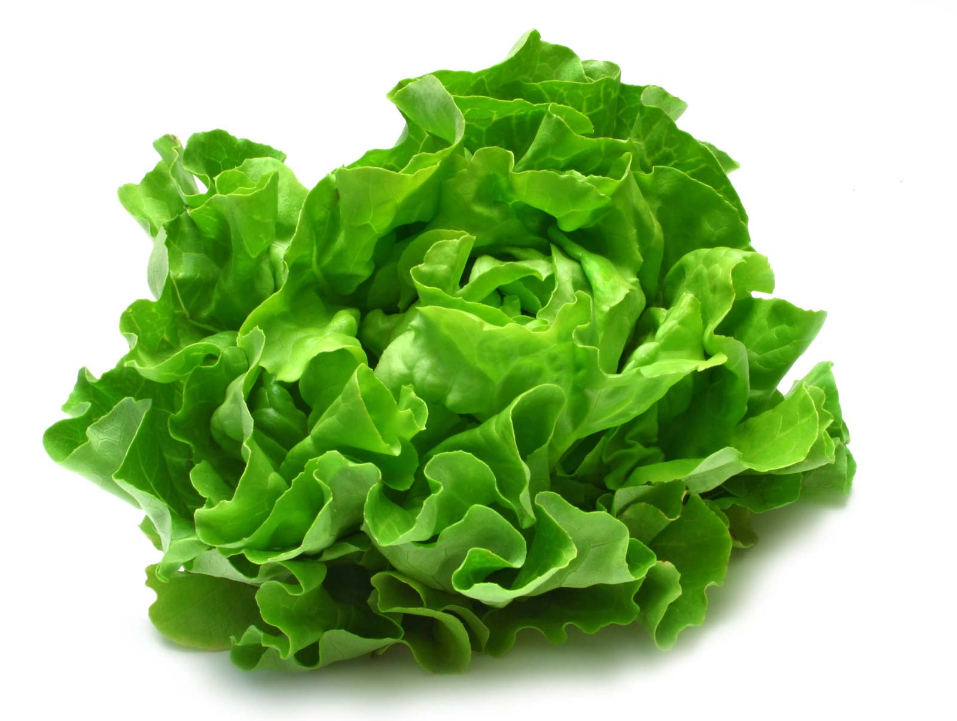
Lettuces
This is a lettuce

Slide 6
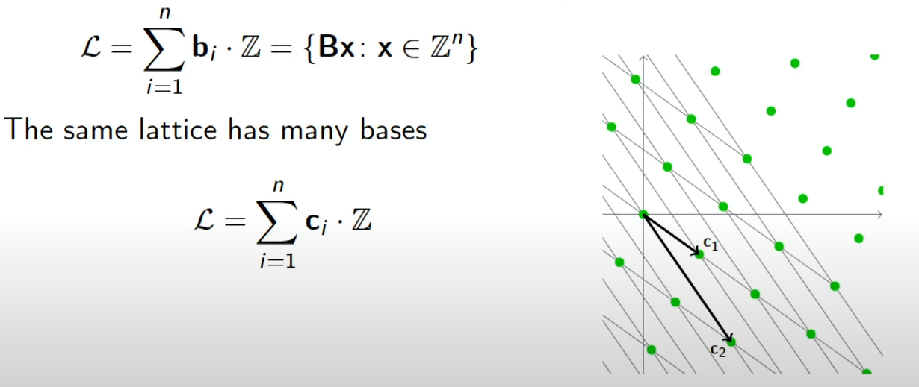
Lettuces Lattices
A lattice is the set of all integer linear combinations of linearly independent basis vectors B = {b₁, …, b_{n}} in R^{n}

Slide 7
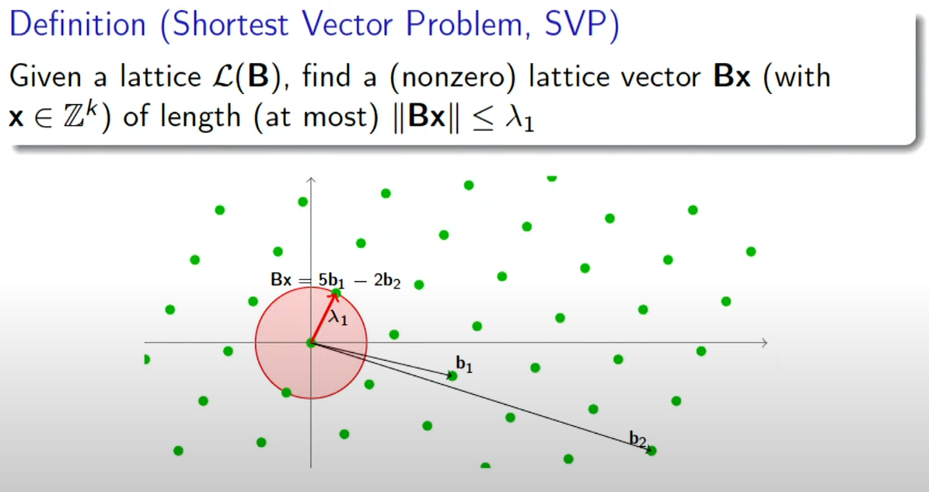

Slide 8
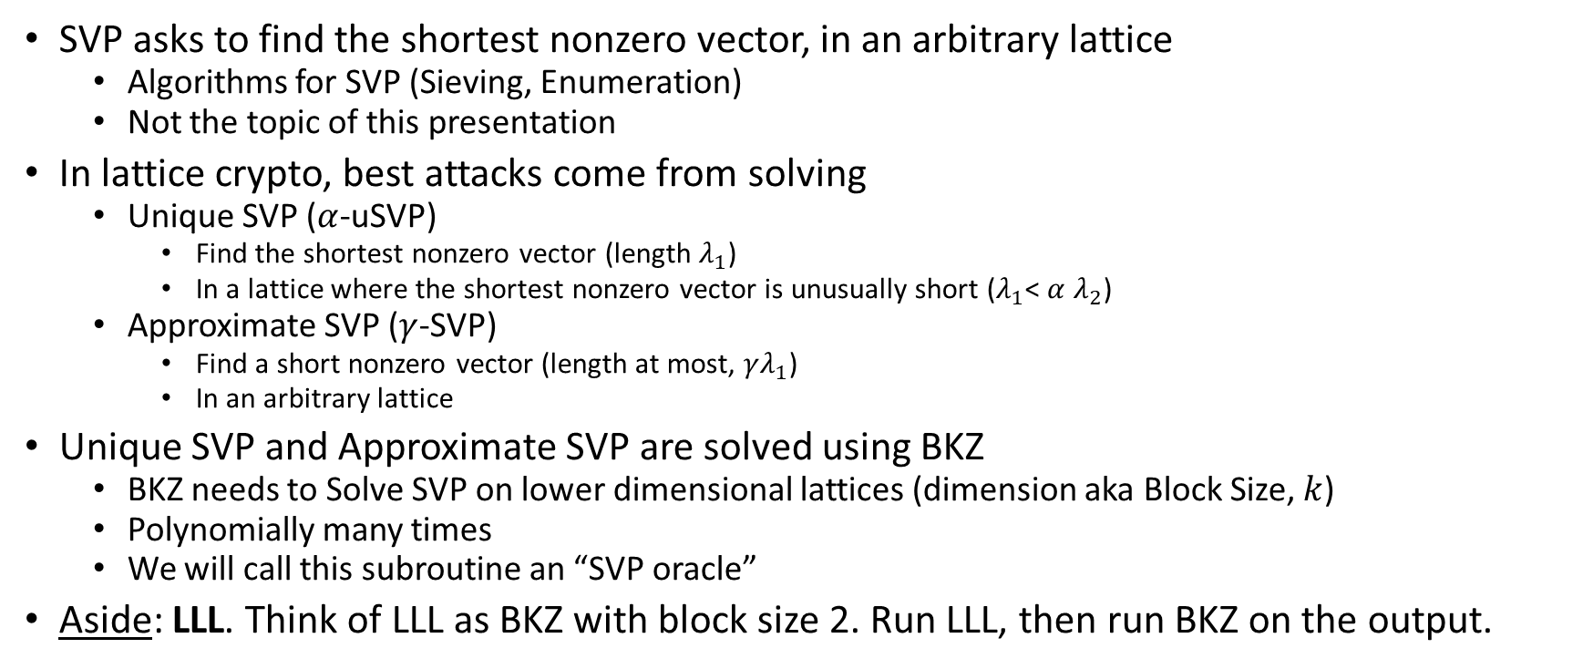
BKZ Overview
SVP asks to find the shortest nonzero vector, in an arbitrary lattice
  Algorithms for SVP (Sieving, Enumeration)
  Not the topic of this presentation
In lattice crypto, best attacks come from solving
  Unique SVP ($α$-uSVP)
    Find the shortest nonzero vector (length $λ_{1}$)
    In a lattice where the shortest nonzero vector is unusually short ($λ_{1}$< $α$ $λ_{2}$)
  Approximate SVP ($γ$-SVP)
    Find a short nonzero vector (length at most, $γλ_{1}$)
    In an arbitrary lattice
Unique SVP and Approximate SVP are solved using BKZ
  BKZ needs to Solve SVP on lower dimensional lattices (dimension aka Block Size, $k$)
  Polynomially many times
  We will call this subroutine an “SVP oracle”
Aside: LLL. Think of LLL as BKZ with block size 2. Run LLL, then run BKZ on the output.

Slide 9
Tools for reasoning about BKZ
Lattice Determinant
Minkowski’s theorem
Gaussian Heuristic
Gram-Schmidt Orthogonalization
QR factorization
Geometric Series Assumption

Slide 10
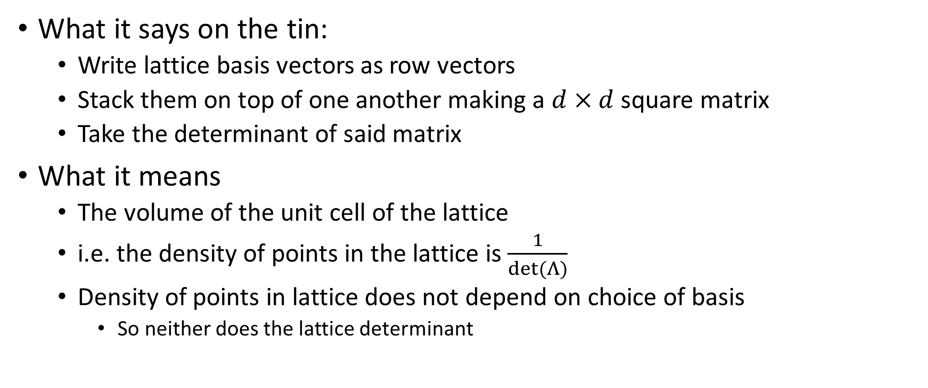

Lattice Determinant $det⁡(Λ)$
What it says on the tin:
  Write lattice basis vectors as row vectors
  Stack them on top of one another making a $d×d$ square matrix
  Take the determinant of said matrix
What it means
  The volume of the unit cell of the lattice
  i.e. the density of points in the lattice is $\frac{1}{det⁡(Λ)}$
  Density of points in lattice does not depend on choice of basis
    So neither does the lattice determinant

Slide 11


Using $det⁡(Λ)$ to Bound/Estimate $λ_{1}$
Minkowski’s theorem
$$λ_{1}≤\sqrt{d}∙{(det⁡(Λ))}^{\frac{1}{d}}$$
Gaussian Heuristic
$$λ_{1}≈\sqrt{\frac{d}{2πe}}∙{(det⁡(Λ))}^{\frac{1}{d}}$$

Slide 12
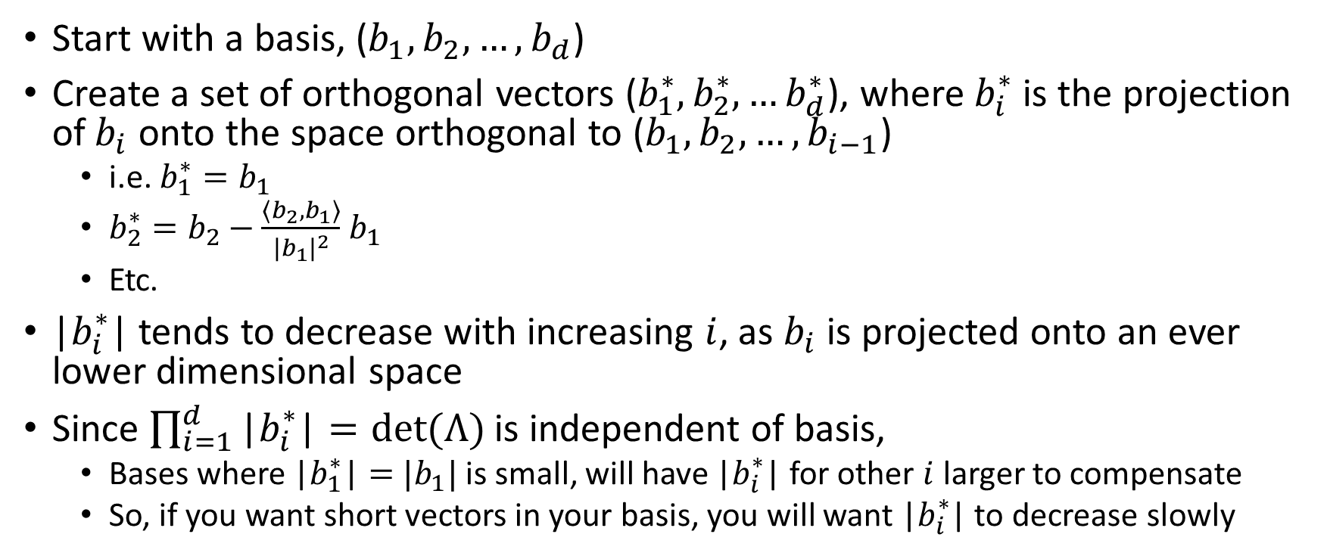
Gram Schmidt Orthogonalization
Start with a basis, ($b_{1}, b_{2}, …, b_{d}$)
Create a set of orthogonal vectors ($b_{1}^{∗},b_{2}^{∗},…b_{d}^{∗}$), where $b_{i}^{∗}$ is the projection of$b_{i}$ onto the space orthogonal to ($b_{1}, b_{2}, …, b_{i−1}$)
  i.e. $b_{1}^{∗}=b_{1}$
  $b_{2}^{∗}=b_{2}−\frac{\left\langle b_{2},b_{1}\right\rangle }{{|b_{1}|}^{2}}$ $b_{1}$
  Etc.
|$b_{i}^{∗}$| tends to decrease with increasing $i$, as $b_{i}$ is projected onto an ever lower dimensional space
Since $\prod_{i=1}^{d}{\text{|}b_{i}^{∗}\text{|}=det⁡(Λ)}$ is independent of basis,
  Bases where $\text{|}b_{1}^{∗}\text{|}=$ $|b_{1}|$ is small, will have $\text{|}b_{i}^{∗}\text{|}$ for other $i$ larger to compensate
  So, if you want short vectors in your basis, you will want |$b_{i}^{∗}$| to decrease slowly

Slide 13
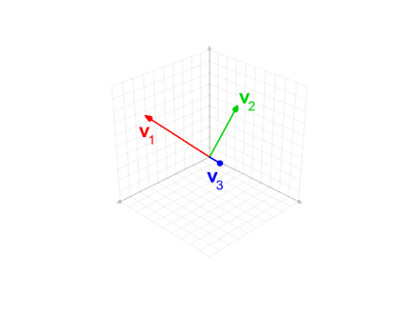

Slide 14


Lattice reduction and Gram-Schmidt norm
Bad Basis
Good Basis
$$\left|b_{i}^{∗}\right|$$
$$i$$

Slide 15
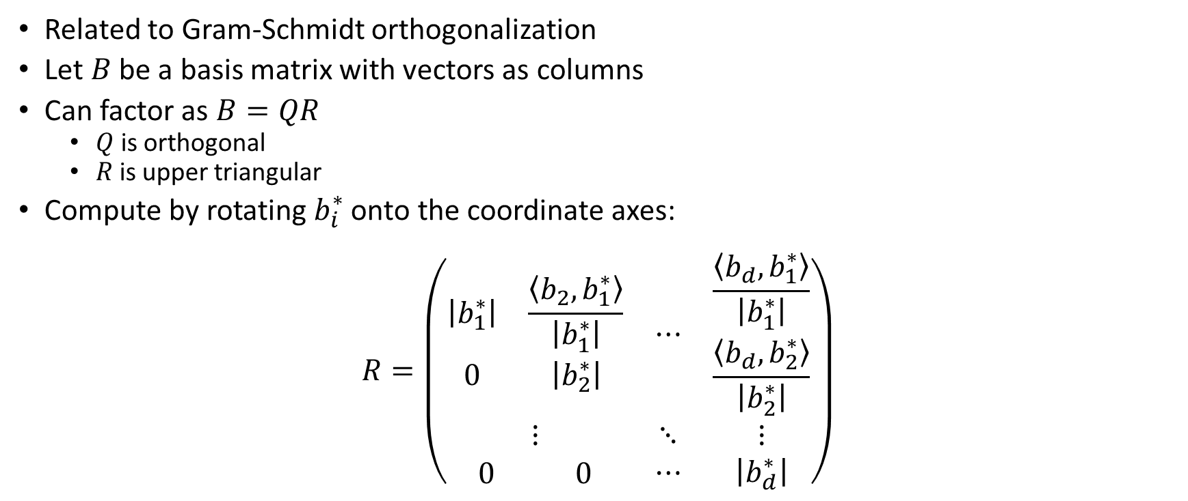
QR factorization
Related to Gram-Schmidt orthogonalization
Let $B$ be a basis matrix with vectors as columns
Can factor as $B=QR$
  $Q$ is orthogonal
  $R$ is upper triangular
Compute by rotating $b_{i}^{∗}$ onto the coordinate axes:
$$R=\left(\begin{matrix}\begin{matrix}\left|b_{1}^{∗}\right| & \frac{\left\langle b_{2},b_{1}^{∗}\right\rangle }{\left|b_{1}^{∗}\right|} \\ 0 & \left|b_{2}^{∗}\right|\end{matrix} & ⋯ & \begin{matrix}\frac{\left\langle b_{d},b_{1}^{∗}\right\rangle }{\left|b_{1}^{∗}\right|} \\ \frac{\left\langle b_{d},b_{2}^{∗}\right\rangle }{\left|b_{2}^{∗}\right|}\end{matrix} \\ ⋮ & ⋱ & ⋮ \\ \begin{matrix}0 & 0\end{matrix} & ⋯ & \left|b_{d}^{∗}\right|\end{matrix}\right)$$

Slide 16
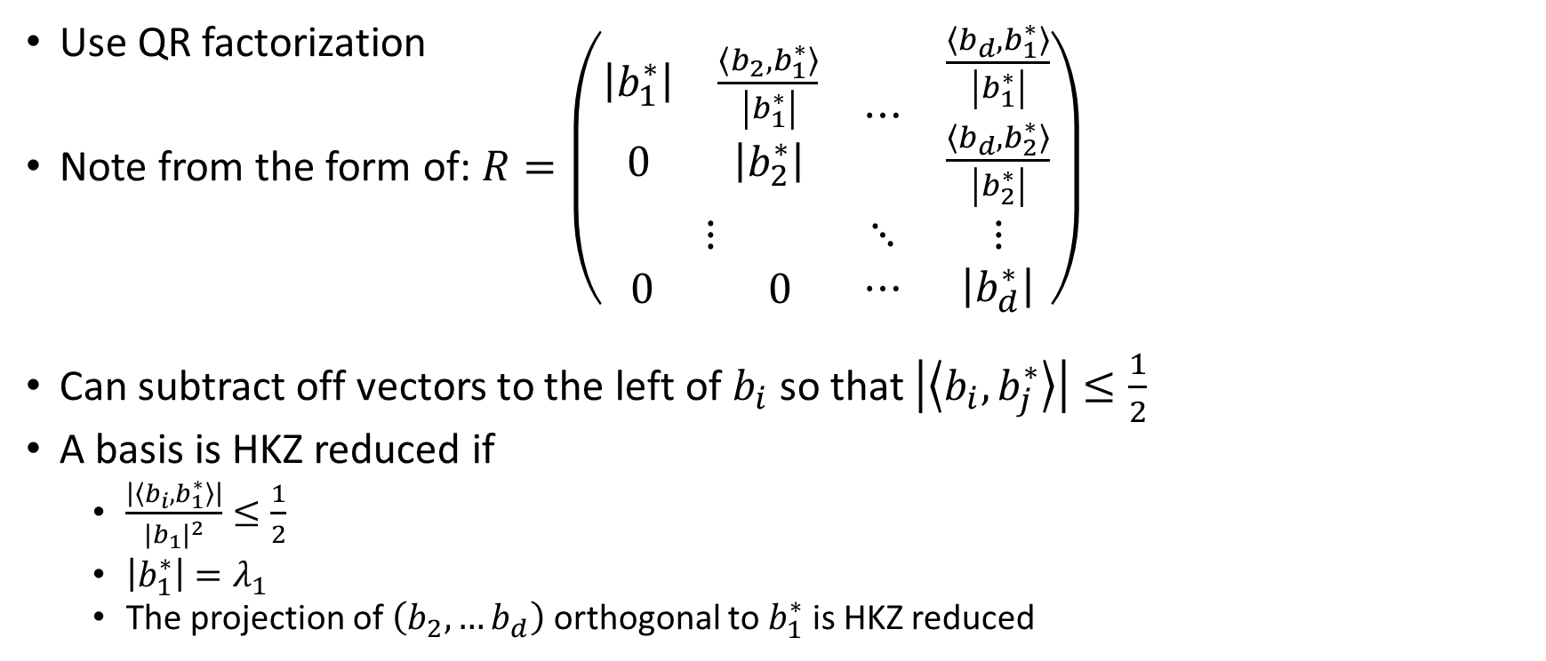
HKZ reduction
(What to do with an SVP oracle)
Use QR factorization
Note from the form of: $R=\left(\begin{matrix}\begin{matrix}\left|b_{1}^{∗}\right| & \frac{\left\langle b_{2},b_{1}^{∗}\right\rangle }{\left|b_{1}^{∗}\right|} \\ 0 & \left|b_{2}^{∗}\right|\end{matrix} & ⋯ & \begin{matrix}\frac{\left\langle b_{d},b_{1}^{∗}\right\rangle }{\left|b_{1}^{∗}\right|} \\ \frac{\left\langle b_{d},b_{2}^{∗}\right\rangle }{\left|b_{2}^{∗}\right|}\end{matrix} \\ ⋮ & ⋱ & ⋮ \\ \begin{matrix}0 & 0\end{matrix} & ⋯ & \left|b_{d}^{∗}\right|\end{matrix}\right)$
Can subtract off vectors to the left of $b_{i}$ so that $\left|\left\langle b_{i},b_{j}^{∗}\right\rangle \right|≤\frac{1}{2}$
A basis is HKZ reduced if
  $\frac{\left|\left\langle b_{i},b_{1}^{∗}\right\rangle \right|}{{|b_{1}|}^{2}}≤\frac{1}{2}$
  $\left|b_{1}^{∗}\right|=λ_{1}$
  The projection of $\left(b_{2},…b_{d}\right)$ orthogonal to $b_{1}^{∗}$ is HKZ reduced

Slide 17
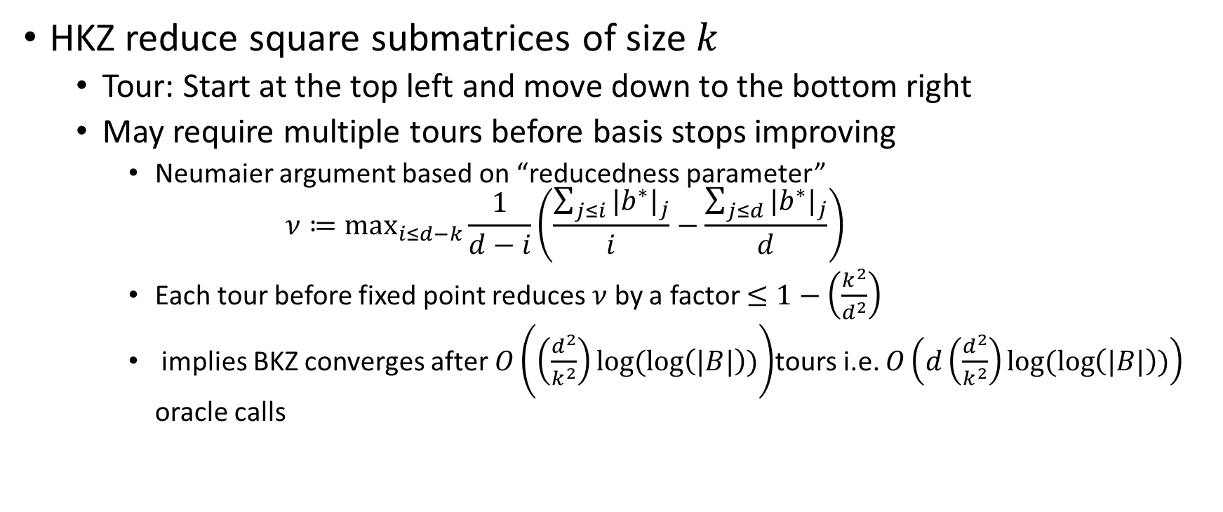
BKZ algorithm
HKZ reduce square submatrices of size $k$
  Tour: Start at the top left and move down to the bottom right
  May require multiple tours before basis stops improving
    Neumaier argument based on “reducedness parameter”
    $$ν≔\max_{i≤d−k}\frac{1}{d−i}\left(\frac{\sum_{j≤i}{{|b^{∗}|}_{j}}}{i}−\frac{\sum_{j≤d}{{|b^{∗}|}_{j}}}{d}\right)$$
    Each tour before fixed point reduces $ν$ by a factor $≤1−\left(\frac{k^{2}}{d^{2}}\right)$
    implies BKZ converges after $O\left(\left(\frac{d^{2}}{k^{2}}\right)log⁡(\log\left(|B|\right))\right)$tours i.e. $O\left(d\left(\frac{d^{2}}{k^{2}}\right)log⁡(\log\left(|B|\right))\right)$ oracle calls

Slide 18
Sandpile model illustration
(From 2016 presentation by Stehlé https://wheat2016.lip6.fr/HEAT_Paris_Damien.pdf)

Slide 19
Sandpile model illustration
(From 2016 presentation by Stehlé https://wheat2016.lip6.fr/HEAT_Paris_Damien.pdf)

Slide 20
Sandpile model illustration
(From 2016 presentation by Stehlé https://wheat2016.lip6.fr/HEAT_Paris_Damien.pdf)

Slide 21
Sandpile model illustration
(From 2016 presentation by Stehlé https://wheat2016.lip6.fr/HEAT_Paris_Damien.pdf)

Slide 22
Sandpile model illustration
(From 2016 presentation by Stehlé https://wheat2016.lip6.fr/HEAT_Paris_Damien.pdf)

Slide 23
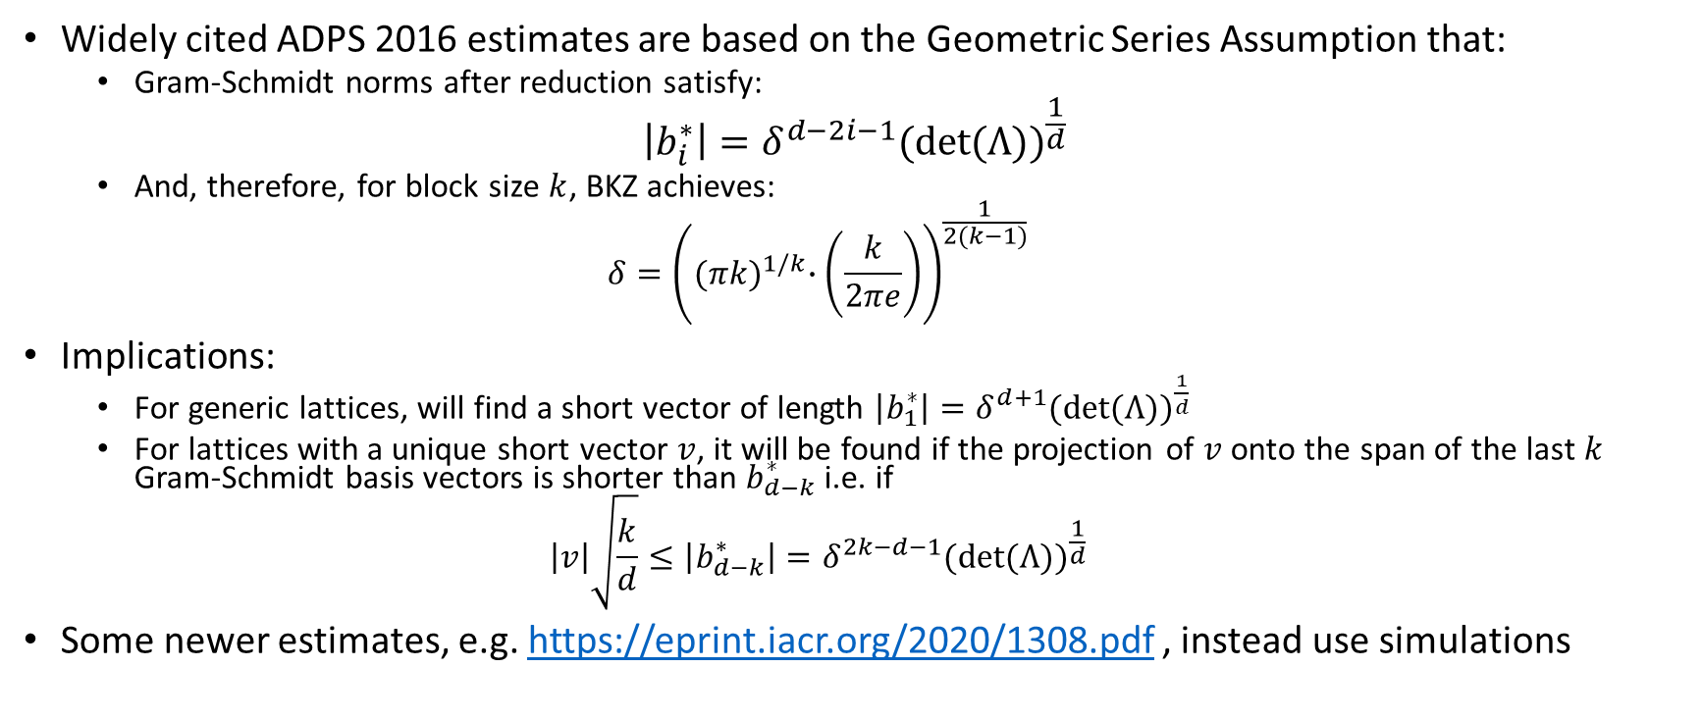
BKZ basis quality
Widely cited ADPS 2016 estimates are based on the Geometric Series Assumption that:
  Gram-Schmidt norms after reduction satisfy:
$$\left|b_{i}^{∗}\right|=δ^{d−2i−1}{(det⁡(Λ))}^{\frac{1}{d}}$$
  And, therefore, for block size $k$, BKZ achieves:
  $$δ={\left({(πk)}^{1/k}∙\left(\frac{k}{2πe}\right)\right)}^{\frac{1}{2(k−1)}}$$
Implications:
  For generic lattices, will find a short vector of length $\left|b_{1}^{∗}\right|=δ^{d+1}{(det⁡(Λ))}^{\frac{1}{d}}$
  For lattices with a unique short vector $v$, it will be found if the projection of $v$ onto the span of the last $k$ Gram-Schmidt basis vectors is shorter than $b_{d−k}^{∗}$ i.e. if
  $$\left|v\right|\sqrt{\frac{k}{d}}≤\left|b_{d−k}^{∗}\right|=δ^{2k−d−1}{(det⁡(Λ))}^{\frac{1}{d}}$$
Some newer estimates, e.g. https://eprint.iacr.org/2020/1308.pdf , instead use simulations

Slide 24
More Accurate BKZ Profile (log scale)
(From 2016 presentation by Stehlé https://wheat2016.lip6.fr/HEAT_Paris_Damien.pdf)
Note GSA profile would be a straight line:

Slide 25
What About the SVP Oracle?

Slide 26
Two Strategies for solving exact SVP
Enumeration
  Asymptotically worse, but
    Not memory intensive
    Can be sped up by Grover’s algorithm
  Was used for some older security estimates of lattice based crypto
Sieving
  Asymptotically better, but
    Needs lots of memory
    Little if any quantum speedup
  New techniques like “Progressive Sieving,” and “Dimensions for Free” have made Sieving better in practice
  Universally used fo lattice security estimates now.

Slide 27
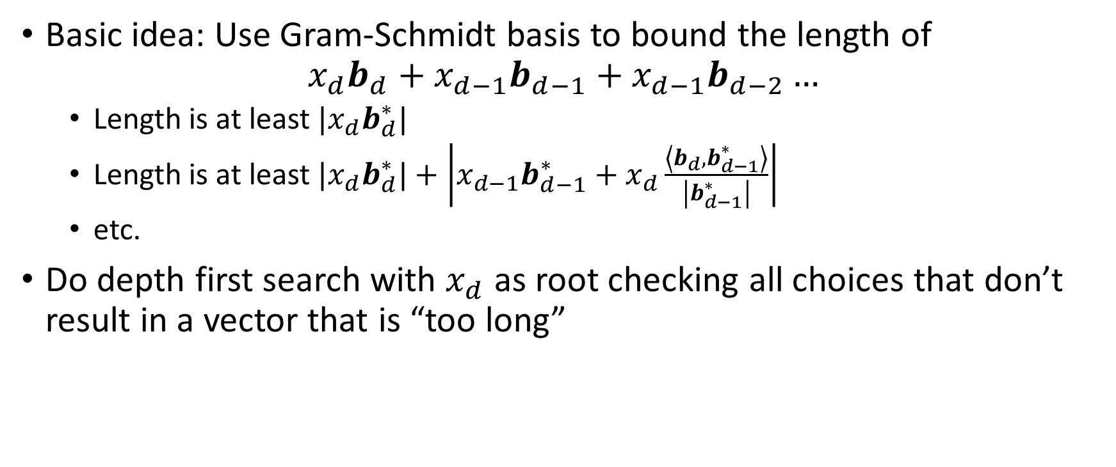
Enumeration 1
Basic idea: Use Gram-Schmidt basis to bound the length of
$$x_{d}b_{d}+x_{d−1}b_{d−1}+x_{d−1}b_{d−2}…$$
  Length is at least ${{|x}_{d}b}_{d}^{∗}|$
  Length is at least ${{|x}_{d}b}_{d}^{∗}|+\left|{x_{d−1}b}_{d−1}^{∗}+x_{d}\frac{\left\langle b_{d},b_{d−1}^{∗}\right\rangle }{\left|b_{d−1}^{∗}\right|}\right|$
  etc.
Do depth first search with $x_{d}$ as root checking all choices that don’t result in a vector that is “too long”

Slide 28
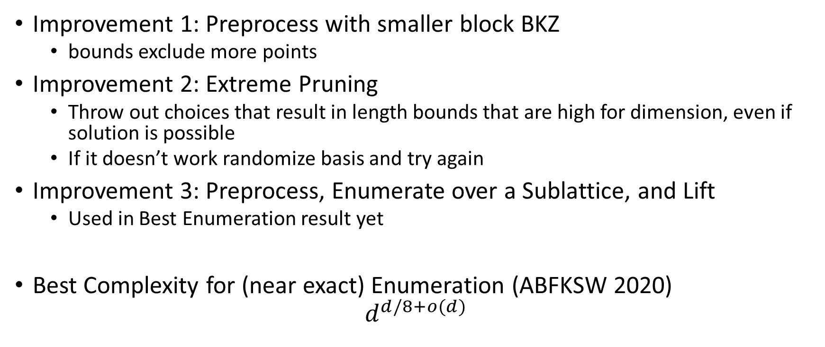
Enumeration 2
Improvement 1: Preprocess with smaller block BKZ
  bounds exclude more points
Improvement 2: Extreme Pruning
  Throw out choices that result in length bounds that are high for dimension, even if solution is possible
  If it doesn’t work randomize basis and try again
Improvement 3: Preprocess, Enumerate over a Sublattice, and Lift
  Used in Best Enumeration result yet
Best Complexity for (near exact) Enumeration (ABFKSW 2020)
$$d^{d/8+o(d)}$$

Slide 29
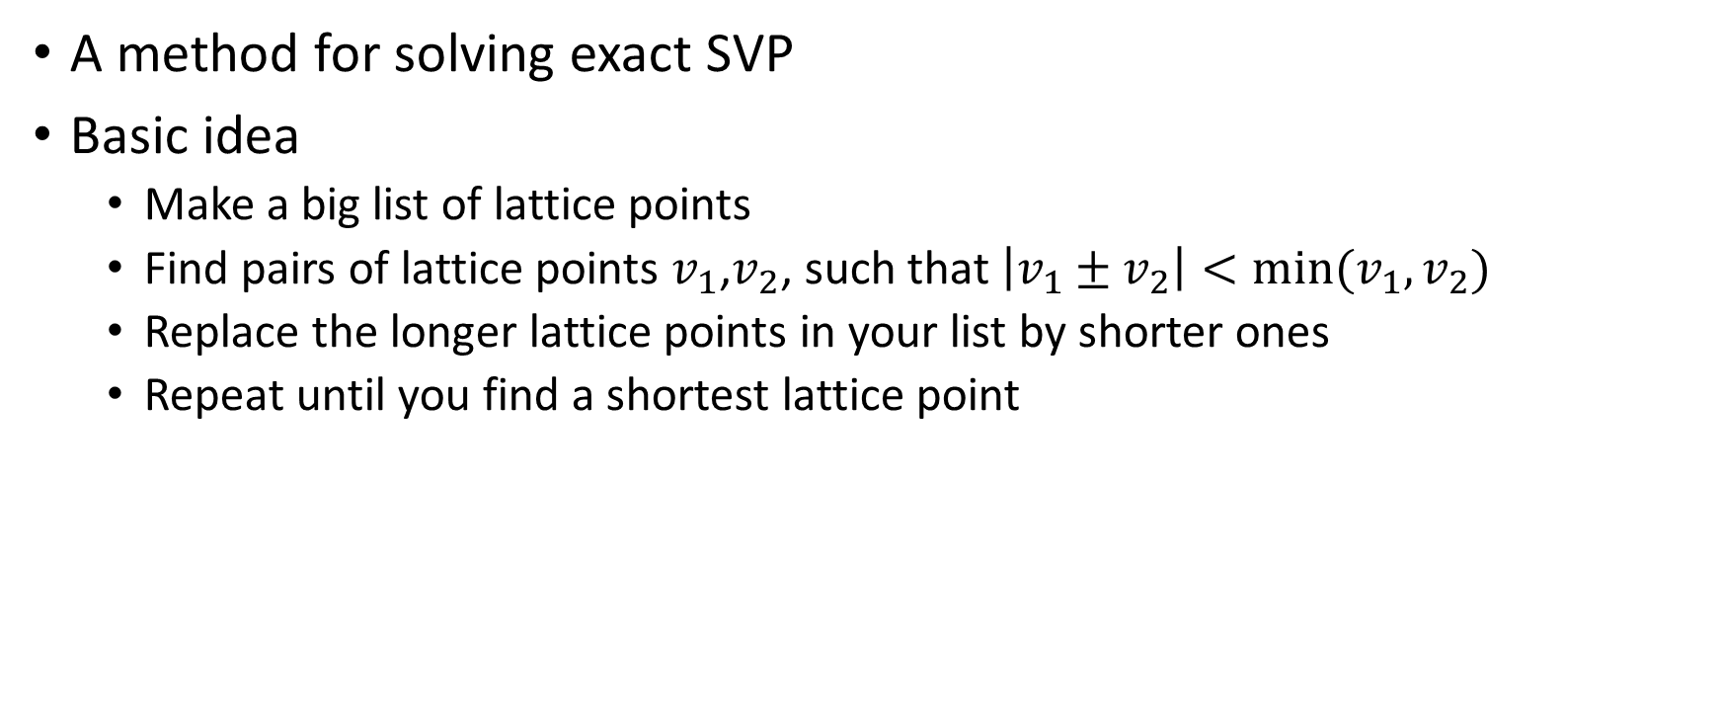
Sieving 1
A method for solving exact SVP
Basic idea
  Make a big list of lattice points
  Find pairs of lattice points $v_{1}$,$v_{2}$, such that $\left|v_{1}±v_{2}\right|<min⁡(v_{1},v_{2})$
  Replace the longer lattice points in your list by shorter ones
  Repeat until you find a shortest lattice point

Slide 30
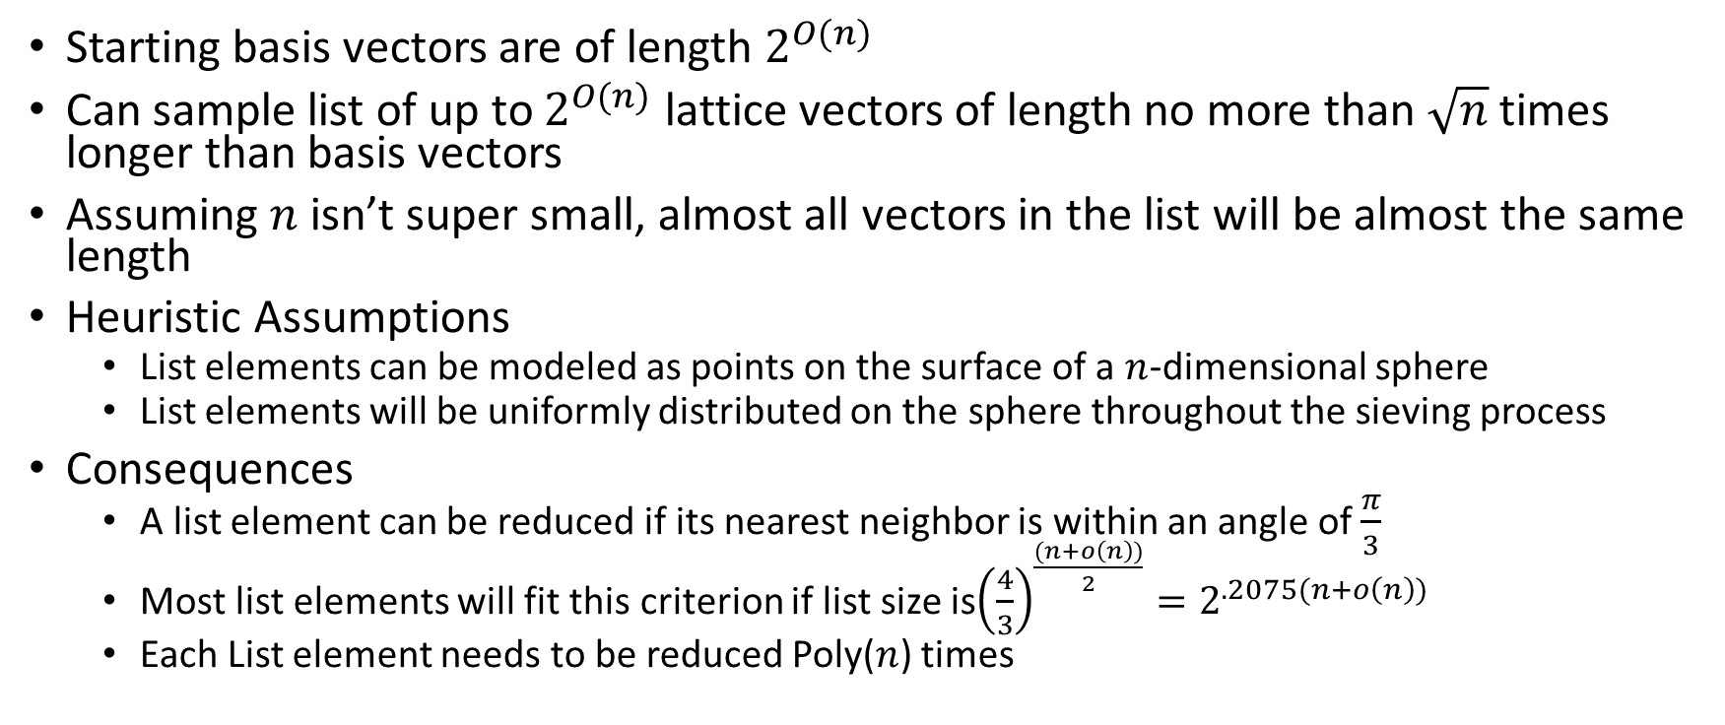
Assumptions for Heuristic Sieving
Starting basis vectors are of length $2^{O(n)}$
Can sample list of up to $2^{O(n)}$ lattice vectors of length no more than $\sqrt{n}$ times longer than basis vectors
Assuming $n$ isn’t super small, almost all vectors in the list will be almost the same length
Heuristic Assumptions
  List elements can be modeled as points on the surface of a $n$-dimensional sphere
  List elements will be uniformly distributed on the sphere throughout the sieving process
Consequences
  A list element can be reduced if its nearest neighbor is within an angle of $\frac{π}{3}$
  Most list elements will fit this criterion if list size is${\left(\frac{4}{3}\right)}^{\frac{(n+o\left(n\right))}{2}}=2^{.2075(n+o\left(n\right))}$
  Each List element needs to be reduced Poly($n$) times

Slide 31




Sieving Progress (Locally Sensitive Hashing)
The Basic NV Sieve and Gauss sieve compare every list vector to every other list vector to find pairs that will reduce
BGJ15 sorts list vectors into buckets that are more likely to contain nearest neighbors than same-size random sub-lists
BGDL16 uses list decoding of product codes to more efficiently assign buckets.
$v$ passes
$$s_{ij}$$
$v$ fails
$$α$$

Slide 32

How Good is Sieving?
Diagram from BGDL16 paper
Best Time, Space complexity is
$2^{.292d+o(d)}$, $2^{.208d+o(d)}$

Slide 33
Asymptotically Minor Speedups
Progressive Sieving
  Start out sieving sublattices (smaller dimension) to get a list of relatively short vectors
    Gets rid of the cost of having to reduce every vector polynomially many times
    Since most reductions happen at a lower dimension, the cost is dominated by the last reductions
Dimensions for free
  Sieving doesn’t just give the shortest vector in the lattice, but an exponentially large list of short vectors
  Can get the shortest vector, by sieving a slightly lower-dimensional projected lattice, and keeping the whole list as candidates
    Lift Candidates to see if they are shortest

Slide 34
Turning NTRU and LWE into Lattice Problems

Slide 35
Attacks and Lattice Problems
LWE and NTRU style cryptosystems get unique SVP and approximate SVP instances via various attack strategies:
  LWE (NewHope ADPS2016 terminology):
    Primal: uSVP
    Dual: Approximate SVP
  NTRU
    “Primal”, “Dual” attack
      Numbers are cited for “Primal” and “Dual” attack in NewHope paper
      Obvious analogy attempts message recovery where LWE attack would attempt key recovery
      Both of these can be uSVP (Approximate SVP may be relevant too for dual)
    Coppersmith-Shamir97, extended by May99 (this is called “Primal” in NTRU spec.): uSVP
    Howgrave-Graham05: Hybrid meet in the middle uSVP
We will study these strategies in the next few slides

Slide 36
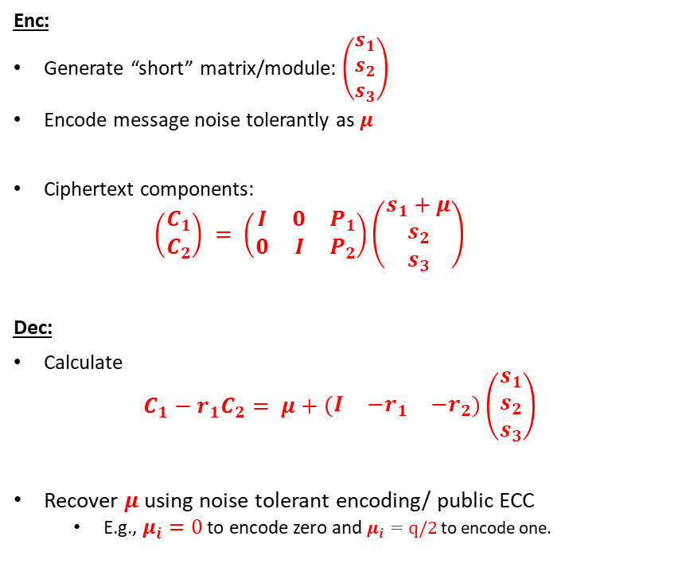
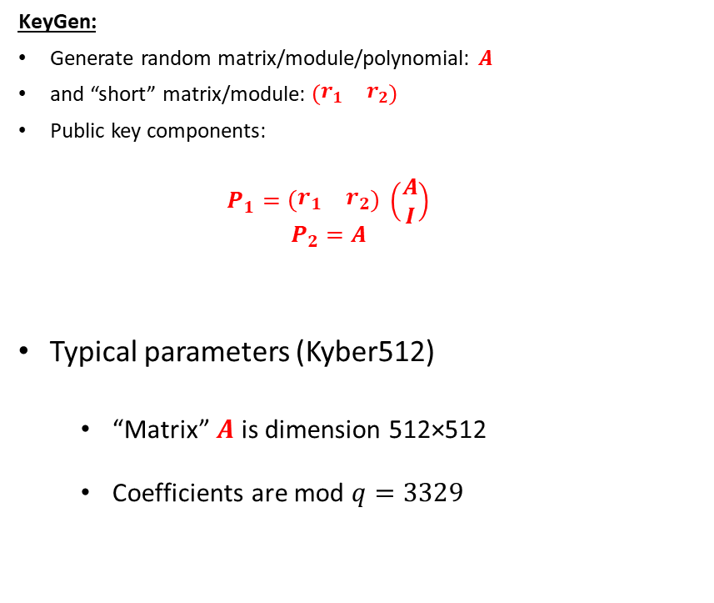
Typical LWE cryptosystem
KeyGen:
Generate random matrix/module/polynomial: $A$
and “short” matrix/module: $\left(\begin{matrix}r_{1} & r_{2}\end{matrix}\right)$
Public key components:
  $$P_{1}=\left(\begin{matrix}r_{1} & r_{2}\end{matrix}\right) \left(\begin{matrix}A \\ I\end{matrix}\right)$$
  $$P_{2}=A$$
Typical parameters (Kyber512)
  “Matrix” $A$ is dimension 512×512
  Coefficients are mod $q=3329$
Enc:
Generate “short” matrix/module: $\left(\begin{matrix}s_{1} \\ s_{2} \\ s_{3}\end{matrix}\right)$
Encode message noise tolerantly as $μ$
Ciphertext components:
  $$\left(\begin{matrix}C_{1} \\ C_{2}\end{matrix}\right) = \left(\begin{matrix}I & 0 & P_{1} \\ 0 & I & P_{2}\end{matrix}\right)\left(\begin{matrix}s_{1}+μ \\ s_{2} \\ s_{3}\end{matrix}\right)$$
Dec:
Calculate
$$C_{1}−r_{1}C_{2}= μ+\left(\begin{matrix}I & {−r}_{1} & {−r}_{2}\end{matrix}\right)\left(\begin{matrix}s_{1} \\ s_{2} \\ s_{3}\end{matrix}\right)$$
Recover $μ$ using noise tolerant encoding/ public ECC
  E.g., $μ_{i}=0$ to encode zero and $μ_{i}=q/2$ to encode one.

Slide 37
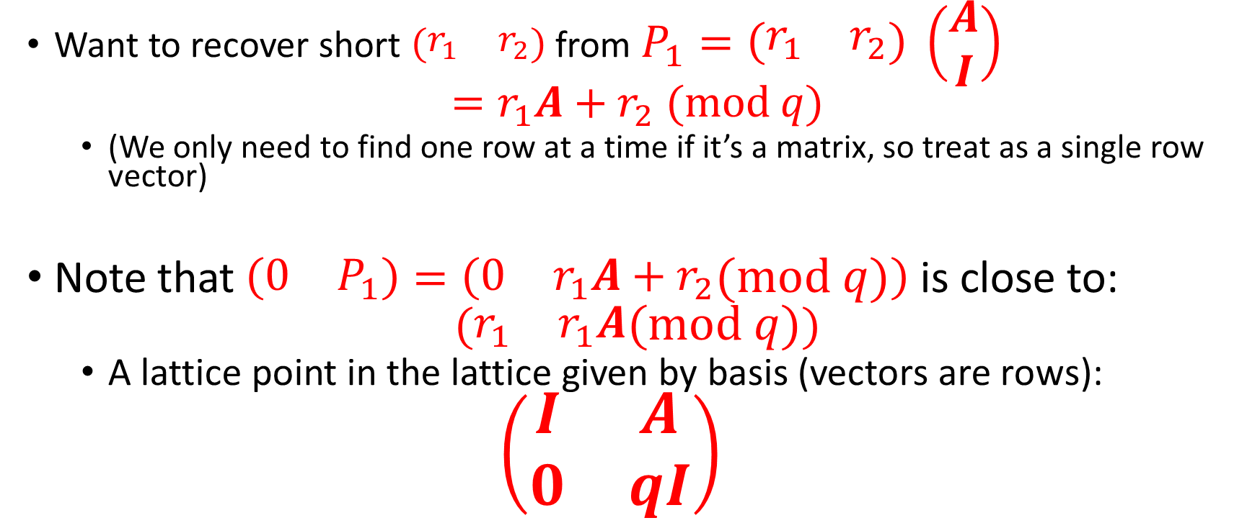
Primal Attack (1/3):
A lattice associated with LWE
Want to recover short $\left(\begin{matrix}r_{1} & r_{2}\end{matrix}\right)$ from $P_{1}=\left(\begin{matrix}r_{1} & r_{2}\end{matrix}\right) \left(\begin{matrix}A \\ I\end{matrix}\right)$
$$=r_{1}A+r_{2} (mod q)$$
  (We only need to find one row at a time if it’s a matrix, so treat as a single row vector)
Note that $\left(\begin{matrix}0 & P_{1}\end{matrix}\right)=\left(\begin{matrix}0 & r_{1}A+r_{2}\end{matrix}(mod q)\right)$is close to:
$$(\begin{matrix}r_{1} & r_{1}A\end{matrix}(mod q))$$
  A lattice point in the lattice given by basis (vectors are rows):
  $$\left(\begin{matrix}I & A \\ 0 & qI\end{matrix}\right)$$

Slide 38
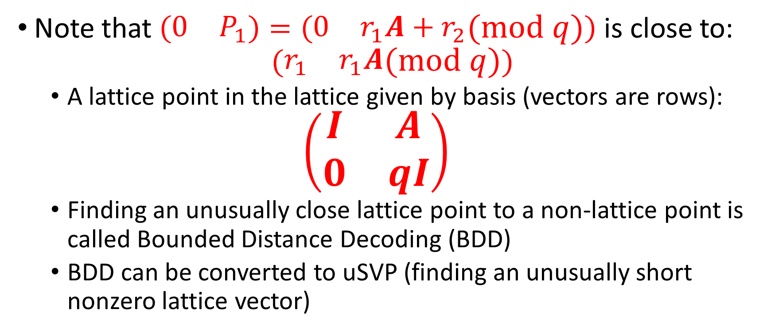
Primal attack (2/3)
LWE as BDD
Note that $\left(\begin{matrix}0 & P_{1}\end{matrix}\right)=\left(\begin{matrix}0 & r_{1}A+r_{2}\end{matrix}(mod q)\right)$is close to:
$$(\begin{matrix}r_{1} & r_{1}A\end{matrix}(mod q))$$
  A lattice point in the lattice given by basis (vectors are rows):
  $$\left(\begin{matrix}I & A \\ 0 & qI\end{matrix}\right)$$
  Finding an unusually close lattice point to a non-lattice point is called Bounded Distance Decoding (BDD)
  BDD can be converted to uSVP (finding an unusually short nonzero lattice vector)

Slide 39
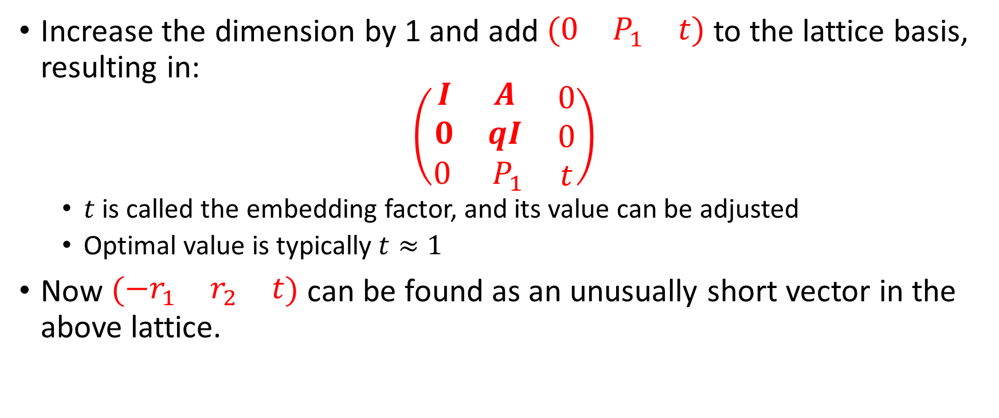
Primal Attack (3/3)
LWE recovery as uSVP (Bai-Galbraith Embedding)
Increase the dimension by 1 and add $\left(\begin{matrix}0 & P_{1} & t\end{matrix}\right)$ to the lattice basis, resulting in:
$$\left(\begin{matrix}\begin{matrix}I & A \\ 0 & qI\end{matrix} & \begin{matrix}0 \\ 0\end{matrix} \\ \begin{matrix}0 & { P}_{1}\end{matrix} & t\end{matrix}\right)$$
  $t$ is called the embedding factor, and its value can be adjusted
  Optimal value is typically $t≈1$
Now $\left(\begin{matrix}−r_{1} & r_{2} & t\end{matrix}\right)$ can be found as an unusually short vector in the above lattice.

Slide 40
Concrete Example
Primal Attack on Kyber512

Slide 41
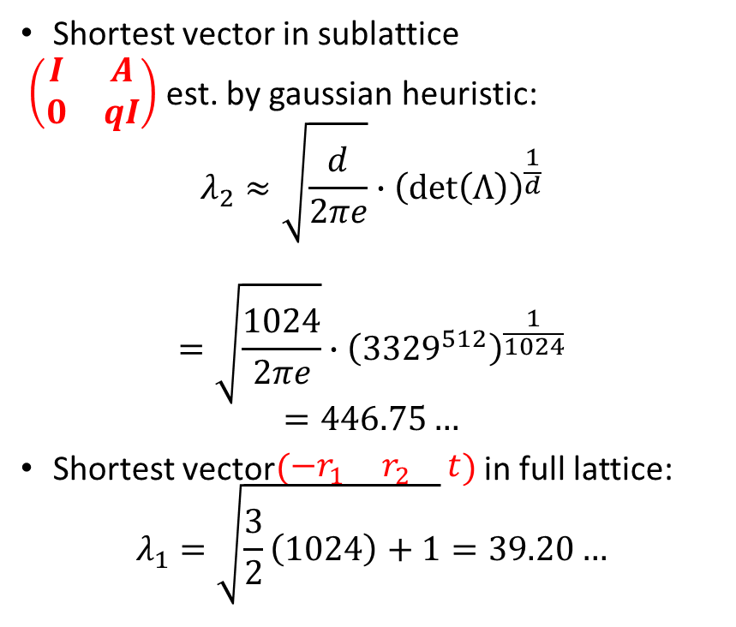
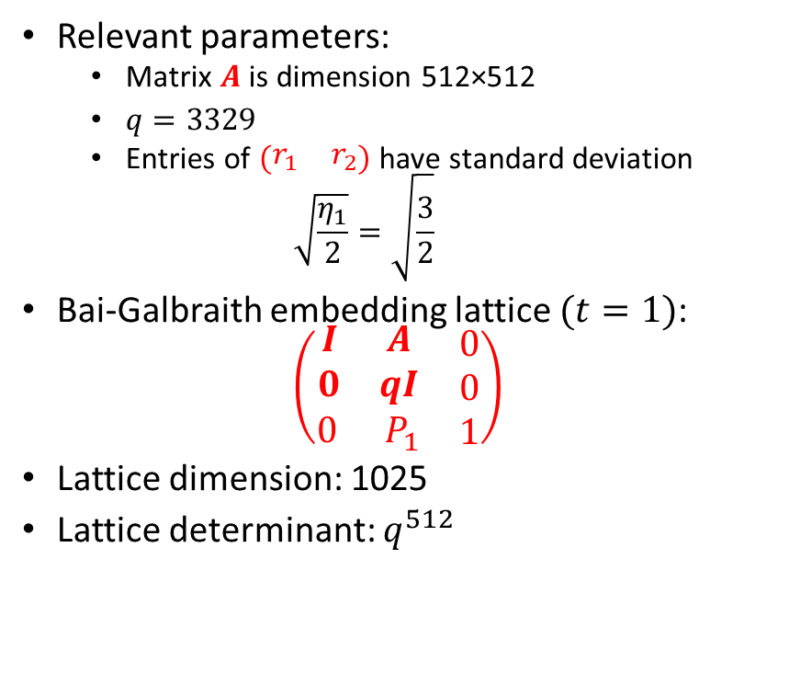
Concrete Example
Primal attack on Kyber512
Relevant parameters:
  Matrix $A$ is dimension 512×512
  $q=3329$
  Entries of $\left(\begin{matrix}r_{1} & r_{2}\end{matrix}\right)$ have standard deviation
  $$\sqrt{\frac{η_{1}}{2}}=\sqrt{\frac{3}{2}}$$
Bai-Galbraith embedding lattice $(t=1)$:
$$\left(\begin{matrix}\begin{matrix}I & A \\ 0 & qI\end{matrix} & \begin{matrix}0 \\ 0\end{matrix} \\ \begin{matrix}0 & { P}_{1}\end{matrix} & 1\end{matrix}\right)$$
Lattice dimension: 1025
Lattice determinant: $q^{512}$
Shortest vector in sublattice
$\left(\begin{matrix}I & A \\ 0 & qI\end{matrix}\right)$ est. by gaussian heuristic:
$$λ_{2}≈\sqrt{\frac{d}{2πe}}∙{\left(\det\left(Λ\right)\right)}^{\frac{1}{d}}$$
$$=\sqrt{\frac{1024}{2πe}}∙{\left({3329}^{512}\right)}^{\frac{1}{1024}}$$
$$=446.75…$$
Shortest vector$\left(\begin{matrix}−r_{1} & r_{2} & t\end{matrix}\right)$ in full lattice:
$$λ_{1}=\sqrt{\frac{3}{2}\left(1024\right)+1}=39.20…$$

Slide 42
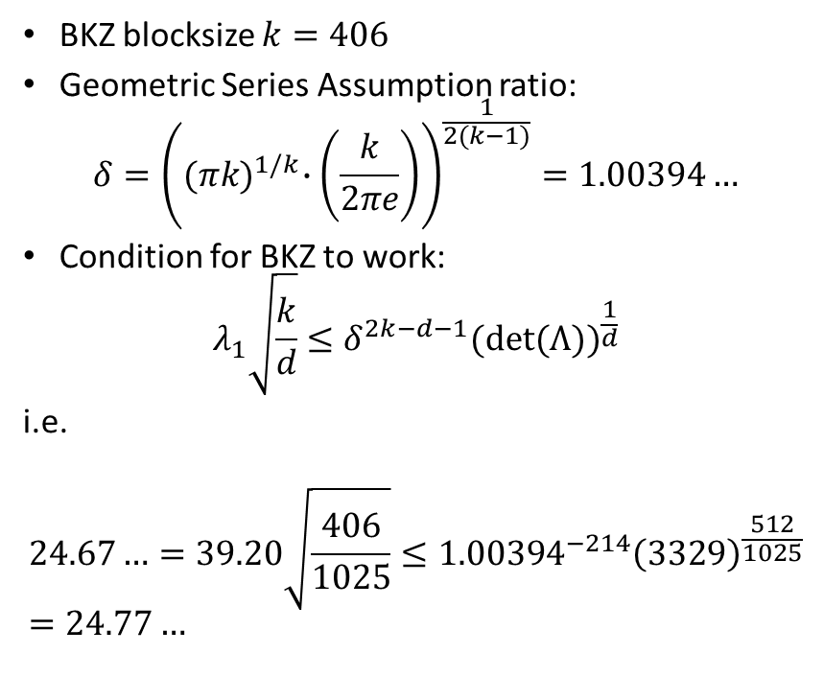
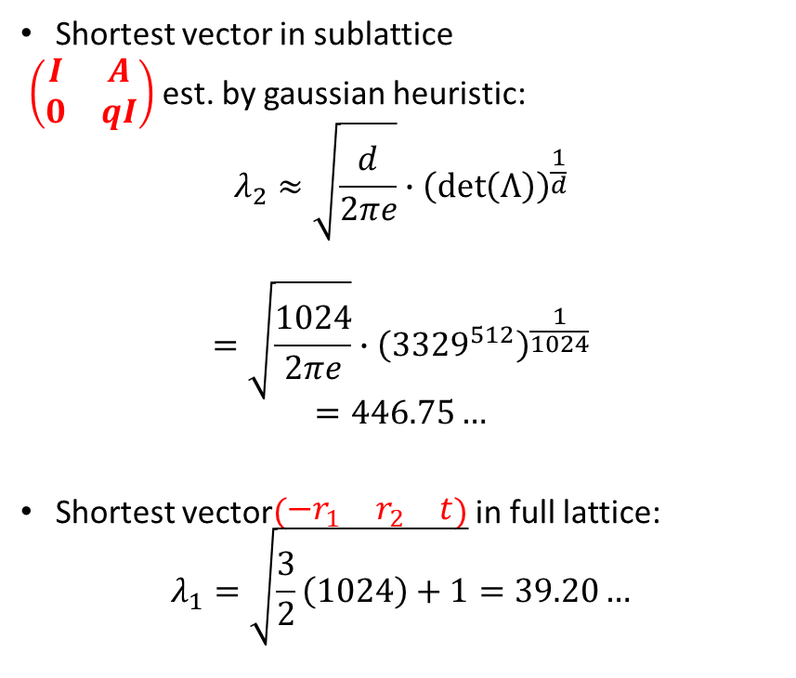
Concrete Example
Primal attack on Kyber512
Shortest vector in sublattice
$\left(\begin{matrix}I & A \\ 0 & qI\end{matrix}\right)$ est. by gaussian heuristic:
$$λ_{2}≈\sqrt{\frac{d}{2πe}}∙{\left(\det\left(Λ\right)\right)}^{\frac{1}{d}}$$
$$=\sqrt{\frac{1024}{2πe}}∙{\left({3329}^{512}\right)}^{\frac{1}{1024}}$$
$$=446.75…$$
Shortest vector$\left(\begin{matrix}−r_{1} & r_{2} & t\end{matrix}\right)$ in full lattice:
$$λ_{1}=\sqrt{\frac{3}{2}\left(1024\right)+1}=39.20…$$
BKZ blocksize $k=406$
Geometric Series Assumption ratio:
$$δ={\left({(πk)}^{1/k}∙\left(\frac{k}{2πe}\right)\right)}^{\frac{1}{2(k−1)}}=1.00394…$$
Condition for BKZ to work:
$$λ_{1}\sqrt{\frac{k}{d}}≤δ^{2k−d−1}{(det⁡(Λ))}^{\frac{1}{d}}$$
i.e.
$$24.67…=39.20\sqrt{\frac{406}{1025}}≤{1.00394}^{−214}{\left(3329\right)}^{\frac{512}{1025}}=24.77…$$

Slide 43
Compare to Kyber Spec.

Slide 44
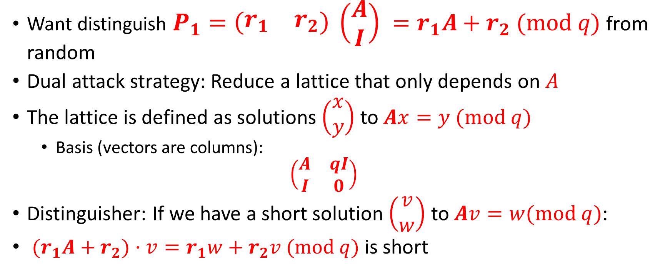
Dual Attack
Want distinguish $P_{1}=\left(\begin{matrix}r_{1} & r_{2}\end{matrix}\right) \left(\begin{matrix}A \\ I\end{matrix}\right) =r_{1}A+r_{2} (mod q)$ from random
Dual attack strategy: Reduce a lattice that only depends on $A$
The lattice is defined as solutions $\left(\begin{matrix}x \\ y\end{matrix}\right)$ to $Ax=y (mod q)$
  Basis (vectors are columns):
  $$\left(\begin{matrix}A & qI \\ I & 0\end{matrix}\right)$$
Distinguisher: If we have a short solution $\left(\begin{matrix}v \\ w\end{matrix}\right)$ to $Av=w(mod q)$:
${(r}_{1}A+r_{2})⋅v=r_{1}w+r_{2}v (mod q)$ is short

Slide 45
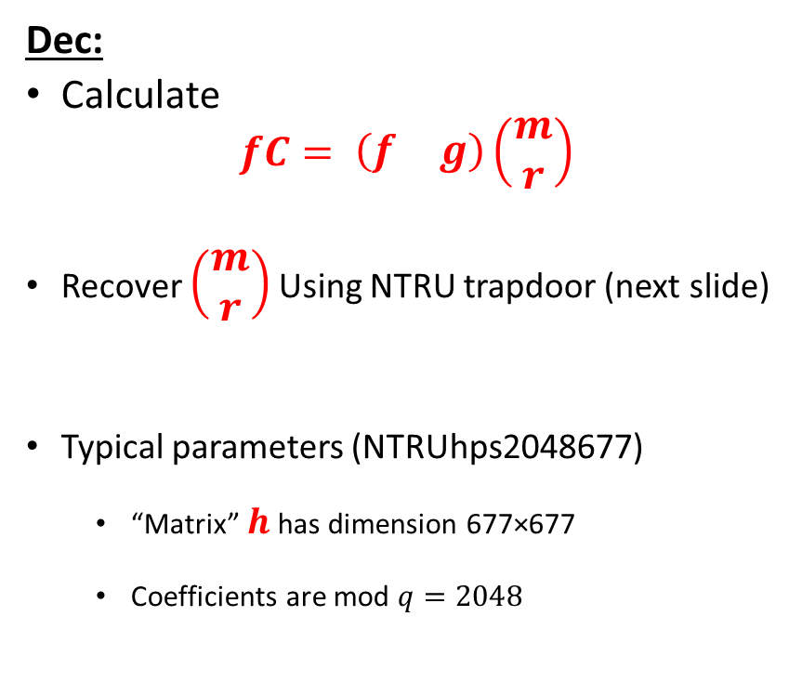
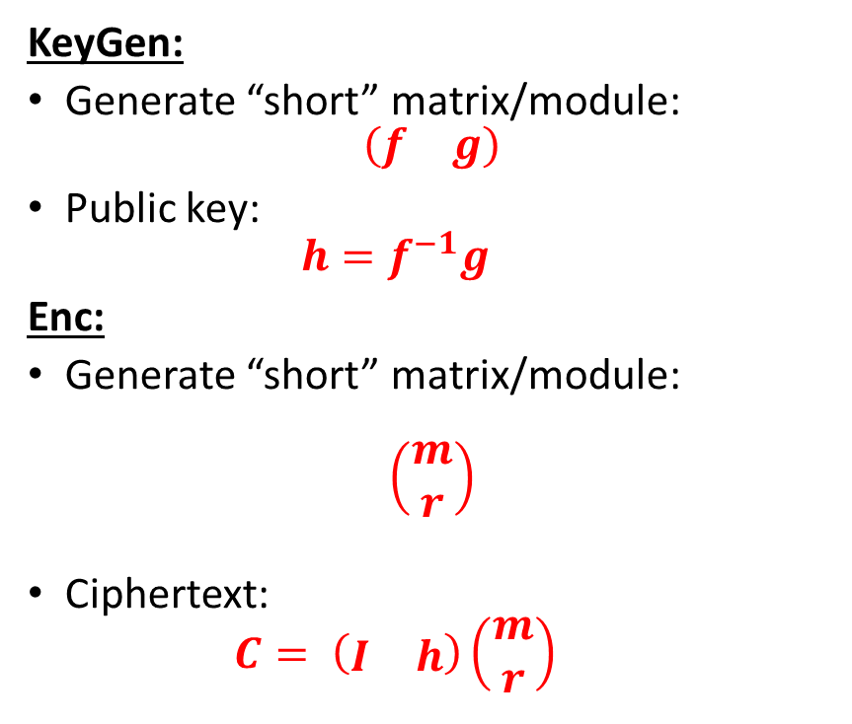
NTRU ((mostly) traditional notation)
KeyGen:
Generate “short” matrix/module:
$$\left(\begin{matrix}f & g\end{matrix}\right)$$
Public key:
  $$h=f^{−1}g$$
Enc:
Generate “short” matrix/module:
$$\left(\begin{matrix}m \\ r\end{matrix}\right)$$
Ciphertext:
  $$C= \left(\begin{matrix}I & h\end{matrix}\right)\left(\begin{matrix}m \\ r\end{matrix}\right)$$
Dec:
Calculate
$$fC= \left(\begin{matrix}f & g\end{matrix}\right)\left(\begin{matrix}m \\ r\end{matrix}\right)$$
Recover $\left(\begin{matrix}m \\ r\end{matrix}\right)$ Using NTRU trapdoor (next slide)
Typical parameters (NTRUhps2048677)
  “Matrix” $h$ has dimension 677×677
  Coefficients are mod $q=2048$

Slide 46
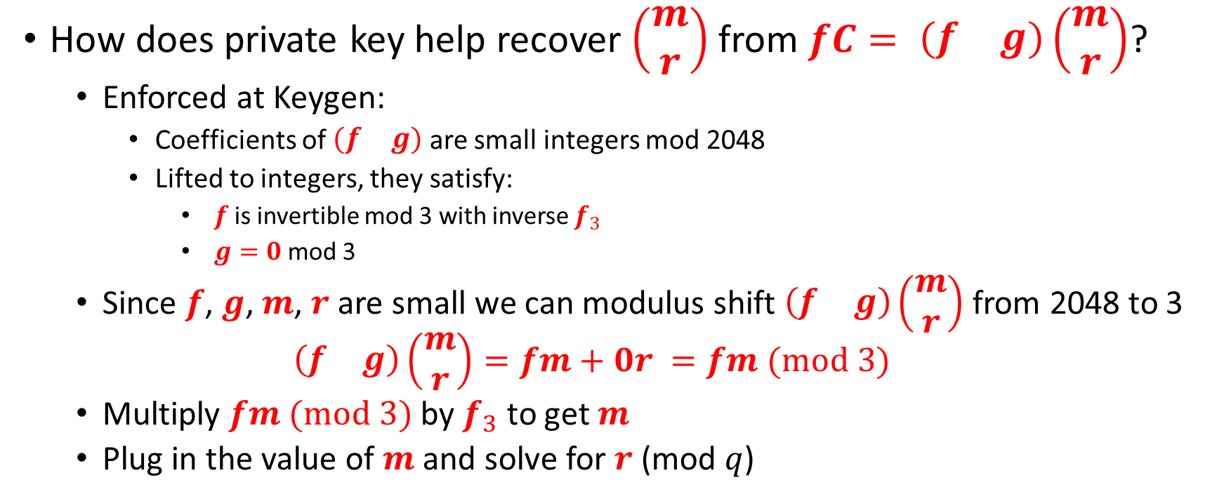
The NTRU Trapdoor
How does private key help recover $\left(\begin{matrix}m \\ r\end{matrix}\right)$ from $fC= \left(\begin{matrix}f & g\end{matrix}\right)\left(\begin{matrix}m \\ r\end{matrix}\right)$?
  Enforced at Keygen:
    Coefficients of $\left(\begin{matrix}f & g\end{matrix}\right)$ are small integers mod 2048
    Lifted to integers, they satisfy:
      $f$ is invertible mod 3 with inverse $f_{3}$
      $g=0$ mod 3
  Since $f$, $g$, $m$, $r$ are small we can modulus shift $\left(\begin{matrix}f & g\end{matrix}\right)\left(\begin{matrix}m \\ r\end{matrix}\right)$ from 2048 to 3
  $$\left(\begin{matrix}f & g\end{matrix}\right)\left(\begin{matrix}m \\ r\end{matrix}\right)=fm+0r =fm (mod 3)$$
  Multiply $fm (mod 3)$ by $f_{3}$ to get $m$
  Plug in the value of $m$ and solve for $r$ (mod $q$)

Slide 47
NTRU ((mostly) traditional notation)
KeyGen:
Generate “short” matrix/module:
$$\left(\begin{matrix}f & g\end{matrix}\right)$$
Public key:
  $$h=f^{−1}g$$
Enc:
Generate “short” matrix/module:
$$\left(\begin{matrix}m \\ r\end{matrix}\right)$$
Ciphertext:
  $$C= \left(\begin{matrix}I & h\end{matrix}\right)\left(\begin{matrix}m \\ r\end{matrix}\right)$$
Dec:
Calculate
$$fC= \left(\begin{matrix}f & g\end{matrix}\right)\left(\begin{matrix}m \\ r\end{matrix}\right)$$
Recover $\left(\begin{matrix}m \\ r\end{matrix}\right)$ Using NTRU trapdoor (next slide)
Typical parameters (NTRUhps2048677)
  “Matrix” $h$ has dimension 677×677
  Coefficients are mod $q=2048$

Slide 48
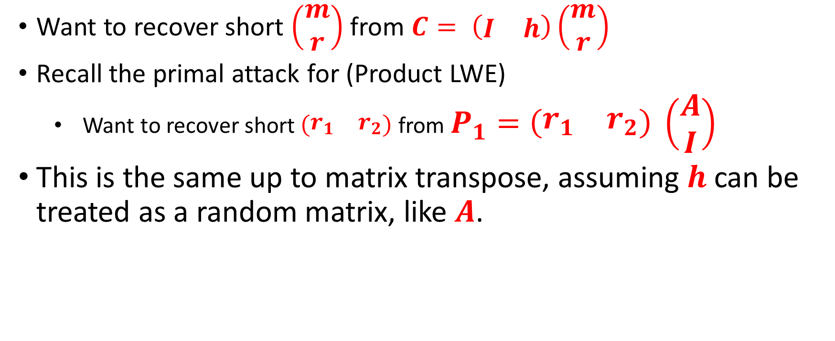
NewHope style Primal attack on NTRU
Want to recover short $\left(\begin{matrix}m \\ r\end{matrix}\right)$ from $C= \left(\begin{matrix}I & h\end{matrix}\right)\left(\begin{matrix}m \\ r\end{matrix}\right)$
Recall the primal attack for (Product LWE)
  Want to recover short $\left(\begin{matrix}r_{1} & r_{2}\end{matrix}\right)$ from $P_{1}=\left(\begin{matrix}r_{1} & r_{2}\end{matrix}\right) \left(\begin{matrix}A \\ I\end{matrix}\right)$
This is the same up to matrix transpose, assuming $h$ can be treated as a random matrix, like $A$.

Slide 49
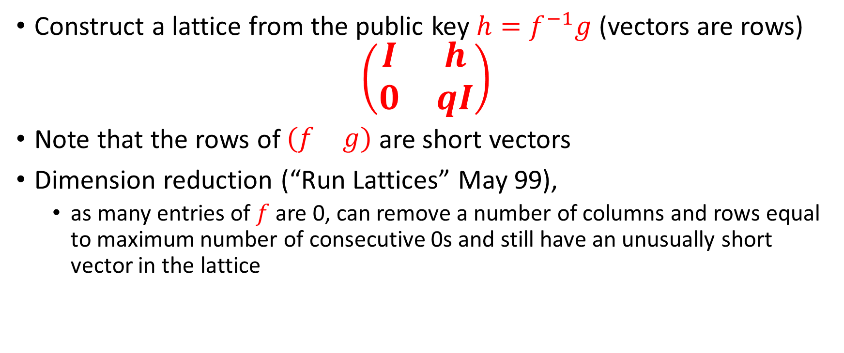
NTRU Lattice attacks
Coppersmith-Shamir 1997
Construct a lattice from the public key $h=f^{−1}g$ (vectors are rows)
$$\left(\begin{matrix}I & h \\ 0 & qI\end{matrix}\right)$$
Note that the rows of $\left(\begin{matrix}f & g\end{matrix}\right)$ are short vectors
Dimension reduction (“Run Lattices” May 99),
  as many entries of $f$ are 0, can remove a number of columns and rows equal to maximum number of consecutive 0s and still have an unusually short vector in the lattice

Slide 50
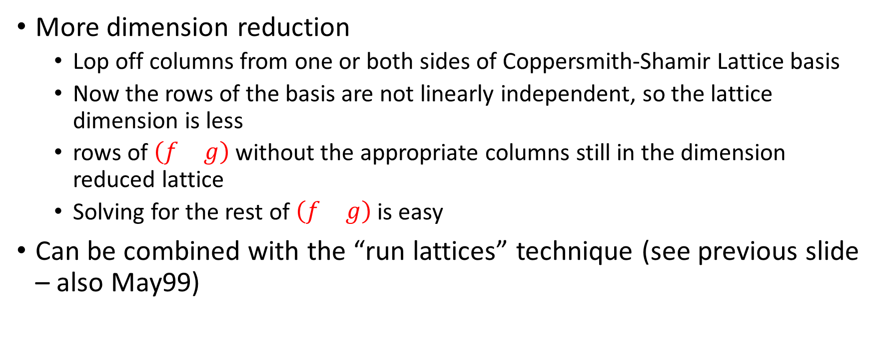
Further Improvements in May99
More dimension reduction
  Lop off columns from one or both sides of Coppersmith-Shamir Lattice basis
  Now the rows of the basis are not linearly independent, so the lattice dimension is less
  rows of $\left(\begin{matrix}f & g\end{matrix}\right)$ without the appropriate columns still in the dimension reduced lattice
  Solving for the rest of $\left(\begin{matrix}f & g\end{matrix}\right)$ is easy
Can be combined with the “run lattices” technique (see previous slide – also May99)

Slide 51
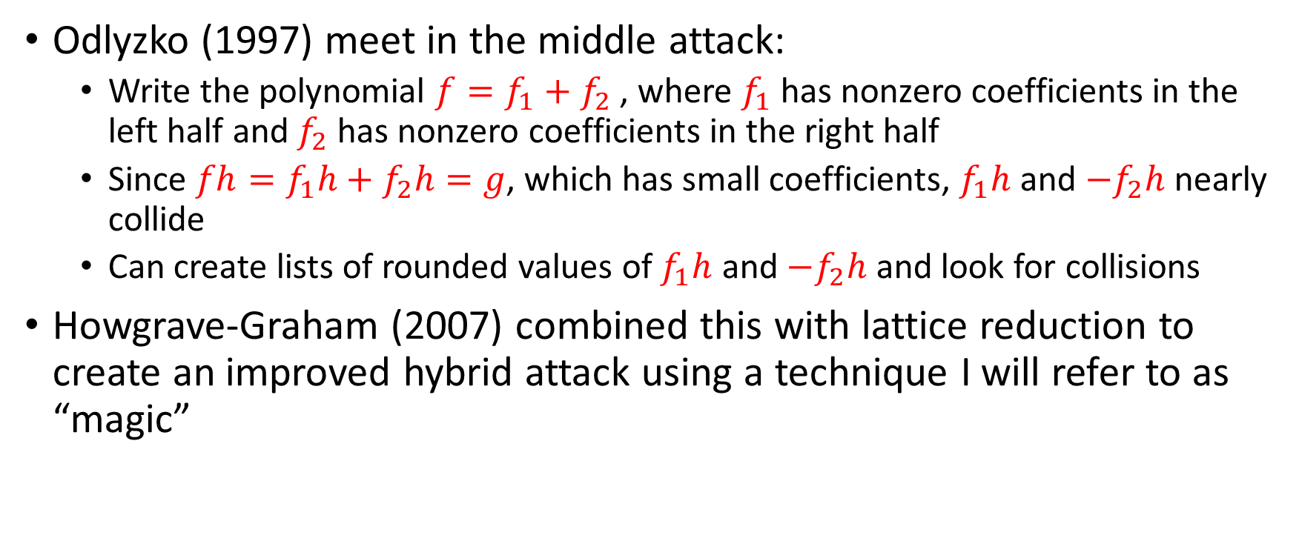
Odlyzko Meet in the Middle attack;
Howgrave-Graham Hybrid Attack
Odlyzko (1997) meet in the middle attack:
  Write the polynomial $f=f_{1}+f_{2}$ , where $f_{1}$ has nonzero coefficients in the left half and $f_{2}$ has nonzero coefficients in the right half
  Since $fh=f_{1}h+f_{2}h=g$, which has small coefficients, $f_{1}h$ and $−f_{2}h$ nearly collide
  Can create lists of rounded values of $f_{1}h$ and $−f_{2}h$ and look for collisions
Howgrave-Graham (2007) combined this with lattice reduction to create an improved hybrid attack using a technique I will refer to as “magic”

Slide 52
Questions?

Slide 53
References
General references:
  Stehle, Review of Lattice Reduction Algorithm: https://wheat2016.lip6.fr/HEAT_Paris_Damien.pdf
  ADPS 2016 (NewHope Paper): https://eprint.iacr.org/2015/1092.pdf
  AGVW 2017: Revisiting the Expected Cost of Solving uSVP with applications to LWE: https://eprint.iacr.org/2017/815.pdf
Enumeration References:
  ABFKSW 2020 https://eprint.iacr.org/2020/707
Sieving References:
  BDGL: https://eprint.iacr.org/2015/1128.pdf
  BGJ15: https://eprint.iacr.org/2015/522.pdf
  MV10: https://epubs.siam.org/doi/pdf/10.1137/1.9781611973075.119
  NV08: https://www.degruyter.com/document/doi/10.1515/JMC.2008.009/html
Kannan embedding: https://pdfs.semanticscholar.org/9253/08b01e1a3a9944774a817c63d84c887ee277.pdf
Bai Galbraith Embedding: https://eprint.iacr.org/2013/839.pdf
NTRU Cryptanalysis
  Coppersmith, Shamir 1997: https://link.springer.com/chapter/10.1007/3-540-69053-0_5
  May 1999: https://citeseerx.ist.psu.edu/viewdoc/download?doi=10.1.1.41.3484&rep=rep1&type=pdf
  Howgrave-Graham 2005 (Hybrid attack): https://iacr.org/archive/crypto2007/46220150/46220150.pdf

