Slide 1


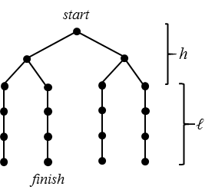


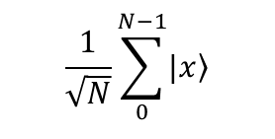

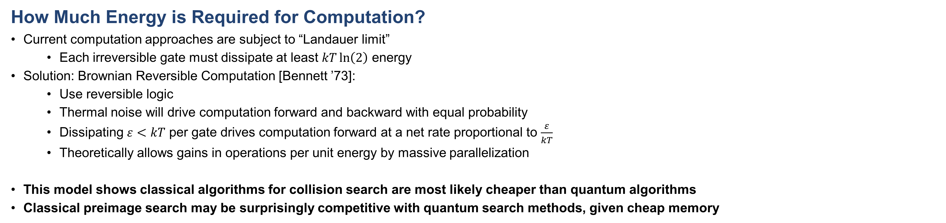
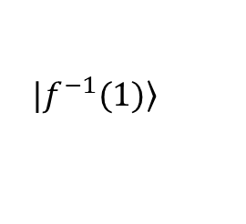
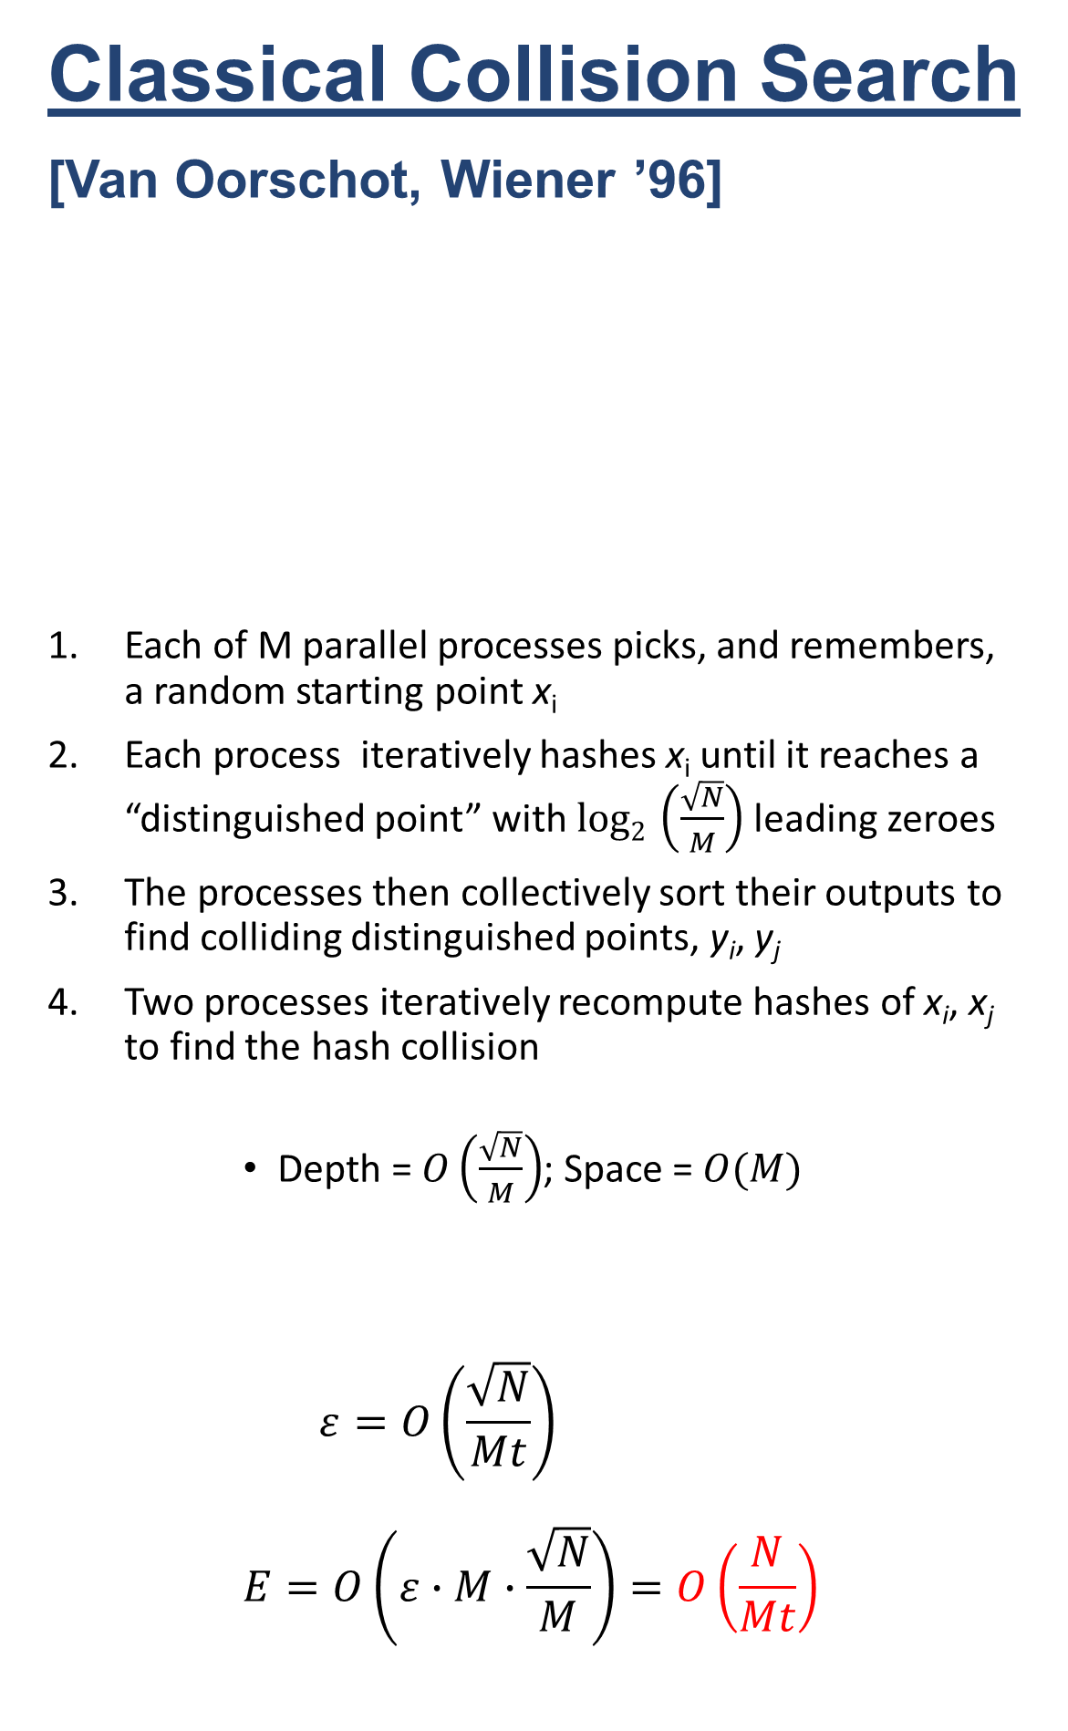



Thermodynamic Analysis of Classical and Quantum Search
Ray Perlner, Yi-Kai Liu
ray.perlner@nist.gov, yi-kai.liu@nist.gov
https://arxiv.org/abs/1709.10510
How Much Energy is Required for Computation?
Current computation approaches are subject to “Landauer limit”
  Each irreversible gate must dissipate at least $kT\ln\left(2\right)$ energy
Solution: Brownian Reversible Computation [Bennett ’73]:
  Use reversible logic
  Thermal noise will drive computation forward and backward with equal probability
  Dissipating $ε<kT$ per gate drives computation forward at a net rate proportional to $\frac{ε}{kT}$
  Theoretically allows gains in operations per unit energy by massive parallelization
This model shows classical algorithms for collision search are most likely cheaper than quantum algorithms
Classical preimage search may be surprisingly competitive with quantum search methods, given cheap memory
  Notation
  E = Energy needed to perform computation
  t = Time to perform computation
  M = Number of processors
  $ε$ = Energy per gate
  T = Temperature
  k = Boltzmann constant
Classical Preimage Search
Powered:
  Try guesses in a fixed sequence
  Power consumption dominated by $ε$
  More Parallelization ($M$) = Less Energy ($E$)
  $$ε=O\left(\frac{N}{Mt}\right)$$
  $$E=O\left(ε∙M∙\frac{N}{M}\right)=O\left(\frac{N^{2}}{Mt}\right)$$
Unpowered:
  Let thermal noise pick random guesses:
  Energy consumption only at start and finish
  Power consumption dominated by initialization
  Higher temperature leads to more expensive initialization, faster computation
    Practical limitations on temperature
  $$T=O\left(\frac{N}{Mt}\right)$$
  $$E=O\left(T∙M\right)=O\left(\frac{N}{t}\right)$$
Quantum Preimage Search
[Grover ’96]
Classical Collision Search
[Van Oorschot, Wiener ’96]
Each of M parallel processes picks, and remembers, a random starting point x_{i}
Each process iteratively hashes x_{i} until it reaches a “distinguished point” with $log2 \left(\frac{\sqrt{N}}{M}\right)$ leading zeroes
The processes then collectively sort their outputs to find colliding distinguished points, y_{i}, y_{j}
Two processes iteratively recompute hashes of x_{i}, x_{j} to find the hash collision
  Depth = $O\left(\frac{\sqrt{N}}{M}\right)$; Space = $O(M)$
  $$ε=O\left(\frac{\sqrt{N}}{Mt}\right)$$
  $$E=O\left(ε∙M∙\frac{\sqrt{N}}{M}\right)=O\left(\frac{N}{Mt}\right)$$
Quantum Collision Search
[Brassard, Hoyer, Tapp ’97]
Generate $M$hash values, H(x₀), … H(x_{k})
  Store them as a sorted list
Define $f(y) =\left\{\begin{matrix}1 H\left(y\right) in the table \\ 0 H\left(y\right) not in the table\end{matrix}\right.$
Use Grover to invert $f$ on a domain of size $\frac{N}{M}$
  Requires $O\left(\sqrt{\frac{N}{M}}\right)$ serial calls to $f$
  Or $O\left(\sqrt{\frac{N}{Mp}}\right)$ calls for each of $p$ parallel processes
Even assuming parallel access to large quantum memory costs $O(1)$, we get:
  $$ε=O\left(\frac{\sqrt{\frac{N}{Mp}}}{t}\right)$$
  $$E=O\left(ε∙p∙\sqrt{\frac{N}{Mp}}\right)=O\left(\frac{N}{Mt}\right)$$
$$\left.|f^{−1}(1)\right\rangle$$
x₀
(0 | y₀)
$$O\left(\sqrt{N}\right) \text{steps}$$
x₁
(0 | y₁) = (0 | y₂)
$$\frac{1}{\sqrt{N}}\sum_{0}^{N−1}{\left.|x\right\rangle }$$
x₂
$$θ≈1/\sqrt{N}$$
x₃
(0 | y₃)
Advantage:
  Requires fewer steps
Disadvantages:
  Only runs on a quantum computer
  Does not Parallelize well
    $M$ way parallelism reduces depth by $\sqrt{M}$
  $$ε=O\left(\frac{\sqrt{\frac{N}{M}}}{t}\right)$$
  $$E=O\left(ε∙M∙\sqrt{\frac{N}{M}}\right)=O\left(\frac{N}{t}\right)$$

