Slide 1
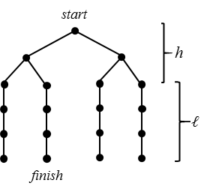
Thermodynamic Analysis of Classical and Quantum Search
Brownian Computation
Current computation approaches are subject to “Landauer limit”
Each irreversible gate must dissipate at least $kT\ln\left(2\right)$ energy
Proposed solution:
Use reversible logic
Thermal noise will drive computation forward and backward with equal probability
Dissipating $ε<kT$ per gate drives computation forward at a net rate proportional to $\frac{ε}{kT}$
Theoretically allows gains in operations per unit energy by massive parallelization
This model shows classical algorithms for collision search are most likely cheaper than quantum algorithms
Classical preimage search may be surprisingly competitive with quantum search methods, given cheap memory
Example below:
Classical Search
Powered:
Try keys in a fixed sequence.
Power consumption dominated by $ε$
More Parallelization ($M$) = Less Energy ($E$)
$$E=O\left(\frac{N}{Mt}∙M∙\frac{N}{M}\right)=O\left(\frac{N^{2}}{Mt}\right)$$
Unpowered:
Let thermal noise pick random keys:
Energy consumption only at start and finish.
Power consumption dominated by initialization.
Higher temperature leads to more expensive initialization, faster computation.
Practical limitations on temperature
$$T=O\left(\frac{N}{Mt}\right)$$
$$E=O\left(\frac{N}{Mt}∙M\right)=O\left(\frac{N}{t}\right)$$
Grover’s Algorithm
$$\left.|f^{−1}(1)\right\rangle$$
$$O\left(\sqrt{N}\right) \text{steps}$$
$$\frac{1}{\sqrt{N}}\sum_{0}^{N−1}{\left.|x\right\rangle }$$
$$θ≈1/\sqrt{N}$$
Advantage:
Requires fewer steps
Disadvantages:
Only runs on a quantum computer
Does not Parallelize well
$M$ way parallelism reduces time by $\sqrt{M}$.
$$E=O\left(\frac{\sqrt{\frac{N}{M}}}{t}∙M∙\sqrt{\frac{N}{M}}\right)=O\left(\frac{N}{t}\right)$$
Ray Perlner, Yi-Kai Liu
https://arxiv.org/abs/1709.10510

