Slide 1
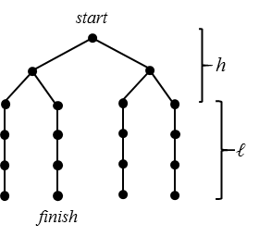


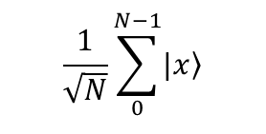

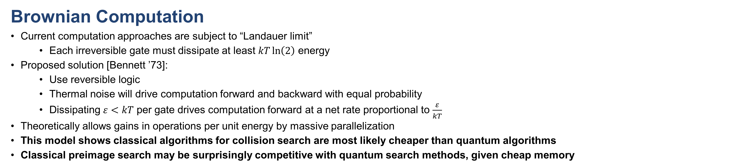
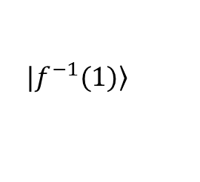



Thermodynamic Analysis of Classical and Quantum Search
Brownian Computation
Current computation approaches are subject to “Landauer limit”
  Each irreversible gate must dissipate at least $kT\ln\left(2\right)$ energy
Proposed solution [Bennett ’73]:
  Use reversible logic
  Thermal noise will drive computation forward and backward with equal probability
  Dissipating $ε<kT$ per gate drives computation forward at a net rate proportional to $\frac{ε}{kT}$
Theoretically allows gains in operations per unit energy by massive parallelization
This model shows classical algorithms for collision search are most likely cheaper than quantum algorithms
Classical preimage search may be surprisingly competitive with quantum search methods, given cheap memory
Ray Perlner, Yi-Kai Liu
https://arxiv.org/abs/1709.10510
Classical Preimage Search
Powered:
  Try keys in a fixed sequence
  Power consumption dominated by $ε$
  More Parallelization ($M$) = Less Energy ($E$)
  $$E=O\left(\frac{N}{Mt}∙M∙\frac{N}{M}\right)=O\left(\frac{N^{2}}{Mt}\right)$$
Unpowered:
  Let thermal noise pick random keys:
  Energy consumption only at start and finish
  Power consumption dominated by initialization
  Higher temperature leads to more expensive initialization, faster computation
    Practical limitations on temperature
  $$T=O\left(\frac{N}{Mt}\right)$$
  $$E=O\left(\frac{N}{Mt}∙M\right)=O\left(\frac{N}{t}\right)$$
Grover’s Algorithm
[Grover ’96]
Classical Collision Search
[Van Oorschot, Wiener ’96]
Each of M threads picks, and remembers, a random starting point x_{i}
Each thread iteratively hashes x_{i} until it reaches a “distinguished point” with $log2 \left(\frac{\sqrt{N}}{M}\right)$ leading zeroes
The threads then collectively sort their outputs to find colliding distinguished points, y_{i}, y_{j}
Two threads iteratively recompute hashes of x_{i}, x_{j} to find the hash collision
  Depth = O$\left(\frac{\sqrt{N}}{M}\right)$; Space = O(M)
  $$ε=O\left(\frac{\sqrt{N}}{Mt}\right)$$
  $$E=O\left(\frac{\sqrt{N}}{Mt}∙M∙\frac{\sqrt{N}}{M}\right)=O\left(\frac{N}{Mt}\right)$$
Quantum Collision Search
[Brassard, Hoyer, Tapp ’97]
Generate $M$hash values, H(x₀), … H(x_{k})
  Store them as a sorted list
Define $f(y) =\left\{\begin{matrix}1 H\left(y\right) in the table \\ 0 H\left(y\right) not in the table\end{matrix}\right.$
Use Grover to invert $f$ on a domain of size $\frac{N}{M}$
  Requires $O\left(\sqrt{\frac{N}{M}}\right)$ serial calls to $f$
  Or $O\left(\sqrt{\frac{N}{Mp}}\right)$ calls for each of $p$ parallel threads
Even assuming parallel access to large quantum memory costs $O(1)$, we get:
  $$ε=O\left(\frac{\sqrt{\frac{N}{Mp}}}{t}\right)$$
  $$E=O\left(\frac{\sqrt{\frac{N}{Mp}}}{t}∙p∙\sqrt{\frac{N}{Mp}}\right)=O\left(\frac{N}{Mt}\right)$$
$$\left.|f^{−1}(1)\right\rangle$$
x₀
(0 | y₀)
$$O\left(\sqrt{N}\right) \text{steps}$$
x₁
(0 | y₁) = (0 | y₂)
$$\frac{1}{\sqrt{N}}\sum_{0}^{N−1}{\left.|x\right\rangle }$$
x₂
$$θ≈1/\sqrt{N}$$
x₃
(0 | y₃)
Advantage:
  Requires fewer steps
Disadvantages:
  Only runs on a quantum computer
  Does not Parallelize well
    $M$ way parallelism reduces time by $\sqrt{M}$.
  $$E=O\left(\frac{\sqrt{\frac{N}{M}}}{t}∙M∙\sqrt{\frac{N}{M}}\right)=O\left(\frac{N}{t}\right)$$

