Slide 2
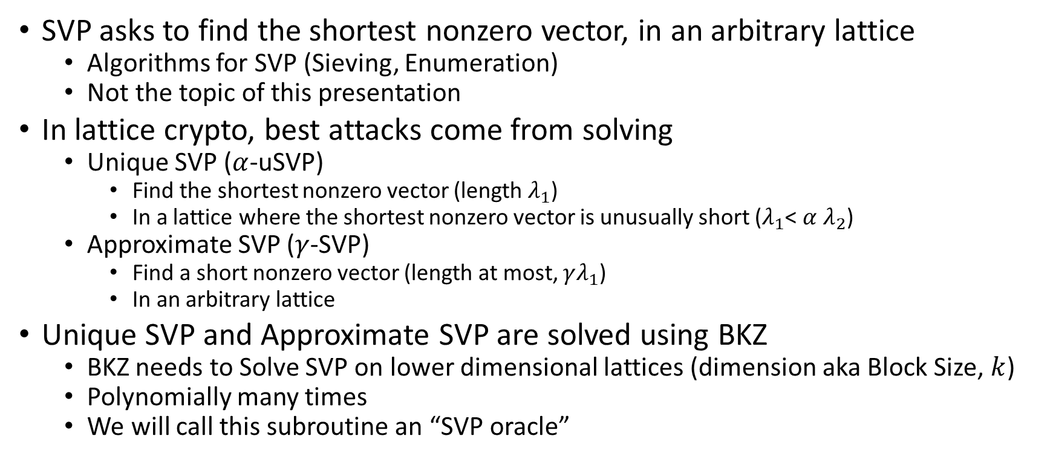
BKZ Overview
SVP asks to find the shortest nonzero vector, in an arbitrary lattice
  Algorithms for SVP (Sieving, Enumeration)
  Not the topic of this presentation
In lattice crypto, best attacks come from solving
  Unique SVP ($α$-uSVP)
    Find the shortest nonzero vector (length $λ_{1}$)
    In a lattice where the shortest nonzero vector is unusually short ($λ_{1}$< $α$ $λ_{2}$)
  Approximate SVP ($γ$-SVP)
    Find a short nonzero vector (length at most, $γλ_{1}$)
    In an arbitrary lattice
Unique SVP and Approximate SVP are solved using BKZ
  BKZ needs to Solve SVP on lower dimensional lattices (dimension aka Block Size, $k$)
  Polynomially many times
  We will call this subroutine an “SVP oracle”

Slide 3
Tools for reasoning about BKZ
Lattice Determinant
Minkowski’s theorem
Gaussian Heuristic
Gram-Schmidt Orthogonalization
QR factorization
Geometric Series Assumption

Slide 4
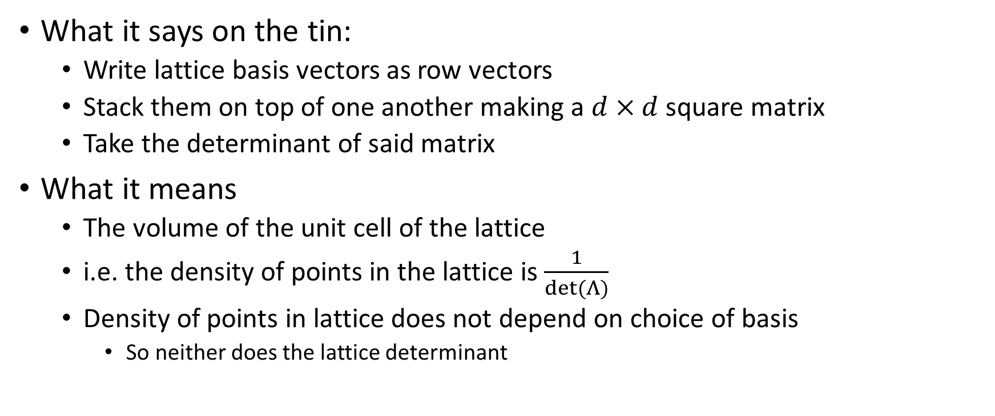

Lattice Determinant $det⁡(Λ)$
What it says on the tin:
  Write lattice basis vectors as row vectors
  Stack them on top of one another making a $d×d$ square matrix
  Take the determinant of said matrix
What it means
  The volume of the unit cell of the lattice
  i.e. the density of points in the lattice is $\frac{1}{det⁡(Λ)}$
  Density of points in lattice does not depend on choice of basis
    So neither does the lattice determinant

Slide 5


Using $det⁡(Λ)$ to Bound/Estimate $λ_{1}$
Minkowski’s theorem
$$λ_{1}≤\sqrt{d}∙{(det⁡(Λ))}^{\frac{1}{d}}$$
Gaussian Heuristic
$$λ_{1}≈\sqrt{\frac{d}{2πe}}∙{(det⁡(Λ))}^{\frac{1}{d}}$$

Slide 6
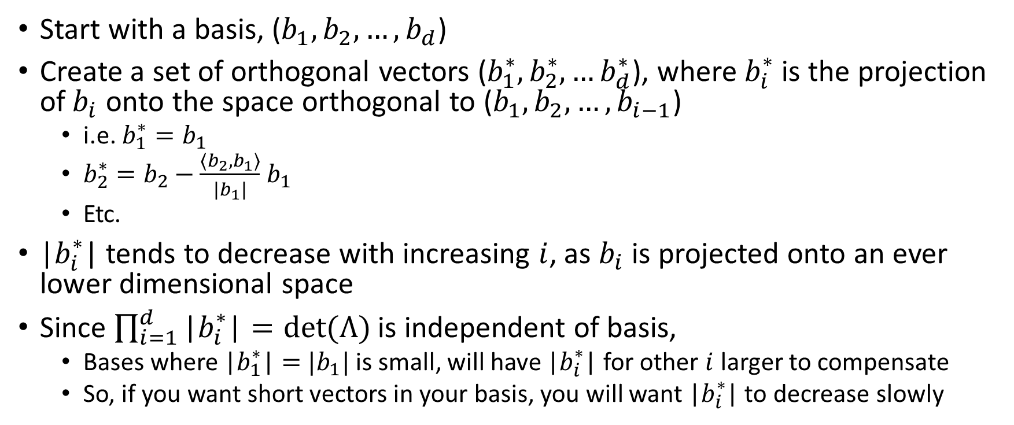
Gram Schmidt Orthogonalization
Start with a basis, ($b_{1}, b_{2}, …, b_{d}$)
Create a set of orthogonal vectors ($b_{1}^{∗},b_{2}^{∗},…b_{d}^{∗}$), where $b_{i}^{∗}$ is the projection of$b_{i}$ onto the space orthogonal to ($b_{1}, b_{2}, …, b_{i−1}$)
  i.e. $b_{1}^{∗}=b_{1}$
  $b_{2}^{∗}=b_{2}−\frac{\left\langle b_{2},b_{1}\right\rangle }{|b_{1}|}$ $b_{1}$
  Etc.
|$b_{i}^{∗}$| tends to decrease with increasing $i$, as $b_{i}$ is projected onto an ever lower dimensional space
Since $\prod_{i=1}^{d}{\text{|}b_{i}^{∗}\text{|}=det⁡(Λ)}$ is independent of basis,
  Bases where $\text{|}b_{1}^{∗}\text{|}=$ $|b_{1}|$ is small, will have $\text{|}b_{i}^{∗}\text{|}$ for other $i$ larger to compensate
  So, if you want short vectors in your basis, you will want |$b_{i}^{∗}$| to decrease slowly

Slide 7


Lattice reduction and Gram-Schmidt norm
Bad Basis
Good Basis
$$\left|b_{i}^{∗}\right|$$
$$i$$

Slide 8
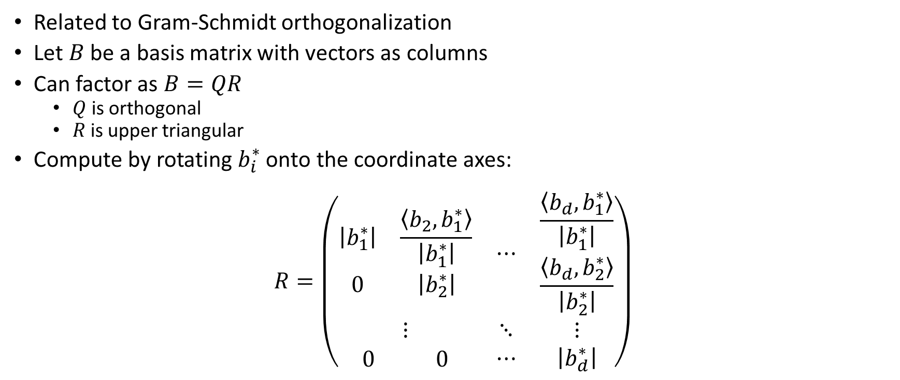
QR factorization
Related to Gram-Schmidt orthogonalization
Let $B$ be a basis matrix with vectors as columns
Can factor as $B=QR$
  $Q$ is orthogonal
  $R$ is upper triangular
Compute by rotating $b_{i}^{∗}$ onto the coordinate axes:
$$R=\left(\begin{matrix}\begin{matrix}\left|b_{1}^{∗}\right| & \frac{\left\langle b_{2},b_{1}^{∗}\right\rangle }{\left|b_{1}^{∗}\right|} \\ 0 & \left|b_{2}^{∗}\right|\end{matrix} & ⋯ & \begin{matrix}\frac{\left\langle b_{d},b_{1}^{∗}\right\rangle }{\left|b_{1}^{∗}\right|} \\ \frac{\left\langle b_{d},b_{2}^{∗}\right\rangle }{\left|b_{2}^{∗}\right|}\end{matrix} \\ ⋮ & ⋱ & ⋮ \\ \begin{matrix}0 & 0\end{matrix} & ⋯ & \left|b_{d}^{∗}\right|\end{matrix}\right)$$

Slide 9
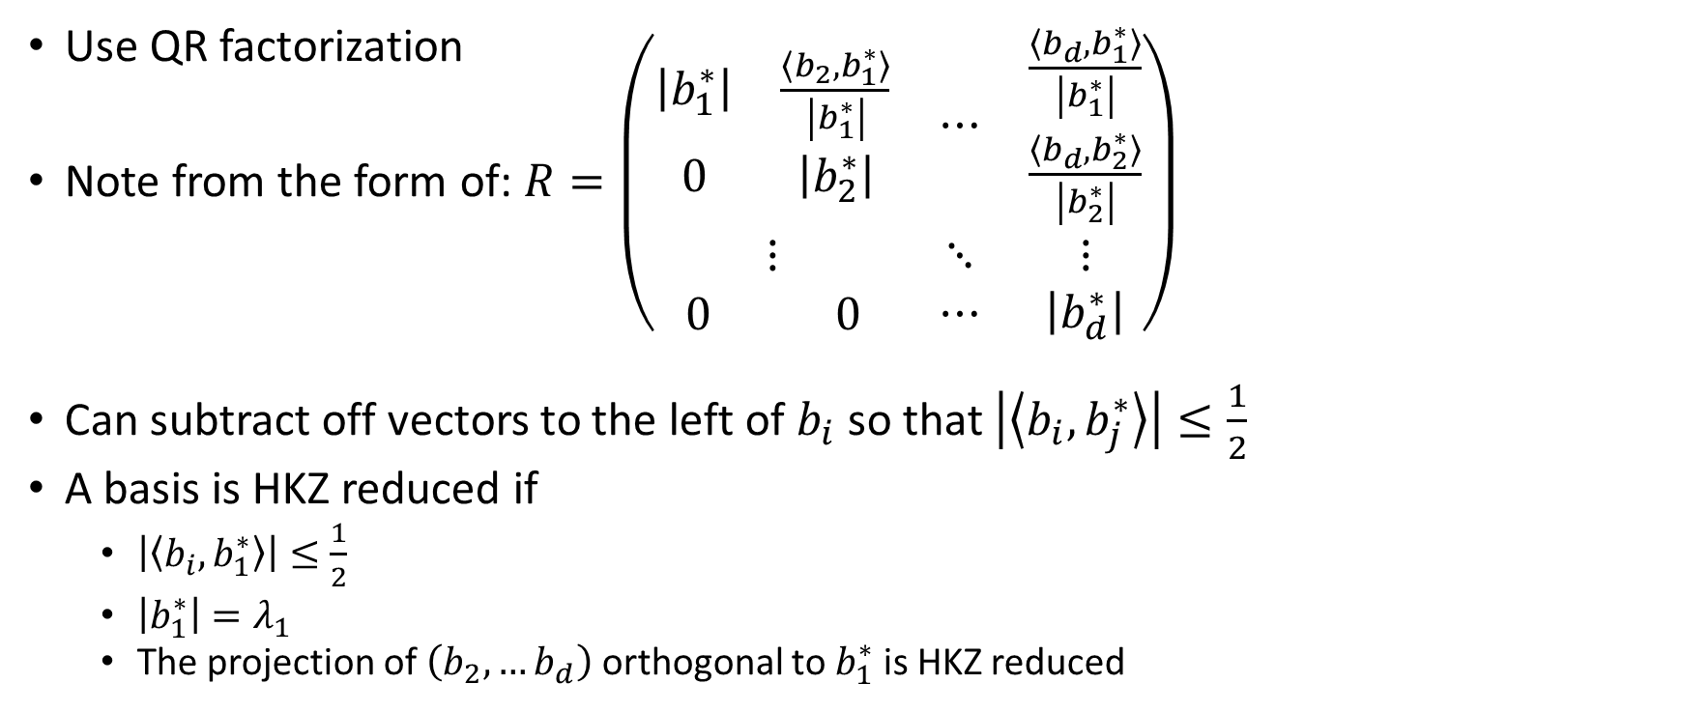
HKZ reduction
(What to do with an SVP oracle)
Use QR factorization
Note from the form of: $R=\left(\begin{matrix}\begin{matrix}\left|b_{1}^{∗}\right| & \frac{\left\langle b_{2},b_{1}^{∗}\right\rangle }{\left|b_{1}^{∗}\right|} \\ 0 & \left|b_{2}^{∗}\right|\end{matrix} & ⋯ & \begin{matrix}\frac{\left\langle b_{d},b_{1}^{∗}\right\rangle }{\left|b_{1}^{∗}\right|} \\ \frac{\left\langle b_{d},b_{2}^{∗}\right\rangle }{\left|b_{2}^{∗}\right|}\end{matrix} \\ ⋮ & ⋱ & ⋮ \\ \begin{matrix}0 & 0\end{matrix} & ⋯ & \left|b_{d}^{∗}\right|\end{matrix}\right)$
Can subtract off vectors to the left of $b_{i}$ so that $\left|\left\langle b_{i},b_{j}^{∗}\right\rangle \right|≤\frac{1}{2}$
A basis is HKZ reduced if
  $\left|\left\langle b_{i},b_{1}^{∗}\right\rangle \right|≤\frac{1}{2}$
  $\left|b_{1}^{∗}\right|=λ_{1}$
  The projection of $\left(b_{2},…b_{d}\right)$ orthogonal to $b_{1}^{∗}$ is HKZ reduced

Slide 10

BKZ algorithm
HKZ reduce square submatrices of size $k$
  Tour: Start at the top left and move down to the bottom right
  May require multiple tours before basis stops improving
    XXXput in estimates for number of SVP calls and basis quality from https://wheat2016.lip6.fr/HEAT_Paris_Damien.pdf if we don’t find anything better XXX

Slide 11
Attacks and Lattice Problems
LWE and NTRU style cryptosystems get unique SVP and approximate SVP instances via various attack strategies:
  LWE (NewHope ADPS2016 terminology):
    Primal: uSVP
    Dual: Approximate SVP
  NTRU
    “Primal”, “Dual” attack
      Numbers are cited for “Primal” and “Dual” attack in NewHope paper
      Obvious analogy attempts message recovery where LWE attack would attempt key recovery
      Both of these can be uSVP (Approximate SVP may be relevant too for dual)
    Coppersmith-Shamir97, extended by May99 (this is called “Primal” in NTRU spec.): uSVP
    Howgrave-Graham05: Hybrid meet in the middle uSVP
We will study these strategies in the next few slides

Slide 12
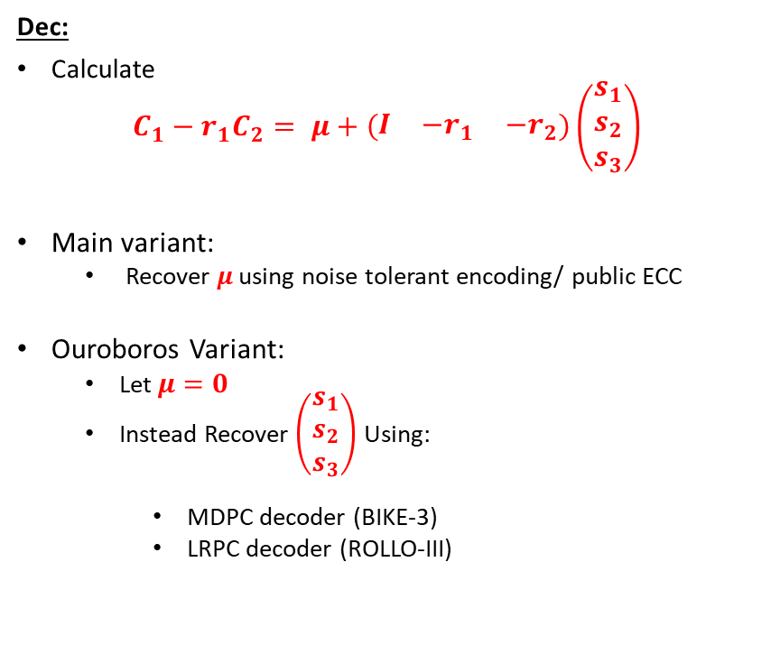
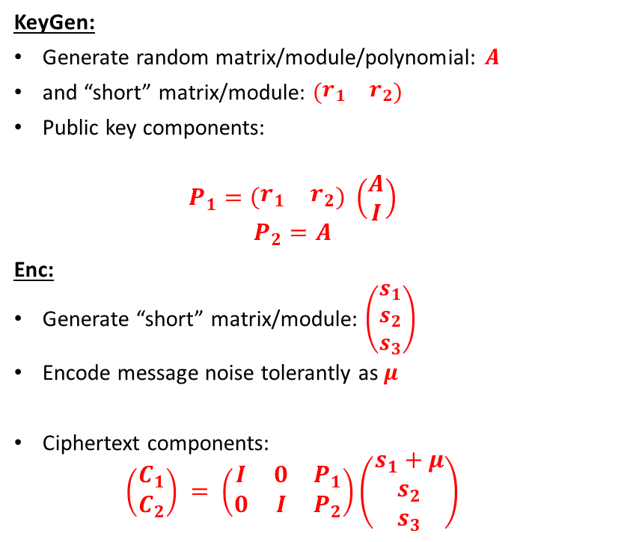
Product LWE (Typical LWE cryptosystem)
KeyGen:
Generate random matrix/module/polynomial: $A$
and “short” matrix/module: $\left(\begin{matrix}r_{1} & r_{2}\end{matrix}\right)$
Public key components:
  $$P_{1}=\left(\begin{matrix}r_{1} & r_{2}\end{matrix}\right) \left(\begin{matrix}A \\ I\end{matrix}\right)$$
  $$P_{2}=A$$
Enc:
Generate “short” matrix/module: $\left(\begin{matrix}s_{1} \\ s_{2} \\ s_{3}\end{matrix}\right)$
Encode message noise tolerantly as $μ$
Ciphertext components:
  $$\left(\begin{matrix}C_{1} \\ C_{2}\end{matrix}\right) = \left(\begin{matrix}I & 0 & P_{1} \\ 0 & I & P_{2}\end{matrix}\right)\left(\begin{matrix}s_{1}+μ \\ s_{2} \\ s_{3}\end{matrix}\right)$$
Dec:
Calculate
$$C_{1}−r_{1}C_{2}= μ+\left(\begin{matrix}I & {−r}_{1} & {−r}_{2}\end{matrix}\right)\left(\begin{matrix}s_{1} \\ s_{2} \\ s_{3}\end{matrix}\right)$$
Main variant:
  Recover $μ$ using noise tolerant encoding/ public ECC
Ouroboros Variant:
  Let $μ=0$
  Instead Recover $\left(\begin{matrix}s_{1} \\ s_{2} \\ s_{3}\end{matrix}\right)$ Using:
    MDPC decoder (BIKE-3)
    LRPC decoder (ROLLO-III)

Slide 13
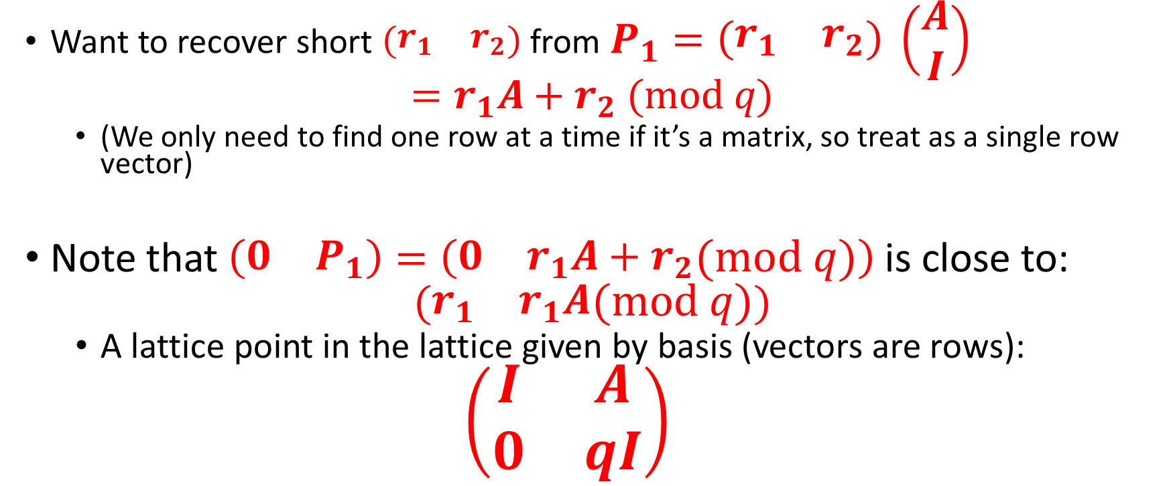
Primal Attack (1/3):
A lattice associated with LWE
Want to recover short $\left(\begin{matrix}r_{1} & r_{2}\end{matrix}\right)$ from $P_{1}=\left(\begin{matrix}r_{1} & r_{2}\end{matrix}\right) \left(\begin{matrix}A \\ I\end{matrix}\right)$
$$=r_{1}A+r_{2} (mod q)$$
  (We only need to find one row at a time if it’s a matrix, so treat as a single row vector)
Note that $\left(\begin{matrix}0 & P_{1}\end{matrix}\right)=\left(\begin{matrix}0 & r_{1}A+r_{2}\end{matrix}(mod q)\right)$is close to:
$$(\begin{matrix}r_{1} & r_{1}A\end{matrix}(mod q))$$
  A lattice point in the lattice given by basis (vectors are rows):
  $$\left(\begin{matrix}I & A \\ 0 & qI\end{matrix}\right)$$

Slide 14
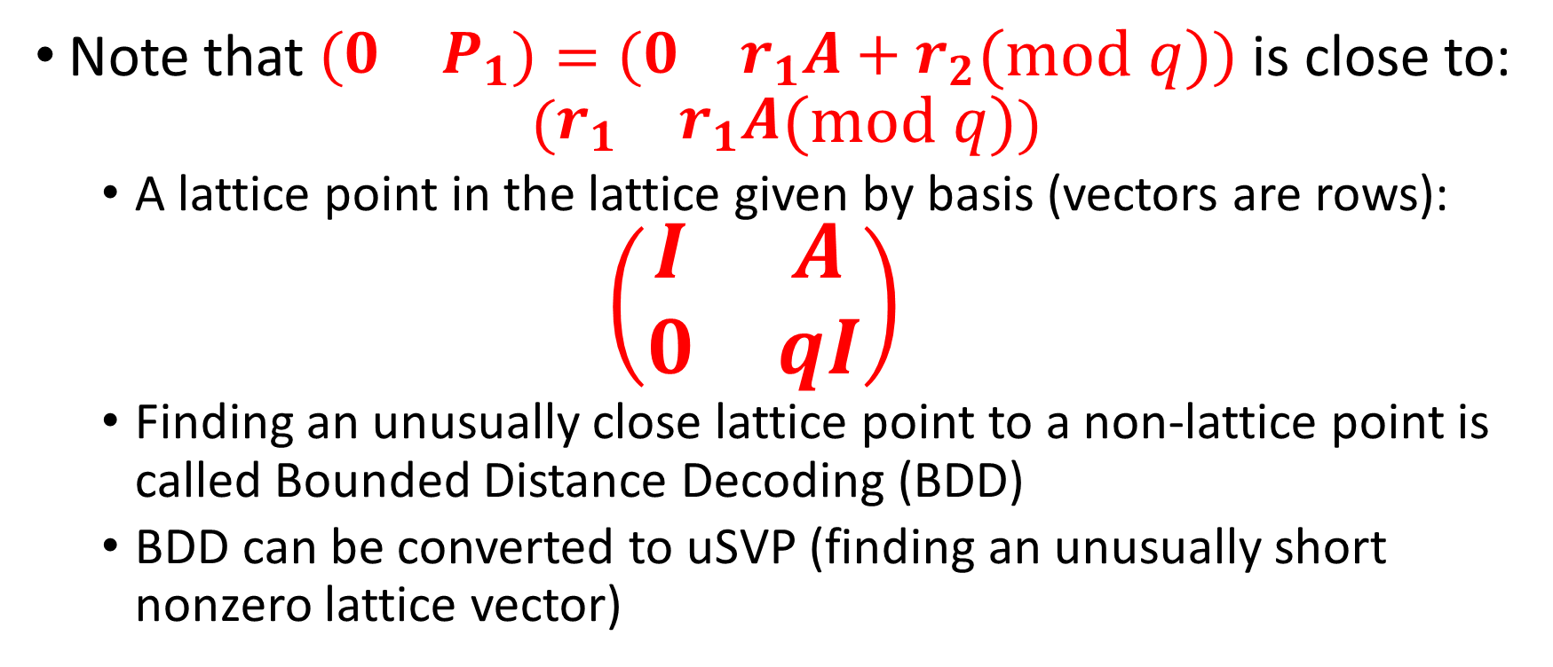
Primal attack (2/3)
LWE as BDD
Note that $\left(\begin{matrix}0 & P_{1}\end{matrix}\right)=\left(\begin{matrix}0 & r_{1}A+r_{2}\end{matrix}(mod q)\right)$is close to:
$$(\begin{matrix}r_{1} & r_{1}A\end{matrix}(mod q))$$
  A lattice point in the lattice given by basis (vectors are rows):
  $$\left(\begin{matrix}I & A \\ 0 & qI\end{matrix}\right)$$
  Finding an unusually close lattice point to a non-lattice point is called Bounded Distance Decoding (BDD)
  BDD can be converted to uSVP (finding an unusually short nonzero lattice vector)

Slide 15
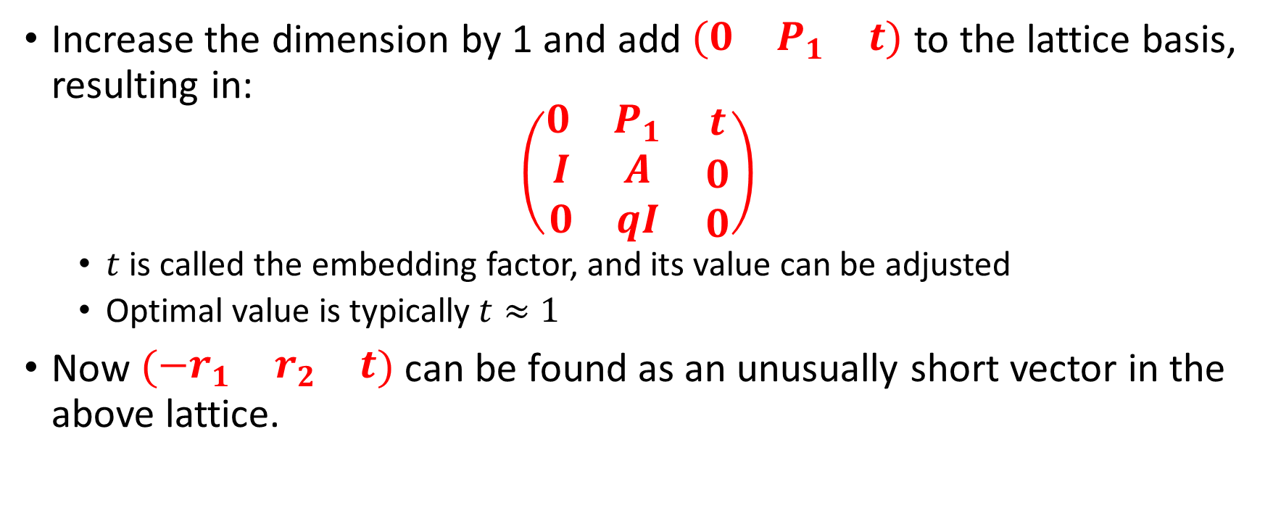
Primal Attack (3/3)
LWE recovery as uSVP (Bai-Galbraith Embedding)
Increase the dimension by 1 and add $\left(\begin{matrix}0 & P_{1} & t\end{matrix}\right)$ to the lattice basis, resulting in:
$$\left(\begin{matrix}\begin{matrix}0 & P_{1}\end{matrix} & t \\ \begin{matrix}I & A \\ 0 & qI\end{matrix} & \begin{matrix}0 \\ 0\end{matrix}\end{matrix}\right)$$
  $t$ is called the embedding factor, and its value can be adjusted
  Optimal value is typically $t≈1$
Now $\left(\begin{matrix}−r_{1} & r_{2} & t\end{matrix}\right)$ can be found as an unusually short vector in the above lattice.

Slide 16
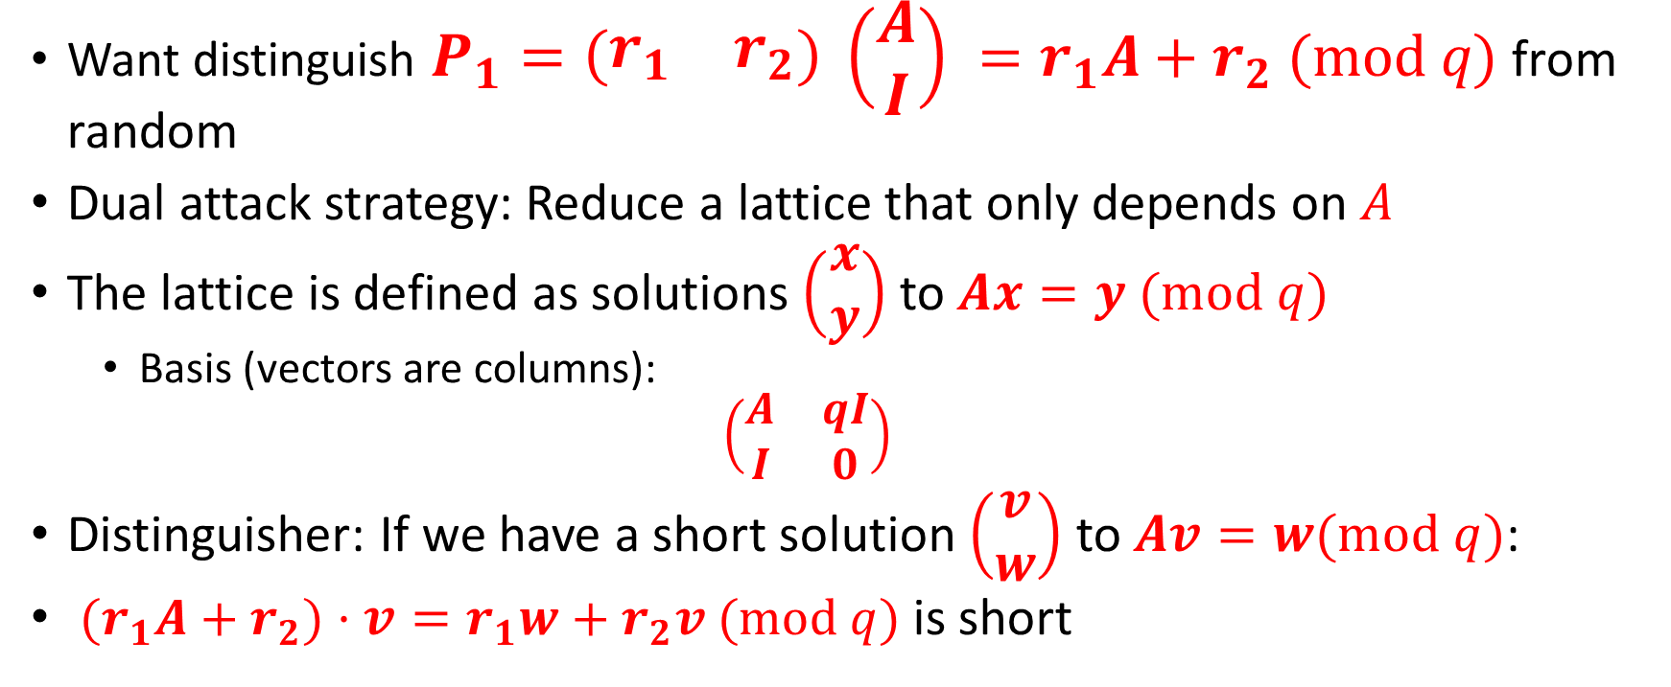
Dual Attack
Want distinguish $P_{1}=\left(\begin{matrix}r_{1} & r_{2}\end{matrix}\right) \left(\begin{matrix}A \\ I\end{matrix}\right) =r_{1}A+r_{2} (mod q)$ from random
Dual attack strategy: Reduce a lattice that only depends on $A$
The lattice is defined as solutions $\left(\begin{matrix}x \\ y\end{matrix}\right)$ to $Ax=y (mod q)$
  Basis (vectors are columns):
  $$\left(\begin{matrix}A & qI \\ I & 0\end{matrix}\right)$$
Distinguisher: If we have a short solution $\left(\begin{matrix}v \\ w\end{matrix}\right)$ to $Av=w(mod q)$:
${(r}_{1}A+r_{2})⋅v=r_{1}w+r_{2}v (mod q)$ is short

Slide 17
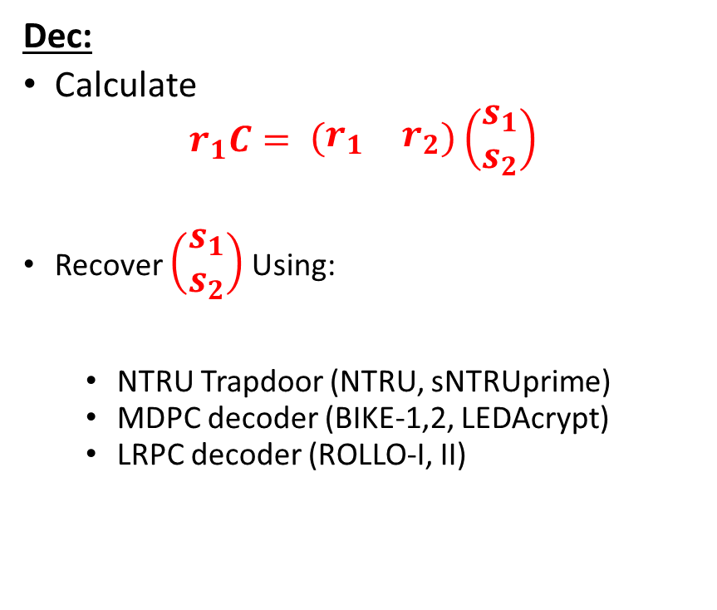
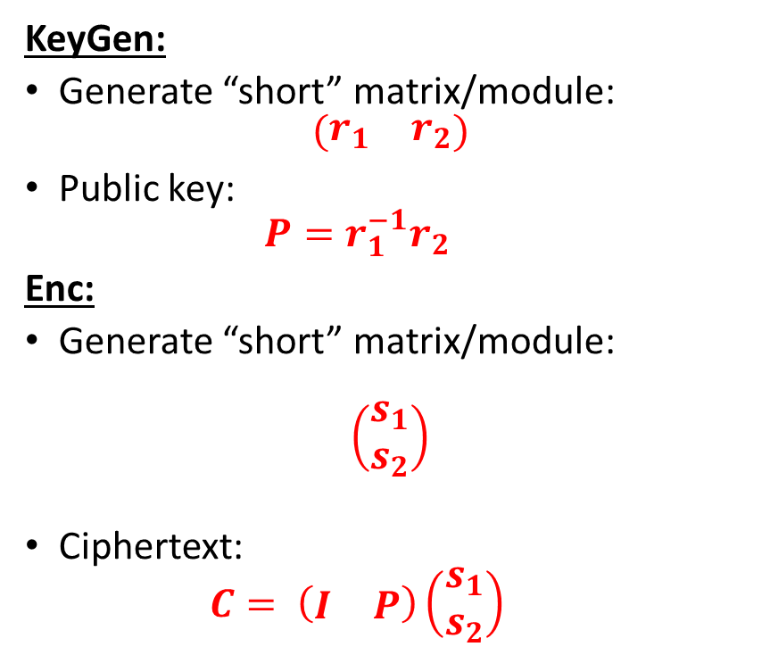
Quotient LWE (NTRU)
KeyGen:
Generate “short” matrix/module:
$$\left(\begin{matrix}r_{1} & r_{2}\end{matrix}\right)$$
Public key:
  $$P=r_{1}^{−1}r_{2}$$
Enc:
Generate “short” matrix/module:
$$\left(\begin{matrix}s_{1} \\ s_{2}\end{matrix}\right)$$
Ciphertext:
  $$C= \left(\begin{matrix}I & P\end{matrix}\right)\left(\begin{matrix}s_{1} \\ s_{2}\end{matrix}\right)$$
Dec:
Calculate
$$r_{1}C= \left(\begin{matrix}r_{1} & r_{2}\end{matrix}\right)\left(\begin{matrix}s_{1} \\ s_{2}\end{matrix}\right)$$
Recover $\left(\begin{matrix}s_{1} \\ s_{2}\end{matrix}\right)$ Using:
  NTRU Trapdoor (NTRU, sNTRUprime)
  MDPC decoder (BIKE-1,2, LEDAcrypt)
  LRPC decoder (ROLLO-I, II)

Slide 18
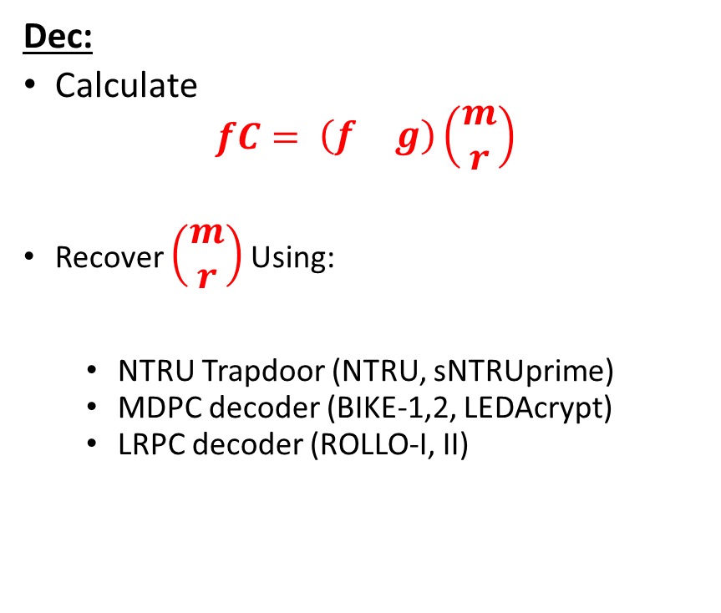
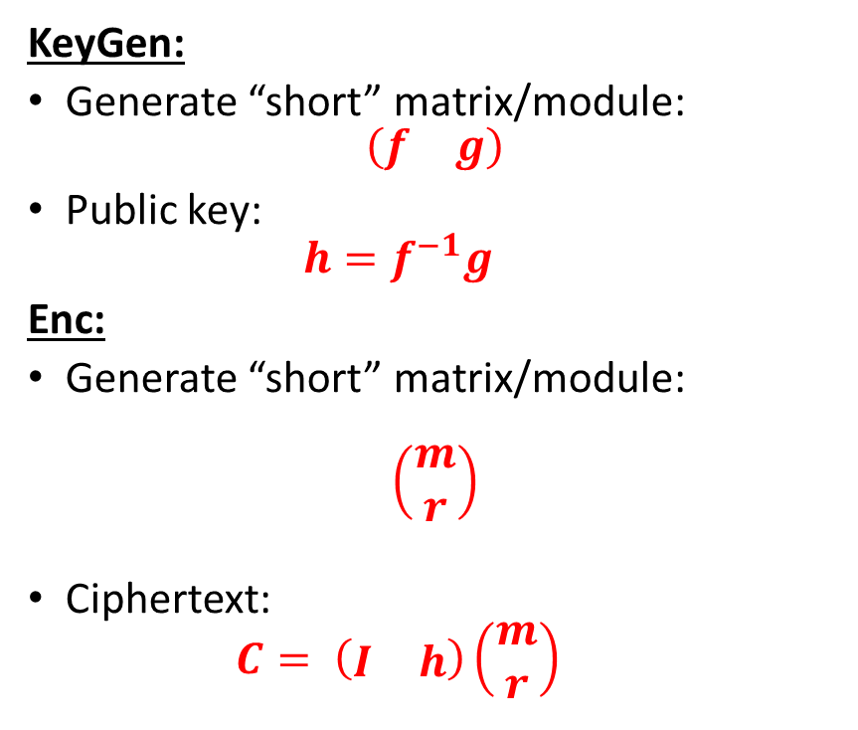
Quotient LWE (NTRU)
KeyGen:
Generate “short” matrix/module:
$$\left(\begin{matrix}f & g\end{matrix}\right)$$
Public key:
  $$h=f^{−1}g$$
Enc:
Generate “short” matrix/module:
$$\left(\begin{matrix}m \\ r\end{matrix}\right)$$
Ciphertext:
  $$C= \left(\begin{matrix}I & h\end{matrix}\right)\left(\begin{matrix}m \\ r\end{matrix}\right)$$
Dec:
Calculate
$$fC= \left(\begin{matrix}f & g\end{matrix}\right)\left(\begin{matrix}m \\ r\end{matrix}\right)$$
Recover $\left(\begin{matrix}m \\ r\end{matrix}\right)$ Using:
  NTRU Trapdoor (NTRU, sNTRUprime)
  MDPC decoder (BIKE-1,2, LEDAcrypt)
  LRPC decoder (ROLLO-I, II)

Slide 19
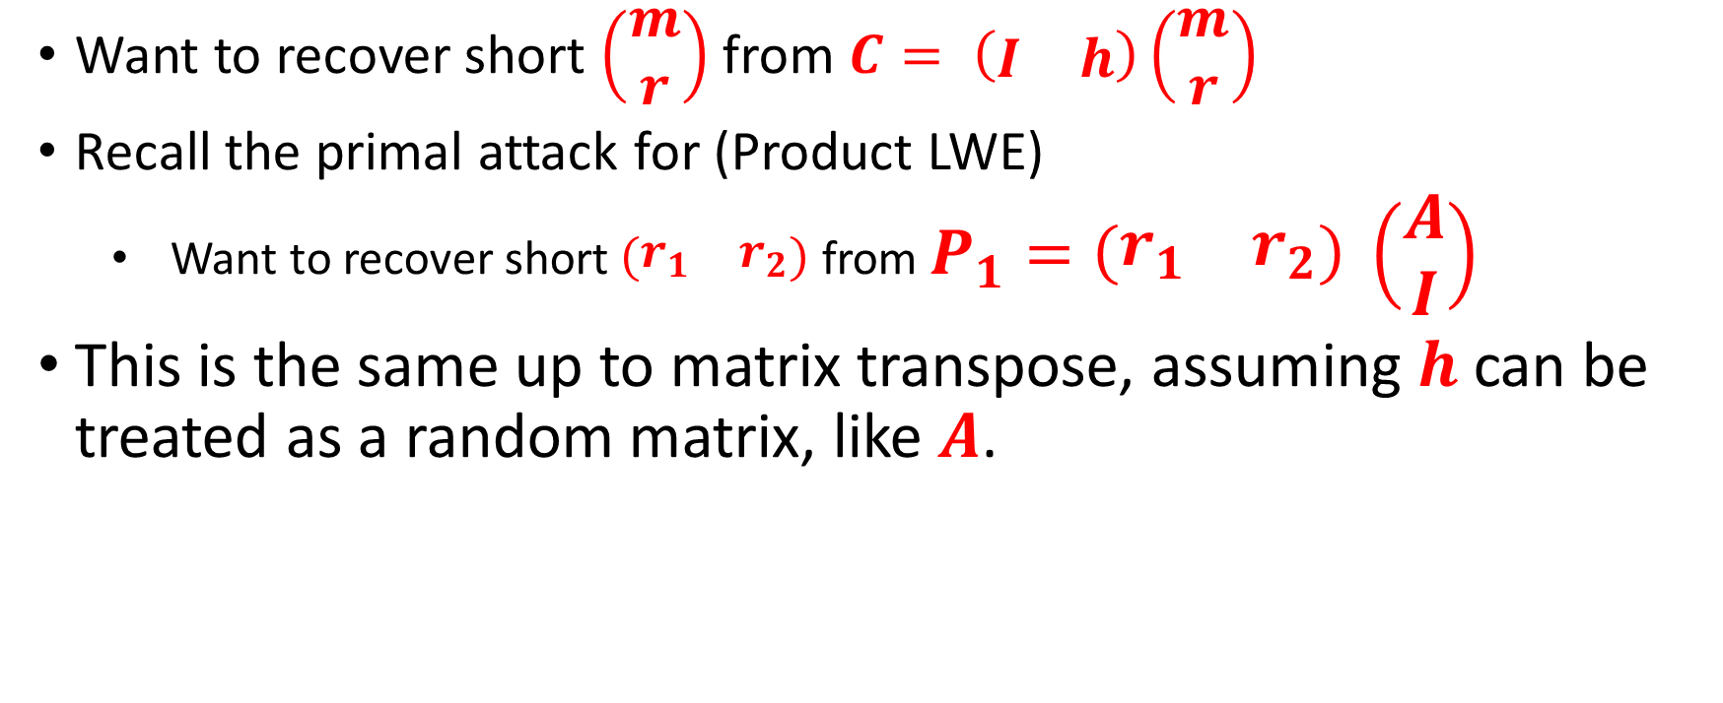
NewHope style Primal attack on NTRU
Want to recover short $\left(\begin{matrix}m \\ r\end{matrix}\right)$ from $C= \left(\begin{matrix}I & h\end{matrix}\right)\left(\begin{matrix}m \\ r\end{matrix}\right)$
Recall the primal attack for (Product LWE)
  Want to recover short $\left(\begin{matrix}r_{1} & r_{2}\end{matrix}\right)$ from $P_{1}=\left(\begin{matrix}r_{1} & r_{2}\end{matrix}\right) \left(\begin{matrix}A \\ I\end{matrix}\right)$
This is the same up to matrix transpose, assuming $h$ can be treated as a random matrix, like $A$.

Slide 20
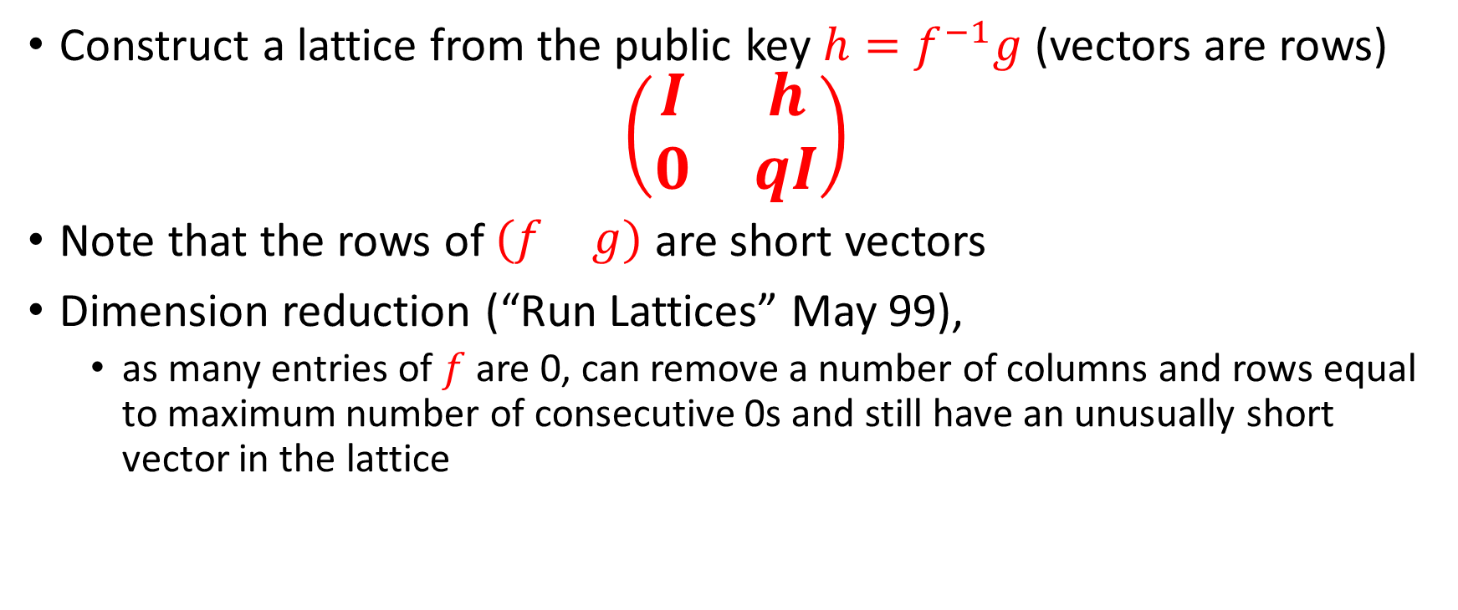
Lattice attacks
Coppersmith-Shamir 1997
Construct a lattice from the public key $h=f^{−1}g$ (vectors are rows)
$$\left(\begin{matrix}I & h \\ 0 & qI\end{matrix}\right)$$
Note that the rows of $\left(\begin{matrix}f & g\end{matrix}\right)$ are short vectors
Dimension reduction (“Run Lattices” May 99),
  as many entries of $f$ are 0, can remove a number of columns and rows equal to maximum number of consecutive 0s and still have an unusually short vector in the lattice

Slide 21
Further Improvements in May99
More dimension reduction

Slide 22
References
General references:
  Stehle, Review of Lattice Reduction Algorithm: https://wheat2016.lip6.fr/HEAT_Paris_Damien.pdf
  ADPS 2016 (NewHope Paper): https://eprint.iacr.org/2015/1092.pdf
  AGVW 2017: Revisiting the Expected Cost of Solving uSVP with applications to LWE: https://eprint.iacr.org/2017/815.pdf
Kannan embedding: https://pdfs.semanticscholar.org/9253/08b01e1a3a9944774a817c63d84c887ee277.pdf
Bai Galbraith Embedding: https://eprint.iacr.org/2013/839.pdf
NTRU Cryptanalysis
  Coppersmith, Shamir 1997: https://link.springer.com/chapter/10.1007/3-540-69053-0_5
  May 1999: https://citeseerx.ist.psu.edu/viewdoc/download?doi=10.1.1.41.3484&rep=rep1&type=pdf
  Howgrave-Graham 2005 (Hybrid attack): https://iacr.org/archive/crypto2007/46220150/46220150.pdf

