Slide 2
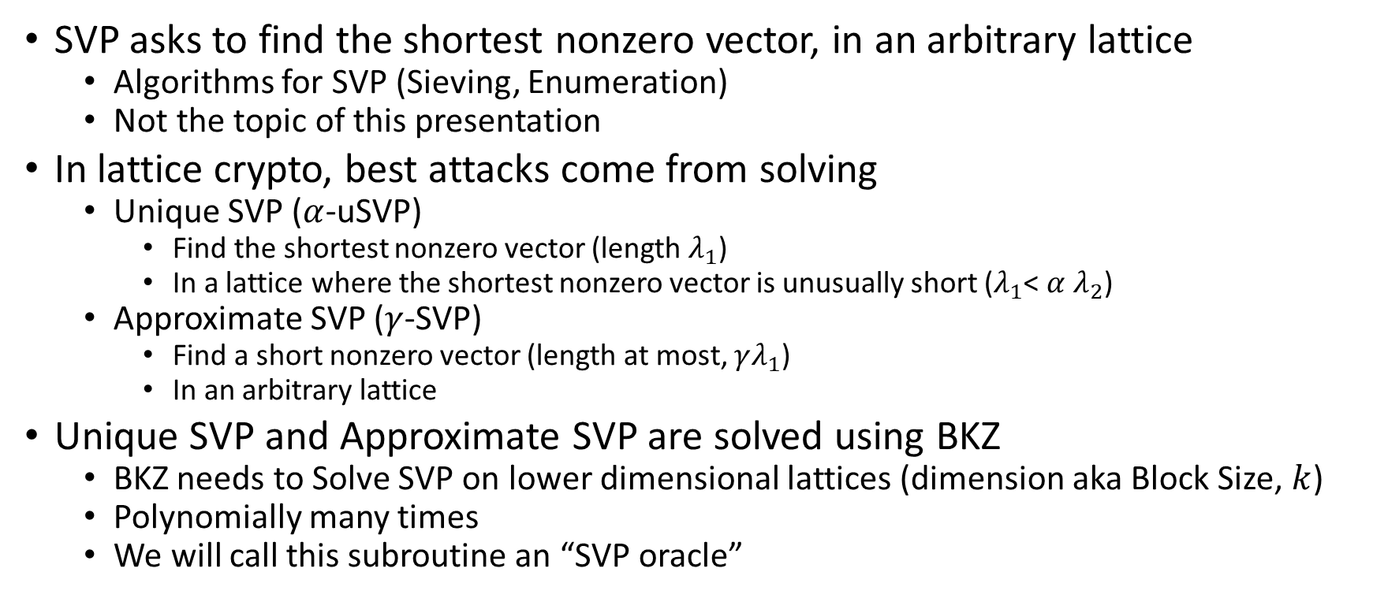
BKZ Overview
SVP asks to find the shortest nonzero vector, in an arbitrary lattice
  Algorithms for SVP (Sieving, Enumeration)
  Not the topic of this presentation
In lattice crypto, best attacks come from solving
  Unique SVP ($α$-uSVP)
    Find the shortest nonzero vector (length $λ_{1}$)
    In a lattice where the shortest nonzero vector is unusually short ($λ_{1}$< $α$ $λ_{2}$)
  Approximate SVP ($γ$-SVP)
    Find a short nonzero vector (length at most, $γλ_{1}$)
    In an arbitrary lattice
Unique SVP and Approximate SVP are solved using BKZ
  BKZ needs to Solve SVP on lower dimensional lattices (dimension aka Block Size, $k$)
  Polynomially many times
  We will call this subroutine an “SVP oracle”

Slide 3
Tools for reasoning about BKZ
Lattice Determinant
Minkowski’s theorem
Gaussian Heuristic
Gram-Schmidt Orthogonalization
QR factorization
Geometric Series Assumption

Slide 4
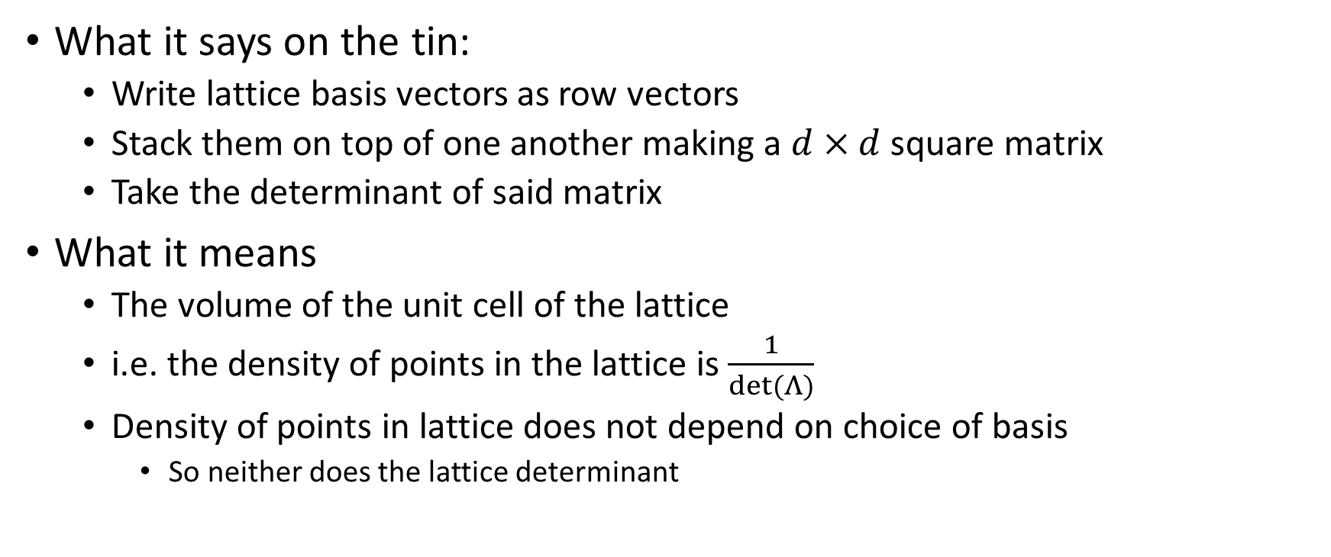

Lattice Determinant $det⁡(Λ)$
What it says on the tin:
  Write lattice basis vectors as row vectors
  Stack them on top of one another making a $d×d$ square matrix
  Take the determinant of said matrix
What it means
  The volume of the unit cell of the lattice
  i.e. the density of points in the lattice is $\frac{1}{det⁡(Λ)}$
  Density of points in lattice does not depend on choice of basis
    So neither does the lattice determinant

Slide 5


Using $det⁡(Λ)$ to Bound/Estimate $λ_{1}$
Minkowski’s theorem
$$λ_{1}≤\sqrt{d}∙{(det⁡(Λ))}^{\frac{1}{d}}$$
Gaussian Heuristic
$$λ_{1}≈\sqrt{\frac{d}{2πe}}∙{(det⁡(Λ))}^{\frac{1}{d}}$$

Slide 6
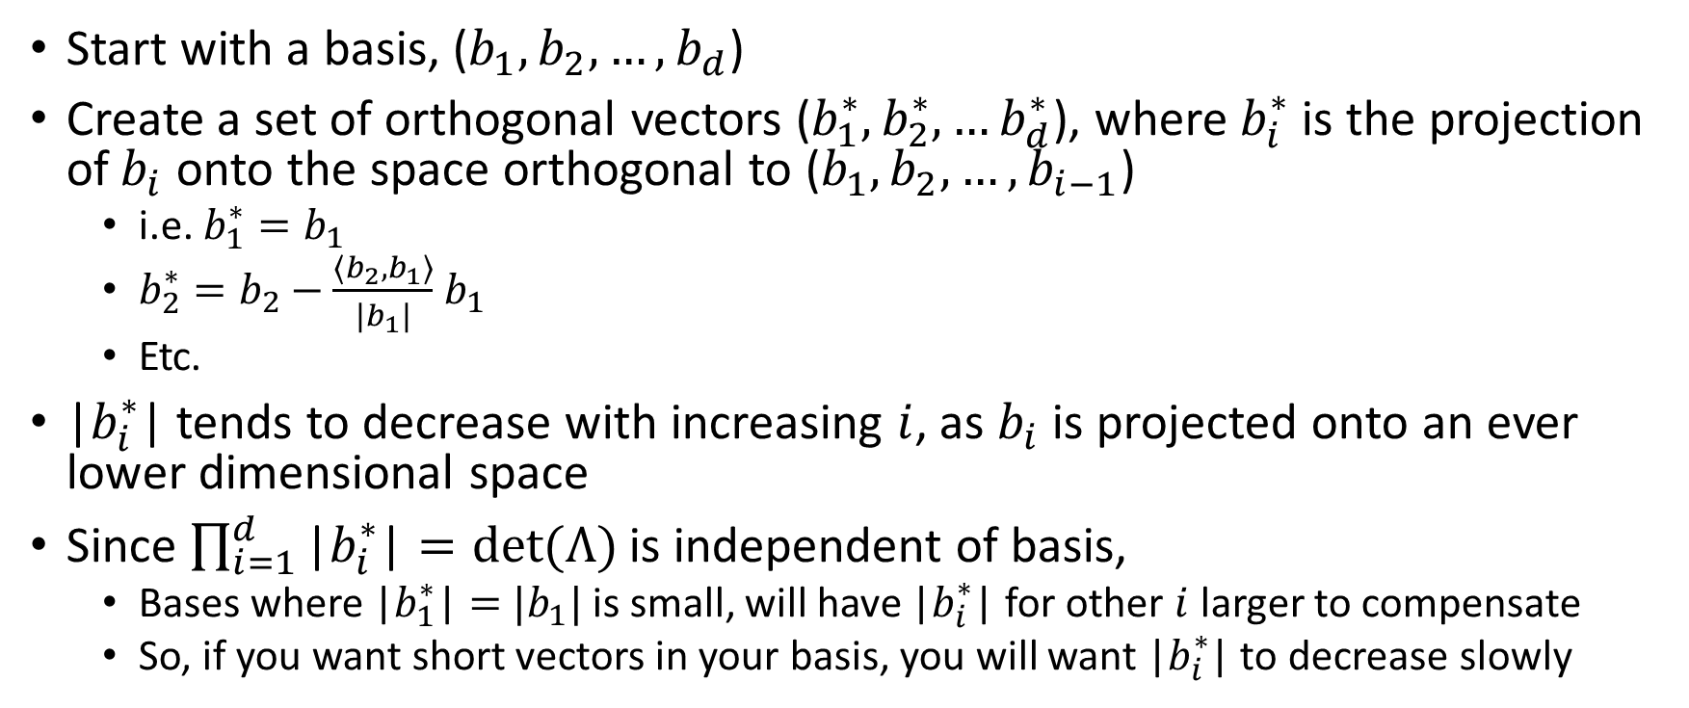
Gram Schmidt Orthogonalization
Start with a basis, ($b_{1}, b_{2}, …, b_{d}$)
Create a set of orthogonal vectors ($b_{1}^{∗},b_{2}^{∗},…b_{d}^{∗}$), where $b_{i}^{∗}$ is the projection of$b_{i}$ onto the space orthogonal to ($b_{1}, b_{2}, …, b_{i−1}$)
  i.e. $b_{1}^{∗}=b_{1}$
  $b_{2}^{∗}=b_{2}−\frac{\left\langle b_{2},b_{1}\right\rangle }{|b_{1}|}$ $b_{1}$
  Etc.
|$b_{i}^{∗}$| tends to decrease with increasing $i$, as $b_{i}$ is projected onto an ever lower dimensional space
Since $\prod_{i=1}^{d}{\text{|}b_{i}^{∗}\text{|}=det⁡(Λ)}$ is independent of basis,
  Bases where $\text{|}b_{1}^{∗}\text{|}=$ $|b_{1}|$ is small, will have $\text{|}b_{i}^{∗}\text{|}$ for other $i$ larger to compensate
  So, if you want short vectors in your basis, you will want |$b_{i}^{∗}$| to decrease slowly

Slide 7


Lattice reduction and Gram-Schmidt norm
Bad Basis
Good Basis
$$\left|b_{i}^{∗}\right|$$
$$i$$

Slide 8
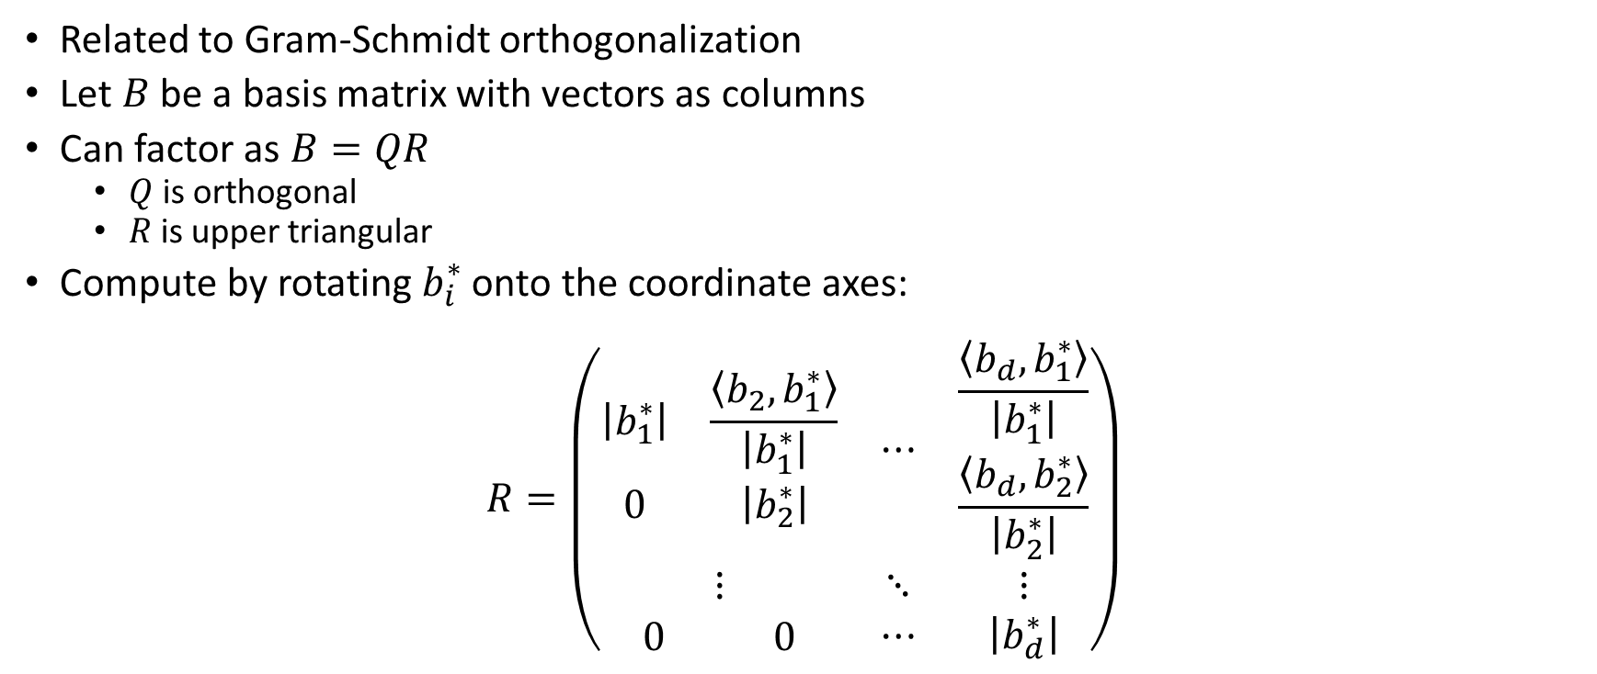
QR factorization
Related to Gram-Schmidt orthogonalization
Let $B$ be a basis matrix with vectors as columns
Can factor as $B=QR$
  $Q$ is orthogonal
  $R$ is upper triangular
Compute by rotating $b_{i}^{∗}$ onto the coordinate axes:
$$R=\left(\begin{matrix}\begin{matrix}\left|b_{1}^{∗}\right| & \frac{\left\langle b_{2},b_{1}^{∗}\right\rangle }{\left|b_{1}^{∗}\right|} \\ 0 & \left|b_{2}^{∗}\right|\end{matrix} & ⋯ & \begin{matrix}\frac{\left\langle b_{d},b_{1}^{∗}\right\rangle }{\left|b_{1}^{∗}\right|} \\ \frac{\left\langle b_{d},b_{2}^{∗}\right\rangle }{\left|b_{2}^{∗}\right|}\end{matrix} \\ ⋮ & ⋱ & ⋮ \\ \begin{matrix}0 & 0\end{matrix} & ⋯ & \left|b_{d}^{∗}\right|\end{matrix}\right)$$

Slide 9
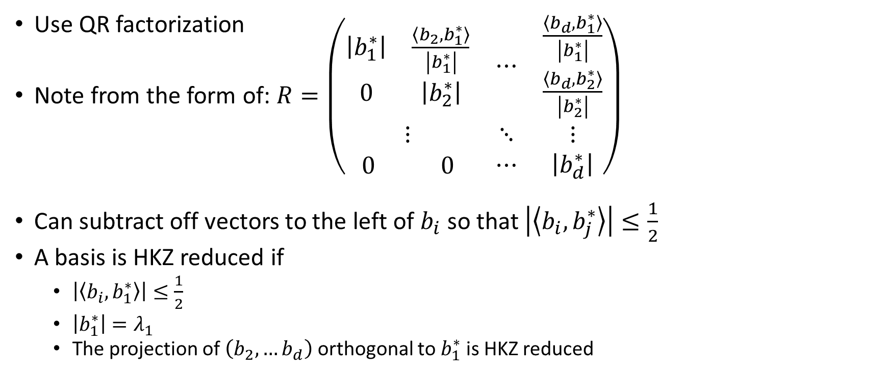
HKZ reduction
(What to do with an SVP oracle)
Use QR factorization
Note from the form of: $R=\left(\begin{matrix}\begin{matrix}\left|b_{1}^{∗}\right| & \frac{\left\langle b_{2},b_{1}^{∗}\right\rangle }{\left|b_{1}^{∗}\right|} \\ 0 & \left|b_{2}^{∗}\right|\end{matrix} & ⋯ & \begin{matrix}\frac{\left\langle b_{d},b_{1}^{∗}\right\rangle }{\left|b_{1}^{∗}\right|} \\ \frac{\left\langle b_{d},b_{2}^{∗}\right\rangle }{\left|b_{2}^{∗}\right|}\end{matrix} \\ ⋮ & ⋱ & ⋮ \\ \begin{matrix}0 & 0\end{matrix} & ⋯ & \left|b_{d}^{∗}\right|\end{matrix}\right)$
Can subtract off vectors to the left of $b_{i}$ so that $\left|\left\langle b_{i},b_{j}^{∗}\right\rangle \right|≤\frac{1}{2}$
A basis is HKZ reduced if
  $\left|\left\langle b_{i},b_{1}^{∗}\right\rangle \right|≤\frac{1}{2}$
  $\left|b_{1}^{∗}\right|=λ_{1}$
  The projection of $\left(b_{2},…b_{d}\right)$ orthogonal to $b_{1}^{∗}$ is HKZ reduced

Slide 10
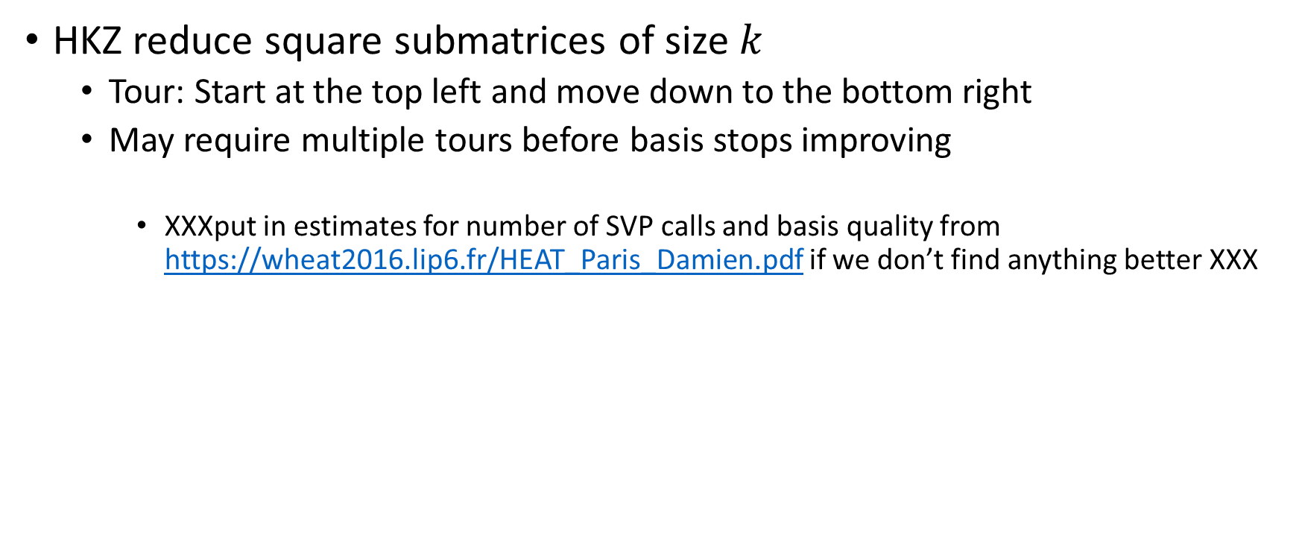
BKZ algorithm
HKZ reduce square submatrices of size $k$
  Tour: Start at the top left and move down to the bottom right
  May require multiple tours before basis stops improving
    XXXput in estimates for number of SVP calls and basis quality from https://wheat2016.lip6.fr/HEAT_Paris_Damien.pdf if we don’t find anything better XXX

Slide 11
Attacks and Lattice Problems
LWE and NTRU style cryptosystems get unique SVP and approximate SVP instances via primal and dual attack strategies
We will study these strategies in the next few slides
 | LWE | NTRU
Primal | uSVP | uSVP
Dual | Approximate SVP | uSVP (Hybrid MITM)

Slide 12
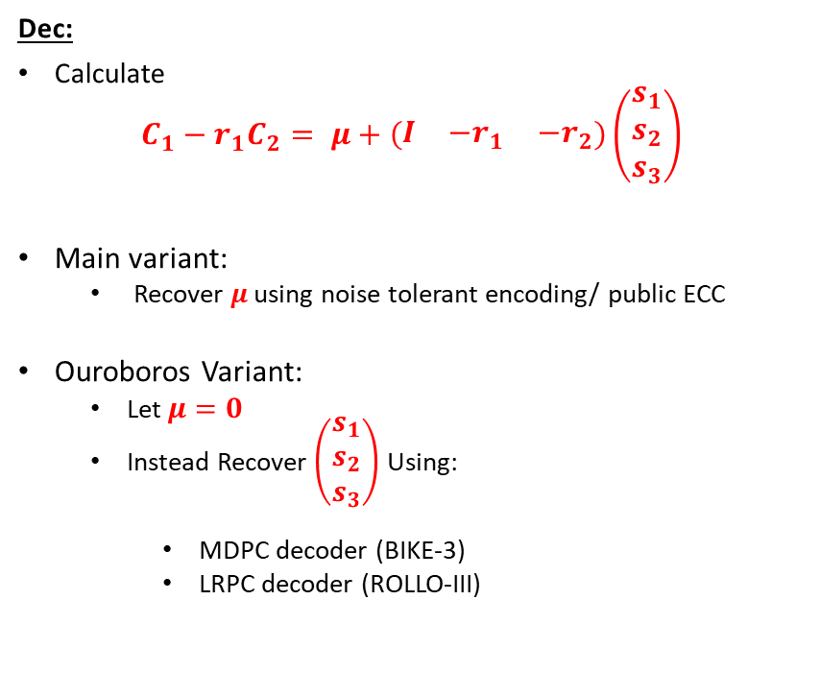
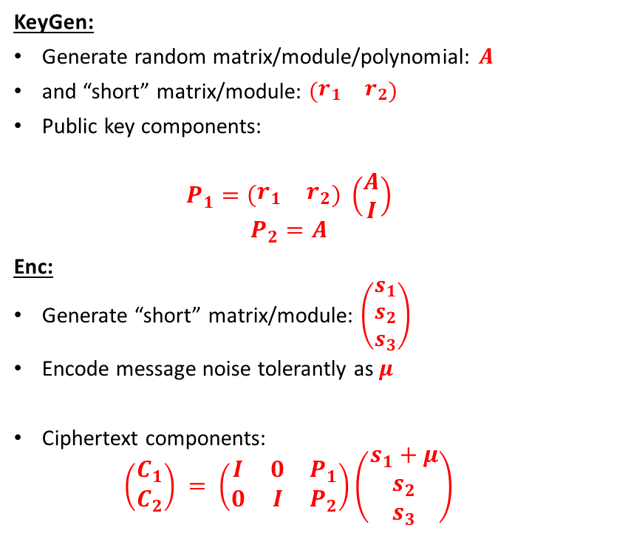
Product LWE (Typical LWE cryptosystem)
KeyGen:
Generate random matrix/module/polynomial: $A$
and “short” matrix/module: $\left(\begin{matrix}r_{1} & r_{2}\end{matrix}\right)$
Public key components:
  $$P_{1}=\left(\begin{matrix}r_{1} & r_{2}\end{matrix}\right) \left(\begin{matrix}A \\ I\end{matrix}\right)$$
  $$P_{2}=A$$
Enc:
Generate “short” matrix/module: $\left(\begin{matrix}s_{1} \\ s_{2} \\ s_{3}\end{matrix}\right)$
Encode message noise tolerantly as $μ$
Ciphertext components:
  $$\left(\begin{matrix}C_{1} \\ C_{2}\end{matrix}\right) = \left(\begin{matrix}I & 0 & P_{1} \\ 0 & I & P_{2}\end{matrix}\right)\left(\begin{matrix}s_{1}+μ \\ s_{2} \\ s_{3}\end{matrix}\right)$$
Dec:
Calculate
$$C_{1}−r_{1}C_{2}= μ+\left(\begin{matrix}I & {−r}_{1} & {−r}_{2}\end{matrix}\right)\left(\begin{matrix}s_{1} \\ s_{2} \\ s_{3}\end{matrix}\right)$$
Main variant:
  Recover $μ$ using noise tolerant encoding/ public ECC
Ouroboros Variant:
  Let $μ=0$
  Instead Recover $\left(\begin{matrix}s_{1} \\ s_{2} \\ s_{3}\end{matrix}\right)$ Using:
    MDPC decoder (BIKE-3)
    LRPC decoder (ROLLO-III)

Slide 13
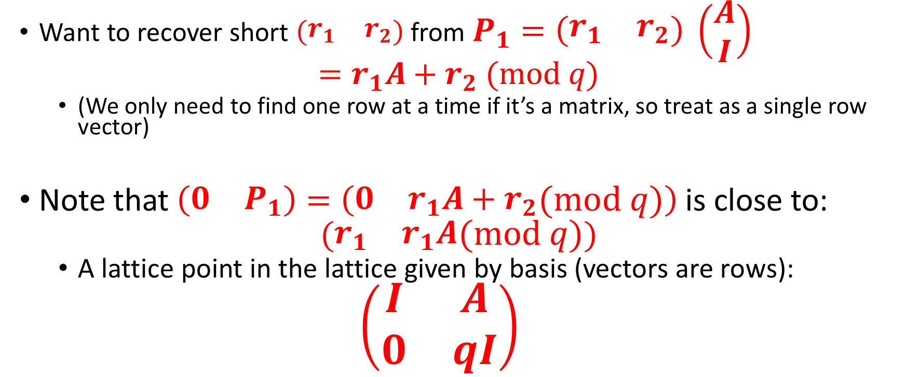
Primal Attack (1/3):
A lattice associated with LWE
Want to recover short $\left(\begin{matrix}r_{1} & r_{2}\end{matrix}\right)$ from $P_{1}=\left(\begin{matrix}r_{1} & r_{2}\end{matrix}\right) \left(\begin{matrix}A \\ I\end{matrix}\right)$
$$=r_{1}A+r_{2} (mod q)$$
  (We only need to find one row at a time if it’s a matrix, so treat as a single row vector)
Note that $\left(\begin{matrix}0 & P_{1}\end{matrix}\right)=\left(\begin{matrix}0 & r_{1}A+r_{2}\end{matrix}(mod q)\right)$is close to:
$$(\begin{matrix}r_{1} & r_{1}A\end{matrix}(mod q))$$
  A lattice point in the lattice given by basis (vectors are rows):
  $$\left(\begin{matrix}I & A \\ 0 & qI\end{matrix}\right)$$

Slide 14
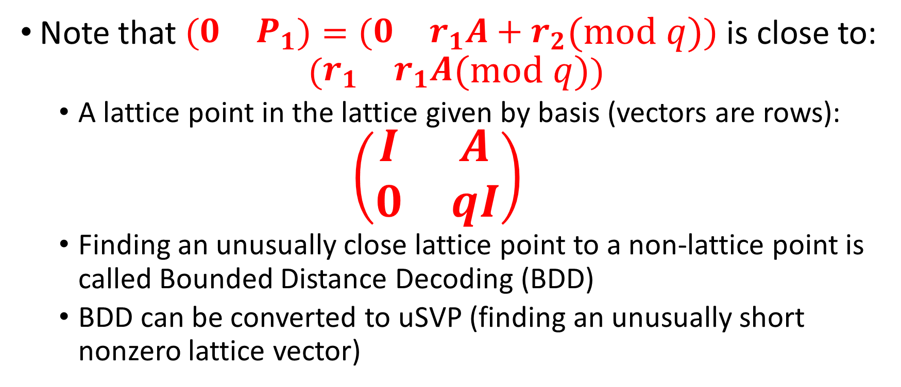
Primal attack (2/3)
LWE as BDD
Note that $\left(\begin{matrix}0 & P_{1}\end{matrix}\right)=\left(\begin{matrix}0 & r_{1}A+r_{2}\end{matrix}(mod q)\right)$is close to:
$$(\begin{matrix}r_{1} & r_{1}A\end{matrix}(mod q))$$
  A lattice point in the lattice given by basis (vectors are rows):
  $$\left(\begin{matrix}I & A \\ 0 & qI\end{matrix}\right)$$
  Finding an unusually close lattice point to a non-lattice point is called Bounded Distance Decoding (BDD)
  BDD can be converted to uSVP (finding an unusually short nonzero lattice vector)

Slide 15
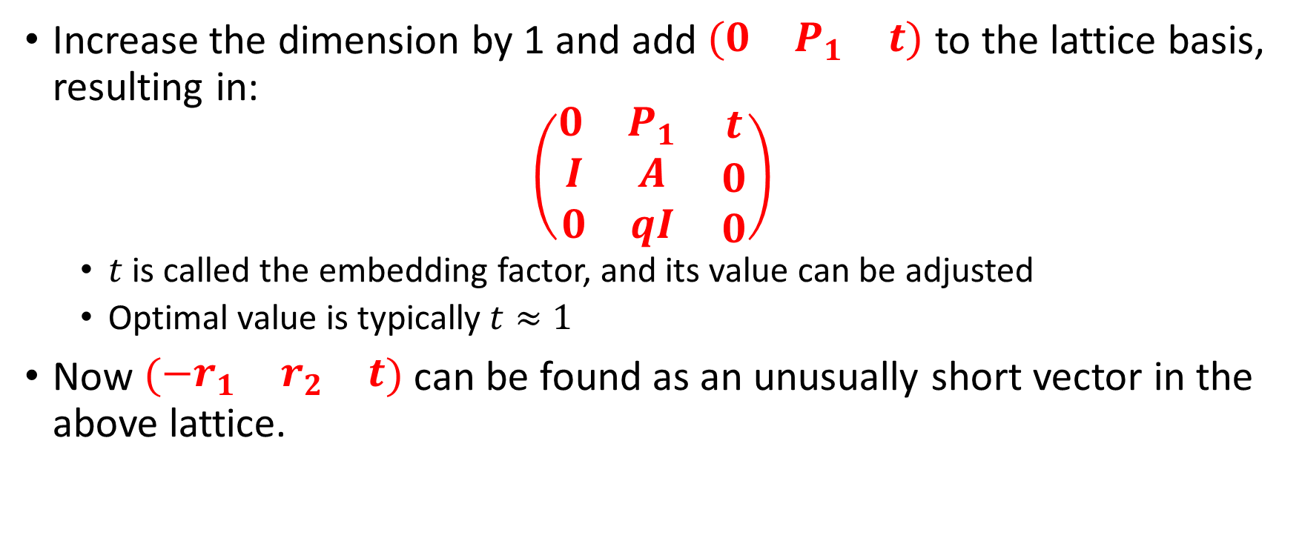
Primal Attack (3/3)
LWE recovery as uSVP
Increase the dimension by 1 and add $\left(\begin{matrix}0 & P_{1} & t\end{matrix}\right)$ to the lattice basis, resulting in:
$$\left(\begin{matrix}\begin{matrix}0 & P_{1}\end{matrix} & t \\ \begin{matrix}I & A \\ 0 & qI\end{matrix} & \begin{matrix}0 \\ 0\end{matrix}\end{matrix}\right)$$
  $t$ is called the embedding factor, and its value can be adjusted
  Optimal value is typically $t≈1$
Now $\left(\begin{matrix}−r_{1} & r_{2} & t\end{matrix}\right)$ can be found as an unusually short vector in the above lattice.

Slide 16
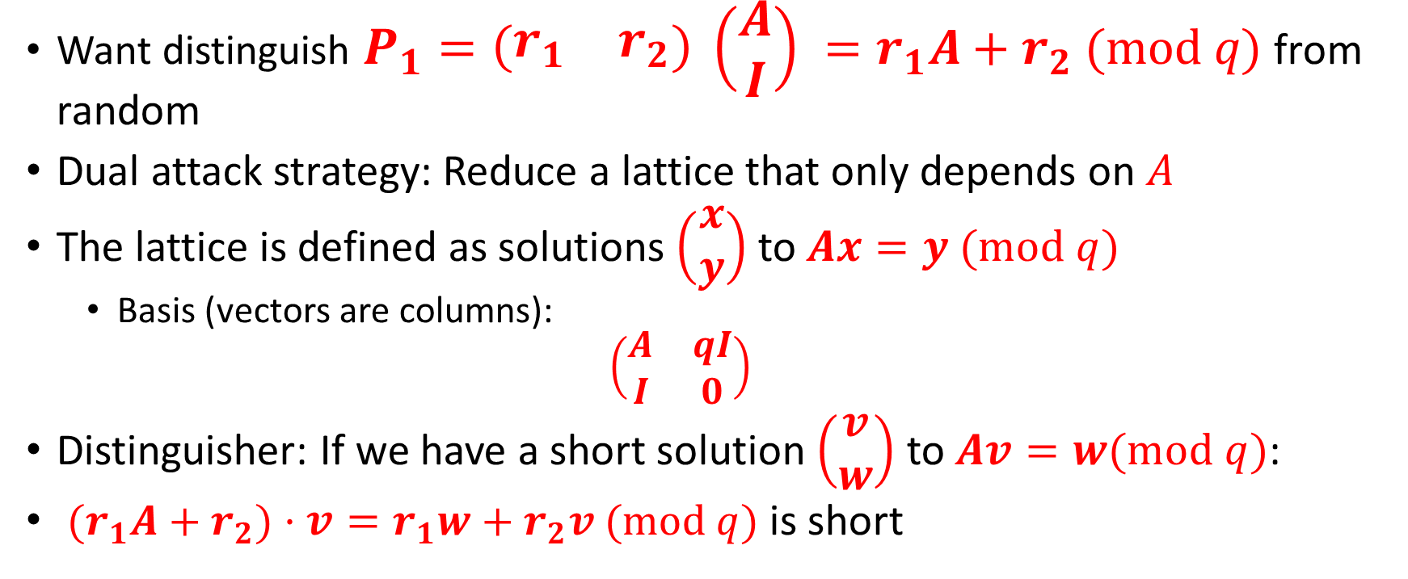
Dual Attack
Want distinguish $P_{1}=\left(\begin{matrix}r_{1} & r_{2}\end{matrix}\right) \left(\begin{matrix}A \\ I\end{matrix}\right) =r_{1}A+r_{2} (mod q)$ from random
Dual attack strategy: Reduce a lattice that only depends on $A$
The lattice is defined as solutions $\left(\begin{matrix}x \\ y\end{matrix}\right)$ to $Ax=y (mod q)$
  Basis (vectors are columns):
  $$\left(\begin{matrix}A & qI \\ I & 0\end{matrix}\right)$$
Distinguisher: If we have a short solution $\left(\begin{matrix}v \\ w\end{matrix}\right)$ to $Av=w(mod q)$:
${(r}_{1}A+r_{2})⋅v=r_{1}w+r_{2}v (mod q)$ is short

Slide 17
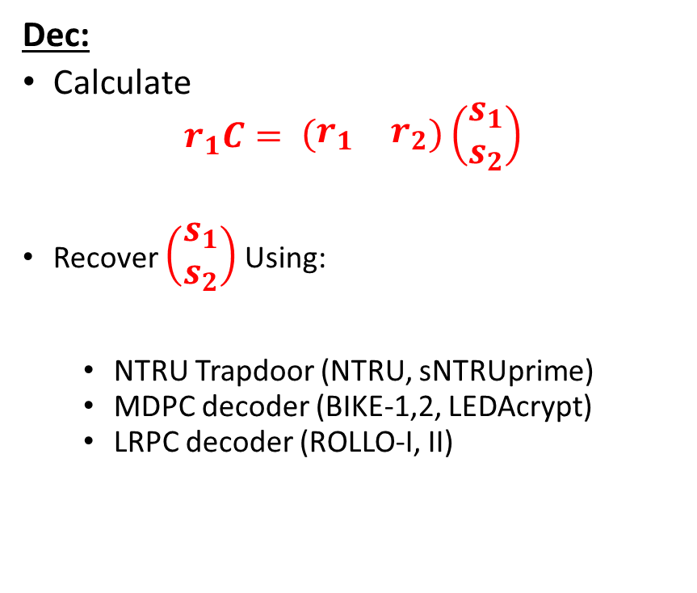
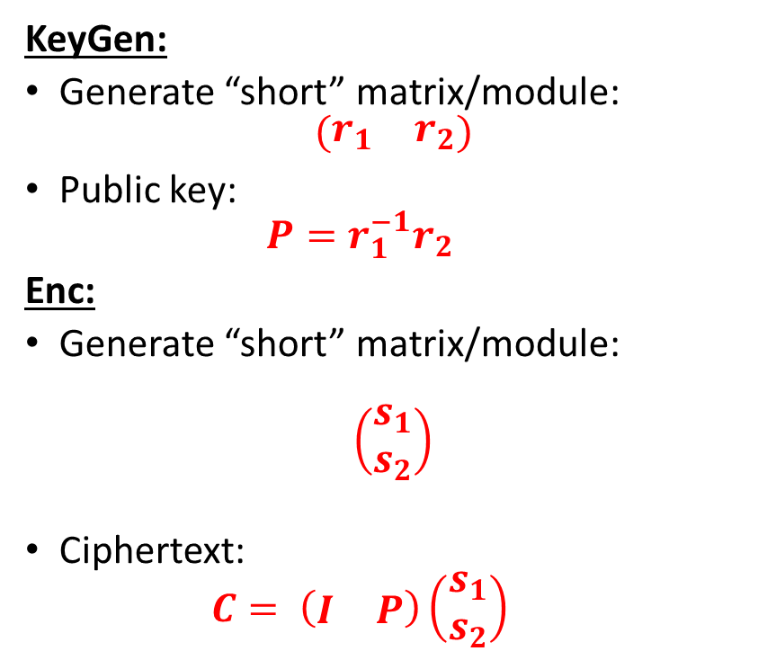
Quotient LWE (NTRU)
KeyGen:
Generate “short” matrix/module:
$$\left(\begin{matrix}r_{1} & r_{2}\end{matrix}\right)$$
Public key:
  $$P=r_{1}^{−1}r_{2}$$
Enc:
Generate “short” matrix/module:
$$\left(\begin{matrix}s_{1} \\ s_{2}\end{matrix}\right)$$
Ciphertext:
  $$C= \left(\begin{matrix}I & P\end{matrix}\right)\left(\begin{matrix}s_{1} \\ s_{2}\end{matrix}\right)$$
Dec:
Calculate
$$r_{1}C= \left(\begin{matrix}r_{1} & r_{2}\end{matrix}\right)\left(\begin{matrix}s_{1} \\ s_{2}\end{matrix}\right)$$
Recover $\left(\begin{matrix}s_{1} \\ s_{2}\end{matrix}\right)$ Using:
  NTRU Trapdoor (NTRU, sNTRUprime)
  MDPC decoder (BIKE-1,2, LEDAcrypt)
  LRPC decoder (ROLLO-I, II)

Slide 18
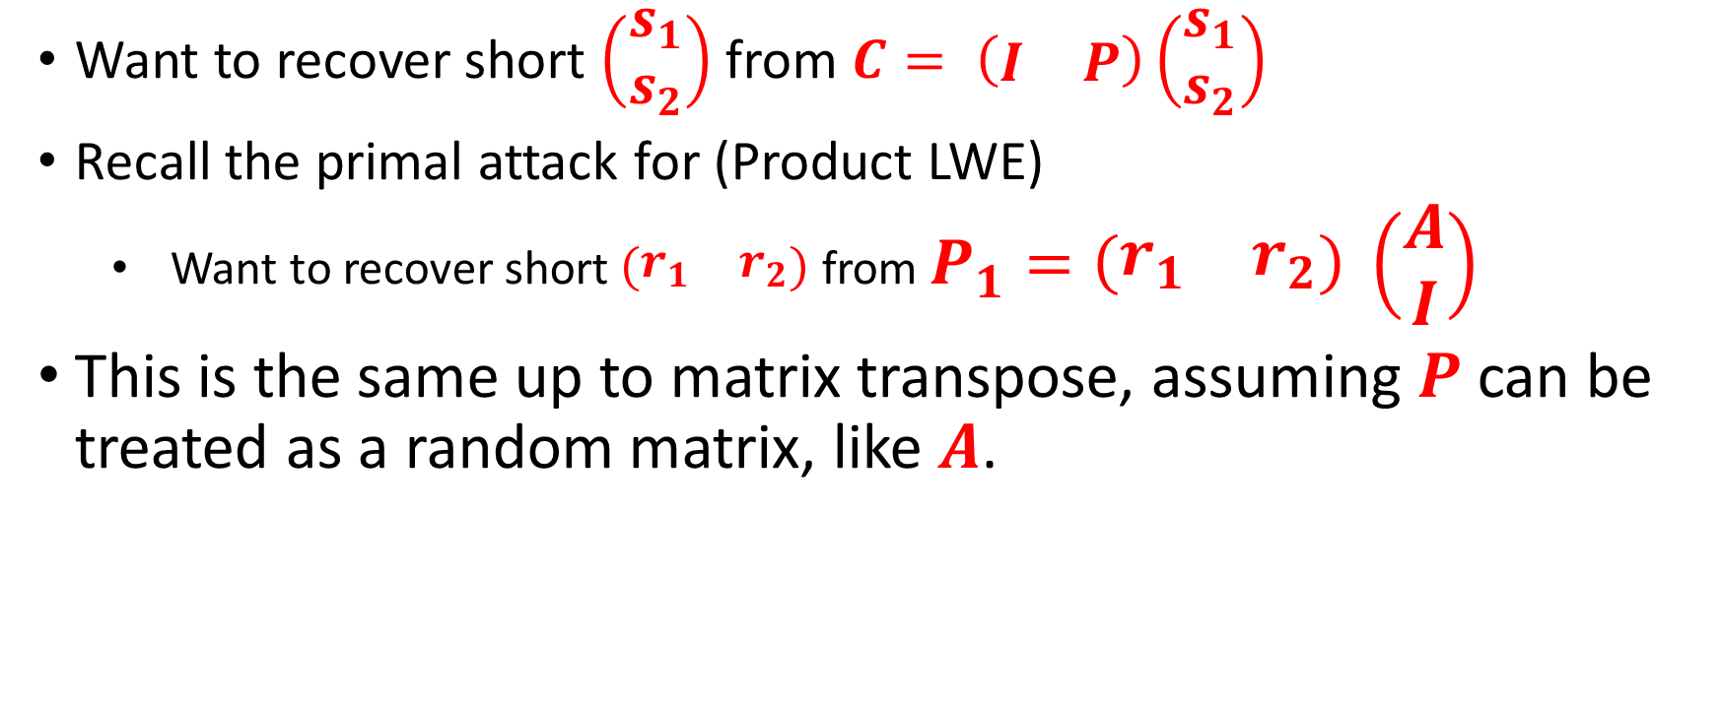
Primal attack on NTRU
Want to recover short $\left(\begin{matrix}s_{1} \\ s_{2}\end{matrix}\right)$ from $C= \left(\begin{matrix}I & P\end{matrix}\right)\left(\begin{matrix}s_{1} \\ s_{2}\end{matrix}\right)$
Recall the primal attack for (Product LWE)
  Want to recover short $\left(\begin{matrix}r_{1} & r_{2}\end{matrix}\right)$ from $P_{1}=\left(\begin{matrix}r_{1} & r_{2}\end{matrix}\right) \left(\begin{matrix}A \\ I\end{matrix}\right)$
This is the same up to matrix transpose, assuming $P$ can be treated as a random matrix, like $A$.

Slide 19
Dual Attack on NTRU
(Hybrid MITM)

