Slide 1
Lattice Cryptanalysis I
Ray Perlner, Daniel Apon
NIST internal talk

Slide 2
This talk series
We want to internally distribute expertise on cryptanalyzing lattices
  Why? Every Finalist in Round 3 is a lattice, or it’s not* subject to cryptanalysis
  *meaning it’s McEliece or SPHINCS+, where we don’t expect big breaks…
We wanted to force most people to give one “hard” talk on lattices.
  Seems the best way to ensure everyone gains some familiarity.
What are our main goal(s)?
  Everyone learns how to calculate concrete bit-security of lattice schemes.
  Maybe spawn some of our own research into lattice cryptanalysis…

Slide 3
The sequence of talks in this series (and why)
Introduction to lattice cryptanalysis (Ray + DanielA)
  Give the high-level framework of the “canonical attack”: Lattice reduction/BKZ
  Everything else is a subroutine that plugs into this framework!
Nguyen-Vidick Sieve (Angela)
BGJ Sieve (Dustin)
BGDL Sieve (Ray)
Dimensions For Free (DanielST)
Progressive Sieving (Yi-Kai)
Jessica / G6K: the General Sieve Kernel (DanielA)
Faster Lattice Enumeration (John + Quynh)
More?? (Let’s find any gaps along the way, and prepare more talks if so)
  Other topics like the “Soliloquy story” are out there, and are interesting! (Research topic?)

Slide 4
This talk (outline)
BKZ overview (and how it helps break our lattice cryptosystems)
Some nice pictures of lattices
Mathematical tools for reasoning about BKZ
  Lattice determinant, Minkowski, the Gaussian Heuristic, GS Orthoganalization,
  QR factorization, HKZ reduction, the Geometric Series assumption, etc.
The Primal attack and the Dual attack (guessing/hybrid attacks?)
How to attack LWE (how to attack NTRU)
  Turning cryptosystems (viewed as LWE/NTRU samples) into bad bases for BKZ
Discussion

Slide 5
What did we leave off for now? A short list…
Quantum cryptanalysis (in general)
Soliloquy (specifically)
How does algebraic structure play into any attack? (It doesn’t…yet?)
Memory costing models
  CoreSVP vs Gate Count vs others (Area/Volume/Death Stars/Solar Computing)

Slide 6
Last preliminary issue: Lecture book-keeping
If we have interesting discussion along the way or if a speaker makes good comments not on slides, it would be good to keep an ongoing record of this on Sharepoint (where anyone can access it later).
I recommend we adopt the “scribing” model, akin to lectures in a grad school course on a specialized topic
  Person A is giving a talk; Person B will be a scribe (Dustin is scribe today)
    Everyone tries to sign up for each job at most once, in a “rotating schedule”
  Person A prepares slides from a paper, gives a talk to the group
  Person B writes 1-2 pages of notes (in LaTeX?) capturing the main ideas,
  and uploads it somewhere (Sharepoint?) so that we can all access it later

Slide 7
Ok, let’s get started. ☺

Slide 8
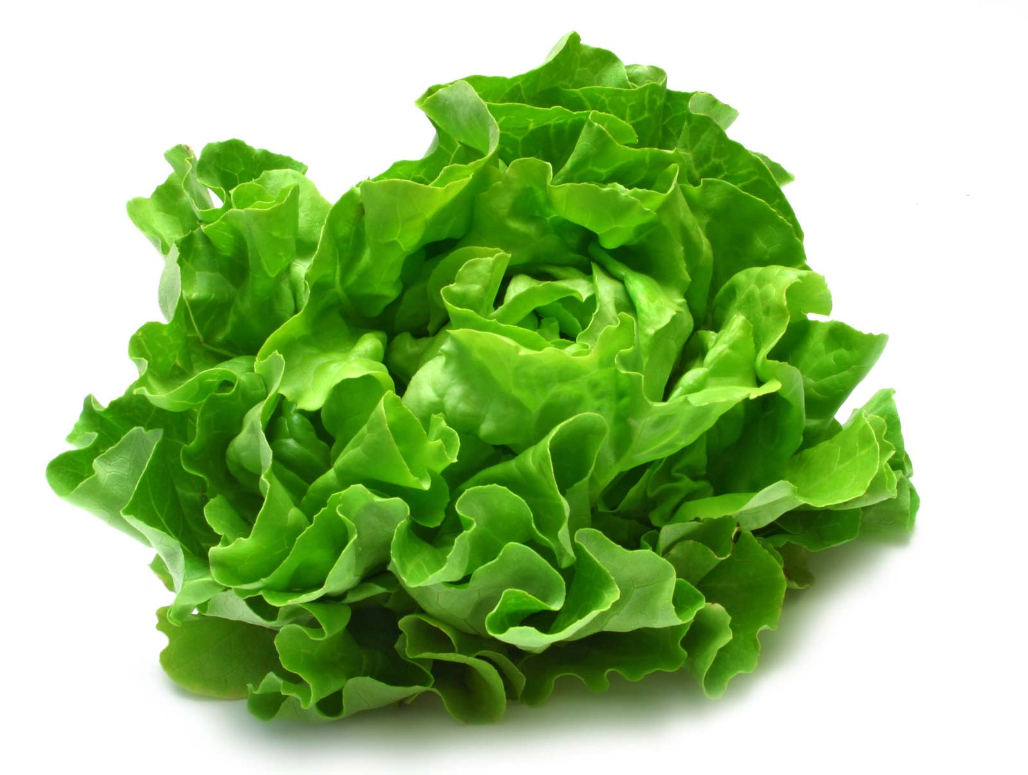
Lettuces
This is a lettuce

Slide 9
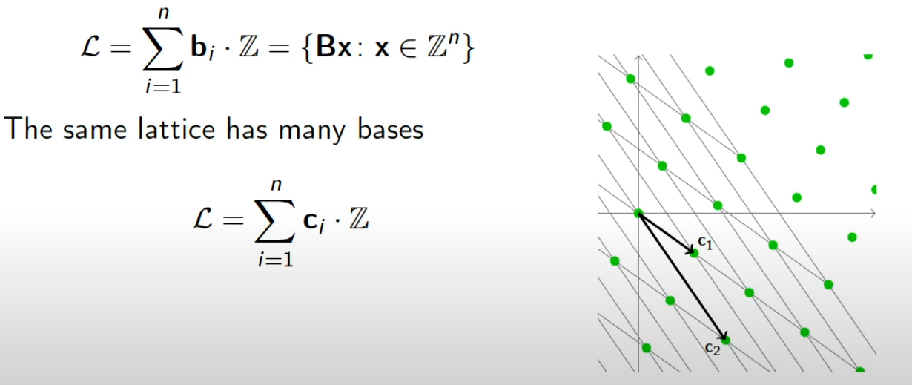
Lettuces Lattices
A lattice is the set of all integer linear combinations of linearly independent basis vectors B = {b₁, …, b_{n}} in R^{n}

Slide 10
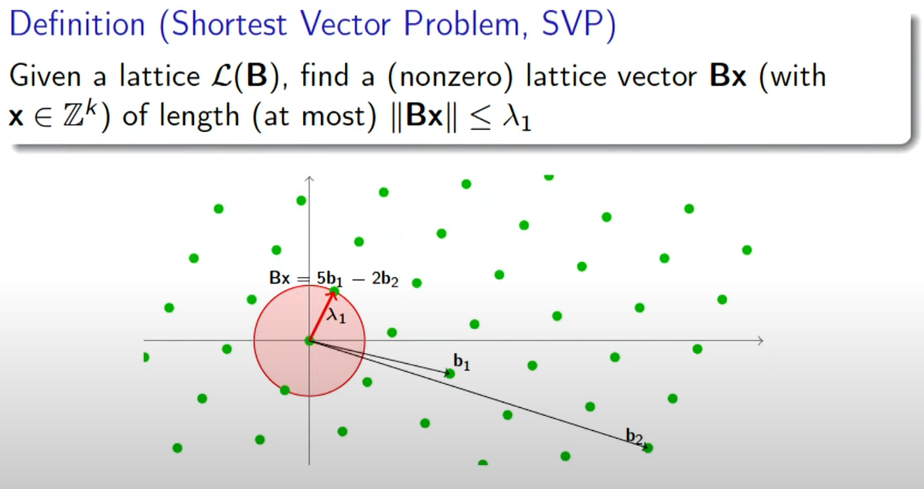

Slide 11
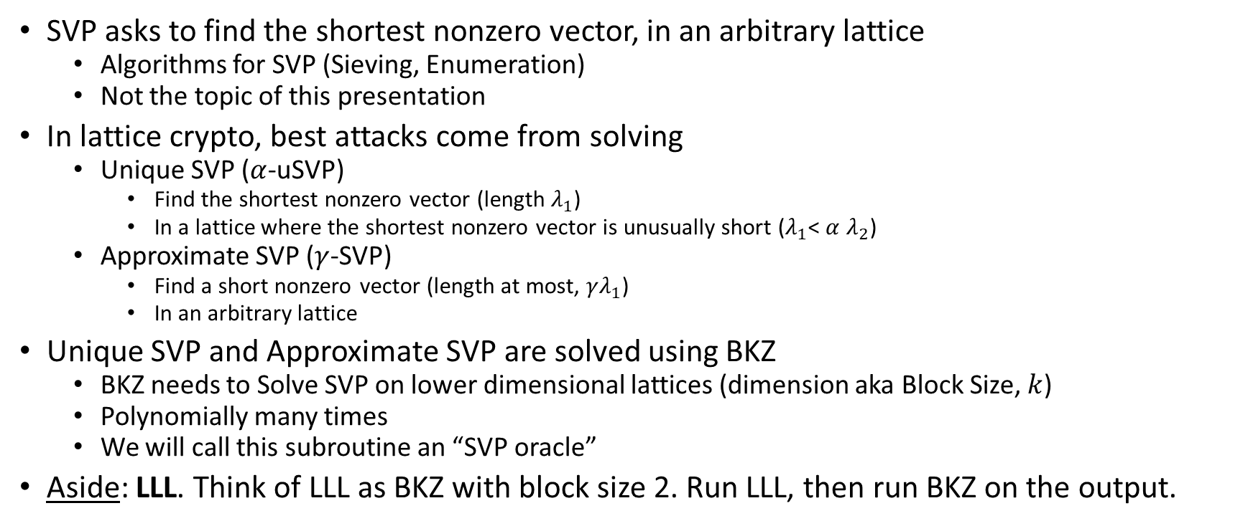
BKZ Overview
SVP asks to find the shortest nonzero vector, in an arbitrary lattice
  Algorithms for SVP (Sieving, Enumeration)
  Not the topic of this presentation
In lattice crypto, best attacks come from solving
  Unique SVP ($α$-uSVP)
    Find the shortest nonzero vector (length $λ_{1}$)
    In a lattice where the shortest nonzero vector is unusually short ($λ_{1}$< $α$ $λ_{2}$)
  Approximate SVP ($γ$-SVP)
    Find a short nonzero vector (length at most, $γλ_{1}$)
    In an arbitrary lattice
Unique SVP and Approximate SVP are solved using BKZ
  BKZ needs to Solve SVP on lower dimensional lattices (dimension aka Block Size, $k$)
  Polynomially many times
  We will call this subroutine an “SVP oracle”
Aside: LLL. Think of LLL as BKZ with block size 2. Run LLL, then run BKZ on the output.

Slide 12
Tools for reasoning about BKZ
Lattice Determinant
Minkowski’s theorem
Gaussian Heuristic
Gram-Schmidt Orthogonalization
QR factorization
Geometric Series Assumption

Slide 13
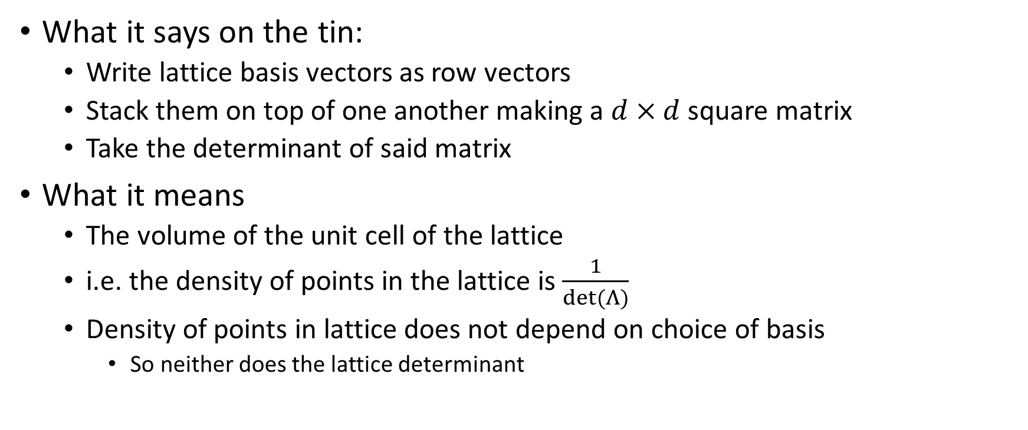

Lattice Determinant $det⁡(Λ)$
What it says on the tin:
  Write lattice basis vectors as row vectors
  Stack them on top of one another making a $d×d$ square matrix
  Take the determinant of said matrix
What it means
  The volume of the unit cell of the lattice
  i.e. the density of points in the lattice is $\frac{1}{det⁡(Λ)}$
  Density of points in lattice does not depend on choice of basis
    So neither does the lattice determinant

Slide 14


Using $det⁡(Λ)$ to Bound/Estimate $λ_{1}$
Minkowski’s theorem
$$λ_{1}≤\sqrt{d}∙{(det⁡(Λ))}^{\frac{1}{d}}$$
Gaussian Heuristic
$$λ_{1}≈\sqrt{\frac{d}{2πe}}∙{(det⁡(Λ))}^{\frac{1}{d}}$$

Slide 15
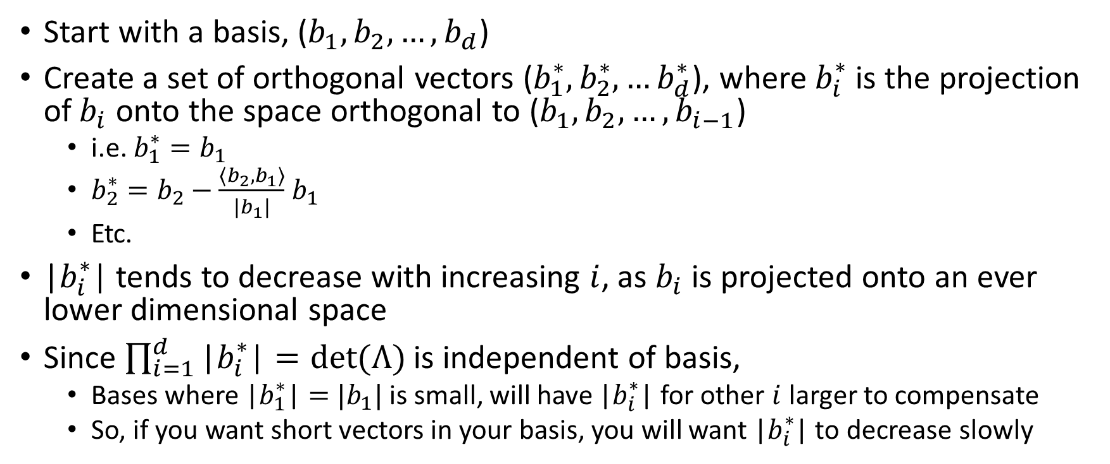
Gram Schmidt Orthogonalization
Start with a basis, ($b_{1}, b_{2}, …, b_{d}$)
Create a set of orthogonal vectors ($b_{1}^{∗},b_{2}^{∗},…b_{d}^{∗}$), where $b_{i}^{∗}$ is the projection of$b_{i}$ onto the space orthogonal to ($b_{1}, b_{2}, …, b_{i−1}$)
  i.e. $b_{1}^{∗}=b_{1}$
  $b_{2}^{∗}=b_{2}−\frac{\left\langle b_{2},b_{1}\right\rangle }{|b_{1}|}$ $b_{1}$
  Etc.
|$b_{i}^{∗}$| tends to decrease with increasing $i$, as $b_{i}$ is projected onto an ever lower dimensional space
Since $\prod_{i=1}^{d}{\text{|}b_{i}^{∗}\text{|}=det⁡(Λ)}$ is independent of basis,
  Bases where $\text{|}b_{1}^{∗}\text{|}=$ $|b_{1}|$ is small, will have $\text{|}b_{i}^{∗}\text{|}$ for other $i$ larger to compensate
  So, if you want short vectors in your basis, you will want |$b_{i}^{∗}$| to decrease slowly

Slide 16
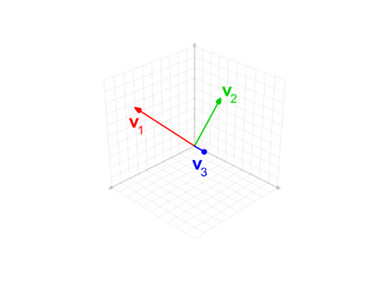

Slide 17


Lattice reduction and Gram-Schmidt norm
Bad Basis
Good Basis
$$\left|b_{i}^{∗}\right|$$
$$i$$

Slide 18
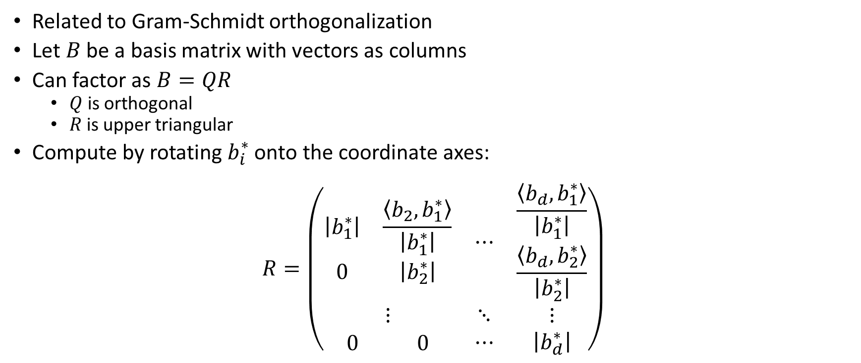
QR factorization
Related to Gram-Schmidt orthogonalization
Let $B$ be a basis matrix with vectors as columns
Can factor as $B=QR$
  $Q$ is orthogonal
  $R$ is upper triangular
Compute by rotating $b_{i}^{∗}$ onto the coordinate axes:
$$R=\left(\begin{matrix}\begin{matrix}\left|b_{1}^{∗}\right| & \frac{\left\langle b_{2},b_{1}^{∗}\right\rangle }{\left|b_{1}^{∗}\right|} \\ 0 & \left|b_{2}^{∗}\right|\end{matrix} & ⋯ & \begin{matrix}\frac{\left\langle b_{d},b_{1}^{∗}\right\rangle }{\left|b_{1}^{∗}\right|} \\ \frac{\left\langle b_{d},b_{2}^{∗}\right\rangle }{\left|b_{2}^{∗}\right|}\end{matrix} \\ ⋮ & ⋱ & ⋮ \\ \begin{matrix}0 & 0\end{matrix} & ⋯ & \left|b_{d}^{∗}\right|\end{matrix}\right)$$

Slide 19
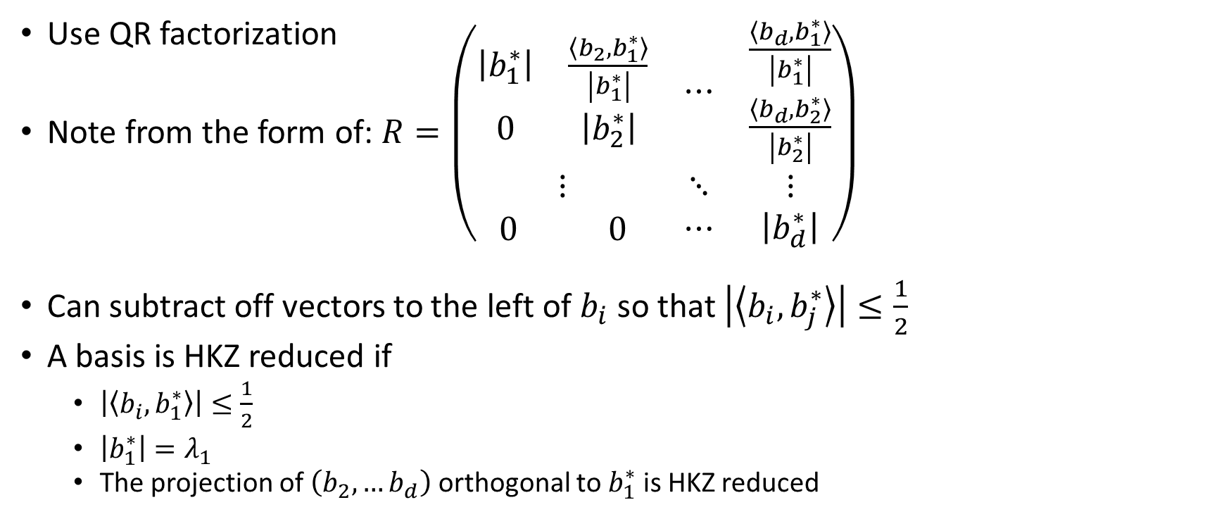
HKZ reduction
(What to do with an SVP oracle)
Use QR factorization
Note from the form of: $R=\left(\begin{matrix}\begin{matrix}\left|b_{1}^{∗}\right| & \frac{\left\langle b_{2},b_{1}^{∗}\right\rangle }{\left|b_{1}^{∗}\right|} \\ 0 & \left|b_{2}^{∗}\right|\end{matrix} & ⋯ & \begin{matrix}\frac{\left\langle b_{d},b_{1}^{∗}\right\rangle }{\left|b_{1}^{∗}\right|} \\ \frac{\left\langle b_{d},b_{2}^{∗}\right\rangle }{\left|b_{2}^{∗}\right|}\end{matrix} \\ ⋮ & ⋱ & ⋮ \\ \begin{matrix}0 & 0\end{matrix} & ⋯ & \left|b_{d}^{∗}\right|\end{matrix}\right)$
Can subtract off vectors to the left of $b_{i}$ so that $\left|\left\langle b_{i},b_{j}^{∗}\right\rangle \right|≤\frac{1}{2}$
A basis is HKZ reduced if
  $\left|\left\langle b_{i},b_{1}^{∗}\right\rangle \right|≤\frac{1}{2}$
  $\left|b_{1}^{∗}\right|=λ_{1}$
  The projection of $\left(b_{2},…b_{d}\right)$ orthogonal to $b_{1}^{∗}$ is HKZ reduced

Slide 20
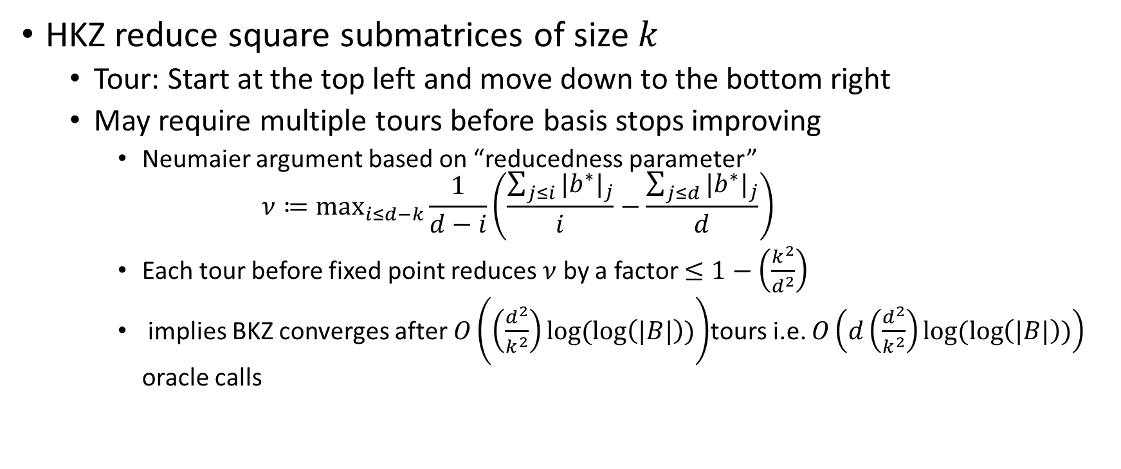
BKZ algorithm
HKZ reduce square submatrices of size $k$
  Tour: Start at the top left and move down to the bottom right
  May require multiple tours before basis stops improving
    Neumaier argument based on “reducedness parameter”
    $$ν≔\max_{i≤d−k}\frac{1}{d−i}\left(\frac{\sum_{j≤i}{{|b^{∗}|}_{j}}}{i}−\frac{\sum_{j≤d}{{|b^{∗}|}_{j}}}{d}\right)$$
    Each tour before fixed point reduces $ν$ by a factor $≤1−\left(\frac{k^{2}}{d^{2}}\right)$
    implies BKZ converges after $O\left(\left(\frac{d^{2}}{k^{2}}\right)log⁡(\log\left(|B|\right))\right)$tours i.e. $O\left(d\left(\frac{d^{2}}{k^{2}}\right)log⁡(\log\left(|B|\right))\right)$ oracle calls

Slide 21
Sandpile model illustration
(From 2016 presentation by Stehlé https://wheat2016.lip6.fr/HEAT_Paris_Damien.pdf)

Slide 22
Sandpile model illustration
(From 2016 presentation by Stehlé https://wheat2016.lip6.fr/HEAT_Paris_Damien.pdf)

Slide 23
Sandpile model illustration
(From 2016 presentation by Stehlé https://wheat2016.lip6.fr/HEAT_Paris_Damien.pdf)

Slide 24
Sandpile model illustration
(From 2016 presentation by Stehlé https://wheat2016.lip6.fr/HEAT_Paris_Damien.pdf)

Slide 25
Sandpile model illustration
(From 2016 presentation by Stehlé https://wheat2016.lip6.fr/HEAT_Paris_Damien.pdf)

Slide 26
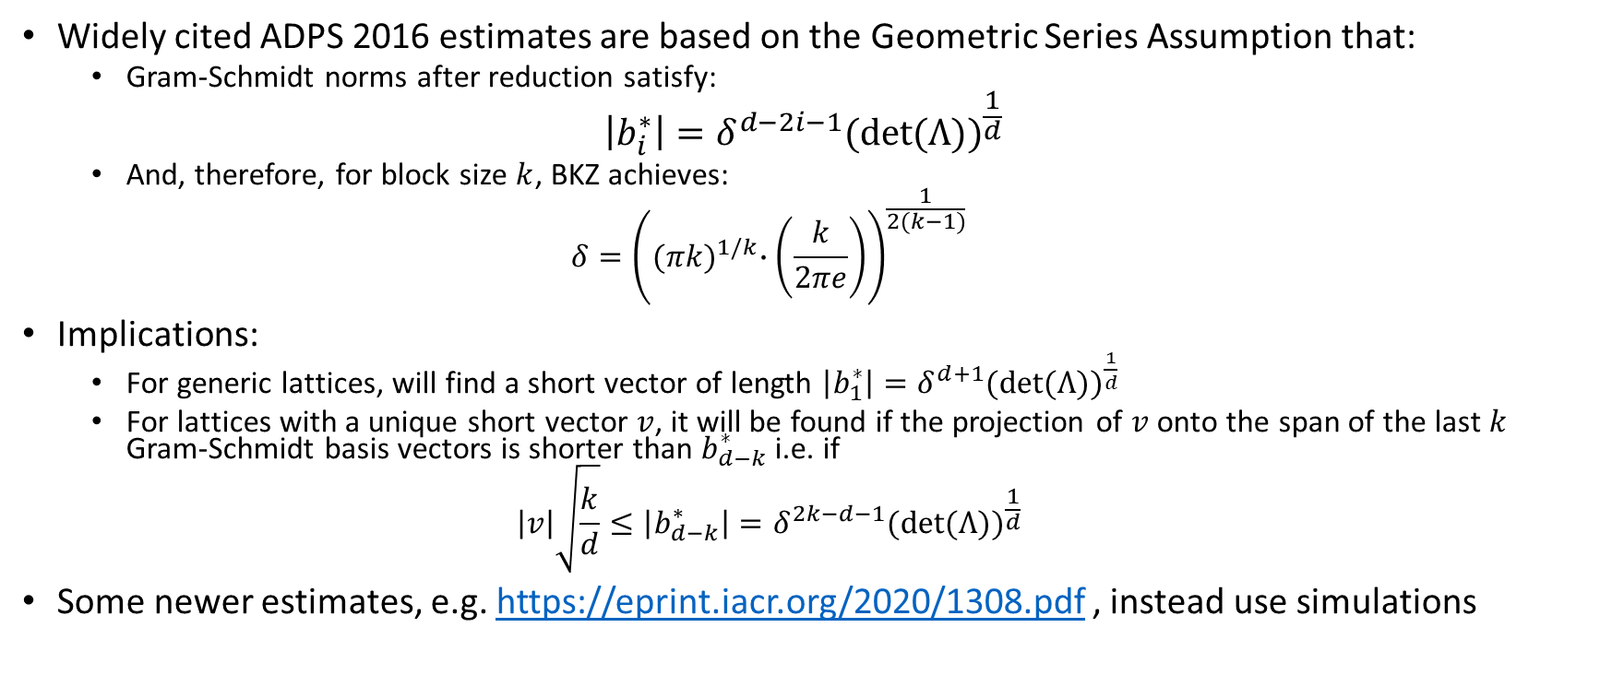
BKZ basis quality
Widely cited ADPS 2016 estimates are based on the Geometric Series Assumption that:
  Gram-Schmidt norms after reduction satisfy:
$$\left|b_{i}^{∗}\right|=δ^{d−2i−1}{(det⁡(Λ))}^{\frac{1}{d}}$$
  And, therefore, for block size $k$, BKZ achieves:
  $$δ={\left({(πk)}^{1/k}∙\left(\frac{k}{2πe}\right)\right)}^{\frac{1}{2(k−1)}}$$
Implications:
  For generic lattices, will find a short vector of length $\left|b_{1}^{∗}\right|=δ^{d+1}{(det⁡(Λ))}^{\frac{1}{d}}$
  For lattices with a unique short vector $v$, it will be found if the projection of $v$ onto the span of the last $k$ Gram-Schmidt basis vectors is shorter than $b_{d−k}^{∗}$ i.e. if
  $$\left|v\right|\sqrt{\frac{k}{d}}≤\left|b_{d−k}^{∗}\right|=δ^{2k−d−1}{(det⁡(Λ))}^{\frac{1}{d}}$$
Some newer estimates, e.g. https://eprint.iacr.org/2020/1308.pdf , instead use simulations

Slide 27
Turning NTRU and LWE into Lattice Problems

Slide 28
Attacks and Lattice Problems
LWE and NTRU style cryptosystems get unique SVP and approximate SVP instances via various attack strategies:
  LWE (NewHope ADPS2016 terminology):
    Primal: uSVP
    Dual: Approximate SVP
  NTRU
    “Primal”, “Dual” attack
      Numbers are cited for “Primal” and “Dual” attack in NewHope paper
      Obvious analogy attempts message recovery where LWE attack would attempt key recovery
      Both of these can be uSVP (Approximate SVP may be relevant too for dual)
    Coppersmith-Shamir97, extended by May99 (this is called “Primal” in NTRU spec.): uSVP
    Howgrave-Graham05: Hybrid meet in the middle uSVP
We will study these strategies in the next few slides

Slide 29
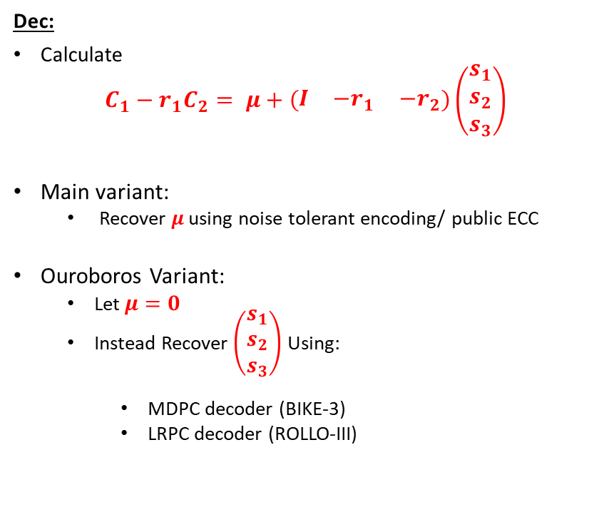
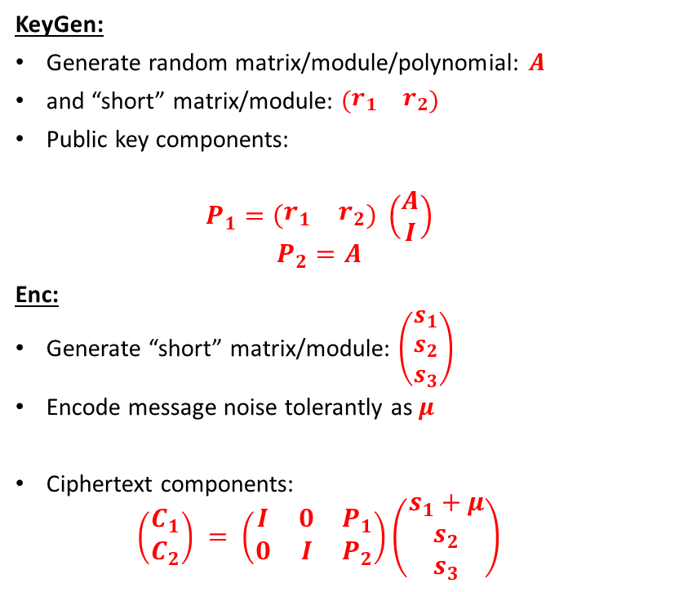
Product LWE (Typical LWE cryptosystem)
KeyGen:
Generate random matrix/module/polynomial: $A$
and “short” matrix/module: $\left(\begin{matrix}r_{1} & r_{2}\end{matrix}\right)$
Public key components:
  $$P_{1}=\left(\begin{matrix}r_{1} & r_{2}\end{matrix}\right) \left(\begin{matrix}A \\ I\end{matrix}\right)$$
  $$P_{2}=A$$
Enc:
Generate “short” matrix/module: $\left(\begin{matrix}s_{1} \\ s_{2} \\ s_{3}\end{matrix}\right)$
Encode message noise tolerantly as $μ$
Ciphertext components:
  $$\left(\begin{matrix}C_{1} \\ C_{2}\end{matrix}\right) = \left(\begin{matrix}I & 0 & P_{1} \\ 0 & I & P_{2}\end{matrix}\right)\left(\begin{matrix}s_{1}+μ \\ s_{2} \\ s_{3}\end{matrix}\right)$$
Dec:
Calculate
$$C_{1}−r_{1}C_{2}= μ+\left(\begin{matrix}I & {−r}_{1} & {−r}_{2}\end{matrix}\right)\left(\begin{matrix}s_{1} \\ s_{2} \\ s_{3}\end{matrix}\right)$$
Main variant:
  Recover $μ$ using noise tolerant encoding/ public ECC
Ouroboros Variant:
  Let $μ=0$
  Instead Recover $\left(\begin{matrix}s_{1} \\ s_{2} \\ s_{3}\end{matrix}\right)$ Using:
    MDPC decoder (BIKE-3)
    LRPC decoder (ROLLO-III)

Slide 30
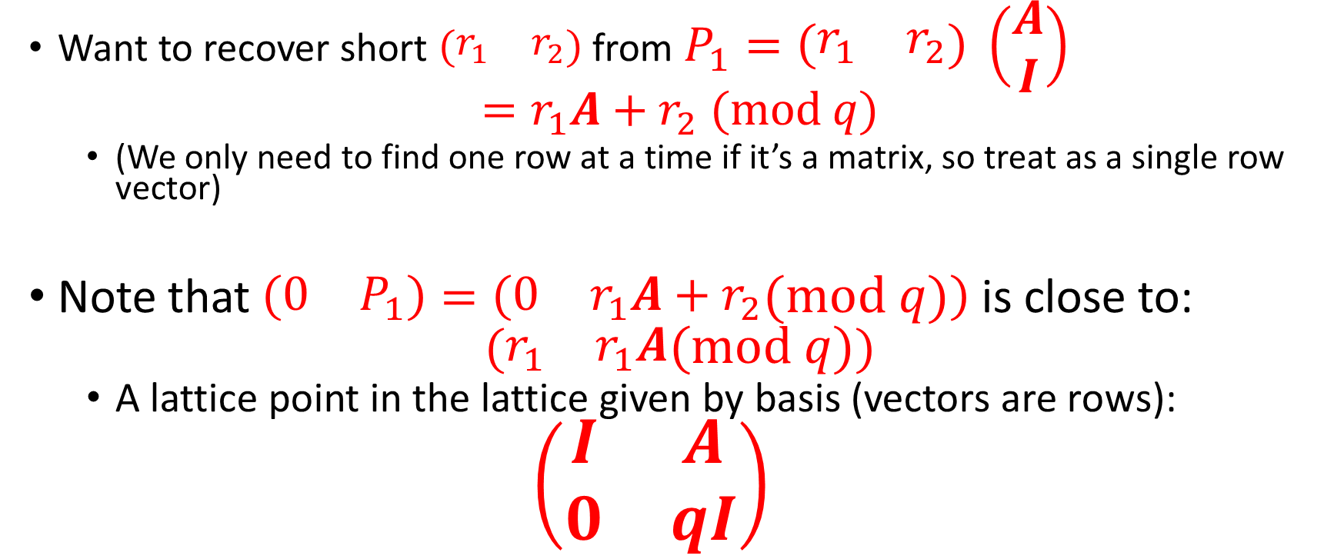
Primal Attack (1/3):
A lattice associated with LWE
Want to recover short $\left(\begin{matrix}r_{1} & r_{2}\end{matrix}\right)$ from $P_{1}=\left(\begin{matrix}r_{1} & r_{2}\end{matrix}\right) \left(\begin{matrix}A \\ I\end{matrix}\right)$
$$=r_{1}A+r_{2} (mod q)$$
  (We only need to find one row at a time if it’s a matrix, so treat as a single row vector)
Note that $\left(\begin{matrix}0 & P_{1}\end{matrix}\right)=\left(\begin{matrix}0 & r_{1}A+r_{2}\end{matrix}(mod q)\right)$is close to:
$$(\begin{matrix}r_{1} & r_{1}A\end{matrix}(mod q))$$
  A lattice point in the lattice given by basis (vectors are rows):
  $$\left(\begin{matrix}I & A \\ 0 & qI\end{matrix}\right)$$

Slide 31
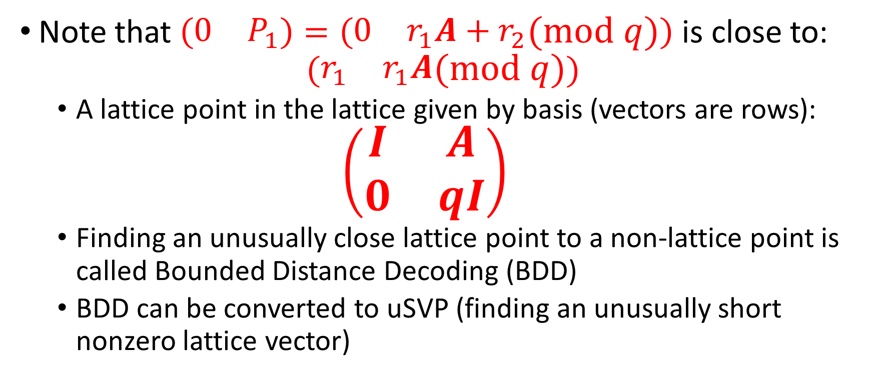
Primal attack (2/3)
LWE as BDD
Note that $\left(\begin{matrix}0 & P_{1}\end{matrix}\right)=\left(\begin{matrix}0 & r_{1}A+r_{2}\end{matrix}(mod q)\right)$is close to:
$$(\begin{matrix}r_{1} & r_{1}A\end{matrix}(mod q))$$
  A lattice point in the lattice given by basis (vectors are rows):
  $$\left(\begin{matrix}I & A \\ 0 & qI\end{matrix}\right)$$
  Finding an unusually close lattice point to a non-lattice point is called Bounded Distance Decoding (BDD)
  BDD can be converted to uSVP (finding an unusually short nonzero lattice vector)

Slide 32
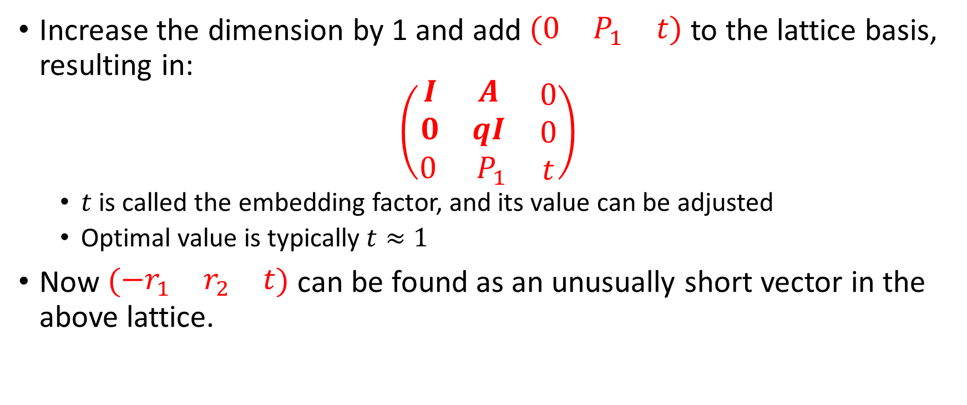
Primal Attack (3/3)
LWE recovery as uSVP (Bai-Galbraith Embedding)
Increase the dimension by 1 and add $\left(\begin{matrix}0 & P_{1} & t\end{matrix}\right)$ to the lattice basis, resulting in:
$$\left(\begin{matrix}\begin{matrix}I & A \\ 0 & qI\end{matrix} & \begin{matrix}0 \\ 0\end{matrix} \\ \begin{matrix}0 & { P}_{1}\end{matrix} & t\end{matrix}\right)$$
  $t$ is called the embedding factor, and its value can be adjusted
  Optimal value is typically $t≈1$
Now $\left(\begin{matrix}−r_{1} & r_{2} & t\end{matrix}\right)$ can be found as an unusually short vector in the above lattice.

Slide 33
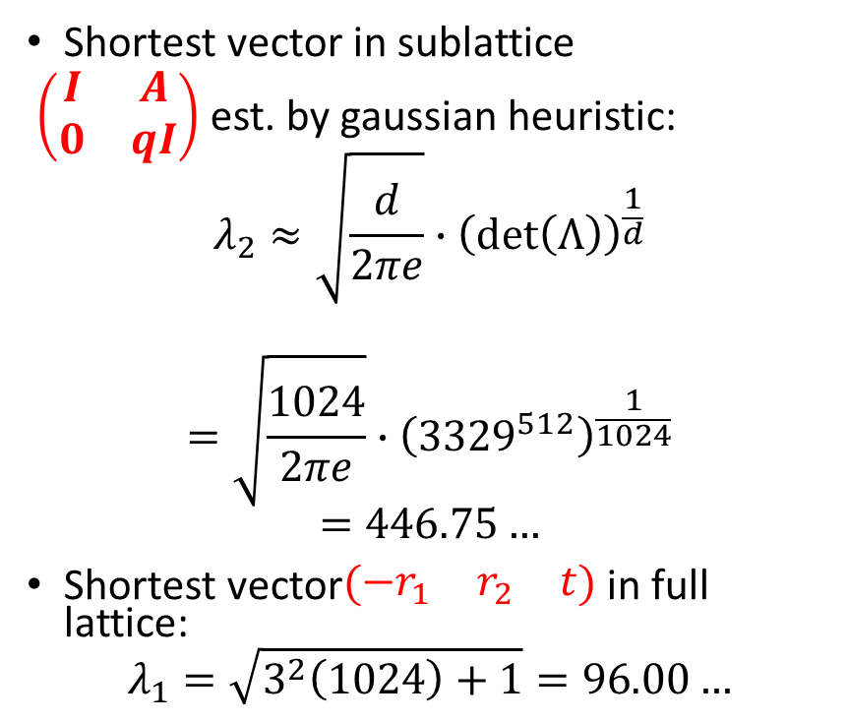
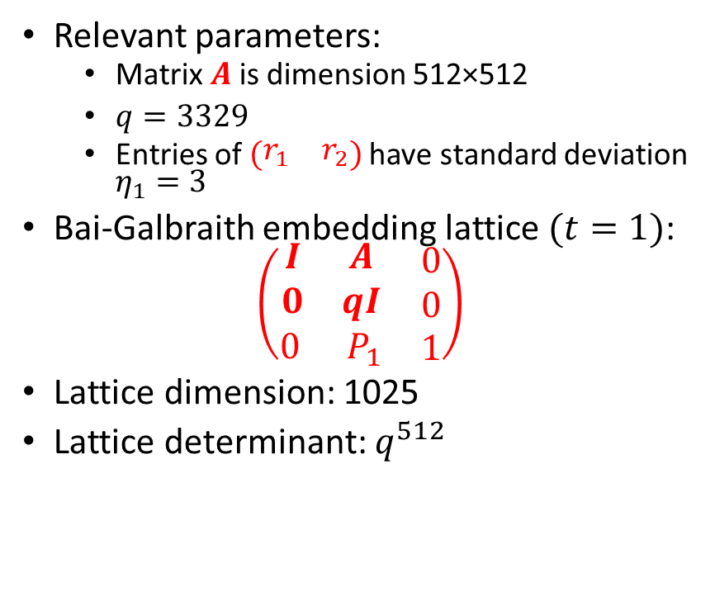
Concrete Example
Primal attack on Kyber512
Relevant parameters:
  Matrix $A$ is dimension 512×512
  $q=3329$
  Entries of $\left(\begin{matrix}r_{1} & r_{2}\end{matrix}\right)$ have standard deviation $η_{1}=3$
Bai-Galbraith embedding lattice $(t=1)$:
$$\left(\begin{matrix}\begin{matrix}I & A \\ 0 & qI\end{matrix} & \begin{matrix}0 \\ 0\end{matrix} \\ \begin{matrix}0 & { P}_{1}\end{matrix} & 1\end{matrix}\right)$$
Lattice dimension: 1025
Lattice determinant: $q^{512}$
Shortest vector in sublattice
$\left(\begin{matrix}I & A \\ 0 & qI\end{matrix}\right)$ est. by gaussian heuristic:
$$λ_{2}≈\sqrt{\frac{d}{2πe}}∙{\left(\det\left(Λ\right)\right)}^{\frac{1}{d}}$$
$$=\sqrt{\frac{1024}{2πe}}∙{\left({3329}^{512}\right)}^{\frac{1}{1024}}$$
$$=446.75…$$
Shortest vector$\left(\begin{matrix}−r_{1} & r_{2} & t\end{matrix}\right)$ in full lattice:
$$λ_{1}=\sqrt{3^{2}\left(1024\right)+1}=96.00…$$

Slide 34
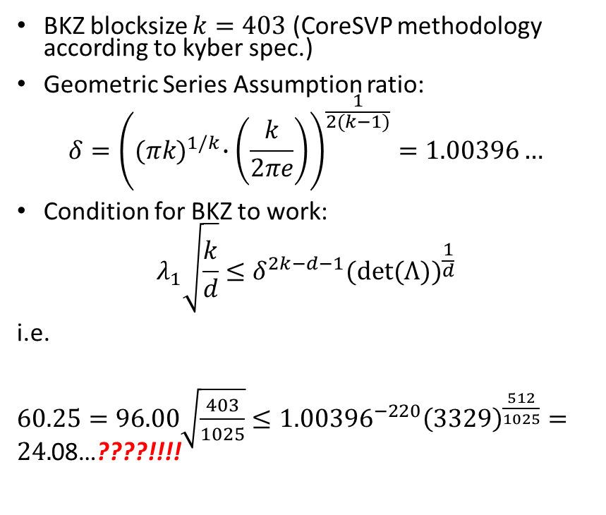
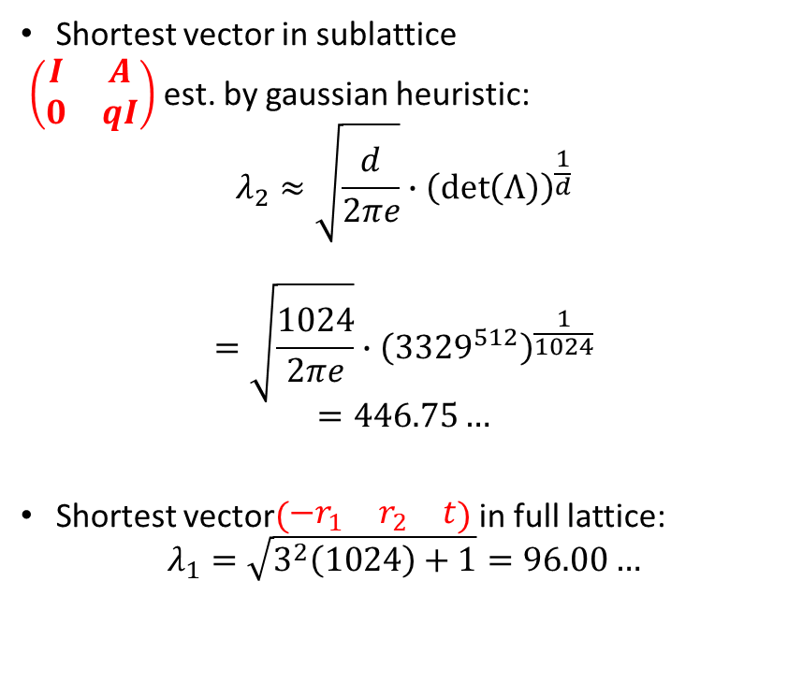
Concrete Example
Primal attack on Kyber512
Shortest vector in sublattice
$\left(\begin{matrix}I & A \\ 0 & qI\end{matrix}\right)$ est. by gaussian heuristic:
$$λ_{2}≈\sqrt{\frac{d}{2πe}}∙{\left(\det\left(Λ\right)\right)}^{\frac{1}{d}}$$
$$=\sqrt{\frac{1024}{2πe}}∙{\left({3329}^{512}\right)}^{\frac{1}{1024}}$$
$$=446.75…$$
Shortest vector$\left(\begin{matrix}−r_{1} & r_{2} & t\end{matrix}\right)$ in full lattice:
$$λ_{1}=\sqrt{3^{2}\left(1024\right)+1}=96.00…$$
BKZ blocksize $k=403$ (CoreSVP methodology according to kyber spec.)
Geometric Series Assumption ratio:
$$δ={\left({(πk)}^{1/k}∙\left(\frac{k}{2πe}\right)\right)}^{\frac{1}{2(k−1)}}=1.00396…$$
Condition for BKZ to work:
$$λ_{1}\sqrt{\frac{k}{d}}≤δ^{2k−d−1}{(det⁡(Λ))}^{\frac{1}{d}}$$
i.e.
$60.25=96.00\sqrt{\frac{403}{1025}}≤{1.00396}^{−220}{\left(3329\right)}^{\frac{512}{1025}}=24.$08…????!!!!

Slide 35
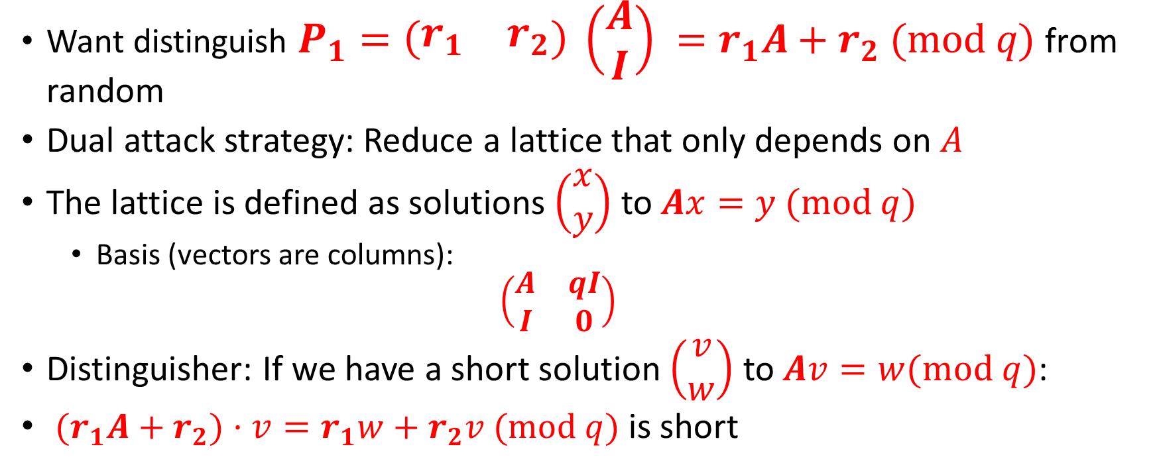
Dual Attack
Want distinguish $P_{1}=\left(\begin{matrix}r_{1} & r_{2}\end{matrix}\right) \left(\begin{matrix}A \\ I\end{matrix}\right) =r_{1}A+r_{2} (mod q)$ from random
Dual attack strategy: Reduce a lattice that only depends on $A$
The lattice is defined as solutions $\left(\begin{matrix}x \\ y\end{matrix}\right)$ to $Ax=y (mod q)$
  Basis (vectors are columns):
  $$\left(\begin{matrix}A & qI \\ I & 0\end{matrix}\right)$$
Distinguisher: If we have a short solution $\left(\begin{matrix}v \\ w\end{matrix}\right)$ to $Av=w(mod q)$:
${(r}_{1}A+r_{2})⋅v=r_{1}w+r_{2}v (mod q)$ is short

Slide 36
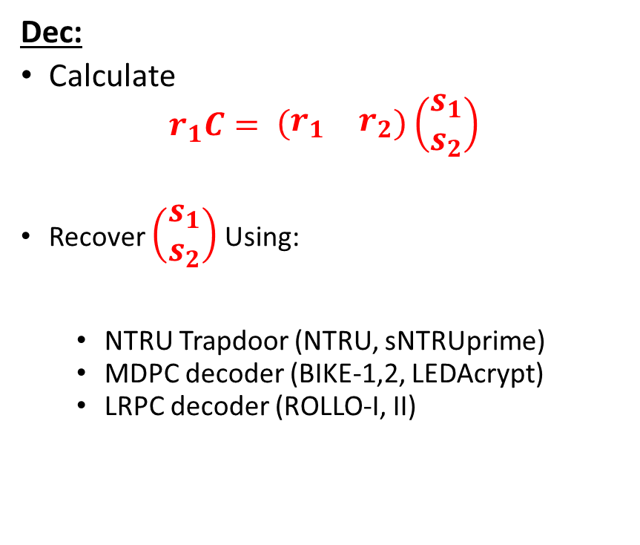
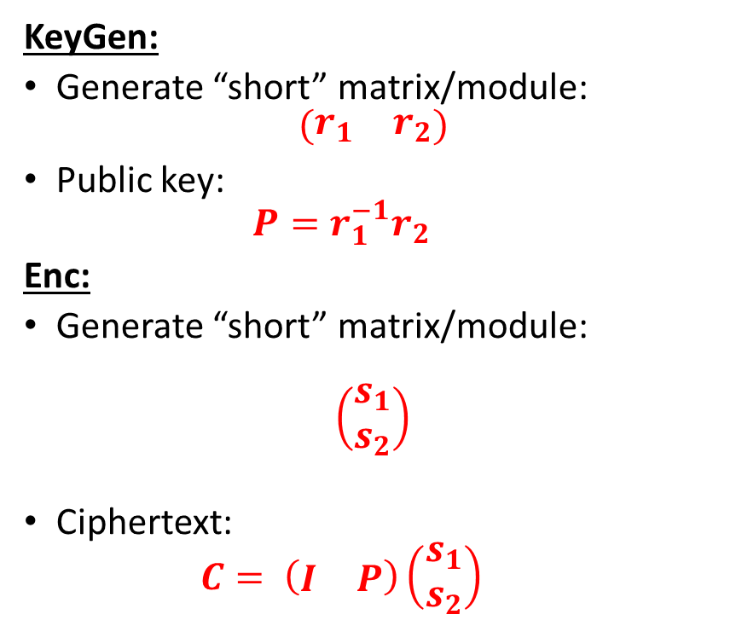
Quotient LWE (NTRU)
KeyGen:
Generate “short” matrix/module:
$$\left(\begin{matrix}r_{1} & r_{2}\end{matrix}\right)$$
Public key:
  $$P=r_{1}^{−1}r_{2}$$
Enc:
Generate “short” matrix/module:
$$\left(\begin{matrix}s_{1} \\ s_{2}\end{matrix}\right)$$
Ciphertext:
  $$C= \left(\begin{matrix}I & P\end{matrix}\right)\left(\begin{matrix}s_{1} \\ s_{2}\end{matrix}\right)$$
Dec:
Calculate
$$r_{1}C= \left(\begin{matrix}r_{1} & r_{2}\end{matrix}\right)\left(\begin{matrix}s_{1} \\ s_{2}\end{matrix}\right)$$
Recover $\left(\begin{matrix}s_{1} \\ s_{2}\end{matrix}\right)$ Using:
  NTRU Trapdoor (NTRU, sNTRUprime)
  MDPC decoder (BIKE-1,2, LEDAcrypt)
  LRPC decoder (ROLLO-I, II)

Slide 37
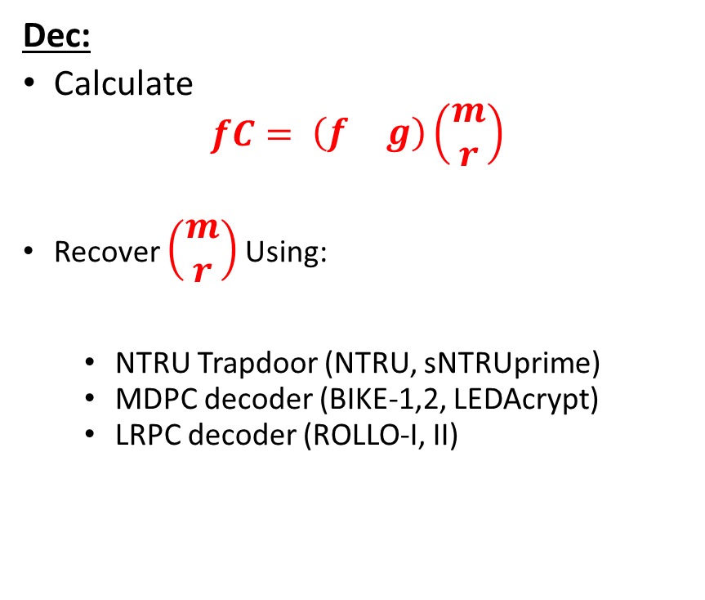
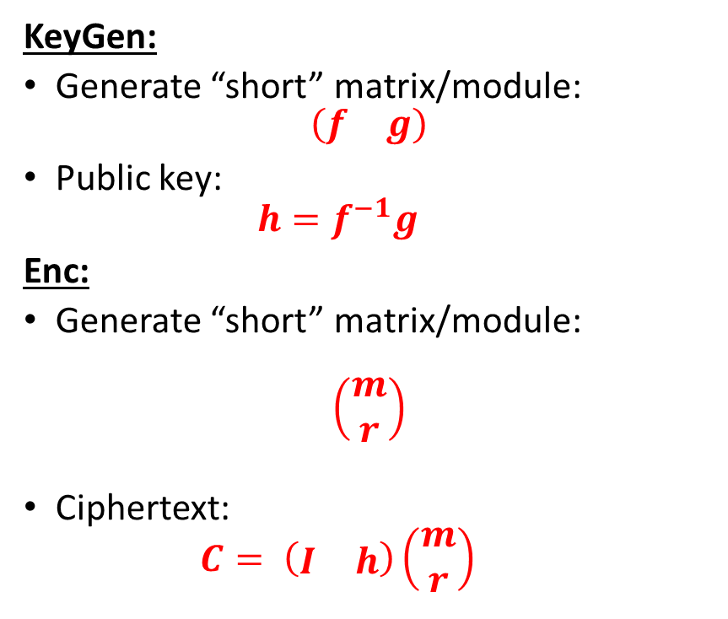
NTRU ((mostly) traditional notation)
KeyGen:
Generate “short” matrix/module:
$$\left(\begin{matrix}f & g\end{matrix}\right)$$
Public key:
  $$h=f^{−1}g$$
Enc:
Generate “short” matrix/module:
$$\left(\begin{matrix}m \\ r\end{matrix}\right)$$
Ciphertext:
  $$C= \left(\begin{matrix}I & h\end{matrix}\right)\left(\begin{matrix}m \\ r\end{matrix}\right)$$
Dec:
Calculate
$$fC= \left(\begin{matrix}f & g\end{matrix}\right)\left(\begin{matrix}m \\ r\end{matrix}\right)$$
Recover $\left(\begin{matrix}m \\ r\end{matrix}\right)$ Using:
  NTRU Trapdoor (NTRU, sNTRUprime)
  MDPC decoder (BIKE-1,2, LEDAcrypt)
  LRPC decoder (ROLLO-I, II)

Slide 38
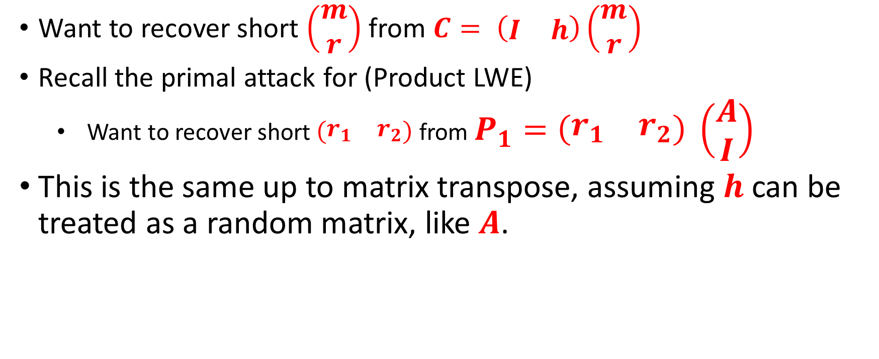
NewHope style Primal attack on NTRU
Want to recover short $\left(\begin{matrix}m \\ r\end{matrix}\right)$ from $C= \left(\begin{matrix}I & h\end{matrix}\right)\left(\begin{matrix}m \\ r\end{matrix}\right)$
Recall the primal attack for (Product LWE)
  Want to recover short $\left(\begin{matrix}r_{1} & r_{2}\end{matrix}\right)$ from $P_{1}=\left(\begin{matrix}r_{1} & r_{2}\end{matrix}\right) \left(\begin{matrix}A \\ I\end{matrix}\right)$
This is the same up to matrix transpose, assuming $h$ can be treated as a random matrix, like $A$.

Slide 39
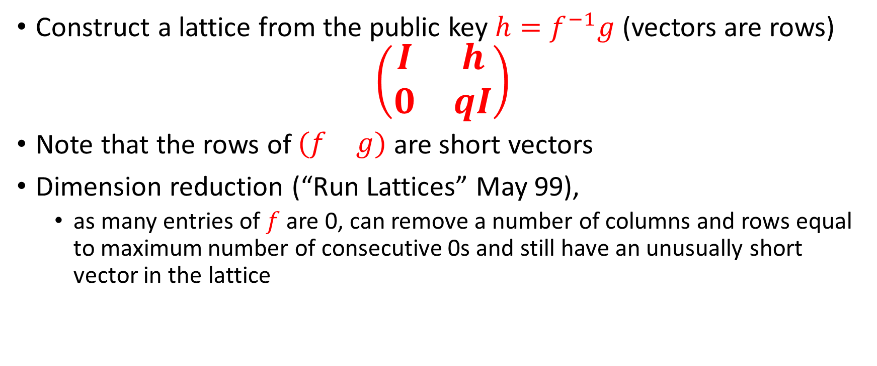
NTRU Lattice attacks
Coppersmith-Shamir 1997
Construct a lattice from the public key $h=f^{−1}g$ (vectors are rows)
$$\left(\begin{matrix}I & h \\ 0 & qI\end{matrix}\right)$$
Note that the rows of $\left(\begin{matrix}f & g\end{matrix}\right)$ are short vectors
Dimension reduction (“Run Lattices” May 99),
  as many entries of $f$ are 0, can remove a number of columns and rows equal to maximum number of consecutive 0s and still have an unusually short vector in the lattice

Slide 40
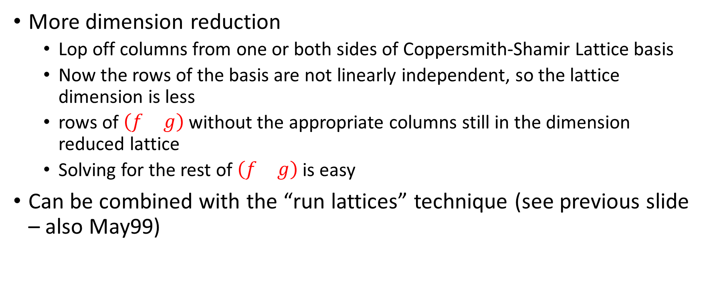
Further Improvements in May99
More dimension reduction
  Lop off columns from one or both sides of Coppersmith-Shamir Lattice basis
  Now the rows of the basis are not linearly independent, so the lattice dimension is less
  rows of $\left(\begin{matrix}f & g\end{matrix}\right)$ without the appropriate columns still in the dimension reduced lattice
  Solving for the rest of $\left(\begin{matrix}f & g\end{matrix}\right)$ is easy
Can be combined with the “run lattices” technique (see previous slide – also May99)

Slide 41
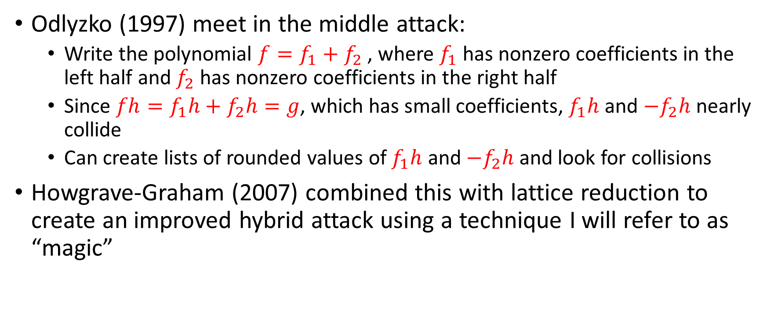
Odlyzko Meet in the Middle attack;
Howgrave-Graham Hybrid Attack
Odlyzko (1997) meet in the middle attack:
  Write the polynomial $f=f_{1}+f_{2}$ , where $f_{1}$ has nonzero coefficients in the left half and $f_{2}$ has nonzero coefficients in the right half
  Since $fh=f_{1}h+f_{2}h=g$, which has small coefficients, $f_{1}h$ and $−f_{2}h$ nearly collide
  Can create lists of rounded values of $f_{1}h$ and $−f_{2}h$ and look for collisions
Howgrave-Graham (2007) combined this with lattice reduction to create an improved hybrid attack using a technique I will refer to as “magic”

Slide 42
References
General references:
  Stehle, Review of Lattice Reduction Algorithm: https://wheat2016.lip6.fr/HEAT_Paris_Damien.pdf
  ADPS 2016 (NewHope Paper): https://eprint.iacr.org/2015/1092.pdf
  AGVW 2017: Revisiting the Expected Cost of Solving uSVP with applications to LWE: https://eprint.iacr.org/2017/815.pdf
Kannan embedding: https://pdfs.semanticscholar.org/9253/08b01e1a3a9944774a817c63d84c887ee277.pdf
Bai Galbraith Embedding: https://eprint.iacr.org/2013/839.pdf
NTRU Cryptanalysis
  Coppersmith, Shamir 1997: https://link.springer.com/chapter/10.1007/3-540-69053-0_5
  May 1999: https://citeseerx.ist.psu.edu/viewdoc/download?doi=10.1.1.41.3484&rep=rep1&type=pdf
  Howgrave-Graham 2005 (Hybrid attack): https://iacr.org/archive/crypto2007/46220150/46220150.pdf

