Slide 1
NIST Cryptography Program - Develop Essential Tools for Cybersecurity
Andy Regenscheid and Lily Chen
Computer Security Division, Information Technology Lab
National Institute of Standards and Technology (NIST)

Slide 2
NIST Cryptography Program
Cryptography
Research
Cryptography
Standards
Cryptography
Applications

Slide 3
Cryptography Research
Conduct research and publish results on
Post-Quantum Cryptography
Hash function and block cipher cryptanalysis
Cryptography for constrained environment
Circuit complexity
Quantum algorithms
Random number generation
etc..
Collaborate with academic teams
Organize research conferences and workshops

Slide 4
Cryptographic Standards
Crypto standards
Public key based
Symmetric key based
Guidelines
AES (FIPS 197 ) TDEA (800-67)
Hash usage/security (800-107)
Signature (FIPS 186)
Modes of operations (800 38A-38G)
Transition (800-131A)
Key establishment (800-56A/B/C)
Key generation (800-133)
SHA-1/2 (FIPS 180) and SHA-3 (FIPS 202)
Key management (800-57)
Tools
Randomized hash (800-106)
RNG (800-90A/B/C)
HMAC (FIPS 198)
KDF (800-108, 800-135)
SHA3 derived functions (parallel hashing, KMAC, etc. (800-185)

Slide 5
Cryptography Applications in Network Security
In communication protocols, public key and symmetric key cryptography schemes are used together, e.g. TLS, IKE/IPsec, etc.
Use public key cryptography to establish keys and authenticate users through signatures
Use symmetric key cryptography to encrypt and authenticate bulk data
In trusted platform technologies,
Use public key to establish root of trust
Use signatures to authenticate/authorize firmware, software and applications
Use symmetric key crypto to protect data
A
B
FIPS 168 Signatures (hash)
-Authentication
SP 800-65A/B
- Key Establishment
Authenticated key establishment
FIPS 197 AES & SP 800-38x
- Encryption or/and authentication
FIPS 198 HMAC &
SP 800-185 KMAC
- Auth. and integrity
Data protection

Slide 6
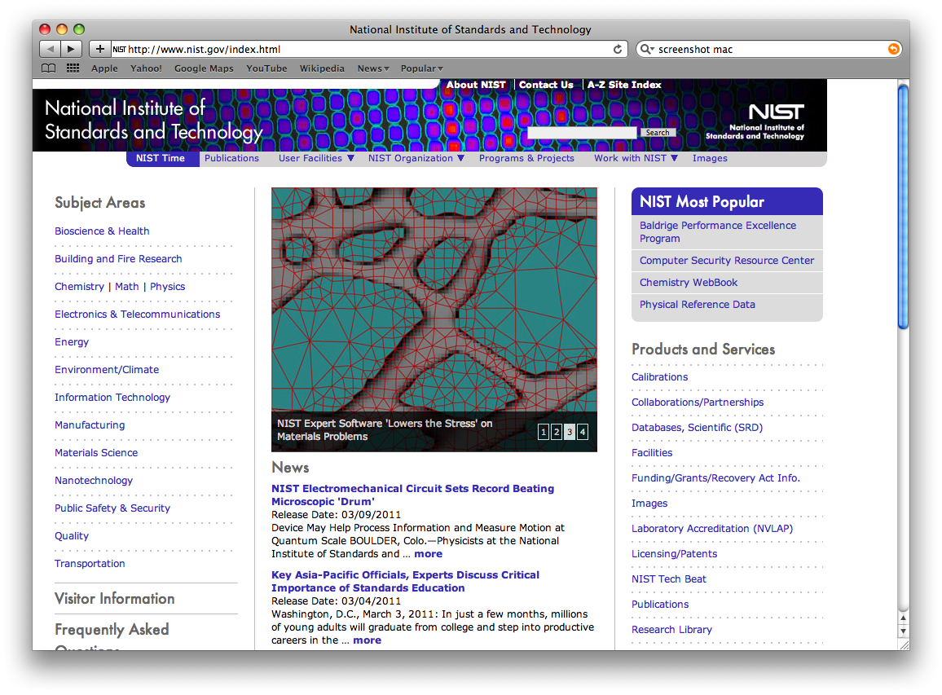
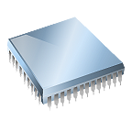
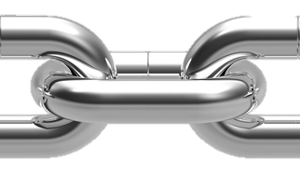
Cryptography Applications in Trusted Computing
Roots of trust are hardware/software components that are inherently trusted
They must be secure by design
Should be small and protected
Ideally implemented in hardware, or protected by hardware
They are trusted to perform security-critical functions, e.g.,
Measure and/or verify software
Protect cryptographic keys
Perform device authentication
Applications
Operating System
Hypervisor
Firmware
Hardware
Verify Signature
Verify Signature
Root of Trust
Component-1
Component-2
Execute
Execute

Slide 7
Challenges
Quantum computers, once available, can break well deployed public key cryptography systems, e.g. RSA, DH, ECDSA, etc.,
These systems have been implemented in the most of the communication and computing devices
Pervasive usage of cryptography including IoT devices
Extremely powerful computing resource against constrained implementation environment
More sophisticated cryptanalysis techniques
New weakness have been constantly discovered on improper implementations (e.g. BEAST attack on CBC in TLS, Heartbleed buffer over-read vulnerability in OpenSSL, DUHK attack with hardcoded keys in PRNGs, etc.)

Slide 8
New Direction 1 – Post-Quantum Cryptography (PQC)
Crypto standards
Post-Quantum Cryptography
Public key based
Symmetric key based
Guidelines
AES (FIPS 197 ) TDEA (800-67)
Hash usage/security (800-107)
Signature (FIPS 186)
Modes of operations (800 38A-38G)
Transition (800-131A)
Key establishment (800-56A/B/C)
Key generation (800-133)
SHA-1/2 (FIPS 180) and SHA-3 (FIPS 202)
Key management (800-57)
Tools
Randomized hash (800-106)
RNG (800-90A/B/C)
HMAC (FIPS 198)
KDF (800-108, 800-135)
SHA3 derived functions (parallel hashing, KMAC, etc. (800-185)

Slide 9
New Direction 1 - NIST PQC Milestones
2012 – NIST begin PQC project
Research and build NIST team
April 2015 – 1st NIST PQC workshop
Feb 2016 – NIST Report on PQC (NISTIR 8105)
Feb 2016 – NIST preliminary announcement of standardization plan
Aug 2016 – Draft submission requirements and evaluation criteria released for public comments
Sep 2016 – Comment period ends
Dec 2016 – Announcement of finalized requirements and criteria(Federal Register Notice)
Nov. 30, 2017 – Submission deadline, received 82 submissions
Dec. 24, 2017 – Announced the first round 69 algorithms, as “complete and proper”

Slide 10
New Direction 1 – First Round PQC Candidate
Upon the submission deadline (Nov. 30, 2017), NIST received 82 submissions from 26 countries and 6 continents
After an initial review, 69 submissions are considered as complete and proper
At the time of this presentation, 3 of them have been confirmed as “broken” and 66 remains as the first round submissions
46 Key Establishment schemes
24 lattice-based
17 code-based
5 other (2 multi-variate, 1 RSA, 1 random walk, 1 isogeny-based)
20 Signature schemes
7 multi-variate
5 lattice
3 code-based
3 hash-based (or symmetric based)
2 other (1 RSA, 1 braids)

Slide 11
New Direction 1 – NIST PQC Standards Timeline
NIST will hold the first PQC Standardization Workshop in April 12-13, 2018
Initial analysis phase 12-18 months
Narrow the pool and hold the second workshop in late 2019
Second analysis phase 12-18 month
May take third analysis phase if needed
Expect draft standards in 2022-2023

Slide 12
New Direction 2 – Lightweight Cryptography
Cryptography that aims to provide crypto solutions for constrained environments
Lightweight cryptography does not mean weak crypto
Security properties may be different than those desired for general use, but must be sufficient for the target application
Lightweight crypto may
be less robust against sophisticated cryptanalysis
vulnerable to dictionary attacks
be less misuse resistant
have fewer features

Slide 13
New Direction 2 – Design Ideas and Implications
Design Strategies
Many iterations of simple rounds, simple operations (e.g., XORs, rotation, 4x4 Sboxes, bit permutations)
Smaller block/key sizes, smaller security margins by design
Simpler key schedules
Implications
Less robust against sophisticated cryptanalysis with lower data complexity
Vulnerable to dictionary attacks
Enable attacks using related key, weak key, known key or even choose key
Counter measures
Change key more frequently
Use good random number generator to generate keys
Even lightweight, do not use shorter than 128 bits

Slide 14
New Direction 2 – Milestones and Next Step
Engage with industry and academic on lightweight crypto
Two workshops in 2015 and 2016
Publish NISTIR 8114 in March 2017
Overview lightweight crypto
Design consideration and profiles
Release Profile white paper April 2017
Prole I Authenticated Encryption with associated data (AEAD) and hashing for constrained software and hardware environments
Prole II AEAD for constrained hardware environments
Plan to call for submissions in the spring of 2018
Complete selection and release drafts for public comments in 2019

Slide 15
Thanks and Contact
NIST Standards, Guidelines, and projects can be found at http://csrc.nist.gov

