Slide 1
NIST Update on Post-Quantum Cryptography Standardization
Computer Security Division, Information Technology Lab
National Institute of Standards and Technology (NIST)

Slide 2
NIST Cryptographic Standards
Crypto standards
Public key based
Symmetric key based
Guidelines
AES (FIPS 197 ) TDEA (800-67)
Hash usage/security (800-107)
Signature (FIPS 186)
Modes of operations (800 38A-38G)
Transition (800-131A)
Key establishment (800-56A/B/C)
Key generation (800-133)
SHA-1/2 (FIPS 180) and SHA-3 (FIPS 202)
Key management (800-57)
Tools
Randomized hash (800-106)
RNG (800-90A/B/C)
HMAC (FIPS 198)
KDF (800-108, 800-135)
SHA3 derived functions (parallel hashing, KMAC, etc. (800-185)

Slide 3

Quantum Impact to NIST Standards
Crypto standards
Post-Quantum Cryptography
Public key based
Symmetric key based
Guidelines
AES (FIPS 197 ) TDEA (800-67)
Hash usage/security (800-107)
Signature (FIPS 186)
Modes of operations (800 38A-38G)
Transition (800-131A)
Key establishment (800-56A/B/C)
Key generation (800-133)
SHA-1/2 (FIPS 180) and SHA-3 (FIPS 202)
Key management (800-57)
Tools
Randomized hash (800-106)
RNG (800-90A/B/C)
HMAC (FIPS 198)
KDF (800-108, 800-135)
SHA3 derived functions (parallel hashing, KMAC, etc. (800-185)

Slide 4
Is it too early to start?
“There is a 1 in 7 chance that some fundamental public-key crypto will be broken by quantum by 2026, and a 1 in 2 chance of the same by 2031.”
– Dr. Michele Mosca, (April 2015)
It takes time to develop and deploy PQC standards (y years)
Considering backward secrecy and product cycle, it is the time to start
Theorem (Mosca): If x + y > z, then worry!
Time to develop PQC standards
Required backward secrecy
y
x
z
Secret leak
Time to develop quantum computers
z = ?

Slide 5
NIST PQC Milestones
2009 – NIST Survey paper on Post-Quantum Cryptography
2012 – NIST begin PQC project
  Research and build NIST team
April 2015 – 1st NIST PQC workshop
Feb 2016 – NIST Report on PQC (NISTIR 8105)
Feb 2016 – NIST preliminary announcement of standardization plan
Aug 2016 – Draft submission requirements and evaluation criteria released for public comments
Sep 2016 – Comment period ends
Dec 2016 – Announcement of finalized requirements and criteria(Federal Register Notice)
Nov. 30, 2017 – Submission deadline, received 82 submissions
Dec. 24, 2017 – Announced the first round 69 algorithms, as “complete and proper”
April 11-13, 2018 – The 1st NIST PQC Standardization Conference
Notes:
The project starts in 2011 – 2012 timeframe with an NRC post doc announcement. 2015 we made substantial move. 2016 we made an important decision (NISTIR 8105, announce the preliminary plan, draft call for prop
osals, etc. )

Slide 6
Submissions to NIST Call for Proposals
82 total submissions received from 26 Countries, 6 Continents
  The submitters in USA are from 16 States
69 accepted as “complete and proper” (5 since withdrawn)
 | Signatures | KEM/Encryption | Overall
Lattice-based | 5 | 21 | 26
Code-based | 2 | 17 | 19
Multi-variate | 7 | 2 | 9
Stateless Hash or Symmetric based | 3 |  | 3
Other | 2 | 5 | 7
Total | 19 | 45 | 64

Slide 7
Differences with Past Competitions
Post-quantum cryptography is far more complicated than AES/SHA-3
  No silver bullet - each algorithm in the literature has some disadvantage
  Not enough research on quantum algorithms to ensure confidence on quantum security for some schemes
We do not expect to “pick a single winner”
  Ideally, several algorithms will emerge as “good choices”
We will narrow our focus at some point
  This does not mean algorithms are “out”
Requirements/timeline could potentially change based on developments in the field

Slide 8
Quantum Security
The comments received on draft requirements and criteria focused on quantum security
  No clear consensus on best way to measure quantum attacks
Uncertainties
  The possibility that new quantum algorithms will be discovered, leading to new attacks
  The performance characteristics of future quantum computers, such as their cost, speed and memory size
For PQC standardization, need to specify concrete parameters with security estimates
Notes:
Currently, NIST crypto standards specify parameters for classical security levels at 112, 128, 192, 256 bits

Slide 9
The Selection Criteria
Security - against both classical and quantum attacks
Performance - measured on various "classical" platforms
Other properties
  Drop-in replacements - Compatibility with existing protocols and networks
  Perfect forward secrecy
  Resistance to side-channel attacks
  Simplicity and flexibility
  Misuse resistance, and
  More
The draft requirements and criteria were announced in August 2016 to call for public comments

Slide 10
The 1st NIST PQC Standardization Conference
The 1st NIST PQC Standardization Conference was held in Ft. Lauderdale April 11-13, collocated with PQCrypto2018
The conference accommodated 52 presentations covering 60 algorithms, attracted 345 attendees
Topics discussed
  measuring the complexity of quantum attacks
  classical attack with super high memory
  the way to handle similar submissions, and
  what constitutes unacceptable key sizes or performance

Slide 11
NIST Timeline (from April 2018)
Initial analysis phase 12-18 months
Narrow the pool and hold the second workshop in August 2019
Second analysis phase 12-18 month
May take third analysis phase if needed
Expect draft standards in 2022-2023
1st round
12-18 months
2nd round
12-18 months
3rd round

Slide 12
Tough Job Ahead
Secure analysis against both classical and quantum attacks
Secure against side-channel attacks
Performance evaluation, including
  Computational efficiency
  Key size, signature size, ciphertext expansion
  Handling decryption failure, auxiliary functions, padding, etc.
Drop-in exercise to existing applications, check whether an algorithm can work (and how well it can work) in
  a protocol like Internet Key Exchange (IKE) and Transport Layer Security (TLS)
  an application like software authentication (code signing)
  etc.

Slide 13
Information on NIST PQC Standardization
For NIST PQC project, please follow us at
  https://csrc.nist.gov/Projects/Post-Quantum-Cryptography
Join discussion mailing list pqc-forum@nist.gov

Slide 14
BACKGROUND

Slide 15
NIST Public Key Cryptography Standards
NIST standardized public key cryptographic schemes are based two “hard problems”
RSA encryption (SP 800-56B for key establishment)
RSA signatures (FIPS 186)
Integer Factorization
DH/ECDH and MQV/ECMQV (SP 800-56A for key establishment)
DSA and ECDSA (FIPS 186)
Discrete Logarithm

Slide 16
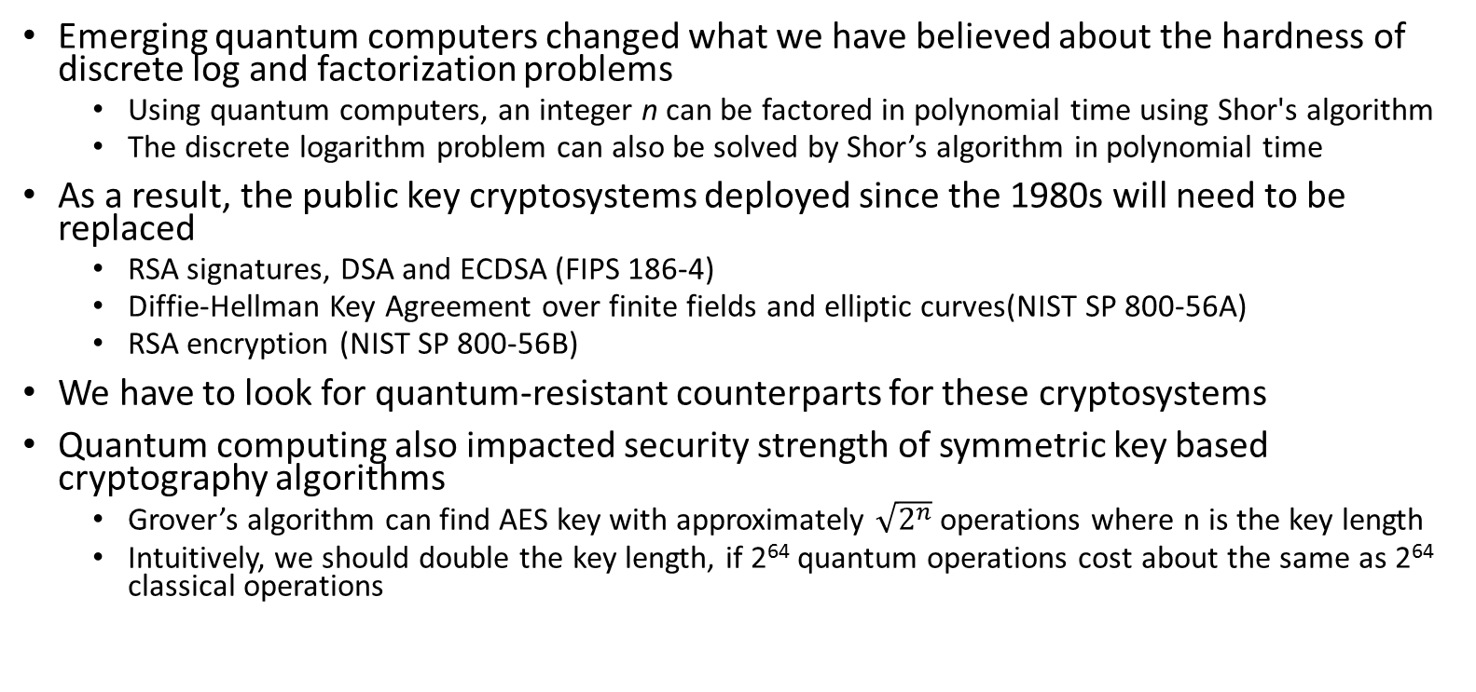
Quantum Impact
Emerging quantum computers changed what we have believed about the hardness of discrete log and factorization problems
  Using quantum computers, an integer n can be factored in polynomial time using Shor's algorithm
  The discrete logarithm problem can also be solved by Shor’s algorithm in polynomial time
As a result, the public key cryptosystems deployed since the 1980s will need to be replaced
  RSA signatures, DSA and ECDSA (FIPS 186-4)
  Diffie-Hellman Key Agreement over finite fields and elliptic curves(NIST SP 800-56A)
  RSA encryption (NIST SP 800-56B)
We have to look for quantum-resistant counterparts for these cryptosystems
Quantum computing also impacted security strength of symmetric key based cryptography algorithms
  Grover’s algorithm can find AES key with approximately $\sqrt{2^{n}}$ operations where n is the key length
  Intuitively, we should double the key length, if 2⁶⁴ quantum operations cost about the same as 2⁶⁴ classical operations
Notes:
Security of most public key cryptography is based on certain hard problems, e.g. RSA – integer factorization, DH – discrete log. Hard – exponent complexity.
We don't need to put it on the slide, but it probably is good to mention the impact on symmetric key cryptography (like AES).
Here we probably should say the difference between the Shor algorithm and Grover algorithm

Slide 17
Scope
Digital signature
  Replace the schemes specified in FIPS 186-4 (RSA, DSA, ECDSA)
Encryption
  Replace key transport specified in SP 800-56B (currently using RSA encryption like OAEP and Key-Encapsulation Mechanism)
Key agreement
  Replace DH/ECDH, MQV/ECMQV in SP 800-56A
  If no good replacement, use public key encryption to exchange selected secret values (as in 56B)
  For perfect forward secrecy, use one-time public key to encrypt the selected secret values, assuming key pair generation is fast

Slide 18
Understand the Challenges
Much broader scope – three crypto primitives
Both classical and quantum attacks
  Security strength assessment on specific parameter selections
Consider various theoretical security models and practical attacks
  Provably security and security against instantiation or implementation related security flaws and pitfalls
Multiple tradeoff factors
  Security, performance, key size, signature size, side-channel attack countermeasures
Migrations into new and existing applications
  TLS, IKE, code signing, PKI infrastructure, and much more
Not exactly a competition – it is and it isn’t

Slide 19
Security Strength Categories
Level | Security Description
I | At least as hard to break as AES128 (exhaustive key search)
II | At least as hard to break as SHA256 (collision search)
III | At least as hard to break as AES192 (exhaustive key search)
IV | At least as hard to break as SHA384 (collision search)
V | At least as hard to break as AES256 (exhaustive key search)
Computational resources should be measured using a variety of metrics
NIST asked submitters to focus on levels 1,2, and 3
  Levels 4 and 5 for high security
Security definitions (proofs recommended, but not required) used to judge whether an attack is relevant
  IND-CPA/IND-CCA2 for encryption, KEMS
  EUF-CMA for signatures
Notes:
These are understood to be preliminary estimates

