Slide 1
Nist crypto standards – at a glance
Cryptography standards
Public key based
Symmetric key based
Guidelines
AES (FIPS 197 ) TDEA (800-67)
Hash usage/security (800-107)
Signature (FIPS 186)
Modes of operations (800 38A-38G)
Transition (800-131A)
Key establishment (800-56A/B/C)
Key generation (800-133)
SHA-1/2 (FIPS 180) and SHA-3 (FIPS 202)
Key management (800-57)
Tools
Randomized hash (800-106)
RNG (800-90A/B/C)
HMAC (FIPS 198)
KDF (800-108, 800-135)
SHA3 derived functions (parallel hashing, KMAC, etc. (800-185)
Notes:
Used to Secure Our Data, Infrastructure, Systems, Protocols

Slide 2
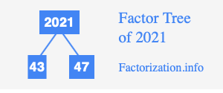
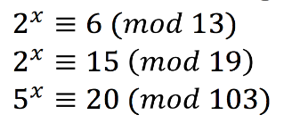
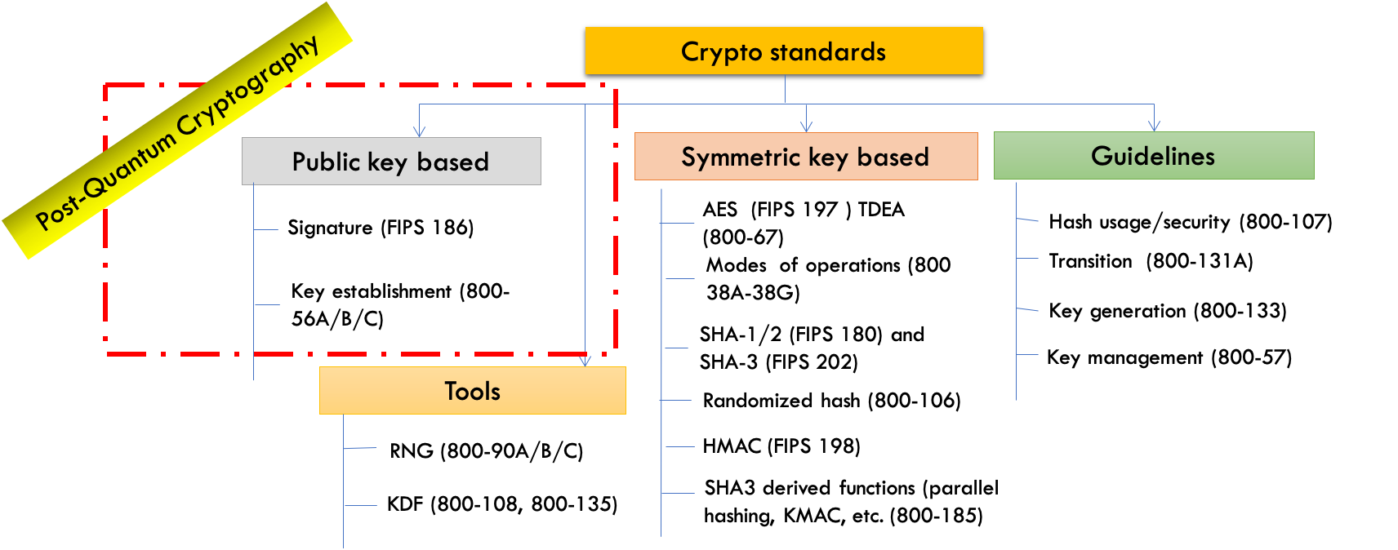
The Quantum Threat
NIST public-key crypto standards
SP 800-56A: Diffie-Hellman, ECDH
SP 800-56B: RSA encryption
FIPS 186: RSA, DSA, and ECDSA signatures
all vulnerable to attacks from
a (large-scale) quantum computer
Symmetric-key crypto (AES, SHA) would also be affected, but less dramatically
Notes:
In the 1990s, this wasn’t yet a practical threat. No real quantum computers

Slide 3
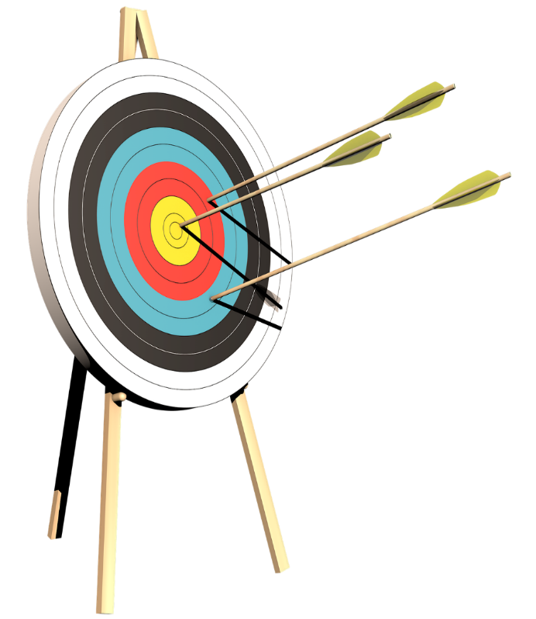
The nist PQC “Competition”
In 2016, NIST called for quantum-resistant cryptographic algorithms for new public-key crypto standards
Digital signatures
Encryption/key-establishment
Our role: managing a process of achieving community consensus in a transparent and timely manner
Different and more complicated than past AES/SHA-3 competitions
There would not be a single “winner”
Ideally, several algorithms will emerge as ‘good choices’

Slide 4
Selection criteria
Secure against both classical and quantum attacks
Performance - measured on various "classical" platforms
Other properties
Drop-in replacements - Compatibility with existing protocols and networks
Perfect forward secrecy
Resistance to side-channel attacks
Simplicity and flexibility
Misuse resistance, etc…
Level | Security Description
I | At least as hard to break as AES128 (exhaustive key search)
II | At least as hard to break as SHA256 (collision search)
III | At least as hard to break as AES192 (exhaustive key search)
IV | At least as hard to break as SHA384 (collision search)
V | At least as hard to break as AES256 (exhaustive key search)

Slide 5
The first three rounds
Round 1 (Dec ‘17 – Jan ‘18)
69 candidates and 278 distinct submitters
Submitters from >25 countries, all 6 continents
Apr 2018, 1st NIST PQC conference
Almost 25 schemes broken/attacked
NISTIR 8240, NIST Report on the 1st Round
Round 2 (Jan ‘18 – Jul ‘20)
26 candidates
Aug 2019 – 2nd NIST PQC conference
7 schemes broken/attacked
NISTIR 8309, NIST Report on the 2nd Round
Round 3 (Jul ‘20 – Jul ‘22)
7 finalists and 8 alternates
June 2021 – 3rd NIST PQC Conference
NISTIR 8413, NIST Report on the 3rd Round
 | Signatures | KEM/Encryption | Overall
Lattice-based | 5 | 21 | 26
Code-based | 2 | 17 | 19
Multi-variate | 7 | 2 | 9
Symmetric based | 3 |  | 3
Other | 2 | 5 | 7
Total | 19 | 45 | 64
 | Signatures | KEMs/Encryption | Total
Lattice-based | 3 | 9 | 12
Code-based | 0 | 7 | 7
Multi-variate | 4 | 0 | 4
Symmetric-based | 2 |  | 2
Other | 0 | 1 | 1
Total | 9 | 17 | 26
 | Signatures | KEMs/Encryption | Total
Lattice-based | 2 | 5 | 7
Code-based | 0 | 3 | 3
Multi-variate | 2 | 0 | 2
Symmetric-based | 2 | 0 | 2
Other | 0 | 1 | 1
Total | 6 | 9 | 15

Slide 6
Round 3 results
Round 3 results
3rd round selection (KEM) | 3rd round selection (Signatures)
CRYSTALS-Kyber | CRYSTALS-Dilithium, Falcon, SPHINCS+
See NISTIR 8413, Status Report on the 3rd Round of the NIST PQC Standardization Process, for the rationale on the selections
4th round candidates (all KEMs) evaluated for 18-24 months
ClassicMcEliece
BIKE
HQC
SIKE
On-ramp signatures
NIST issued a new call for additional signatures – preferably for signatures based on non-lattice problems

Slide 7
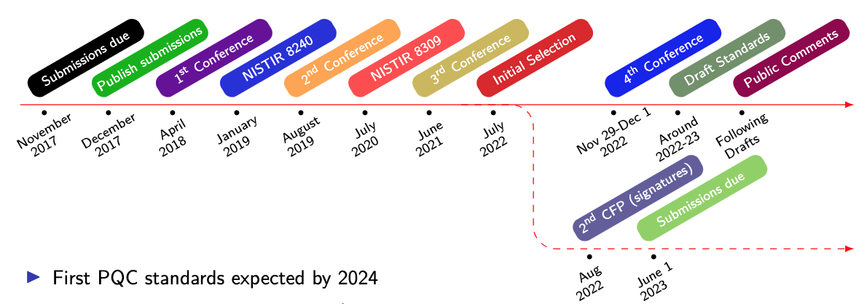
Timeline
The 4th NIST PQC Standardization Conference
Nov 29-Dec 1, 2022, held virtually
Draft standards for public comment will be in summer 2023
The first PQC standards should be published in 2024

Slide 8
The Kems in the 4th round
Classic McEliece
NIST is confident in the security
Smallest ciphertexts, but largest public keys
We’d like feedback on specific use cases for Classic McEliece
BIKE
Most competitive performance of 4th round candidates
We encourage vetting of IND-CCA security
HQC
Offers strong security assurances and mature decryption failure rate analysis
Larger public keys and ciphertext sizes than BIKE
SIKE
The SIKE team acknowledges that SIKE (and SIDH) are insecure and should not be used
Notes:
Mention the use cases of CM we heard back on

Slide 9
An on-ramp for signatures
NIST issued a new Call for Signatures
Deadline for submission: June 1, 2023
This will be much smaller in scope than main NIST PQC effort
The main reason for this call is to diversify our signature portfolio
These signatures will be on a different track than the candidates in the 4th round
We are most interested in a general-purpose digital
signature scheme which is not based on structured lattices
We may be interested in other signature schemes targeted for certain applications.
For example, a scheme with very short signatures.
The more mature the scheme, the better.
NIST will decide which (if any) of the received schemes to focus attention on
No on-ramp for KEMs currently planned.
Notes:
Preliminary submissions – we received almost 20.
(6 multivariate, 3 code-based, 2 lattice, other ideas)
Compare to 1st PQC submission? 37 early submissions -> led to double the # of submissions
Ongoing seminars

Slide 10
Standardization
the PQC standards will be FIPS
Each algorithm will be its own document
Might have some sp’s which contain more guidance/details
All the algorithms will be given a standardized name
Something like ML-KEM (Kyber), ML-DSA (Dilithium), nl-dsa (Falcon) and SLH-dsa (SPHINCS+)
Some choices need to be made
Which parameter sets to include
Which hash functions, Other symmetric primitives, Etc?
How to allow for any potential changes from the round 3 specifications?
Submission teams may submit suggested changes
Any changes by nist (or suggested by teams) will be discussed publicly
Please provide feedback
Pqc-forum, email etc
Notes:
Mention talk on reduced round version of keccak

Slide 11
Standardization
CRYSTALS - KYBER
Selected For its strong security and performance
We are planning to standardize Kyber-512, Kyber-768, and Kyber-1024
The recommended default option would be kyber-768
NIST has signed license agreements* for some patents which potentially applied to Kyber
Summary: The license allows for royalty-free use of implementations which follow the NIST standard (Disclaimer – I’m not a lawyer)
See the PQC license summary and extracts
* The license agreements are with CNRS, the University of Limoges, the laboratory XLIM, and Jintai Ding
Notes:
PRF = SHAKE256
XOF = SHAKE128
H = SHA3-256 and SHA3-512
KDF = SHAKE256

Slide 12
Standardization
CRYSTALS - DILITHIUM
Selected based on its security, high efficiency,
and relatively simple implementation
We recommend it be the primary signature algorithm used
We will standardize the parameter sets for Dilithium corresponding to security categories 2, 3, and 5
Notes:
For pre-hash for now, any hash function. We’ll later narrow it down by specifying some OIDs
H = SHAKE256 and SHAKE128
Any approved RNG

Slide 13
Standardization
Selected for its small bandwidth, fast verification and security
The implementation may be complicated for some applications
We are planning to standardize the parameter sets for falcon corresponding to security categories 1 and 5
The standard will come later - after the Dilithium standard

Slide 14
Standardization
SPHINCS+
Selected for its solid security
based on a different set of assumptions from lattices
There are many parameter sets included in the submission
We will include parameter sets for security categories 1, 3, and 5
NIST is planning on considering the simple version (Not the robust version)
NISt plans to include both the fast and small versions
Allowed hash functions: SHAKE and sha-2
By SHA-2 we mean SHA-256 for category 1 and a mix of SHA-512 and SHA-256 for categories 3 and 5
Notes:
SHAKE version uses SHAKE256 for everything
SHA2 version uses SHA256 for everything (category 1) or SHA256 and SHA512 depending on whether hash, PRF, (categories 3 and 5)

Slide 15
Stateful Hash Based Signatures for Early Adoption
Stateful hash-based signatures from SP 800-208 are allowed for signing software/firmware updates in CNSA 2.0

Slide 16
Standardization challenges
There were several cryptanalytic results in the 3rd (and 4th) Rounds
Advances on the MinRank problem leading to attacks on GeMSS and Rainbow
Improvements in lattice attacks
Attacks on some parameter sets of SPHINCS+
SIKE/SIDH attack
IP considerations
NIST signed license agreements to allow for royalty-free use* of kyber implementations following the nist standard
Disclaimer: I’m not a lawyer.
*Royalty-free use is from the parties in the agreement (CNRS, the University of Limoges, the laboratory xlim, and jintai ding)
Ongoing Suggested changes from round 3 specifications
Notes:
Some of these have big impacts on our confidence in the algorithms, but some do not have quite that effect

Slide 17
Transition and migration
There has been much discussion on hybrid/composite modes
NIST SP800-56C Rev. 2 allows for a certain hybrid mode
We will Work with the community in different stages of migration to assure security
NIST will provide transition guidelines to PQC standards
NIST has provided such guidance before
Examples: Triple Des, Sha-1, keys < 112 bits
Timeframe will be based on risk assessment of quantum attacks
A
B
ECDH
PQC
ECDH
PQC
ECDH
Z
KDF($Z||T$)

Slide 18
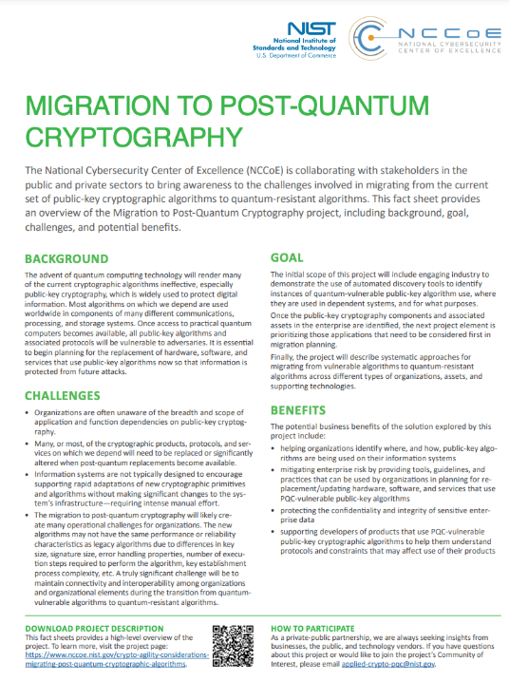
Getting ready for PQC
The National Cybersecurity Center of Excellence (NCCoE) has a project for Migration to PQC. The goals:
Align and complement NIST PQC standardization activities
Raise awareness and develop practices to ease the migration
Deliver white papers, playbooks, and demonstrable implementations for organizations
Collaboration with industry participants through CRADAs and a Community of Interest
Product developers and service providers
Standards development organizations
Service providers and major user organizations and consortia
Government organizations (such as U.S. Department of Homeland Security, Department of Defense)
See Bill Newhouse’s talk later today….

