Slide 1
Cryptography in a post-quantum world
Lily Chen and Dustin Moody
Computer Security Division
NIST

Slide 2
Nist crypto standards – at a glance
Cryptography standards
We use public key cryptography to establish keys and authenticate users through signatures
Diffie-Hellman Key Exchange
RSA & ECDSA signatures
Use symmetric key cryptography to encrypt and authenticate bulk data
AES (CBC, GCM, etc.)
HMAC, CMAC, KMAC
Examples
On line purchasing
Website Security
Full Disk Encryption
Public key based
Symmetric key based
Guidelines
Signature (FIPS 186)
AES (FIPS 197 ) TDEA (800-67)
Hash usage/security (800-107)
Modes of operations (800 38A-38G)
Transition (800-131A)
Key establishment (800-56A/B/C)
Key generation (800-133)
SHA-1/2 (FIPS 180) and SHA-3 (FIPS 202)
Key management (800-57)
Tools
Randomized hash (800-106)
RNG (800-90A/B/C)
HMAC (FIPS 198)
KDF (800-108, 800-135)
SHA3 derived functions (parallel hashing, KMAC, etc. (800-185)
Notes:
Used to Secure Our Data, Infrastructure, Systems, Protocols

Slide 3
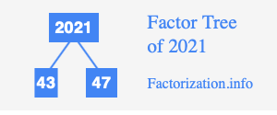
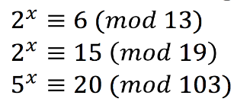
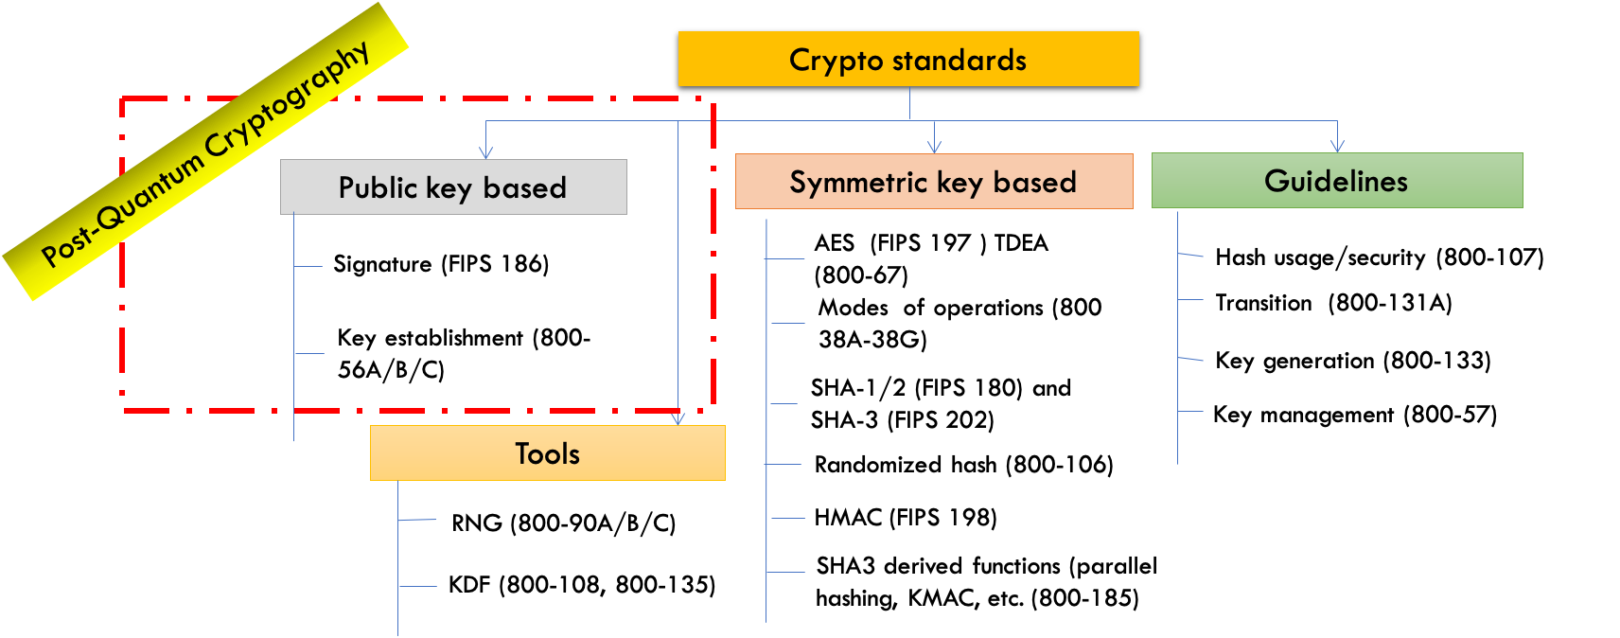
The Quantum Threat
NIST public-key crypto standards
SP 800-56A: Diffie-Hellman, ECDH
SP 800-56B: RSA encryption
FIPS 186: RSA, DSA, and ECDSA signatures
all vulnerable to attacks from
a (large-scale) quantum computer
Symmetric-key crypto (AES, SHA) would also be affected, but less dramatically
Notes:
In the 1990s, this wasn’t yet a practical threat. No real quantum computers

Slide 4
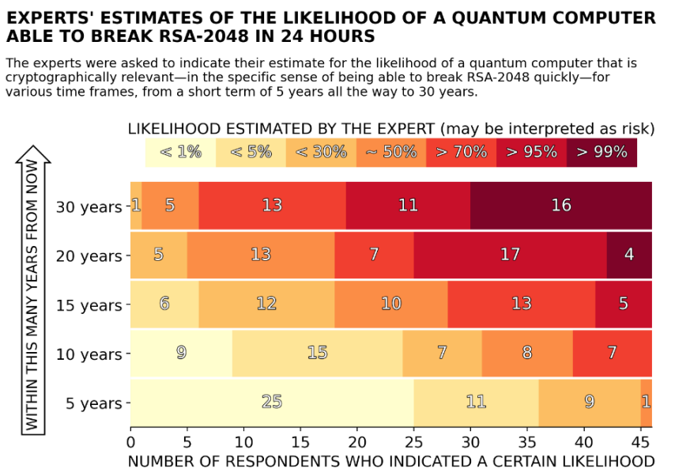
How soon do we need to worry?
Source: M. Mosca, M. Piani, Quantum Threat Timeline Report, 2021 https://globalriskinstitute.org/publications/2021-quantum-threat-timeline-report//

Slide 5
U.S. White House National security memo
“Within 1 year of the release of the first set of NIST standards for quantum-resistant cryptography …, the Director of OMB … shall issue a policy memorandum requiring FCEB Agencies to develop a plan to upgrade their non-NSS IT systems to quantum-resistant cryptography.”

Slide 6
NIST PQC Milestones and Timelines
2016 Determined criteria and requirements, published NISTIR 8105
Announced call for proposals
2017 Received 82 submissions
Announced 69 1st round candidates
2018
Held the 1st NIST PQC standardization Conference
2019 Announced 26 2nd round candidates, NISTIR 8240
Held the 2nd NIST PQC Standardization Conference
2020 Announced 3rd round 7 finalists and 8 alternate candidates. NISTIR 8309
2021 Hold the 3rd NIST PQC Standardization Conference
2022 Make 3rd round selection and draft standards – NISTIR 8413
2023 Release draft standards and call for public comment
2024 Publish the 1st set of PQC Standards
Notes:
PQC is post-quantum cryptography

Slide 7
The PQC “Competition”
NIST called for quantum-resistant cryptographic algorithms for new public-key crypto standards
Digital signatures
Encryption/key-establishment
Our role: managing a process of achieving community consensus in a transparent and timely manner
Different and more complicated than past AES/SHA-3 competitions
There would not be a single “winner”
Ideally, several algorithms will emerge as ‘good choices’

Slide 8
Selection criteria
Secure against both classical and quantum attacks
Performance - measured on various "classical" platforms
Other properties
Drop-in replacements - Compatibility with existing protocols and networks
Perfect forward secrecy
Resistance to side-channel attacks
Simplicity and flexibility
Misuse resistance, etc…
Level | Security Description
I | At least as hard to break as AES128 (exhaustive key search)
II | At least as hard to break as SHA256 (collision search)
III | At least as hard to break as AES192 (exhaustive key search)
IV | At least as hard to break as SHA384 (collision search)
V | At least as hard to break as AES256 (exhaustive key search)

Slide 9
The first three rounds
Round 1 (Dec ‘17 – Jan ‘18)
69 candidates and 278 distinct submitters
Submitters from >25 countries, all 6 continents
Apr 2018, 1st NIST PQC conference
Almost 25 schemes broken/attacked
NISTIR 8240, NIST Report on the 1st Round
Round 2 (Jan ‘18 – Jul ‘20)
26 candidates
Aug 2019 – 2nd NIST PQC conference
7 schemes broken/attacked
NISTIR 8309, NIST Report on the 2nd Round
Round 3 (Jul ‘20 – Jul ‘22)
7 finalists and 8 alternates
June 2021 – 3rd NIST PQC Conference
NISTIR 8413, NIST Report on the 3rd Round
 | Signatures | KEM/Encryption | Overall
Lattice-based | 5 | 21 | 26
Code-based | 2 | 17 | 19
Multi-variate | 7 | 2 | 9
Symmetric based | 3 |  | 3
Other | 2 | 5 | 7
Total | 19 | 45 | 64
 | Signatures | KEMs/Encryption | Total
Lattice-based | 3 | 9 | 12
Code-based | 0 | 7 | 7
Multi-variate | 4 | 0 | 4
Symmetric-based | 2 |  | 2
Other | 0 | 1 | 1
Total | 9 | 17 | 26
 | Signatures | KEMs/Encryption | Total
Lattice-based | 2 | 5 | 7
Code-based | 0 | 3 | 3
Multi-variate | 2 | 0 | 2
Symmetric-based | 2 | 0 | 2
Other | 0 | 1 | 1
Total | 6 | 9 | 15

Slide 10
Round 3 results
3rd round selection (KEM) | 3rd round selection (Signatures)
CRYSTALS-Kyber | CRYSTALS-Dilithium, Falcon, SPHINCS+
See NISTIR 8413, Status Report on the 3rd Round of the NIST PQC Standardization Process, for the rationale on the selections
4th round candidates (all KEMs) evaluated for 18-24 months
ClassicMcEliece
BIKE
HQC
SIKE
On-ramp signatures
NIST issued a new call for additional signatures – preferably for signatures based on non-lattice problems

Slide 11
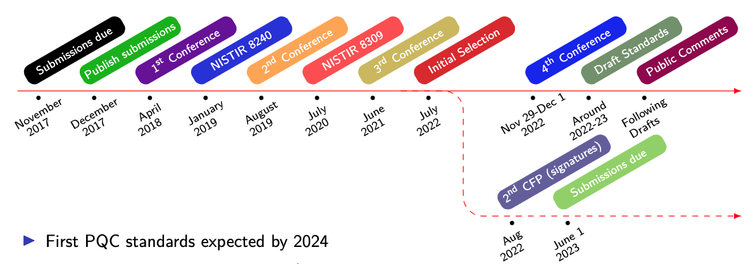
Timeline
The 4th NIST PQC Standardization Conference
Nov 29-Dec 1, 2022, held virtually
Draft standards for public comment will be in 2023
The first PQC standards should be published in 2024

Slide 12
Patent issues
NIST believes it is critical that this process leads to cryptographic standards that can be freely implemented in security technologies and products
NTRU had patents that have expired, and are now dedicated to the public
NIST was aware of (3rd party) patents that could potentially apply to Kyber and Saber
NIST engaged with the parties that owned these patents and has reached agreements so that these patents will not be asserted against implementers (or end-users) of the NIST PQC standard
NIST appreciates the efforts of those who helped obtain this outcome, particularly the cooperation of the parties
Notes:
https://groups.google.com/a/list.nist.gov/g/pqc-forum/c/G0DoD7lkGPk/m/hFdKaHp-AgAJ
https://www.cnrs.fr/fr/accord-de-licence-entre-le-nist-le-cnrs-et-luniversite-de-limoges-le-rayonnement-international-de

Slide 13
Transition and migration
There has been much discussion on hybrid/composite modes
NIST SP800-56C Rev. 2 allows for a certain hybrid mode
We will Work with the community in different stages of migration to assure security
NIST will provide transition guidelines to PQC standards
NIST has provided such guidance before
Examples: Triple Des, Sha-1, keys < 112 bits
Timeframe will be based on risk assessment of quantum attacks
A
B
ECDH
PQC
ECDH
PQC
ECDH
Z
KDF($Z||T$)
Other standards bodies and groups are working on PQC
IEEE, IETF, ETSI, ANSI x9, ISO, and others

Slide 14
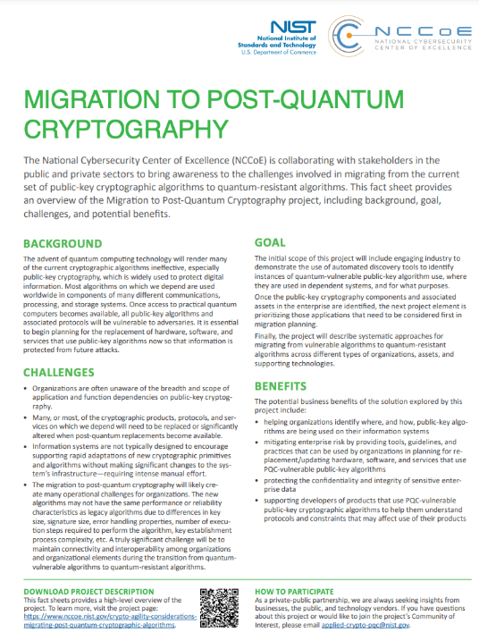
Getting ready for PQC
The National Cybersecurity Center of Excellence (NCCoE) has a project for Migration to PQC. The goals:
Align and complement NIST PQC standardization activities
Raise awareness and develop practices to ease the migration
Deliver white papers, playbooks, and demonstrable implementations for organizations
Collaboration with industry participants through CRADAs and a Community of Interest
Product developers and service providers
Standards development organizations
Service providers and major user organizations and consortia
Government organizations (such as U.S. Department of Homeland Security, Department of Defense)

Slide 15
What can organizations do now?
Perform a quantum risk assessment within your organization
Identify information assets and their current crypto protection
Identify what ‘x’, ‘y’, and ‘z’ might be for you – determine your quantum risk
Prioritize activities required to maintain awareness, and to migrate technology to quantum-safe solutions
Evaluate vendor products with quantum safe features
Know which products are not quantum safe
Ask vendors for quantum safe features in procurement templates
Develop an internal knowledge base amongst IT staff
Track developments in quantum computing and quantum safe solutions, and to establish a roadmap to quantum readiness for your organization
Act now – it will be less expensive, less disruptive, and less likely to have mistakes caused by rushing and scrambling

Slide 16
Conclusion
The Beginning of the End is here!
Or is it the end of the beginning?
NIST is grateful for everybody’s efforts
Check out www.nist.gov/pqcrypto
Sign up for the pqc-forum for announcements & discussion
send e-mail to pqc-comments@nist.gov
Notes:
Talk about some attacks on lattices and sphincs+

