Slide 1
NIST and PQC
Dustin Moody
NIST PQC Team
Crypto Technology Group
Computer Security Division
Information Technology Lab

Slide 2
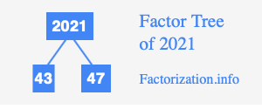
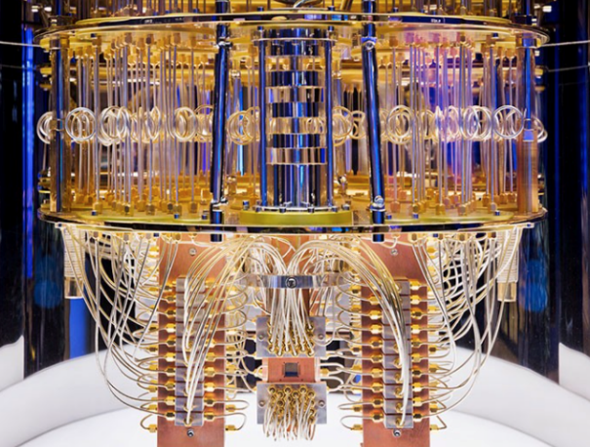
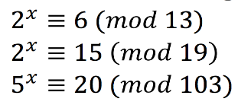
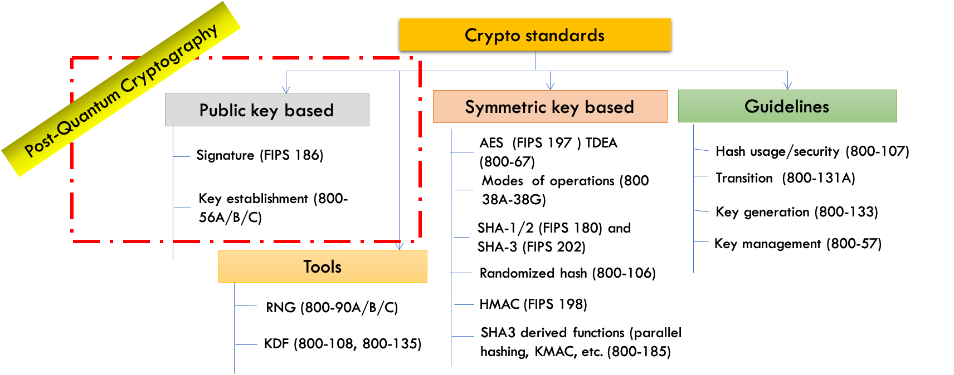
The Quantum Threat
NIST public-key crypto standards
  SP 800-56A: Diffie-Hellman, ECDH
  SP 800-56B: RSA encryption
  FIPS 186: RSA, DSA, and ECDSA signatures
all vulnerable to attacks from
a (large-scale) quantum computer
Symmetric-key crypto (AES, SHA) would also be affected, but less dramatically
Notes:
Add picture of quantum computer

Slide 3
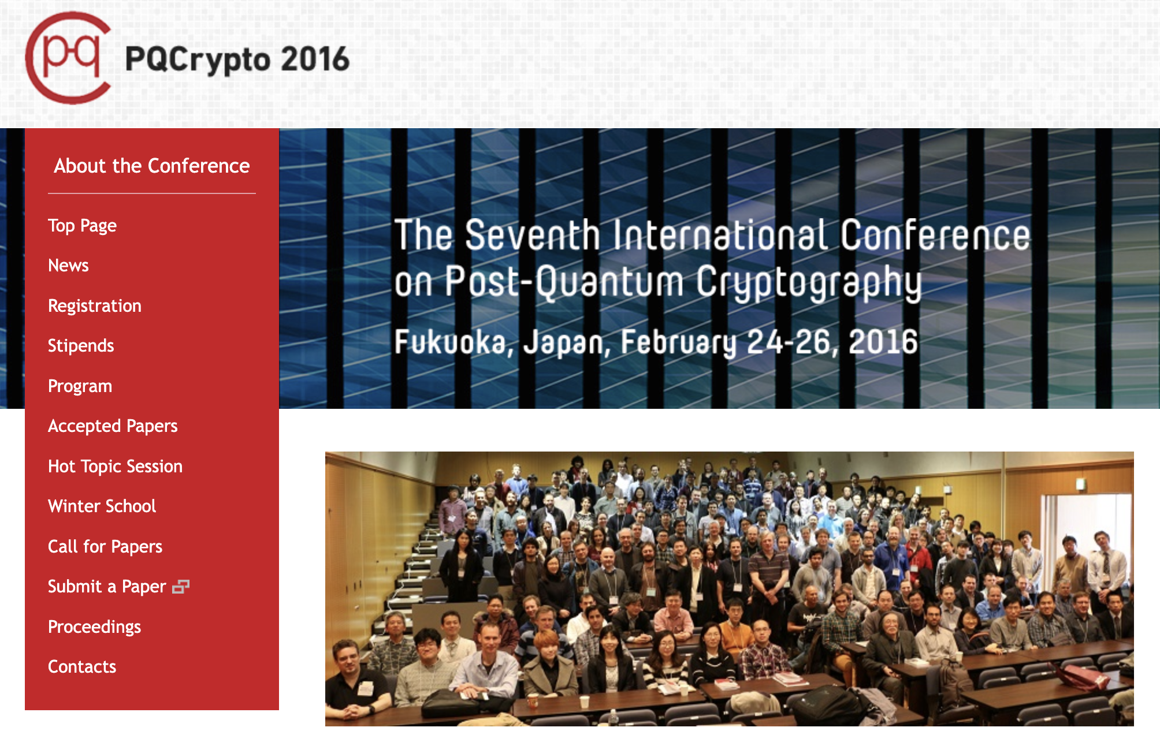
7 years ago….

Slide 4

The PQC “Competition”
NIST called for quantum-resistant cryptographic algorithms for new public-key crypto standards
  Digital signatures
  Encryption/key-establishment
Our role: managing a process of achieving community consensus in an open, transparent, and timely manner
Different and more complicated than past AES/SHA-3 competitions
There would not be a single “winner”
  Ideally, several algorithms will emerge as ‘good choices’
Notes:
2016 – Fukuoka Japan

Slide 5
Selection criteria
Secure against both classical and quantum attacks
Performance - measured on various "classical" platforms
Other properties
  Drop-in replacements - Compatibility with existing protocols and networks
  Perfect forward secrecy
  Resistance to side-channel attacks
  Simplicity and flexibility
  Misuse resistance, etc…
Level | Security Description
I | At least as hard to break as AES128 (exhaustive key search)
II | At least as hard to break as SHA256 (collision search)
III | At least as hard to break as AES192 (exhaustive key search)
IV | At least as hard to break as SHA384 (collision search)
V | At least as hard to break as AES256 (exhaustive key search)

Slide 6
The first three rounds
Round 1 (Dec ‘17 – Jan ‘18)
  69 candidates and 278 distinct submitters
  Submitters from >25 countries, 6 continents
  Apr 2018, 1st NIST PQC conference
  Almost 25 schemes broken/attacked
  NISTIR 8240, NIST Report on the 1st Round
Round 2 (Jan ‘18 – Jul ‘20)
  26 candidates
  Aug 2019 – 2nd NIST PQC conference
  7 schemes broken/attacked
  NISTIR 8309, NIST Report on the 2nd Round
Round 3 (Jul ‘20 – Jul ‘22)
7 finalists and 8 alternates
June 2021 – 3rd NIST PQC Conference
NISTIR 8413, NIST Report on the 3rd Round
 | Signatures | KEM/Encryption | Overall
Lattice-based | 5 | 21 | 26
Code-based | 2 | 17 | 19
Multi-variate | 7 | 2 | 9
Symmetric based | 3 |  | 3
Other | 2 | 5 | 7
Total | 19 | 45 | 64
 | Signatures | KEMs/Encryption | Total
Lattice-based | 3 | 9 | 12
Code-based | 0 | 7 | 7
Multi-variate | 4 | 0 | 4
Symmetric-based | 2 |  | 2
Other | 0 | 1 | 1
Total | 9 | 17 | 26
 | Signatures | KEMs/Encryption | Total
Lattice-based | 2 | 5 | 7
Code-based | 0 | 3 | 3
Multi-variate | 2 | 0 | 2
Symmetric-based | 2 | 0 | 2
Other | 0 | 1 | 1
Total | 6 | 9 | 15

Slide 7

Round 3 results
Round 3 results
3rd round selection (KEM) | 3rd round selection (Signatures)
CRYSTALS-Kyber | CRYSTALS-Dilithium, Falcon, SPHINCS+
See NISTIR 8413, Status Report on the 3rd Round of the NIST PQC Standardization Process, for the rationale on the selections
4th round candidates (all KEMs) evaluated for 18-24 months
ClassicMcEliece
BIKE
HQC
SIKE
On-ramp signatures
NIST issued a new call for additional signatures – preferably for signatures based on non-lattice problems

Slide 8
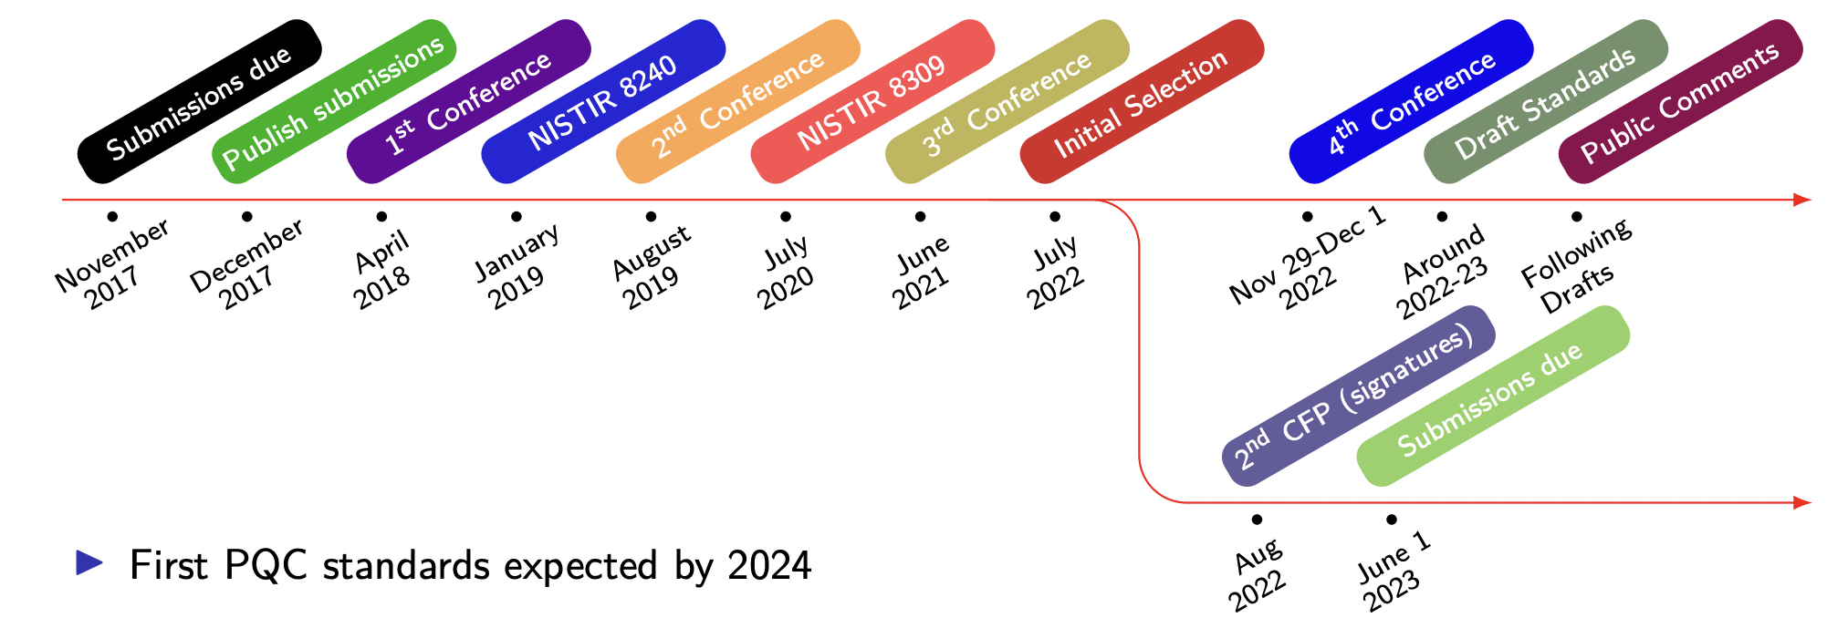

Timeline
Draft standards for public comment are expected in summer 2023
The first PQC standards should be published in 2024

Slide 9

The Kems in the 4th round
Classic McEliece
  NIST is confident in the security
  Smallest ciphertexts, but largest public keys
  We’d like feedback on specific use cases for Classic McEliece
BIKE
  Most competitive performance of 4th round candidates
  We encourage vetting of IND-CCA security
HQC
  Offers strong security assurances and mature decryption failure rate analysis
  Larger public keys and ciphertext sizes than BIKE
SIKE
  The SIKE team acknowledges that SIKE (and SIDH) are insecure and should not be used
Notes:
Mention the use cases of CM we heard back on

Slide 10

An on-ramp for signatures
NIST issued a new Call for Signatures
  Deadline for submission: June 1, 2023
  This will be much smaller in scope than main NIST PQC effort
  The main reason for this call is to diversify our signature portfolio
  These signatures will be on a different track than the candidates in the 4th round
We are most interested in a general-purpose digital
signature scheme which is not based on structured lattices
  We may be interested in other signature schemes targeted for certain applications.
  For example, a scheme with very short signatures.
The more mature the scheme, the better.
NIST will decide which (if any) of the received schemes to focus attention on
No on-ramp for KEMs currently planned.
Notes:
Preliminary submissions – we received almost 20.
(6 multivariate, 3 code-based, 2 lattice, other ideas)
Compare to 1st PQC submission? 37 early submissions -> led to double the # of submissions
Ongoing seminars

Slide 11
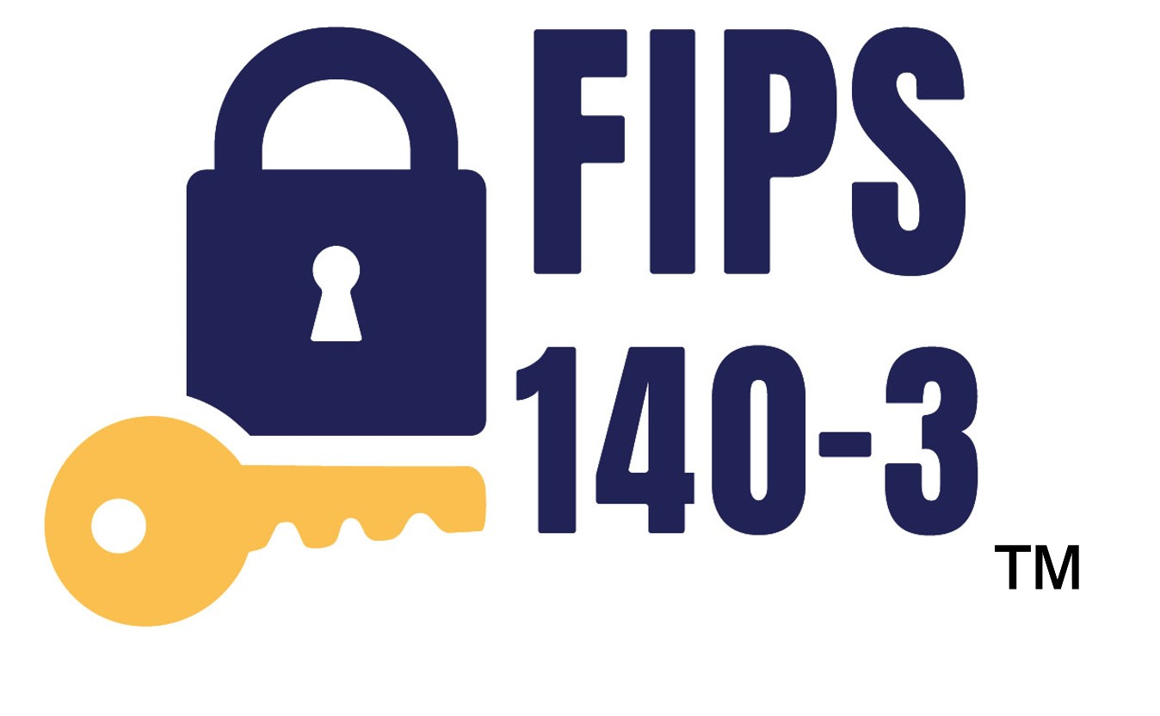

Standardization
the PQC standards will be FIPS
  Each algorithm will be its own document
  Might have some sp’s which contain more technical details
  All the algorithms will be given a standardized name
    Something like MLWE-KEM (Kyber), MLWE-SIG (Dilithium), NSIS-SIG (Falcon) and SHBS-SIG (SPHINCS+)
Some choices need to be made
  Which parameter sets to include
  Which hash functions, Other symmetric primitives, Etc?
  How to allow for any potential changes from the round 3 specifications?
    Submission teams may submit suggested changes
    Any changes by nist (or suggested by teams) will be discussed publicly
Please provide feedback
  Pqc-forum, email etc
Notes:
Mention talk on reduced round version of keccak

Slide 12

Standardization
CRYSTALS - KYBER
Selected For its strong security and performance
We are planning to standardize both Kyber-768 and Kyber-1024
What about Kyber-512?
  The security margin for Kyber-512 is close in the gate metric
  NIST is currently leaning in the direction of including kyber-512 in the standard
NIST is not planning on standardizing the 90’s version of Kyber
Notes:
PRF = SHAKE256
XOF = SHAKE128
H = SHA3-256 and SHA3-512
KDF = SHAKE256

Slide 13
Standardization
CRYSTALS - KYBER
We are still leaning towards include kyber-512
  The recommended default option would be kyber-768
Some topics discussed on pqc-forum
  leave domain separation as was specified in the round 3 spec (use FIPS 202 functions with internal domain separation)
  NIST noted that it will not be using turboshake
  Still to be decided: Should the FO transform be slightly tweaked for additional security properties?

Slide 14

IP update
the license agreements mentioned in NISTIR 8413 have been signed by all parties
  NIST appreciates the efforts of those who helped obtain this outcome and the cooperation of third parties
    CNRS, the University of Limoges, the laboratory xlim, and jintai ding
The (relevant) text of the license is available on our website
Summary: The license allows for royalty-free use (from the third parties listed above) of implementations which follow the NIST standard
  Disclaimer: I’m not a lawyer. See the license text for details
We are not considering ntru for standardization
Notes:
We’re working on an FAQ page to answer common questions.
(Though don’t expect our lawyers to let us say too much!)

Slide 15

Standardization
CRYSTALS - DILITHIUM
Selected based on its security, high efficiency,
and relatively simple implementation
We recommend it be the primary signature algorithm used
We will standardize the parameter sets for Dilithium corresponding to security categories 2, 3, and 5
Pre-hash version allowed, but not the default
Allowing for a randomized version of dilithium
(we’re not considering the AES variant)
Notes:
For pre-hash for now, any hash function. We’ll later narrow it down by specifying some OIDs
H = SHAKE256 and SHAKE128
Any approved RNG

Slide 16

Standardization
Selected for its small bandwidth, fast verification and security
The implementation may be complicated for some applications
We are planning to standardize the parameter sets for falcon corresponding to security categories 1 and 5
The standard will come after the Dilithium standard

Slide 17

Standardization
SPHINCS+
Selected for its solid security
based on a different set of assumptions from lattices
There are many parameter sets included in the submission
  We will include parameter sets for security categories 1, 3, and 5
  NIST is planning on considering the simple version (Not the robust version)
  NISt plans to include both the fast and small versions
  Allowed hash functions: SHAKE and sha-2
    By SHA-2 we mean SHA-256 for category 1 and a mix of SHA-512 and SHA-256 for categories 3 and 5
Notes:
SHAKE version uses SHAKE256 for everything
SHA2 version uses SHA256 for everything (category 1) or SHA256 and SHA512 depending on whether hash, PRF, (categories 3 and 5)

Slide 18
Standardization
SPHINCS+
Pre-hash version allowed, but not the default
We are not considering SPHINCS+C
  This was a tweaked variant introduced after the 3rd round
NIST will standardize a version of sphincs+ with a lower number for maxsig in a future special publication
Notes:
For pre-hash for now, any hash function. We’ll later narrow it down by specifying some OIDs

Slide 19

Transition and migration
There has been much discussion on hybrid/composite modes
  NIST SP800-56C Rev. 2 allows for a certain hybrid mode
  We will Work with the community in different stages of migration to assure security
NIST will provide transition guidelines to PQC standards
  NIST has provided such guidance before
    Examples: Triple Des, Sha-1, keys < 112 bits
  Timeframe will be based on risk assessment of quantum attacks
A
B
ECDH
PQC
ECDH
PQC
ECDH
Z
KDF($Z||T$)

Slide 20

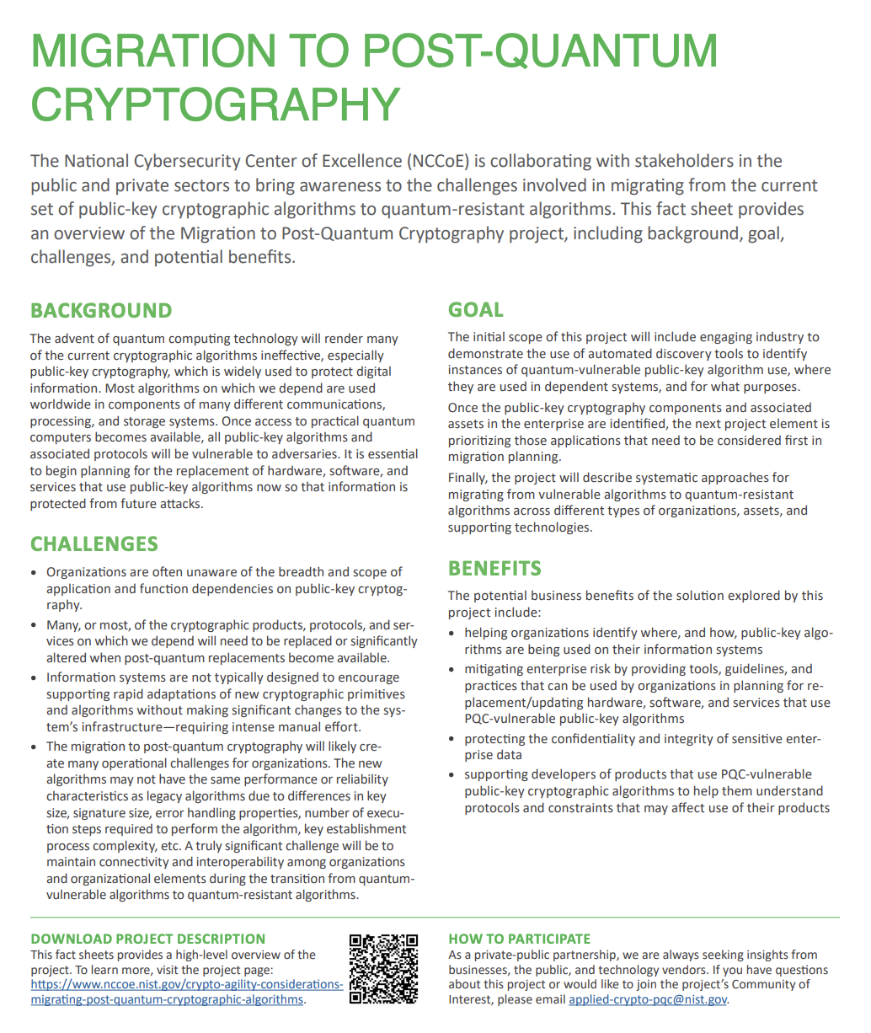
The NCCOE Migration to PQC Project
Complement standardization and tackle challenges with adoption, implementation and deployment to pqc
  Coordinate with SDO’s and industry collaborators
Product deliverables
  Practice guides, playbooks, reference architectures, automated tools, proof of concept code, etc
Outreach and engagement
  Community of interest, webinars, public events
  Applied-crypto-pqc@nist.gov
Notes:
April 2023 - Plan to publish Preliminary Draft SP 1800 Volume A

Slide 21
The NCCOE Migration to PQC Project
Discovery workstream
  Define common data elements for PQC
  Build the NCCoE lab environment with classical and PQC systems and applications
  Start deployment of the collaborators’ contributed discovery tools and collect the assessment reports
Interoperability and performance workstream
  Demonstrate interoperability between collaborators’ software and hardware components
  Develop known answer tests (KATs) and test vectors
  Identify metrics to measure (time, memory, etc.)
  Vary demonstration conditions and crypto modes
  Develop interop and performance demonstration plan for TLS, SSH, HSM, and X.509 certificate format
  Document issues and gaps to report back to the developers’ standards and protocols

Slide 22

Conclusion
The Beginning of the End is here!
Or is it the end of the beginning?
NIST is grateful for everybody’s efforts
Please provide us with feedback!
Check out www.nist.gov/pqcrypto
  Sign up for the pqc-forum for announcements & discussion
  send e-mail to pqc-comments@nist.gov

